Slide 1
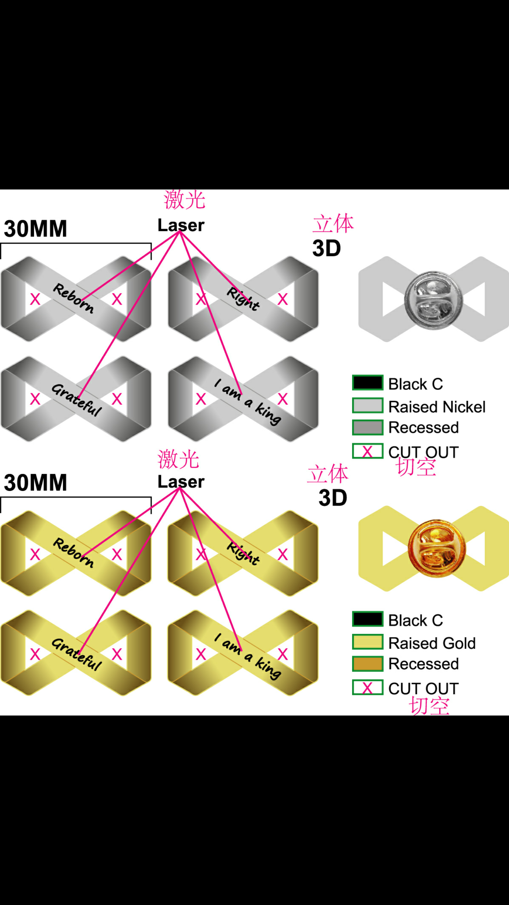


I
R
R
I
R
R
I
I
R
I

Slide 2
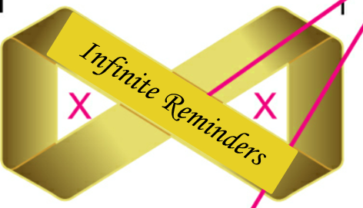
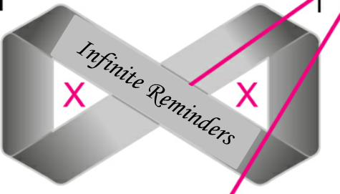
Infinite Reminders
I
R

Slide 3
