Slide 1


"New Age Pocket Money"

Slide 2

The Problem
Parents have no control over cash pocket money
It is difficult to send immediate cash money to child in urgent cases
Most of the teens wants to spend their money in online channels
It is easy to loose cash money
Teens will not use cash when they grow-up
No benefits and campains for cash pocket money

Slide 3

The Idea
Founded by parents to help make the next generation of young people better at managing their money than the last.
manibux created the first fully digital family banking solution designed specially for children and teenagers aged 8-18, offering a pre-paid Mastercard card and app with unique parental controls. These tools help children learn to earn, save and spend responsibly, whilst giving parents peace of mind, an easy way to pay pocket money and full control.

Slide 4

How It Works?
Receive your cards from online or offline store
Open an online account on Android or IOS App for you and your children within minutes
Assign cards to your children
Set your automatic pocket money transfers and spending rules

Slide 5

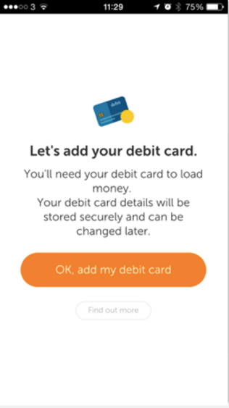
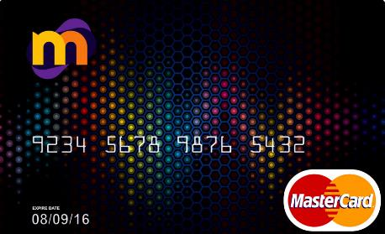
The Product
manibux consists of:
manibux app: The manibux app, is used to activate manibux card, load money, set manibux Allowances and check balances. Manibux app is the main component of the Pocket Money Management System. Parents and teens has different interfaces.
manibux card: The manibux card, is a completely safe and secure way to spend. Use it anywhere that MasterCard®debit cards are accepted.

Slide 6



Distribution Channels
Online: manibux card can be ordered from http://www.manibux.com
Offline: Our cards will be available in most of the big retailers in Turkey. Starting with D&R, Migros

Slide 7

Powered by ininal
ininal was founded in 2012 in order to provide basic financial services to both retail and corporate customers and become “the Leading New Generation Payment Platform of Turkey and Region”. Ininal serves millions of people thanks to industry leader partners such as ; MasterCard, Paypal, Migros, PTT, D&R ve Teknosa
Retail financial services
ininal offers ininal card, a pre-paid MasterCard, through more than 5.000 retail sales points (Migros, Tansaş, D&R, Teknosa, Yaysat and PTT) and ininal mobile wallet application to its customers.
ininal users can deposit money into their cards or accounts via more than 10.000 retail and ATM points and spend their deposits in all physical and virtual POS all over the world.
ininal users can reach all the services they desire through ininal online transactions and ininal mobile wallet.
Corporate financial services
ininal develops customized platforms and offers co-branded cards with its customer customers
ininal offers lump-sum payment and expense tracking system to its corporate customers through its payment platforms and cards. Furthermore, it increases new customer acquisition through directing campaings and loyalty programs to end users.

Slide 8

Global Examples
goHenry: UK Based digital banking solution for parents company founded by parents at 2014. They are already rised 4.000.000 £ for %15 share from crowdcube in May 2016.
Osper: Osper is a UK Based prepaid debit card and mobile banking service empowering young people to manage their money responsibly and founded at 2012.

Slide 9
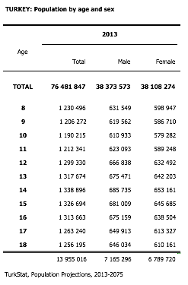
The Market
Turkey's young population between 8-18 ages is 13.955.016 which is 20% of total population*
This carries Turkey to leading position amongst all EU countries
As of 2015 in Turkey**:
  5.434.150 students - primary school
  5.278.107 students - high-school
  5.691.017 students - lycee

Slide 10
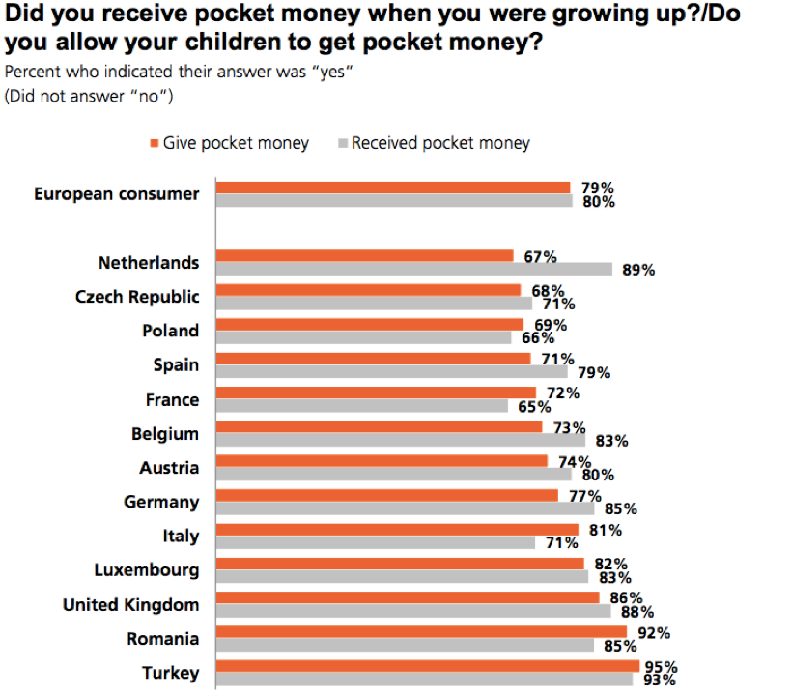
The Market
Turkish people are highly familiar with pocket money in both receiving when they were youngsters and also giving to their kids as parents
Average Pocket Money by age:
5-10 : 40TL
10-15 : 80TL
15-18 : 192 TL
*Source - ING Bank 2015 Mobile Banking and Financial Habbits Research

Slide 11
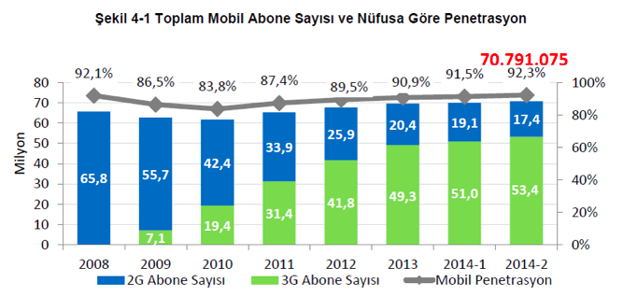
The Market
Mobile Phone penetration is 92%+ in Turkey
At the age 10, youngster start using Mobile Phones
* Source: TÜİK Hanehalkı Bilişim Teknolojileri Kullanım Araştırması,2013

Slide 12

Manibux Ecosystem
Joy Game
Yemek Sepeti
McDonald's
Little Ceasers
D&R
Babil.com
BiTaksi
S.O.S
Kidzania
Vialand
KidzMondo
FunLoft
Biletix
Sinemia
S-Film
Kiko
MAC
Accessorize
Victoria's Secret

