Slide 1
Taxation for Real Estate Professionals©
The Bearded CPA
15640 NE Fourth Plain Blvd Ste 200, Vancouver, WA 98682
Notes:
Many years ago I also had a NYS Real Estate Salesman’s license
Housekeeping
Handout packages include:
1. “Slides”
2. Firm brochure on TAPeR services
3. Newsletter – IRS Times & Inquirer
4. Response Form
5. Business card
I was a Realtor many years ago—It was too hard!
Story: Mrs. Higgins
Speaker's Notes

Slide 2
Introductions
Roy Martin, CPA
Member of the American Society of Tax Problem Solvers

Slide 3
Table of Contents – Part 1
Taxation and Client
Sale of principal residence
Federal tax lien on real estate
Cancellation of debt

Slide 4
Table of Contents – Part 2
Taxation and the Realtor
- Estimated taxes
- Tax areas of special interest
- Home office
- Automobile
- Employ children
- Employ adult family
- Family employees
- Accounting Systems
- $$$$$$$$$$$$$$

Slide 5
Table of Contents – Part 3
Tax Problem Solutions
Unfiled returns
Ostrich method
If you owe money
How about audits?

Slide 6
Part One
Taxation and Your Client
Closing controls commissions.
Liens control closings.
Notes:
A seller with tax problems doesn’t necessarily keep you from earning a commission.
IRS will permit payment of the expenses the sale including your commission out of the proceeds at closing.
The problem may arise when a buyer is unwilling to close on the property subject to a federal tax lien.
Closing controls commissions
Liens control closings

Slide 7
Sale of Principal Residence
Only one principal residence permitted.
Exclusion of $250,000 of gain, or $500,000 for married persons filing jointly.
Must have been taxpayer's principal residence for 2 of the last 5 years.
Notes:
If you have a gain from the sale of your main home, you may qualify to exclude all or part of that gain from your income. Pub. 523, Selling Your Home, provides rules and worksheets.
If you sold your home under a contract that provides for part or all of the selling price to be paid in a later year, you made an "installment sale.“
In general, you are eligible for the exclusion if you have owned and used your home as your main home for a period aggregating at least two years out of the five years prior to its sale. Refer to Pub. 523 for the complete eligibility requirements as well as exceptions to the two year rule.
What if they had an office and home?
Cease taking home office in year before sale and year of sale to avoid split transaction
What if they have a principal residence and a vacation home with large potential gains?
Sell principal and avoid tax, then live in vacation home for 2 years and sell that with no tax.

Slide 8
Federal Tax Lien on Real Estate
Selling price $ 200,000
Less: Balance of PMM 100,000
Excess cash $ 100,000
Current tax on sale 20,000
Cash to IRS $ 80,000*
*apply to old tax liability, any excess would remain with taxpayer
Not applicable to principal residence
Notes:
Federal tax liens, may be released, subordinated, or discharged.
New rules permit release or, nonfiling of federal tax liens below $25,000 of liability when a taxpayer is willing to set up a direct debit installment agreement.

Slide 9
Cancellation of Debt (Short Sale)
Notes:
1099 Form will be issued to homeowner (seller) by the bank that is canceling his debt.
Sale of a multiple dwelling - will require allocation
The Mortgage Forgiveness Debt Relief Act of 2007 generally allows taxpayers to exclude income from the discharge of debt on their principal residence. Debt reduced through mortgage restructuring, as well as mortgage debt forgiven in connection with a foreclosure, qualify for this relief.
This provision applies to debt forgiven in calendar years 2007 through 2012. Up to $2 million of forgiven debt is eligible for this exclusion ($1 million if married filing separately). Was extended through 2013, unknown for 2014.
The exclusion doesn’t apply if the discharge is due to services performed for the lender or any other reason not directly related to a decline in the home’s value or the taxpayer’s financial condition.
The amount excluded reduces the taxpayer’s cost basis in the home.
Further information, including detailed examples, can also be found in Pub. 4681, Canceled Debts, Foreclosures, Repossessions, and Abandonments.
War story: Property was costing taxpayer $1,000 per month, but sale was stopped due to FTL exceeding value of property and buyers refused to even make an offer.
We applied for a discharge and IRS agreed to release it as remaining assets were more than double the liability.

Slide 10
Part Two
Taxes and
the Realtor
Taxes reduce profits.
Expenses reduce taxes.

Slide 11

Estimated Taxes
Tax is due when income is earned.
No magic to the 15th of April, June, September, or January.
Send in taxes only when you have money.
We send in payments for many clients, at all different times.
Notes:
If you make an estimated payment from each commission check, regardless of dates there will be no penalties applied—as long as the amount of the estimate is appropriate to your tax bracket. It just requires a little more work

Slide 12
Documentation Issues
IRS believes that taxpayers
are truthful and honest,
As long as it is wrapped in proof!
More on this in Part 3 on audits…
Notes:
IRS believes in the truth and honesty of taxpayers…
As long as it’s wrapped in proof!

Slide 13


Tax Areas of Special Interest
The most audited: Schedule C
Home office.(8829)
Auto expense (2106)
Actual expenses
Mileage method
Family employees
Tracking expenses
Computer, Logbooks and Journals
Notes:
2014 56 cents [Notice 2013-80]
2013 56.5 cents [Notice 2012-72]
55.5 cents [Notice 2012-1]
51 cents (1/1/11-6/30/11) [Notice 2010-88; Rev. Proc. 2010-51]
55.5 cents (7/1/11-12/31/11) [Announcement 2011-40]

Slide 14
Home Office
Regular and exclusive use
Indirect expenses – must allocate, generally on square footage
Mortgage interest & property taxes
Homeowner’s insurance
Repairs & maintenance
Rent or depreciation (no land, 39 yrs.)
Utilities (may require different allocation %)
Water, sewer, trash, snow plowing, etc.
Lawn care/landscaping???
How aggressive are you?!?!
Notes:
Exclusive use test must be met. Total exclusive use area divided by total area
Home equity loans – tracing rules apply. If proceeds went to purchase a personal asset you may still deduct on Schedule A, but none can be used on Form 8829. If proceeds were used to by a business asset then the interest can be treated as business interest and deducted on Schedule C – not on 8829. This is to your benefit. Tracing rules also apply here.
600 sq’ apartment with home office

Slide 15
Home Office-Concluded
Direct expenses – no allocation
Computers-Buy or Lease? It depends
Limitation on deductions
Home costs for insurance, repairs, utilities and depreciation are limited to net income from business
Disallowed deductions carried forward
Notes:
On computers we may need to allocate based on usage.
Lease usually has lower impact on cash flow, often higher total expense.
You may be able to deduct costs for Internet access, business related software
Sale of residence with home office – cease deduction in year before sale. If unsure, cease and amend later if you decide to stay

Slide 16

Automobile
Actual expense vs. mileage method
Track details for actual
Track mileage – log book, need total and business
Repair bills reflect mileage
Parking and tolls are separate
Buy or lease? It depends
Notes:
As with the computer:
Lease usually has lower impact on cash flow, often higher total expense.
Mileage method OK for either owned or leased vehicles.
For 2014 .56 per mile, for 2013 .565 per mile, for 2012 .555 per mile, for 2010 .50 per mile, and for 2011 .51 per mile
Medical and moving: 2014 .235; 2013 .24; 2012 .23
Charitable .14
Owned auto: Election to standard rate general must be made in 1st yr.
May switch to actual later w/o depreciation or if not fully depreciated must use SL method.
Leased auto: If elected standard rate per mile method must used for entire period of lease.

Slide 17

Employ Children
Income-shifting strategy
Factors to consider:
Appropriate work done in business
Services must be actually rendered
Earned income not subject to “kiddie tax”
Child’s wages deducted as business expense
May save education credit lost by parent due to adjusted gross income limitation
Notes:
Be careful not to disturb dependency deductions

Slide 18


Employ Adult Family
Larger salary may be justified
Wage and benefit plan contributions deducted as business expense
Employee-spouse of sole proprietor can contribute to IRA or be included in retirement plans
AGI-based deductions, phase-outs, and exclusions maximized
Notes:
Health insurance benefit often motivates this situation

Slide 19
Family Employees
Notes:
A recap of the rules on having family employees
Example: Child < 18 years of age, not HS graduate
Wages of: $2,500
Exempt from FICA, FUTA, NYSUI, WC, NYS DBL
Savings to parent:
15.3% X 2500 = $385
28.0% x 2500 = $700
Total saved = $1,085
Must consider impact on education credits, etc.
But, generally no effect on children of HS age or less.
No ‘Kiddie Tax’ on earned income.

Slide 20
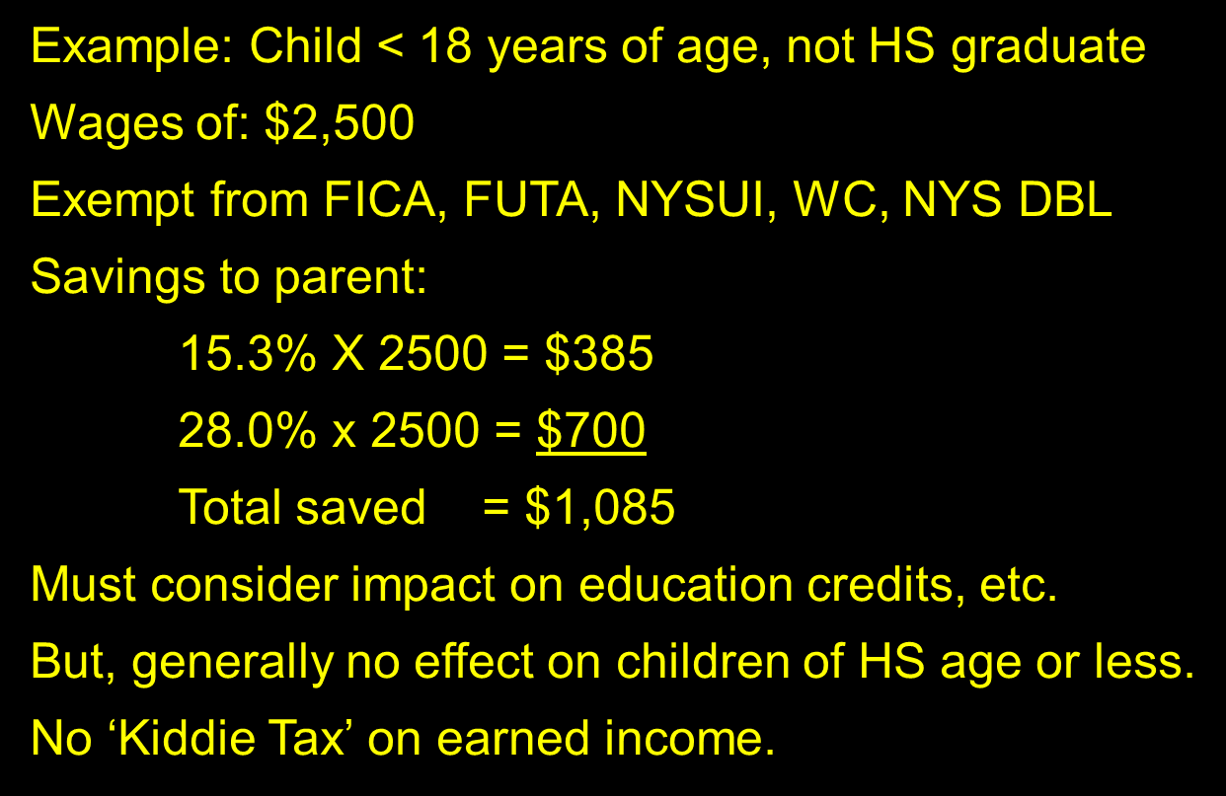
Family Employees

Slide 21


Accounting Systems
Disbursements journal (Expenses)
Separate bank account & reconciliation
Computerized-QuickBooks/Quicken
You may need to issue 1099’s or W-2s
1099’s from broker (Income)
Receipts journal (Income)
Record sources of deposits & transfers
Notes:
We help set-up systems for a basic package for $500
Track expenses and sale to which they relate.
Example: Business gift to home buyer deduction is $25 per person.
What about $25 to each spouse when they jointly purchase a home?

Slide 22


$$$$$$$$$$$$$$$
How much should it cost?
One-time costs
Set-up computerized accounting system
Hardware $500-$600 (Computer & Printer)
Software $150 - $250
Set-up and training $250 - $450
Annual
1040 with Sch. C, Forms 8829 & 2106
$350 - $550
Optional
Mid-year tax planning review
$250 - $350
Notes:
We also reward referral sources

Slide 23
Part Three
Tax Problem Solutions
Face it, fix it.
Sooner, not later.
Notes:
“Every tax problem has a solution”

Slide 24



Unfiled Returns
IRS wants you!
Failure to file can result in criminal charge
Get back in the system
File on time, even without money
Avoid penalties
Statute of limitations starts
Notes:
They want the paperwork done – perhaps more important than the money!
Many of the taxpayer assistance programs are not available until returns are filed.
Discharges in bankruptcy are often frustrated by non-filing.

Slide 25
The Ostrich Method
You can’t see what’s coming and your rear end is exposed!

Slide 26

If You Owe Money
Get time to pay
Get rid of penalties
Settle for a percentage of amount due
Based on ability to pay, not amount owed
Bankruptcy usually not an answer
Third party financing

Slide 27

How About Audits
Do not talk to IRS without representation.
“Cohan Rule”
Be aware of direction of auditor.
Financial Status Questions
MSSP directed at Real Estate Agents
Usually involves several years.
Repetitive Audits
Notes:
We represent clients at audits, we do not accompany them.
George M. Cohan
Lifestyle questions are a sign of danger
Error in year under examination will often cause them to look at other years or project an adjustment – for ex: disallow 30% of entertainment expense.
MSSP directed at Realtors

Slide 28
Three Double D’s Avoid Audit Agony
Don’t Delay
Direct Deposit
Document Deductions
Three P’s
Purchase
Payment
Purpose

Slide 29
Call for a Free Consultation
Roy Martin, CPA
(360)836-0379
15640 NE Fourth Plain Blvd Ste 200, Vancouver, WA 98682
Notes:
Appointments with no waiting and prompt turn-around. No surprises on fees.
Pick-up the completed response forms and request permission to email IRS Times Newsletter Monthly.

