Slide 1
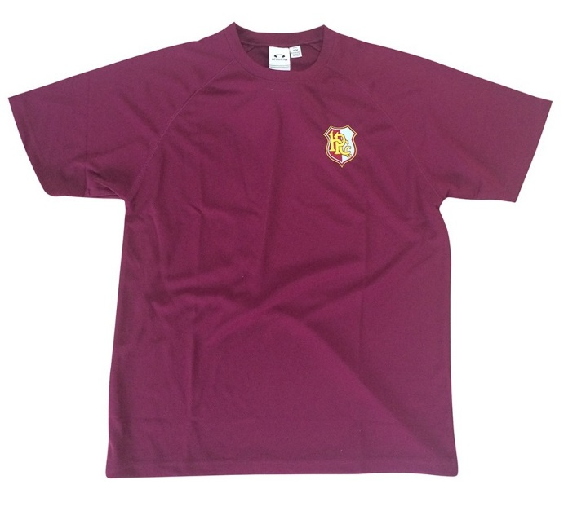

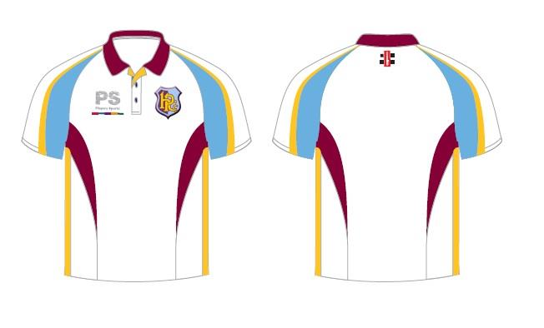
HPCC CURRENT LOOK

Slide 2



HPCC LOGOS

