Slide 1
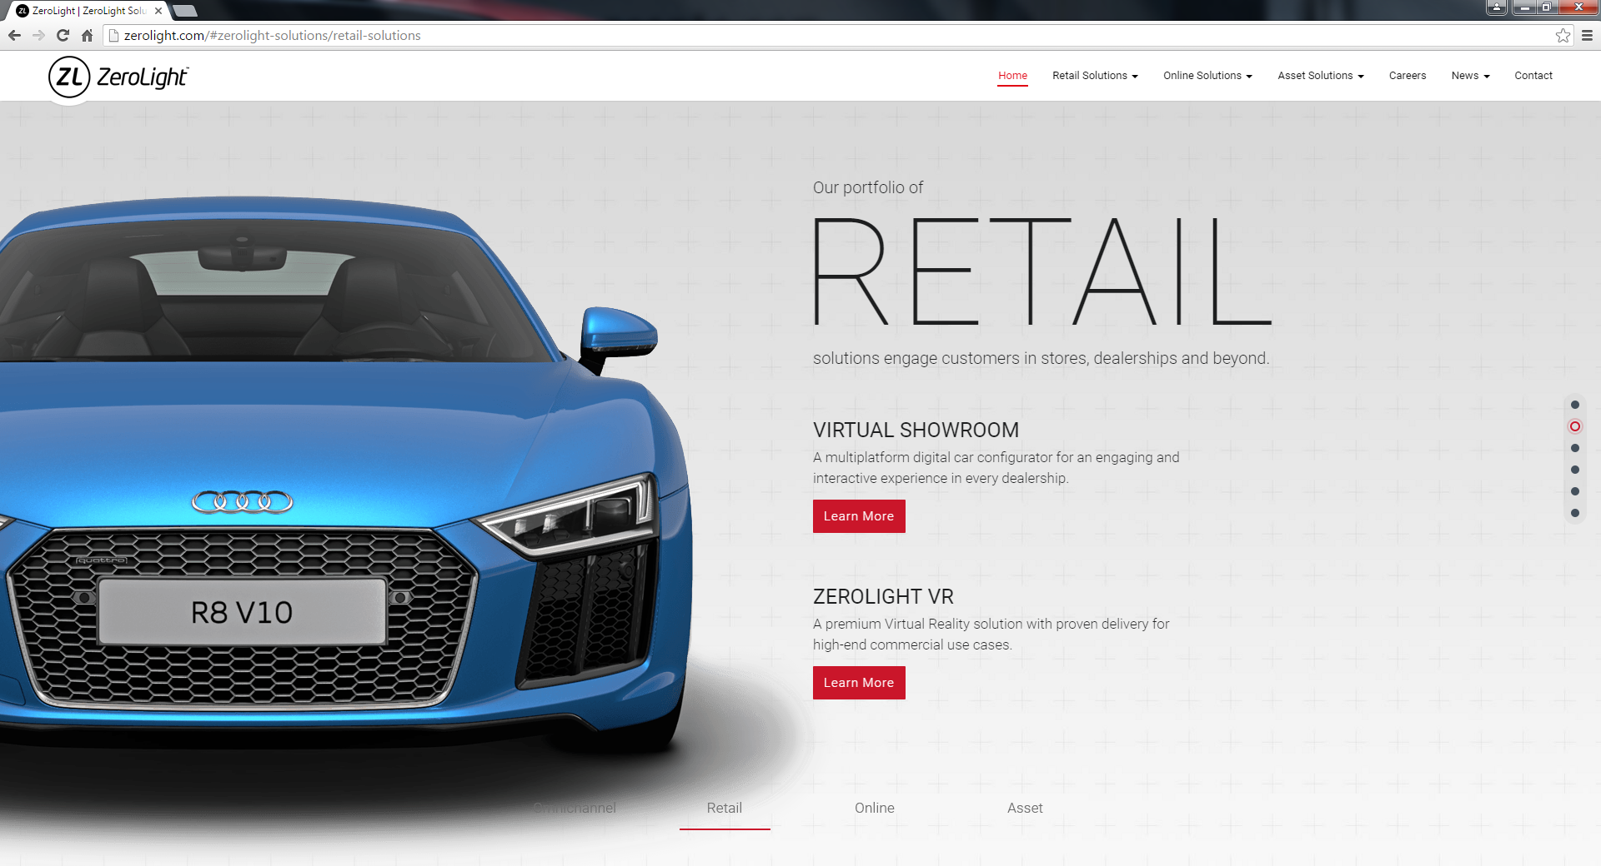
LOGO
HOME BENEFITS VEHICLE LISTINGS START ADVERTISING NOW CONTACT
MERCEDES BENZ S300
PRICE INFORMATION Selling Price S$26,800 Downpayment S$8040 (30% Selling Price) Loan Amount $S18,760 (70% Selling Price) Installment S$1297 (15month)
8 IMAGE SCROLL
VEHICLE INFORMATION Vehicle Reg No SKD 9590 X Vehicle Make Mercedes Benz Vehicle Model S300 Vehicle Reg Date 29 September 2007 (15 months) Vehicle Scheme Normal Vehicle Category PARF Vehicle Transmission Auto Engine Capacity 2999cc OMV 45,000 COE 23,000 ARF 22,500 Scrap Value 11,250 (50% of ARF) Depreciation Mileage 83,889KM No. of Owner 4 (No of Transfer plus 1) COE Expire Date (Renewed COE Only)
DESCRIPTION All original condition, only uses this vehicle to fetch my kids to school and technically under utilised. Always parked at the basement and sheltered areas all the time.
LISTING ID - 0985
CONTACT NOW
WHY IT IS WORTH? Four-way cameras, Pioneer sound system with woofer. 17 inch Sports Rim with brand new Pirelli tyres. Leather interior seats. Servicing by agent with records.

