Slide 1
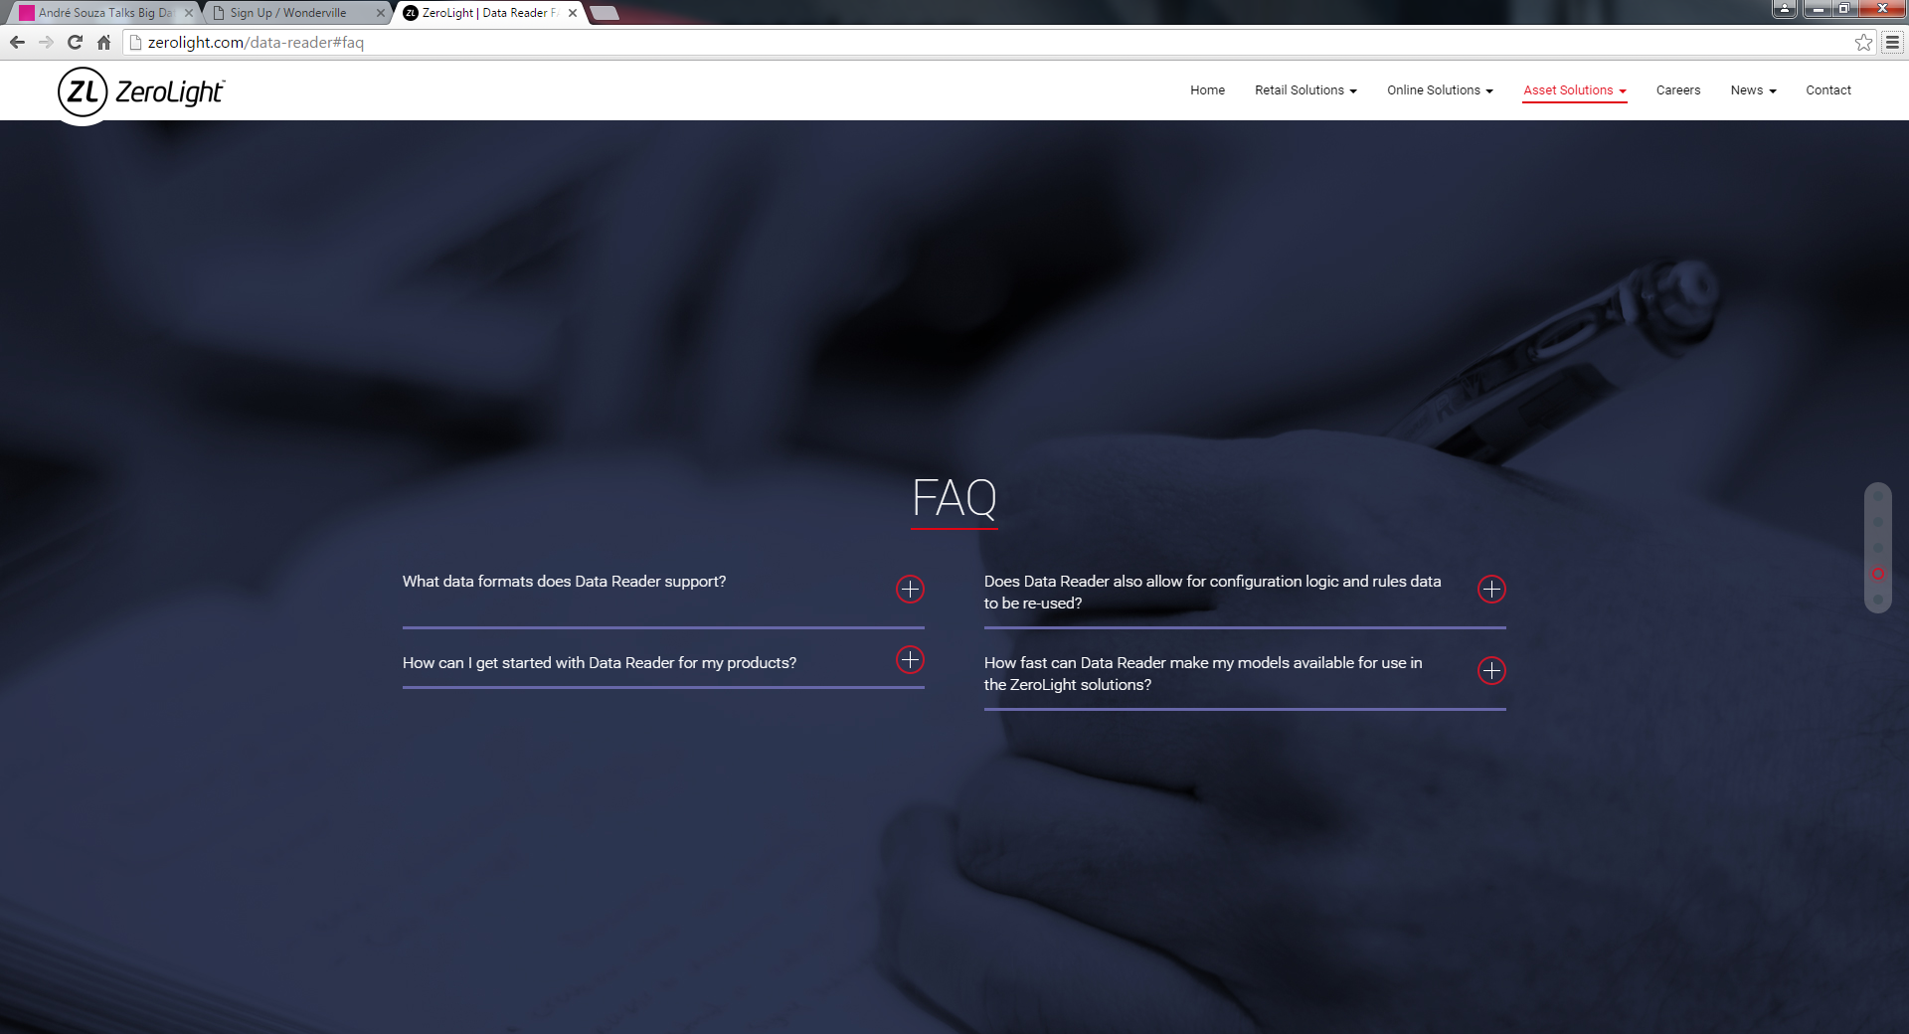
Accordion Effect on the + button
Expand Content
Page 1 of 2

Slide 2
How do I start to advertise my vehicle on Sellablez.com?
Ans: Sign up, create an account, upload good resolution photos & details of your vehicles and start advertising right away!
Is it true advertising on Sellablez.com platform is free?
Ans: Yes, there is no charges or fees when you sign up an account or when you start advertising your vehicles.
How many vehicles can I advertise with one account created?
Ans: No limits. Once you have sign in to create an account on Sellablez.com, there is no limit to how many number of vehicles you wish to advertise.
Once advertisement are posted online, how does potential buyer or seller keep in touch with each other?
Ans: A customer service officer will filter all enquiries, assign a Servicing Agent and schedules all genuine viewing appointments for the buyer and seller.
What is the role of a Servicing Agent?
Ans: A Servicing Agent entrusted by Sellablez.com to help manage/assist both buyer & seller through all ownership documentation, loan arrangement, insurance quotations.
Who will prepare all the documentations required If I wish to proceed to sell or purchase any vehicle listed in Sellablez.com?
Ans: All relevant sales agreement, final settlement form, insurance quotation form, handing/taking over form, payment official receipts shall be prepared and executed by the Servicing Agent.
Can I engaged an external party services to manage my vehicle transaction?
Ans: No, it is mandatory to accept the Servicing Agent appointed by Sellablez.com at all times. It is an assurance that each individual attached to you are responsible and possess high level of credibility to manage your vehicle transaction for Sellablez.com.
Will there be any additional marked up prices for commission payout to appointed Servicing Agent?
Ans: No, Servicing Agent has a strict S.A.F “Servicing Agent Fee” payable by both seller & buyer at 2% maximum base on the agreed sale price of the vehicle.
Example: Richard sold his car at $19,000, so the calculation of the S.A.F “Servicing Agent Fee” Richard needs to pay is computed below.
$19,000 X 2% = $380.00 (S.A.F) charges.
Page 2 of 2

