Slide 1
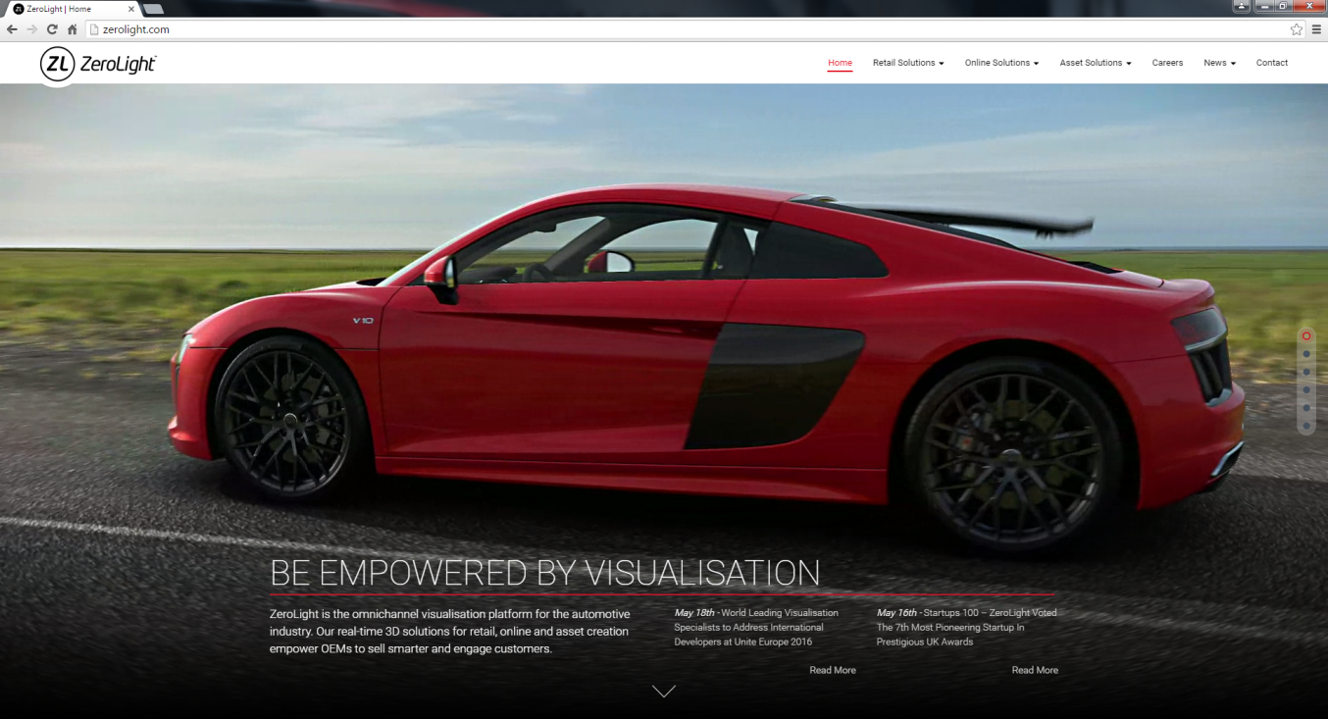
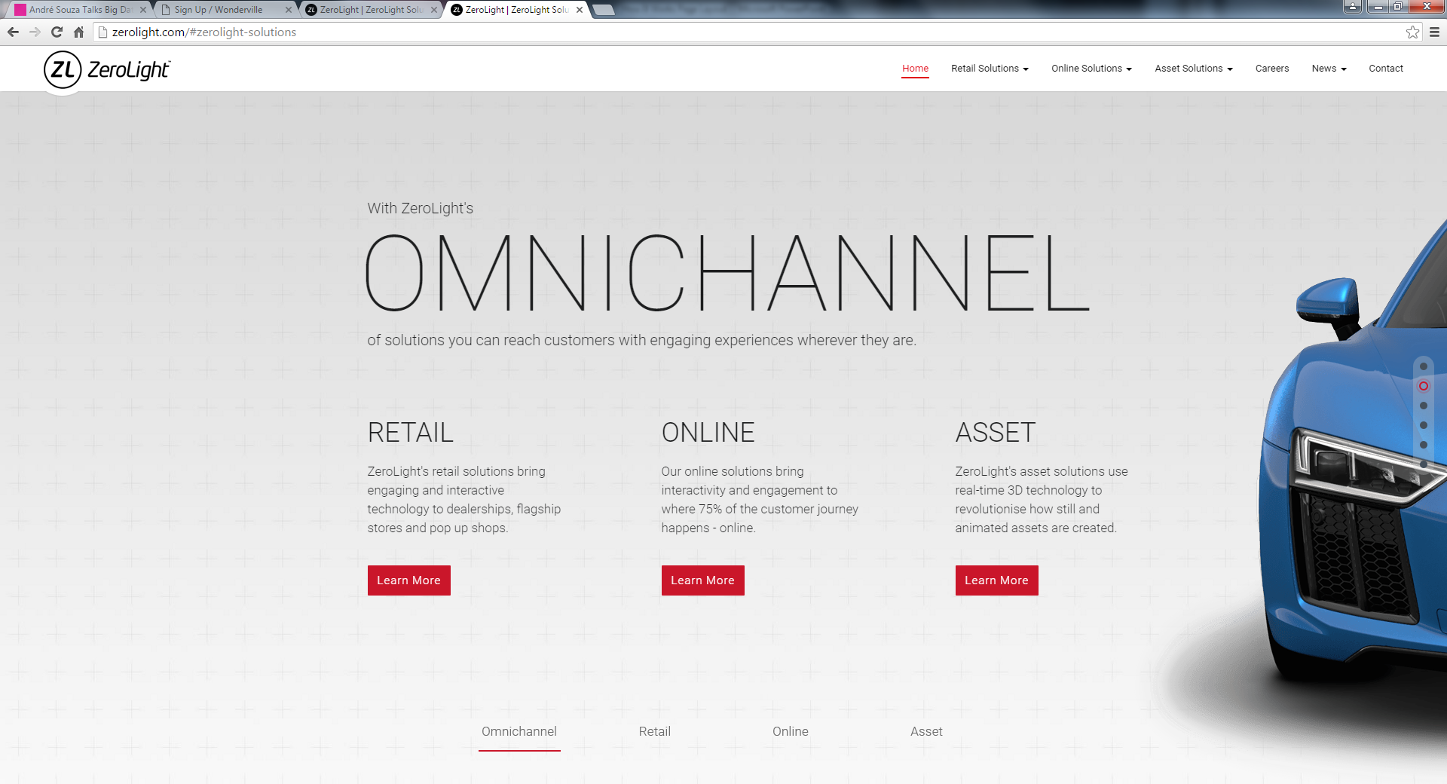
LOGO
HOME BENEFITS VEHICLE LISTINGS START ADVERTISING NOW CONTACT
Banner Slider
WE’VE GOT IT ARRANGED
Sellablez.com is an online platform which covers every single aspects from buying to selling of your vehicles. From engagement of a Servicing Agent till successfully handing over its ownership through a smarter and secure solutions
With Sellablez.com platform
THE MARGIN IS YOURS
when you reaches out to potential vehicle enthusiasts directly.
ADVERTISE NOW
Upload images and vehicle
details right after creating an
account which is absolutely
hassle & cost free.
PROMOTE YOUR BUSINESS
Leverage our busy online traffic which
makes us an excellent business platform for
limitless exposure.
ONLINE INSURANCE
Fill up your details on one form, we will
provide several quotation to suits
your requirement.

