Slide 1
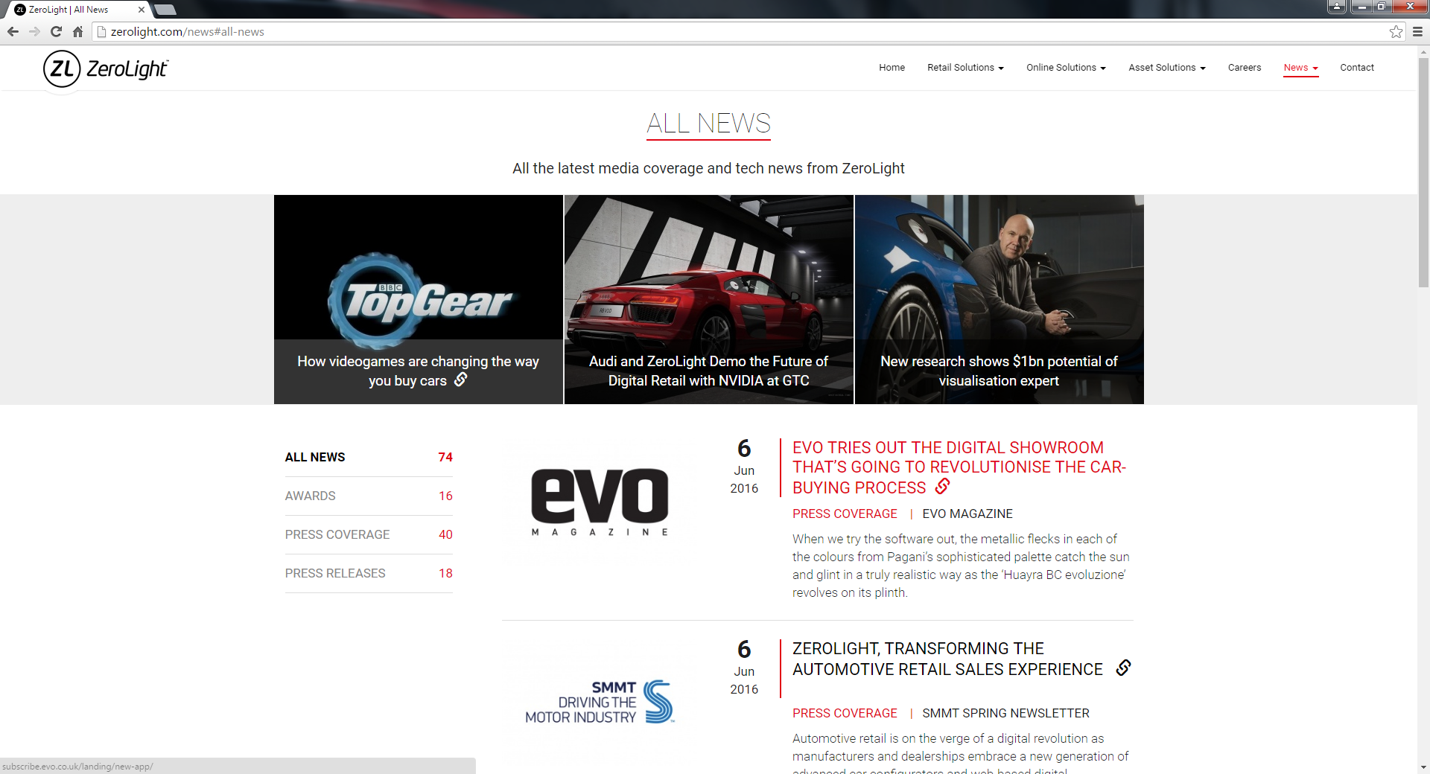
LOGO
HOME BENEFITS VEHICLE LISTINGS START ADVERTISING NOW CONTACT
VEHICLE LISTINGS
LISTINGS OF ALL LATEST VEHICLES FOR SALE
ADVERTISEMENT BAR
Note: Use a search: dropdown field for the model,year,price,transmission
SEARCH : MODEL> YEAR> PRICE> TRANSMISSION> LATEST>
IMAGE
27
Aug
2019
MERCEDES BENZ S300
1 OWNER | AUTO TRANSMISSION
Upgrading to an suv, needs to sell this vehicle off urgent.
Agent maintain, low mileage, always park at basement
carpark under the shades.
IMAGE
27
Aug
2019
MERCEDES BENZ S300
1 OWNER | AUTO TRANSMISSION
Upgrading to an suv, needs to sell this vehicle off urgent.
Agent maintain, low mileage, always park at basement
carpark under the shades.
SOLD
IMAGE
27
Aug
2019
MERCEDES BENZ S300
1 OWNER | AUTO TRANSMISSION
Upgrading to an suv, needs to sell this vehicle off urgent.
Agent maintain, low mileage, always park at basement
carpark under the shades.
Pagination

