Slide 1
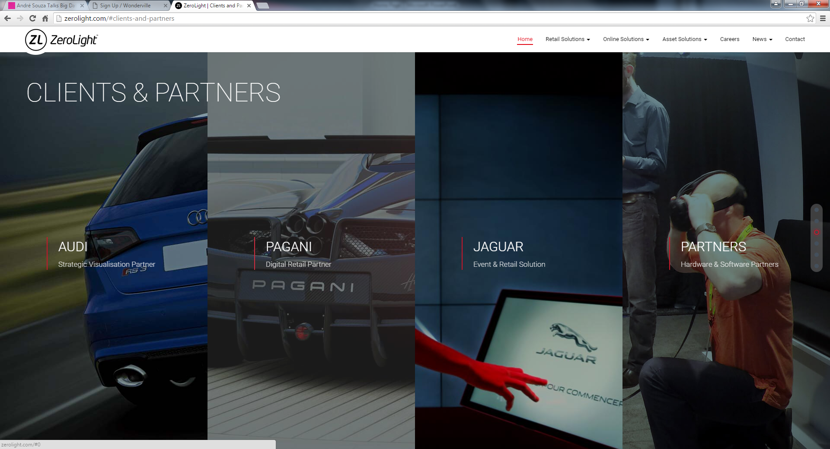
LOGO
HOME BENEFITS VEHICLE LISTINGS START ADVERTISING NOW CONTACT
ADVERTISING PARTNERS
Leverage on our busy online traffic.
BRAND NAME
BRAND TAGLINE
BRAND NAME
BRAND TAGLINE
BRAND NAME
BRAND TAGLINE
BRAND NAME
BRAND TAGLINE
Hover the image, will expand to full width column
BRAND NAME
BRAND TAGLINE
BRAND NAME
BRAND TAGLINE

