Slide 1
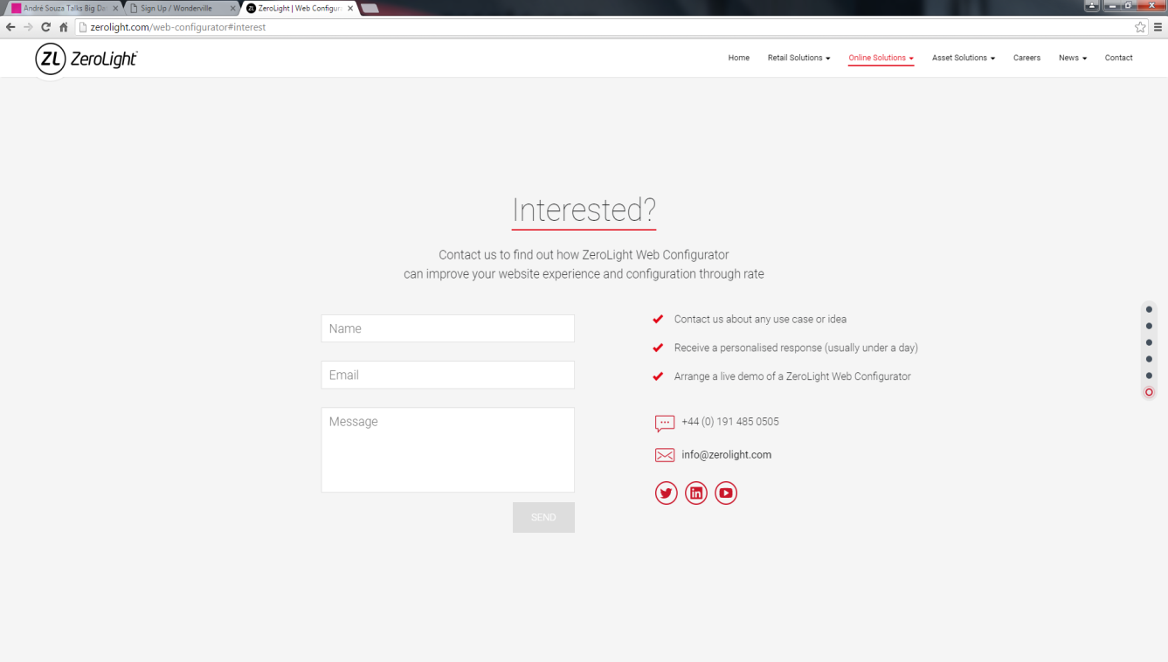
LOGO
HOME BENEFITS VEHICLE LISTINGS START ADVERTISING NOW CONTACT
Get in touch?
Contact us to find out how Sellablez.com can secure you a safe direct vehicle owner transaction. Potentially saves your pocket.
Name
Contacting us is easy, simply fill out the form below and it will be delivered to us right away.
Email
Mobile No
Message
SEND

