Slide 1




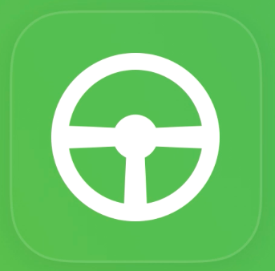


Main brand
Solutions/
Product lines
Managed
Mobility
Connected
Assets
Green Fleet
Monitor
Telematics platform allowing remote device management, secure wireless comms, data mgt, etc etc. This is sort of a utility on which all other online services run. Some partners use this platform without the Sycada services, just to receive telematics data.
Icon idea: The ‘old’ Sycada logo/icon
Online system to track & trace all kinds of remote assets using GPS. The locations and status of cars, vans, trucks, buses, trailers, containers etc is made available online.
Icon idea: Connected assets as a meshed network
Online system to monitor fuel & CO2 consumption, to analyse drive style of individual drivers and to coach them to become more mindful and economical drivers.
Icon idea: As illustrated above..leaf with savings chart integrated
Apps
DriveTag
StreetWise
Book ‘n Go
360ºEV
Driver extension to Green Fleet Monitor; driver gets feedback on how well he drives, tips for improvement and can compete for prizes.
Icon idea: Icon reflecting the shape of the drivetag
App/Driver extension to Green Fleet Monitor; driver gets feedback on how well he drives, tips for improvement and can compete for prizes.
Icon idea: In brand animation uses RijWijzer (Dutch)
App that allows users to book a shared car (or scooter) to make a zero-emission trip. The app has a planning tool that allows users to define a mobility need and to book a vehicle that caters for this.
Icon idea: ?
App that helps drivers of electric vehicles search for available charge points, monitor battery condition and range and much more. It’s a full service app for zero –emission mobility
Icon idea: Updatedversion of the current icon

