Slide 1





I like these kinds of colors and banners. bright and simple

Slide 2

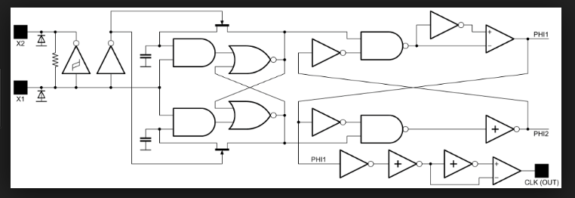

Anything that shows a circuit with different part numbers getting turned into a tiny integrated IC. I like the way the lines are lighted as in below picture. You can use those kind of lighted lines to show the circuit or to show circuit components or part numbers travelling on the lines. I’m completely open to interpretation and new ideas. Whatever looks best
GreenPak: Design a chip and have a sample IC ready to use in minutes
IC
Random circuit

