Slide 1
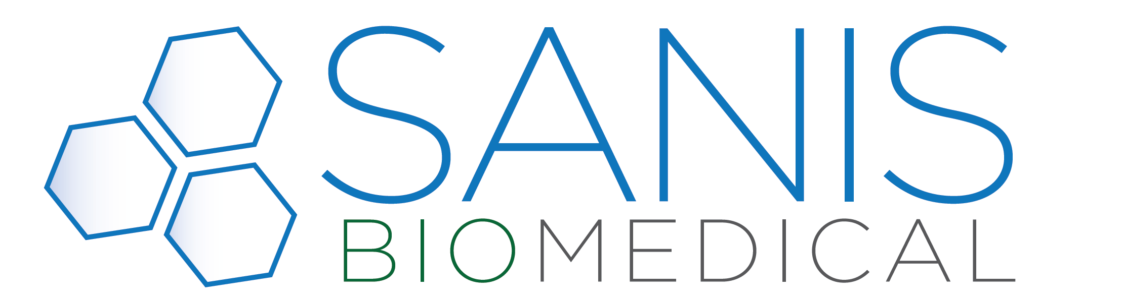
Small Sample Volumes are Small Problems
Kris Franklin, Chief Scientific Officer
Andréa Forsyth, PhD. Senior Scientist
Timothy J Dodson, Mol. Biologist & Chemist
Ashley Navarro, Medical Technologist

Slide 2
Small Volume Testing- the Good, the Bad & the Ugly
A recent literature search of American Chemical Society reveals 1642 publications within the last year of “small volume samples” with clinical aspects
THE GOOD
THE BAD & UGLY
Depending on the matrix, may be less invasive than traditional testing.
Collection Time is shorter
Lower shipping costs
Smaller storage requirements
Sample handling is unique to the matrix.
Matrices require special sample prep.
No “one size fit all” option.
“Dilute-and-shoot” won’t work.
Sensitivity of the instrument.
Inability to run sample multiple times

Slide 3
Endocrine Panel Objectives
Develop a less invasive way to get a baseline measurement on patient.
Allows physician to have a window into how a patient is responding to therapy, or determine there is a need of therapy or supplementation.
The ability to routinely monitor a patient to observe circadian changes or patterns in hormones
Remove the need for venous puncture allowing for point of care type collection device

Slide 4
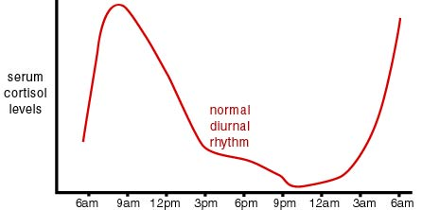
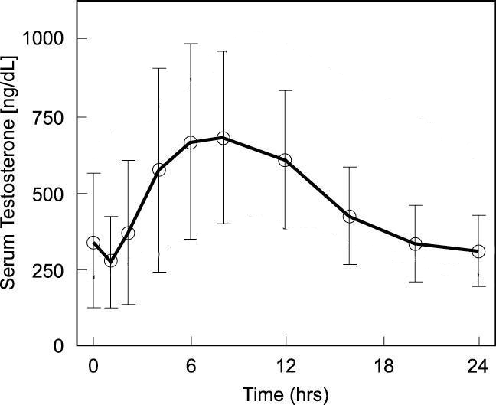
Endocrine Panel Challenges
Endogenous problems:
Levels vary by time (day of the month, time of collection, etc.)
Some hormones may be bound to proteins (SHBG, albumin, etc).
Top image: Endocrine Surgeon.co.uk. http://www.endocrinesurgeon.co.uk/index.php/adrenals-the-cortex-cortisol
(Accessed Feb 12, 2016).
Bottom Image: S H Ho Urology and Laparoscopy Centre. http://www.urologycentre.com.sg/hypogonadism_testosteronelevel.html (Accessed Feb 12 2016).

Slide 5
Endocrine Panel Challenges - Specificity
Multiple Isobaric Pairs:
Aldosterone, Cortisone
11-deoxycortisol, 21-deoxycortisol, corticosterone
DHEA, Testosterone, Estrone
17a-hydroxyl-progesterone, 11-deoxycorticosterone
Hormone | Mass
11-deoxycorticosterone | 330.461
17-alpha-hydroxyprogesterone | 330.461
21-deoxycortisol | 346.46
11-deoxycortisol | 346.461
corticosterone | 346.47
cortisone | 360.44
cortisol | 362.46
Hormone | Mass
estrone | 270.366
estradiol | 272.382
androstenedione | 286.409
estriol | 288.38
testosterone | 288.42
dhea | 288.424
progesterone | 314.46

Slide 6
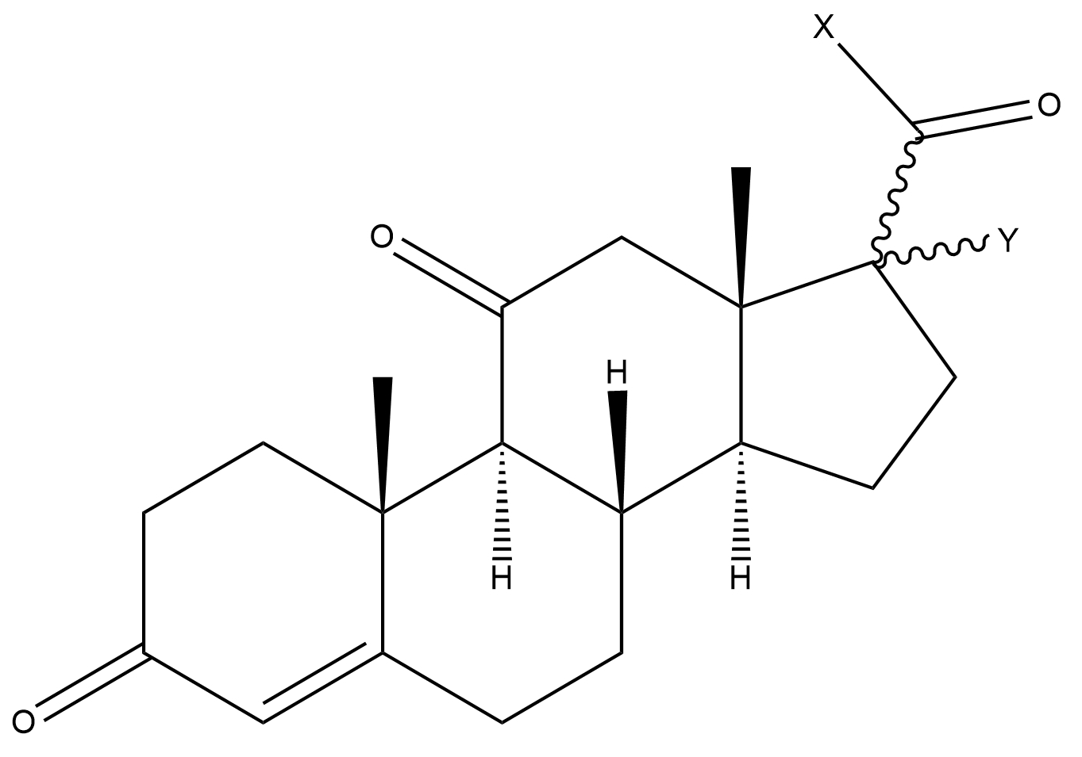
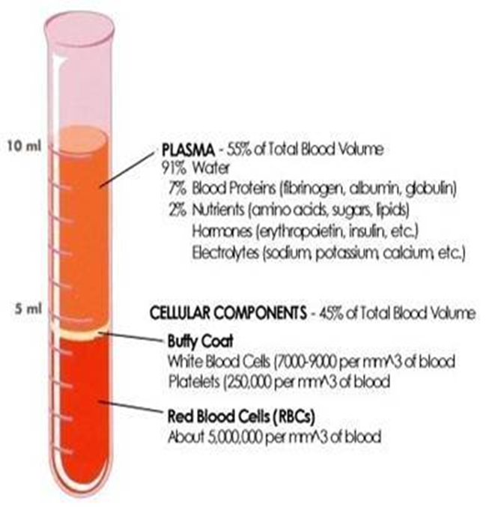
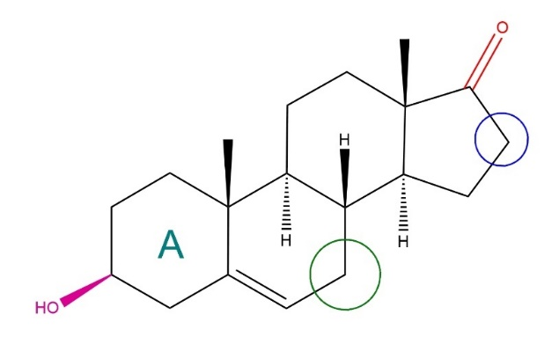
Endocrine Panel Challenges
Sensitivity
Hormones are poor ionizers (no proton donor / acceptor group)
Clinically many requires greater sensitivity and several have a wide dynamic range
Cholesterol similar structure in a significantly higher concentration
Matrix Effects and Ion Suppression may have more significant effect on sensitivity than drug analytes.
American Society of Hematology. http://www.hematology.org/Patients/Basics/ (Accessed Feb 1, 2016).
Medical Assessment. http://medicalassessmentonline.com/terms.php?R=568&L=B (Accessed Feb 12, 2016).

Slide 7
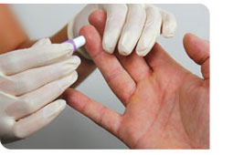
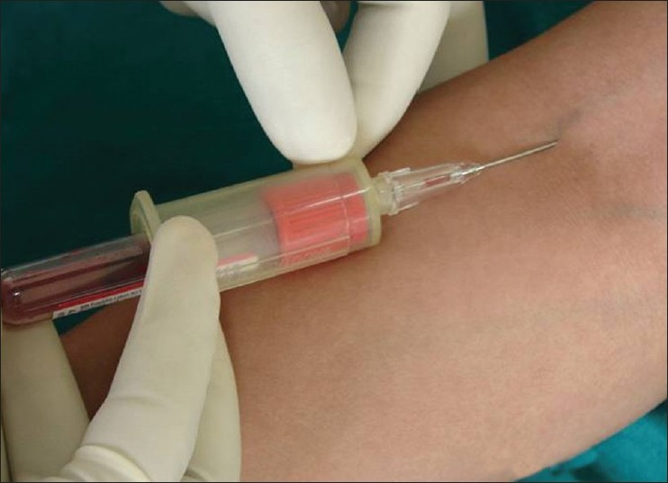
Sanis vs. Traditional Methods
350 μL sample is used to quantify 14 different hormones.
Capillary puncture is safe, simple, and gives reliable results.
No need for phlebotomist, nurse, etc.
Traditional methods use venous puncture and focus on only a few hormones in per prep or injection
Larger volume & additional Medical Professional required.
Images from: Austin Community College. http://www.austincc.edu/mlt/phb/phb_equipment.html
(Accessed Nov 11, 2015).

Slide 8
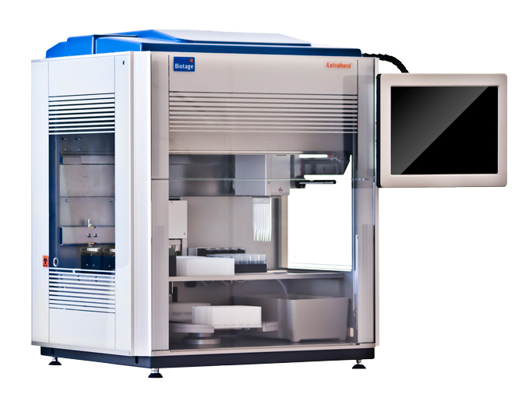
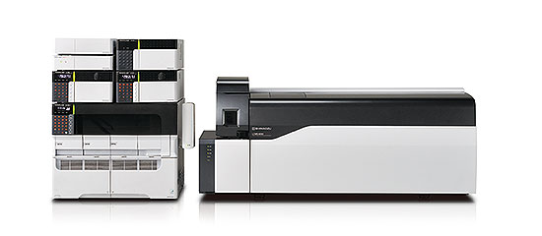
LC-MS/MS & Robotic Sample Prep Methodology
Single injection
Semi-Automated Sample preparation
8 min run time with 8.5 min loop time
Positive /Negative ionization single run
R² value of 0.99 or greater
CV less than 20%

Slide 9
Sanis vs Other Laboratories
 |  | Sanis Biomedical |  |  | Lab Y |  |  | Lab Z
 | Min vol (mL) | Partnered w/other tests? | Turn around? | Min vol mL | Partnered w/other tests? | Turn around? | Min vol | Partnered w/other tests? | Turn around?
Cortisol | 0.35 | All analytes listed. | 2-3 d | 0.3 | yes (cortisone) | n. l. | 0.2 | yes (0.5 ml x 4) | n. l.
Cortisone | 0.35 |  | 2-3 d | 0.2 | yes (cortisol) | n. l. | 0.3 | yes (0.25 ml) | n. l.
Corticosterone | 0.35 |  | 2-3 d | 0.2 | yes (1.5 ml) | n. l. | 0.25 | yes (0.25 ml) | n. l.
11-Deoxycortisol | 0.35 |  | 2-3 d | 0.2 | yes | n. l. | 0.25 | yes (0.25 ml) | n. l.
21-Deoxycortisol | 0.35 |  | 2-3 d | n/a | n/a | n. l. | n/a | n/a | n. l.
11-Deoxycorticosterone | 0.35 |  | 2-3 d | 0.5 | no | n. l. | n/a | n/a | n. l.
17-alpha-Hydroxyprogesterone | 0.35 |  | 2-3 d | 0.5 | no | n. l. | 0.25 | yes (0.25 ml) | n. l.
Progesterone | 0.35 |  | 2-3 d | 0.3 | yes (2 ml) | n. l. | 0.25 | yes (0.25 ml) | n. l.
Estrone (E1) | 0.35 |  | 2-3 d | 1 | yes (2.2 ml) | n. l. | 0.25 | yes (0.8 ml) | n. l.
Estradiol (E2) | 0.35 |  | 2-3 d | 0.6 | yes (2.2 ml) | n. l. | 0.45 | yes (0.8 ml) | n. l.
Estriol (E3) | 0.35 |  | 2-3 d | 0.3 | yes (2.2 ml) | n. l. | 0.3 | yes (0.8 ml) | n. l.
Androstenedione | 0.35 |  | 2-3 d | 0.5 | yes (0.5 ml) | n. l. | 0.25 | yes (0.6 ml) | n. l.
Dehydroepiandrosterone | 0.35 |  | 2-3 d | 0.5 | yes (0.5 ml) | n. l. | 0.3 | yes (0.25 ml, or 1.1 ml) | n. l.
Testosterone | 0.35 |  | 2-3 d | 0.4 | yes (1 ml) | n. l. | 0.2 | yes (0.25 ml, or 0.6 ml) | n. l.

Slide 10
Scientific Outline & Thought Process
Can the method be harmonized to regulatory standards?
Correlation study with CDC (testosterone)
Would a doctor get the same result as a traditional method?
Correlation study with Mt. Sinai (cortisol, testosterone)
Can capillary prick replace the venous puncture?
Correlation study with venous puncture versus capillary prick data.
Can we get the same result reproducibly?
Precision using external control (UTAK steroids mixtures; levels 1 and 3).
Does the method meet all the requirements of a clinical validation?
Validation Guidelines based on CLSI guidelines

Slide 11
Can the method meet CDC standards?
40 samples from the CDC tested Concentrations ranged from ~0.07 ng/ml to ~8 ng/ml
Notes:
40 samples from the CDC tested multiple times.
Concentrations ranged from ~0.07 ng/ml to ~8 ng/ml

Slide 12
Would the doctor get the same result, compared to a traditional method?
Sought to compare data from two commonly measured hormones:
Cortisol (n = 17)
Testosterone (n = 22)
Samples provided by Mt. Sinai hospital (Toronto)

Slide 13
Cortisol - Correlation Study with Mt. Sinai

Slide 14
Testosterone – Correlation Study with Mount Sinai

Slide 15

Can capillary prick compare to venous puncture?
Small scale study, looked at the entire panel.
Good correlation between venous and capillary measurements.
Critical to being able to replace current trends
Larger scale study planned.

Slide 16
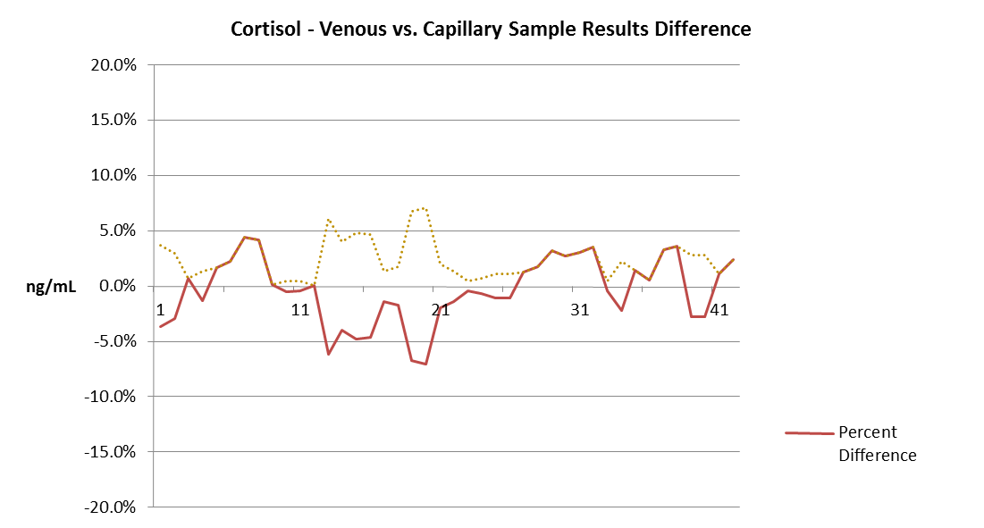
Cortisol (Vein vs. Capillary)
N | 42
 | Minimum | Maximum
Vein | 4.2170 | 180.6270
Cap | 4.4260 | 179.5080
Correlation - r | 0.973

Slide 17
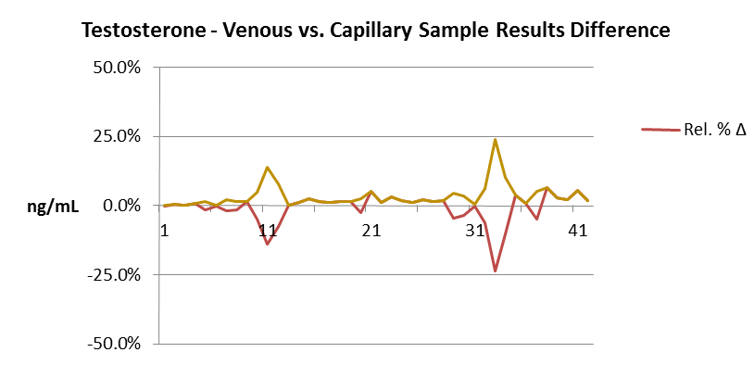
Testosterone (venous vs. capillary data)
Passing-Bablok fit
Equation | Cap = 0.05273 + 0.9254 Vein
Parameter | Estimate | Bootstrap 99% CI
Intercept | 0.05273 | 0.004135 | to 0.1402
Slope | 0.9254 | 0.8884 | to 0.9596
CI based on 99 bootstrap samples.
N | 42
 | Minimum | Maximum
Vein | 0.0570 | 5.5680
Cap | 0.1380 | 4.4550
Correlation - r | 0.987

Slide 18
Can the Results be consistently Reproduced?
Externally Prepared UTAK QC material at clinical levels
Measured over the course of a month to determine stability of QC material
Confidence that Results will be the same over time

Slide 19
Cortisol Precision with External UTAK Serum
LOW QC
HIGH QC
LOW QC
 | Avg. | Std. Dev. | CV
Conc. | 25.944 | 2.8148 | 10.850
Ratio | 4.027 | 0.1942 | 4.822
ISTD | 1,811,550 | 212643.3 | 11.738
HIGH QC
 | Avg. | Std. Dev. | CV
Conc. | 126.704 | 18.8101 | 14.846
Ratio | 19.578 | 1.1336 | 5.790
ISTD | 1,503,191 | 152952.1 | 10.175

Slide 20
Testosterone Precision & Accuracy UTAK Serum 2 Levels
LOW QC
 | Avg. | Std. Dev. | CV
Conc. | 0.976 | 0.0345 | 3.538
Ratio | 0.131 | 0.0068 | 5.188
ISTD | 10,171,862 | 2888714 | 28.399
HIGH QC
 | Avg. | Std. Dev. | CV
Conc. | 4.801 | 0.3272 | 6.816
Ratio | 0.645 | 0.0534 | 8.278
ISTD | 11,491,413 | 3326020 | 28.944

Slide 21
Fully Designed Clinical Validation for Lab Developed Test (LDT)
Linearity
Sensitivity
Carryover
Ion Suppression
Limit of Quantification
Reproducibility

Slide 22
Cortisol Linearity

Slide 23
Testosterone Linearity
Specificity | AVG | St Dev | CV
Ret Time | 3.386 | 0.008 | 0.245
MRM Ratio | 89.272 | 3.086 | 3.457

Slide 24
Applications of Small Volume Blood
Direct Effect of Therapies effecting Hormone imbalance
Dexamethasone Suppression
Routine Monitoring for Environment Stress Factors
Cortisol & Testosterone
Effects of Diet & Supplementation
Notes:
2 application of point of care small volume blood draw

Slide 25
Dexamethasone Suppression Effect
Two patients enrolled in our test had been given dexamethasone shots.
 | Conc. (ng/ml) | Average (ng/ml) | Clinical Range (ng/ml)
Patient 1
Cortisol | 9.853 | 130.00 | 70 - 280 (a.m.)
Cortisone | 2.003 | 26.40 | 12 - 35 (a.m.)
Patient 2
Cortisol | 4.21 | n/a | 70 - 280 (a.m.)
Cortisone | 0.35 | n/a | 12 - 35 (a.m.)

Slide 26
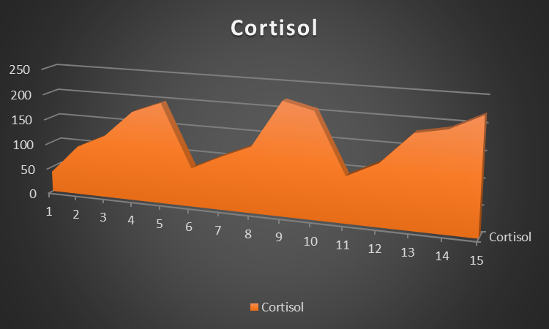
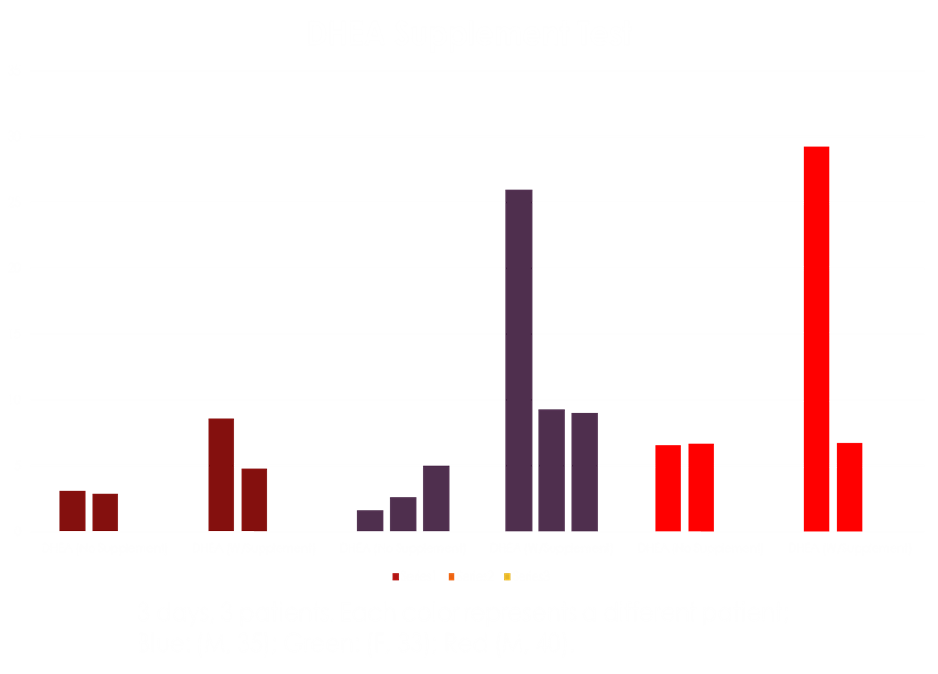
Effects of Stress and Supplementation
Can quantify the effects of long hours of work or over exhaustion.
Marker for overtraining can be established.
Food and supplements that can lower cortisol can be tested.
Can give a view for whether or not an athlete’s diet or supplements are affecting their health.
For supplements:
Are they giving me the boost that I want/need?
Are they effecting me in other ways?

Slide 27
Summary
Small volumes present unique, but not insurmountable challenges.
Good sample prep is key; regardless of matrix.
Small sample volumes can be used to search for multiple analytes with accuracy and sensitivity.
Ultimate goal is always to provide accurate information in a minimally invasive way to the patient and primary care provider.

Slide 28
The Brighter Path through Innovative Testing –Sanis Biomedical
Small sample serum toxicology panel
Allows for Therapeutic Drug Monitoring
Allows application of Goodwin & Gillman ranges in the clinical space
Endogenous markers and therapeutic drug monitoring
Utilziing Small volume Chemistry to obtain more health related information quicker.

Slide 29
Toxicology Panel 60 - 80 Analytes
6 General Classes:
Stimulants
Barbiturates
Muscle Relaxants
Opioids
Synthetic
Natural
Psychiatric Medications
SSRI
TCA
Benzodiazepines
Anti-Psychotics
Substances of Abuse
Bath Salts
Synthetic Cannabinoids
Cannabinoids

Slide 30
Endogenous Biomarkers and Therapeutic Drug Monitoring
5 Main Classes:
Inflammatory markers
Neurotransmitters
Therapeutic Drug Monitoring
Thyroid Markers
Vitamins and Amino Acid Metabolism
Notes:
Inflammatory markers
Thyroid markers
Vitamins & Amino acid metabolism
Neurotransmitters
TDM

Slide 31
Endogenous Biomarkers and Therapeutic Drug Monitoring
Entry | Name | Class
1 | Uric acid | IM
2 | Lactic acid | IM
3 | Homocysteine | IM
4 | Bilirubin | IM
5 | Vanillylmandelic acid | NT
6 | Homovanillic acid | NT
7 | Mandelic acid | NT
8 | Valproic acid | TDM
9 | Gabapentin | TDM
10 | Salicylates | TDM
11 | Phenobarbital | TDM
12 | Naproxen | TDM
13 | Ibuprofen | TDM
Entry | Name | Class
1 | T-3 | THY
2 | Reverse T-3 | THY
3 | T-4 | THY
4 | Tyrosine | V+AA
5 | 3,4-dihydroxy-L-Phenylalanine | V+AA
6 | L-Tryptophan | V+AA
7 | L-Histidine | V+AA
8 | L-Phenylalanine | V+AA
9 | Niacin | V+AA
10 | Folic acid | V+AA
11 | Biotin | V+AA
12 | Pyridoxine hydrochloride | V+AA
13 | L-Ascorbic acid | V+AA
Notes:
Inflammatory markers
Thyroid markers
Vitamins & Amino acid metabolism
Neurotransmitters
TDM

Slide 32

External Acknowledgment
Dr. Eleftherios P. Diamandis, MD, PhD, FRCP(C),FRSC
Mt. Sinai Clinical Hospital
Centers for Disease Control
Trinity (Vein vs. Capillary)
Biotage
Shimadzu

Slide 33
End
Questions?

