Slide 1



Presentation to:

Slide 2
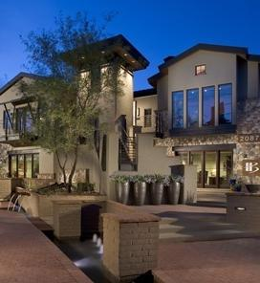
HBR1 OVERVIEW
Formed 4 years after HB (1996) as a Direct Response to our Clients’ Needs
One Stop Shopping
As Former Clients, our mission is to provide what we always wanted:
  Staff with Experience
  Outstanding Value
  The Real Magic - Customized Service

Slide 3
YOUR HBR1 TEAM
Kaye Sparks, Vice President
Tracy McCallan, Sales
Laura Baesel, Director of Operations
Karen McCallson, Program Director
Nick Van Stratt, Director of Technology

Slide 4
HB RESOURCEONE
Full Meetings Management Division of HelmsBriscoe
Corporate Meetings
Annual Meetings, Sales & Marketing Meetings
Incentive Programs
Sales Incentive Programs
Conferences & Tradeshows
Multi-Track Conferences
CEO Summits/Board of Director’s Meetings
Investigator Meetings / Board Meetings
Weekend Incentive Programs
Incentive Trips
Domestic & International
30 Attendees – 6,000+ Attendees
Education & Training
Client & Hospitality Events

Slide 5
HB RESOURCEONE
EVENT MANAGEMENT SERVICES Overall Logistics & Event Coordination, BEOs, Timelines Supplier Management, Contracting, Payment Schedules Conference/Program Promotion, Marketing Plans Production, Entertainment, Speakers Tradeshow Management, Sponsor & Exhibit Sales Air Ticketing & Ground Transportation Off-Site Events, including Tours & Recreational Activities Financial Management & Post-Program Reconciliation Gifts, Amenities, Awards, Hospitality Desks, Team Buildings, and more…
REGISTRATION SERVICES Website Design & Development Online Registration Turnkey Services: Licensed Platforms to select from include eTouches, Cvent, and SignUp4 Housing/Registration Management, including call centers
ONSITE EVENT MANAGEMENT Uniformed, Resourceful and Experienced On-Site Staff Available 24/7 while on-site
EVENT MANAGEMENT SERVICES
REGISTRATION SERVICES
ONSITE EVENT MANAGEMENT
FULL SERVICE MEETING SOLUTION

Slide 6
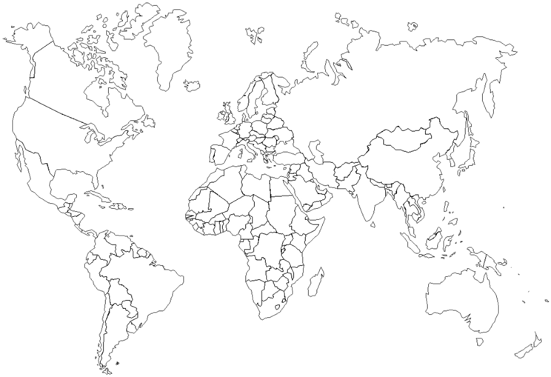
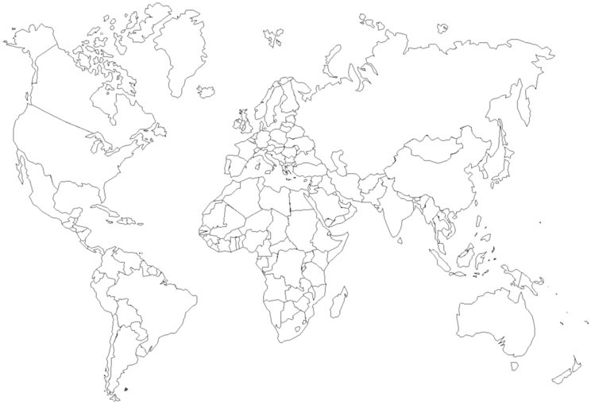
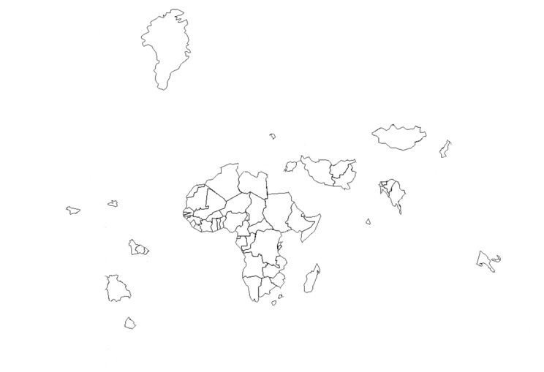

GLOBAL
EXPERIENCE
Global Experience
HB has booked business with over 35,000 properties
in more than 150 countries
HB has booked business with over 18,000 properties
in more than 120 countries
HB has booked business with over 18,000 properties
in more than 120 countries
HBR1 Team has managed events on every continent, except Antarctica!

Slide 7
























Client Partners
CUSTOMER PORTFOLIO

Slide 8
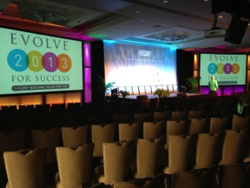

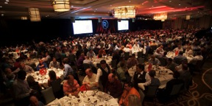


Corporate Meetings
SALES MEETING & CONFERENCES

Slide 9





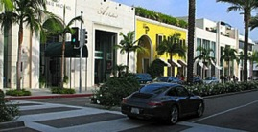

Incentive Trips
INCENTIVE
TRIPS
Notes:
9

Slide 10
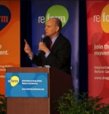

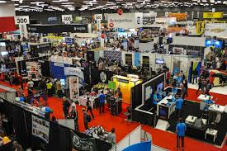
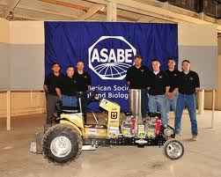
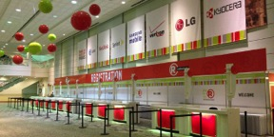
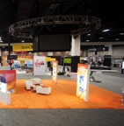
TRADE SHOWS

Slide 11

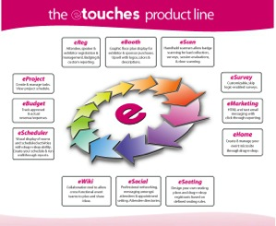
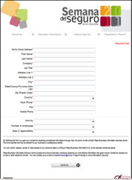
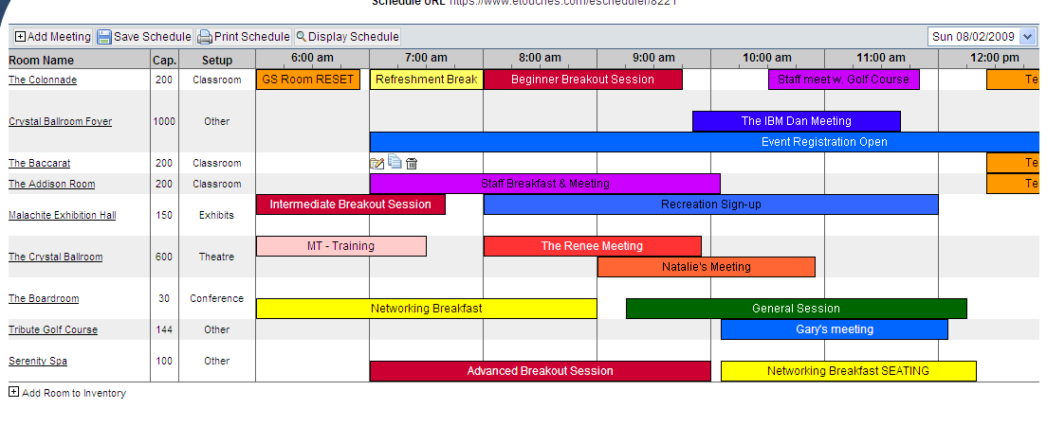

REGISTRATION TOOL:
Not Just Registration Anymore
Plan, Market, Manage, & Execute Your Events
Highlights: eSurvey, eBudget, eScheduler, eSeating, eBooth, eMobile
Hot Trend: Mobile Apps
  Connection to Online Air Ticketing
  Supported in 26 Languages
  PCI-Level 1 Compliant
  Interactive Demo

Slide 12
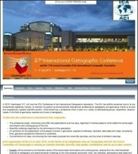
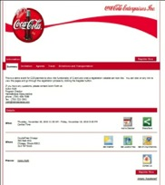
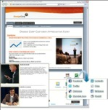
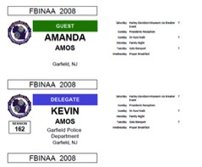
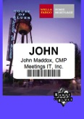
TURNKEY REGISTRATION SERVICES
Event Website Design
Professionally Designed Event Websites
Customized Look and Feel with Custom URL
  Registration Management Services
Call Center, Point of Contact
Housing Management, Rooming Lists
Data Scrubbing
Custom Reporting/Report Management
HBR1 will manage on your behalf, but your planners have full access
  Name Badges (Barcodes, Scanners)
  On-Site Registrars

Slide 13
PRICING
STRUCTURE
MEETING MANAGEMENT
Dedicated Program Director
ON-LINE REGISTRATION & MOBILE APP
Custom Reporting/Report Management
ON-SITE STAFFING
Fully Trained, Experienced Staff on 24/7
THIRD PARTY SUPPLIERS
One Point of
Delivering a Successful Program; No matter what it takes
Fixed, Flat Fee; No surprises on the final bill
Call Center for email and phone inquiries
Billed on Actuals
Billed on Actuals
Worldwide Vendor Network
Pass-Through Costs: no mark up!

Slide 14

FROM CONCEPT TO COMPLETION
One Stop Shopping
With a master contract already in place, HBR1 can provide McDonald’s with a full scope of meeting management services options; we become an extension of your team
Global Experience
Average experience on our team of 19+ years
Unparalleled Value
Flat fee pricing model and transparent pass-through costs – no surprises!
Outstanding Customized Service
95% retention rate
HBR1 is the Solution from Concept To Completion!

