Slide 1
  HelmsBriscoe ResourceOne
  Presentation to XXXXX
  Insert Date

Slide 2
Table of Contents

Slide 3

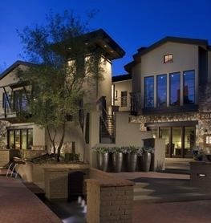
Company Overview
Formed 4 years after HB (1996) as a Direct Response to our Clients’ Needs
One Stop Shopping
As Former Clients, our mission is to provide what we always wanted:
  Staff with Experience
  Outstanding Value
  The Real Magic - Customized Service

Slide 4
Your hbr1 team
Kaye Sparks
Vice President, HelmsBriscoe ResourceOne
Laura Baesel
Senior Director, Operations
Insert Name
Program Director
Kay Burke Director Global Sales
Nick Van Stratt
Director of Technology

Slide 5
Kaye sparks vice president
Kaye is responsible for the day-to-day operation of HelmsBriscoe ResourceOne’s full meeting management division. Kaye’s role includes leadership of the HBR1 team, strategic development and execution of sales and marketing strategies, new business development, relationship building with internal and external Clients, solidifying brand identity and managing HBR1’s Preferred Vendor program. Kaye joined HBR1 in 2001. Prior to joining HBR1, Kaye was the Director of Global Events for Nortel Networks and has 33 years of experience in the event industry. Kaye and her team managed events ranging from 100 to 5,000 plus attendees including sales conferences, association conferences, product launches, incentive trips, hospitality events, tradeshows, and road shows.
Kaye has managed such prestigious events as: Palm Springs International Film Festival, Master’s Golf Tournaments, PGA golf tournaments, US Open, Olympics, Super Bowl, Indy 500 and Formula One racing events globally. Kaye attended University of Houston Victoria and Texas Tech University and is based in Dallas, Texas.

Slide 6
Kay burke director, global sales
Kay joined HelmsBriscoe ResourceOne as a Director, Global Sales in 2012. With over 20 years in the event industry, Kay’s experience and enthusiasm for excellent event design and customer service enhances the remarkable team of professionals associated with the HBR1 organization.
Prior to HBR1, Kay spent nine year with JCPenney directing company initiatives for events such as store managers conferences, incentive programs, charity fundraisers, analyst and board of directors meetings ranging in attendance up to 4,500. She was also responsible for meeting and events held within the 70,000 sq. ft. of combined function space at the JCPenney corporate office where she managed a team of 10 meeting planners. While working with Sprint, RIA Thomson Reuters and Pearle Vision, Kay was the program director for major golf tournaments, national tradeshows, key Client events, medical continuing education programs and national franchise conferences giving her a vast range of expertise. Kay is actively involved in philanthropic efforts where she offers her experience in fundraising and serves on the board of directors and advisory council of various nonprofit organizations. She is based in Dallas, Texas.

Slide 7
Laura Baesel senior director, operations
Laura joined HelmsBriscoe ResourceOne in 2003. After two years of operating programs with HBR1, Laura moved into a sales role, managing all HB territories and a number of Clients over the course of the following 5 years. In addition to managing her Clients, she is now enjoying promoting ResourceOne as Director of Operations handling personnel issues, training, contracts, financials and overall structure for the HBR1 team. Laura began her meeting planning career in Southern California in 1994. Working in the Sales & Marketing department for Canon USA, Inc. she managed large-scale events such as national sales meetings, kick-offs, incentive trips, dealer non-disclosures, tradeshows, trainings, celebrity golf tournaments and charity fundraisers.
After a move with her husband to Dallas, Texas, Laura joined the Texas District of Merrill Lynch. She managed approximately 40 events per year including high-end sales incentive trips, trainings, seminars, senior management road shows, and Client hospitality events. As a Program Director for HelmsBriscoe ResourceOne, Laura worked with a host of Clients ranging from associations to Fortune 500 corporations. Event types she managed included tradeshows, cruises, association conferences, sales kick-offs, multi-city webcasts, and incentive trips (both domestic and international). Laura holds a BA in Political Science from Biola University and is based in Dallas, Texas.

Slide 8
Who is hbr1?
Full Meetings Management Division of HelmsBriscoe
Corporate Meetings
Annual Meetings, Sales & Marketing Meetings
Incentive Programs
Sales Incentive Programs
Conferences & Tradeshows
Multi-Track Conferences
CEO Summits/Board of Director’s Meetings
Investigator Meetings / Board Meetings
Weekend Incentive Programs
Incentive Trips
Domestic & International
30 Attendees – 6,000+ Attendees
Education & Training
Client & Hospitality Events

Slide 9
What we do
EVENT MANAGEMENT SERVICES Overall Logistics & Event Coordination, BEOs, Timelines Supplier Management, Contracting, Payment Schedules Conference/Program Promotion, Marketing Plans Production, Entertainment, Speakers Tradeshow Management, Sponsor & Exhibit Sales Air Ticketing & Ground Transportation Off-Site Events, including Tours & Recreational Activities Financial Management & Post-Program Reconciliation Gifts, Amenities, Awards, Hospitality Desks, Team Buildings, and more…
REGISTRATION SERVICES Website Design & Development Online Registration Turnkey Services: Licensed Platforms to select from include eTouches, Cvent, and SignUp4 Housing/Registration Management, including call centers
ONSITE EVENT MANAGEMENT Uniformed, Resourceful and Experienced On-Site Staff Available 24/7 while on-site
EVENT MANAGEMENT SERVICES
REGISTRATION SERVICES
ONSITE EVENT MANAGEMENT
FULL SERVICE MEETING SOLUTION

Slide 10
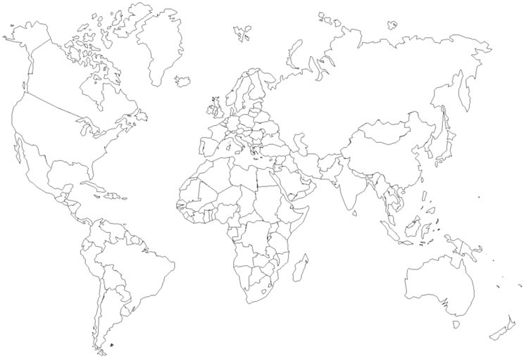
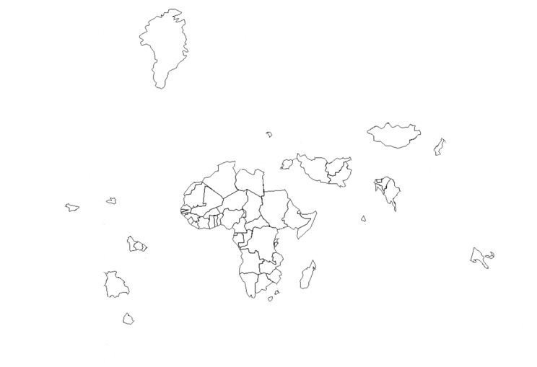

Global experience
HB has booked business with over 35,000 properties
in more than 150 countries
HBR1 Team has managed events on every continent, except Antarctica!

Slide 11





















CUSTOMER PORTFOLIO

Slide 12
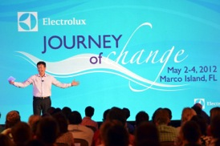

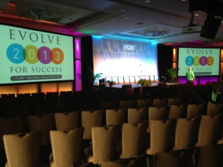

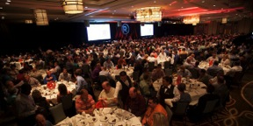
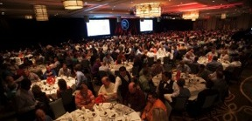


SALES MEETINGS
& CONFERENCES

Slide 13
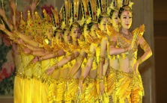

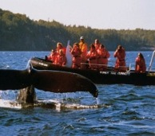


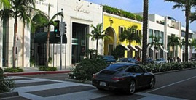
INCENTIVE TRIPS

Slide 14

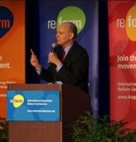
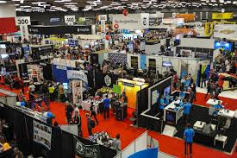
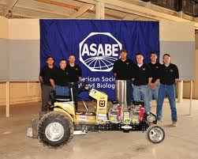
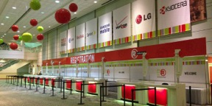
tradeshows

Slide 15
  Registration Services

Slide 16


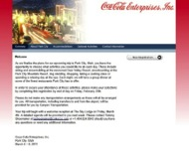
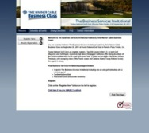
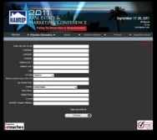
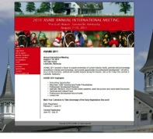
Website development
Drive excitement for your event by creating an interactive and informative website
From conferences to incentive trips, keep attendance high with the right “look” to your program
HBR1’s web team will take your graphics and design a fully-customized website to keep your attendees informed

Slide 17

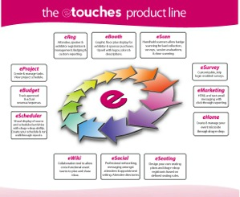
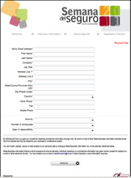
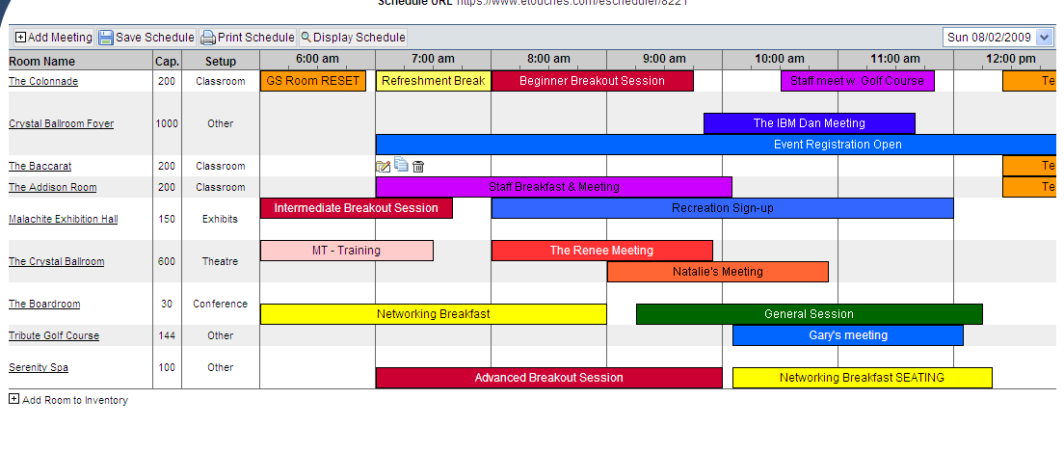

Online registration
Not Just Registration Anymore
Plan, Market, Manage, & Execute Your Events
Highlights: eSurvey, eBudget, eScheduler, eSeating, eBooth, eMobile
Hot Trend: Mobile Apps
  Connection to Online Air Ticketing
  Supported in 26 Languages
  PCI-Level 1 Compliant
  Interactive Demo

Slide 18

Data management
& call center
After your website launches,
your event registrar will be the
point of contact for all questions
pertaining to registration and the
overall event.
Registrar Services
  Available during business hours daily leading up to event
  Full-access to online registration system in order to assist and edit registrations, look-up information, and answer questions
  Coordination of rooming list with the hotel – watch room block and pick-up
  Customized reporting and lists to client

Slide 19
Air ticketing services
HBR1 delivers start-to-finish air fulfillment and management of group air services.
Typical service offerings:
  Group Air Reservations – air ticketing, consultation, air lift analysis, airline negotiations & contracting, block space coordination, international and domestic expertise. 24-hour emergency service
  Management Assistance – partner to set program goals and workable air budgets, define optimal air procedures
  Value Added Services – on-site air agent support, upgrade and waitlist processing, VIP & concierge services, in-flight attendee tracking system, budget consultation, assistance with documents and visa/passport services

