Slide 1


Slide 2
Agenda
Who is Ryno Strategic Solutions
Google Relationship
Our Products and Capabilities
RYNO 5 Steps To Online Success
Findings for Western Reporting/Performance
        - SEO Report Card (being pulled 48 hours)
        - Western Directory Presence
        Western Goals/re-cap
Ryno Good, Better & Best Recommendation
Next Steps
Notes:
Change out Dealer Logo and name

Slide 3

Who is Ryno Strategic Solutions
Established in 2008
Headquarter in Phoenix/Indianapolis Offices
Co-op Approved Vendor for Carrier/Bryant
Factory Approved
Every Service We Offer is In-House

Slide 4



Our Relationship with Google
Google Preferred Partner
Google Engage All-Star Winner 2012
Google Managed Agency

Slide 5
What is a Google Managed Agency?
Were 1 of the Top 200 Agencies in North America and the only Agency in the HVAC Industry
  Client retention above 88%
  Company growth
  Campaign Spend and Metrics
  Strictly “White Hat” practices

Slide 6
Ryno Products and Capabilities
Website Design/Mobile
SEO
PPC
Apps
Social Media
Call/Lead Reporting
Local Directory Synchronization

Slide 7
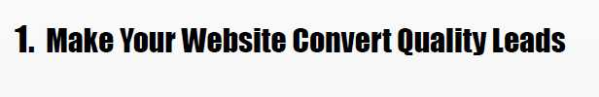

Slide 8
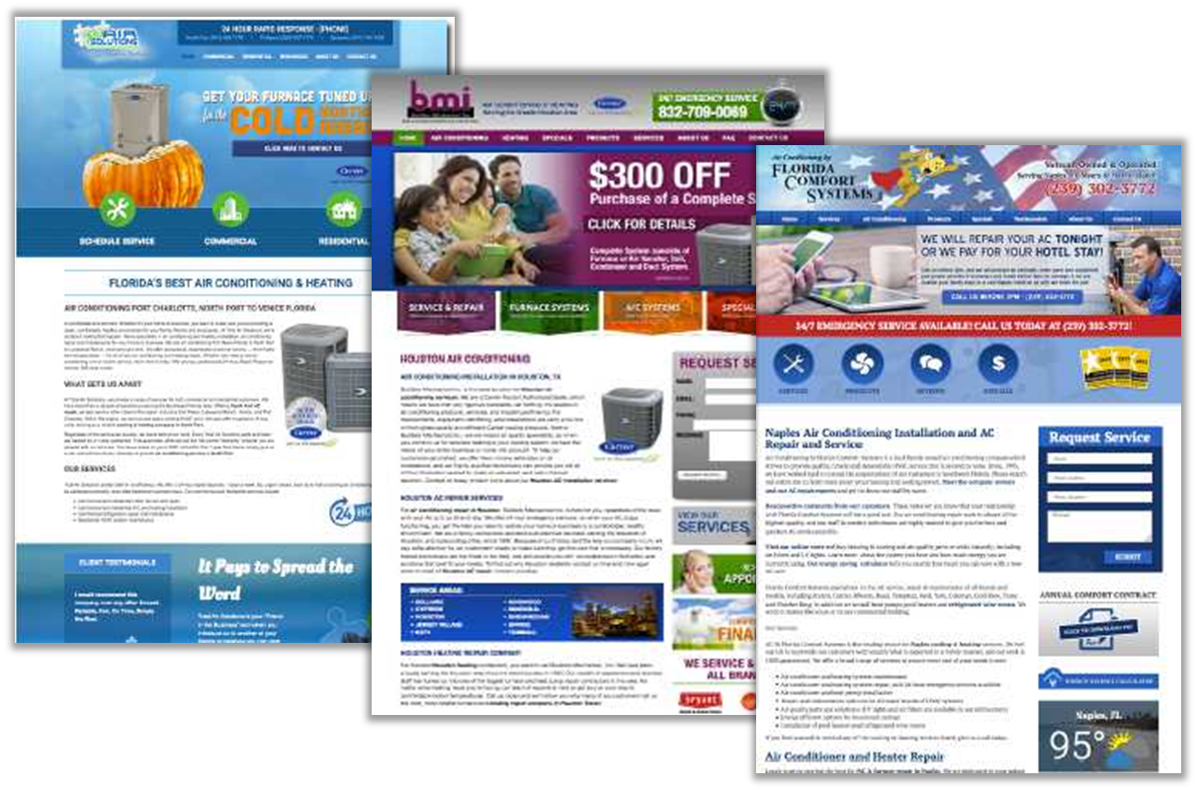
Promotion
Price
Product
Placement
4 P’s: Promotion|Placement|Product|Price

Slide 9
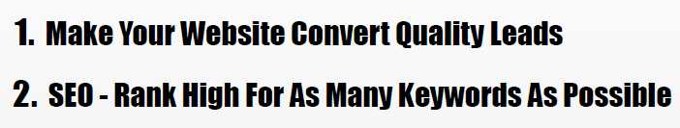

Slide 10
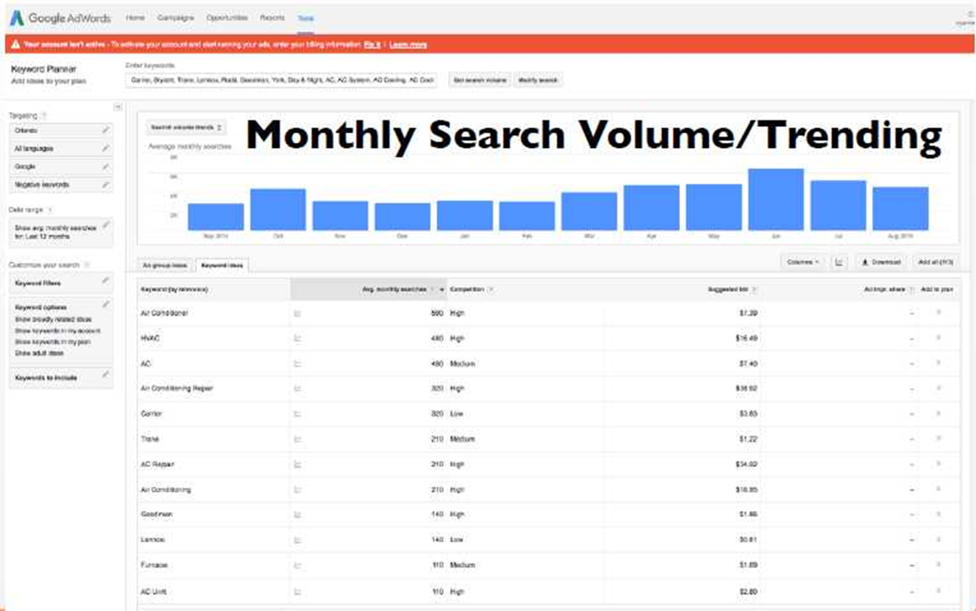
What does this mean for you?

Slide 11
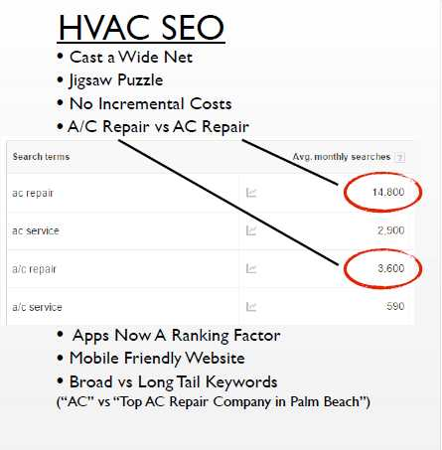
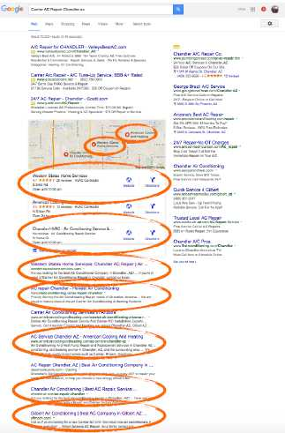

Slide 12
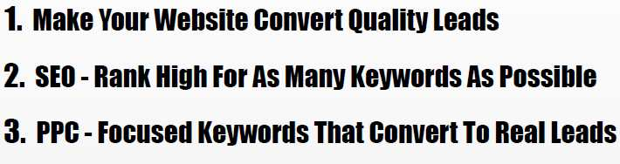

Slide 13
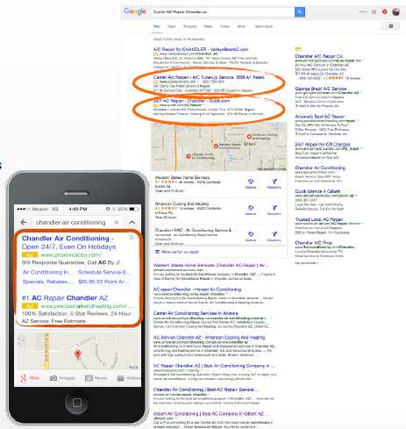
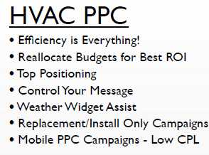

Slide 14
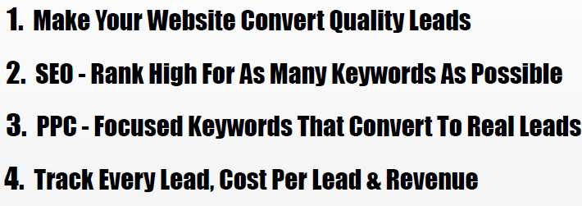

Slide 15
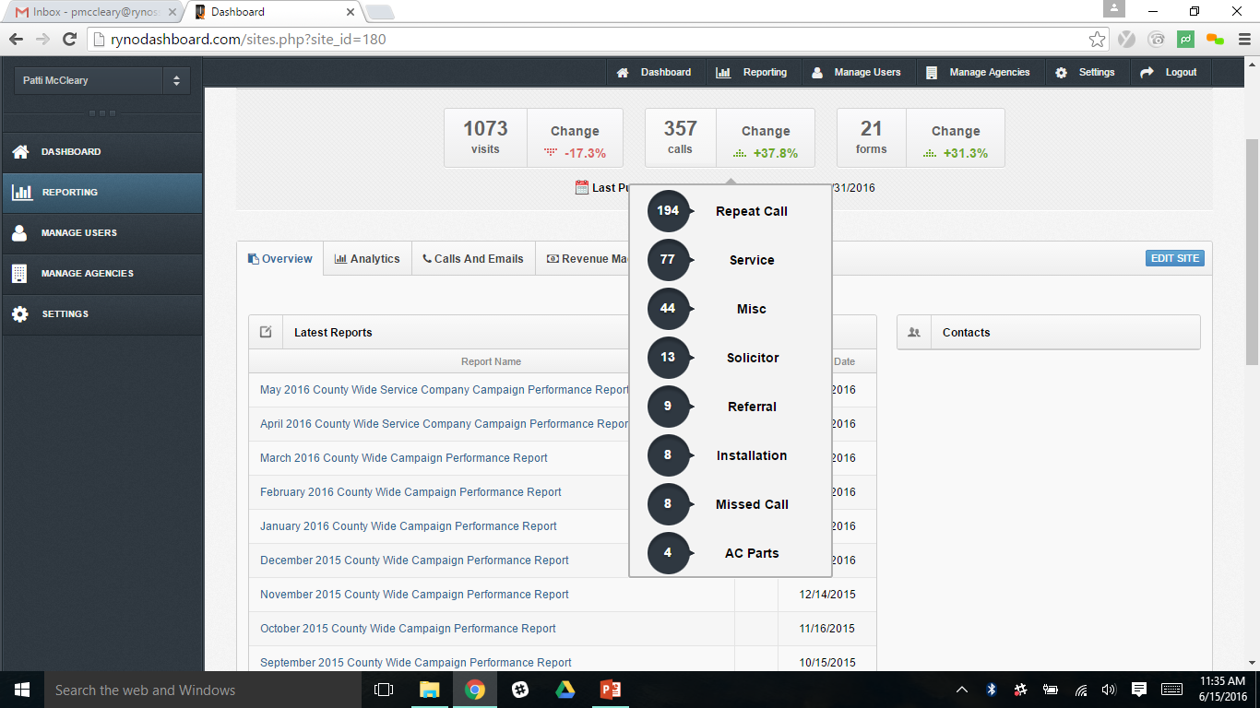

Slide 16
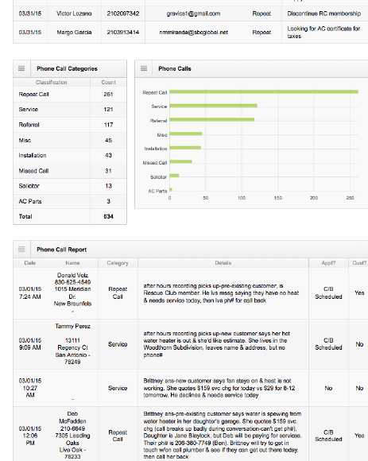

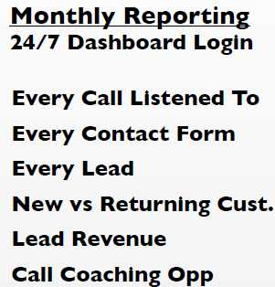

Slide 17
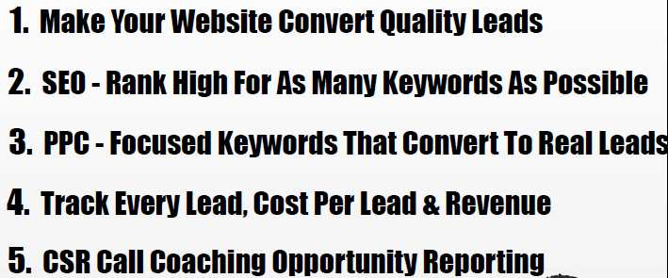

Slide 18
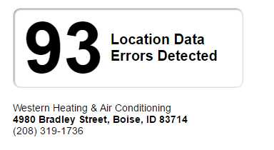
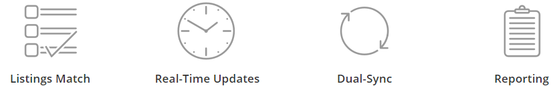
RYNO Local Business Synchorization
Western Heating and Air Conditioning
Inconsistent business location information across online maps, GPS devices, social networks, and search engines costs you real sales
Found 93 incorrect listings
Listings complete with enhanced content receive 416% more views than those without
Notes:
Required Slide

Slide 19
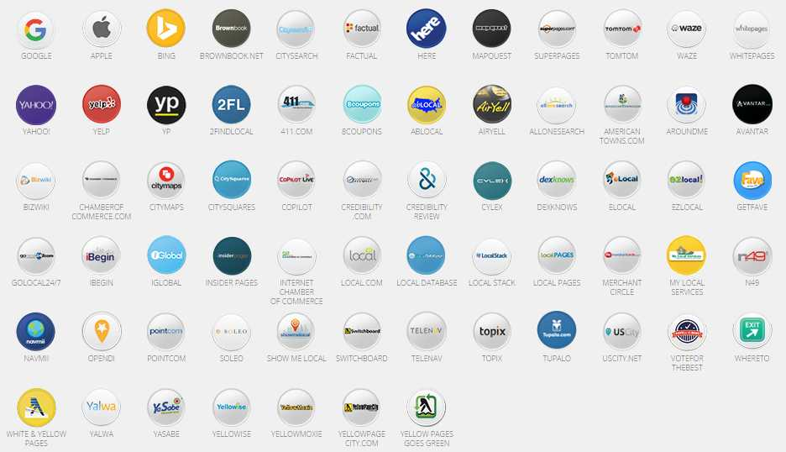

RYNO Local Business Synchorization
Notes:
Required Slide

Slide 20
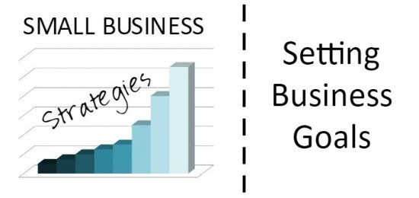
Western Heating & Air Conditioning Goals
Business Landscape: Company is approximately $10M and 75% residential replacement and service = $7.5M
Focus on new customer generation
Build a brand presence digitally that speaks to the consumer about the 3 Generations
Build holistic campaign with all the other marketing and advertising/ Brand awareness Bob has built – 50th year Anniversary
Notes:
Required Slide

Slide 21
RYNO Recommendations
Targeted Cities: Boise, Meridian, Eagle, Star, Nampa and Treasure Valley
Notes:
Required Slide

Slide 22
Next Steps
Finalize custom approach and decide best fit
RYNO Internal review on site coding, content and back end lay out
Process Agreement and Payment terms
Introduction to Account Team (Launch Manager and Account Manager)
Set up monthly meetings

Slide 23



Thank You

