Slide 1

STEAM Pilot Program
Nanosatellites
Seton Catholic School

Slide 2
Mission
Twiggs Space Lab is dedicated to developing STEAM based products and curriculum to engage and inspire students to pursue interests in science, technology, engineering, arts, and math. Develop a Tag Line – some concepts.
Expanding Curious Minds Stimulating Innovation
Inspiring Curious Minds
New Horizons for Curious Minds
Curious Minds in Action
Elevating Innovation through Curiosity Accelerating Curiosity through Innovation
Accelerating Curiosity through Innovation
Elevating Curiosity
Accelerating Curiosity
http://www.nsf.gov/pubs/2016/nsf16049/nsf16049.jsp

Slide 3
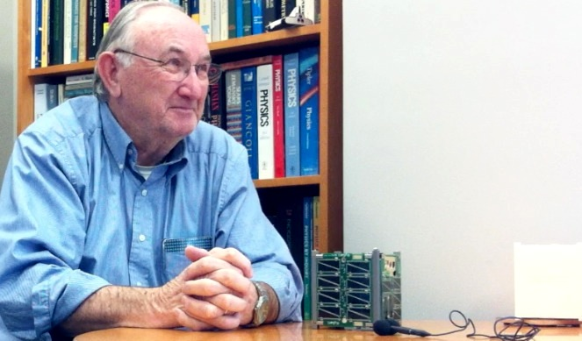
Our Founder
Robert Twiggs has been a professor of astronautical engineering at Morehead State University since July 2009, where he was instrumental in the development of a space systems curriculum. Prior to his time at MSU, Professor Twiggs was a consulting professor in the aeronautics and astronautics at Stanford University for 14 years. He is responsible for developing the curriculum for students interested in designing, building and operating small space experiments. He developed the original concepts for the CricketSat, CanSat, CubeSat and PocketQub for educational applications for use in space. In 2010 he was selected by the Space News publication as one of 10 space professionals “That Made a Difference in Space”. One of his recent publications is as a co-author of the article “Citizen Satellites” in the February 2011 Scientific American. He has a bachelor's degree in electrical engineering from the University of Idaho and an master's degree in electrical engineering from Stanford University.
Robert Twiggs, President
Twiggs Space Lab

Slide 4
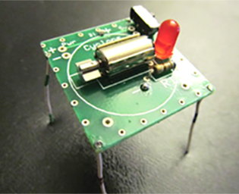
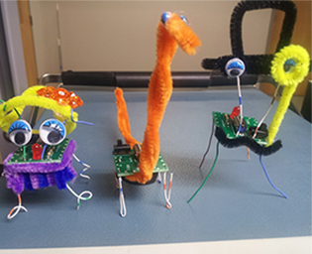
Jiggy
Learn about electronics, solder components, and designing and creating your own very active Jiggy.

Slide 5
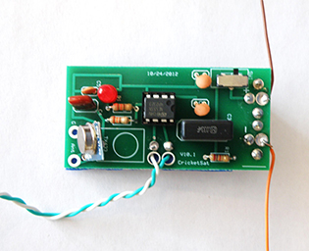
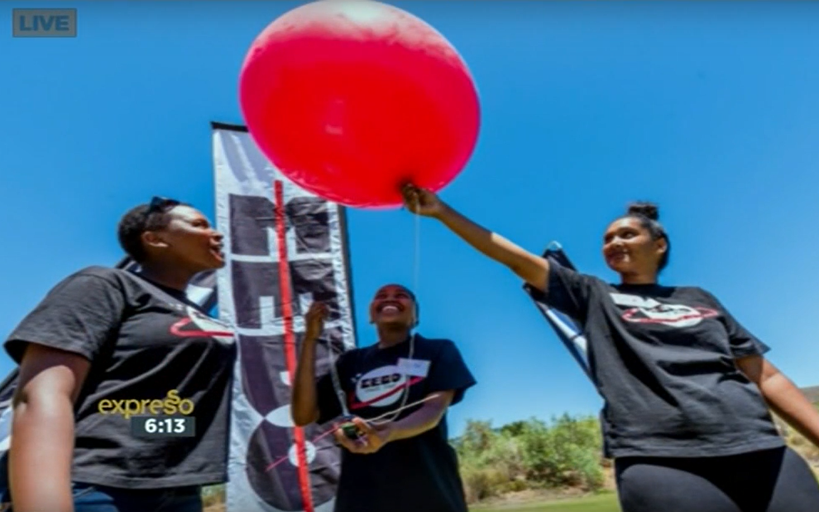
Cricket Sat
Build and launch a small satellite to collect atmospheric data.

Slide 6
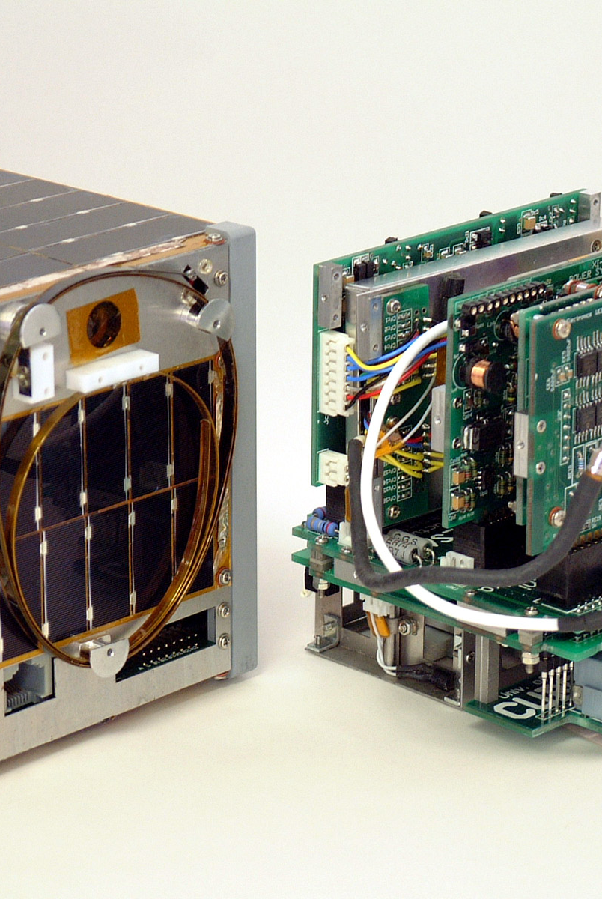
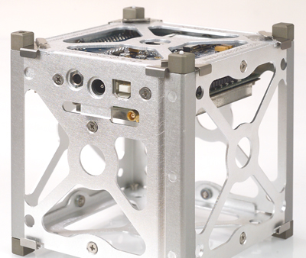
Desktop Sat
Build a working CubeSat capable of collecting and transmitting data based on payload sensors.

Slide 7
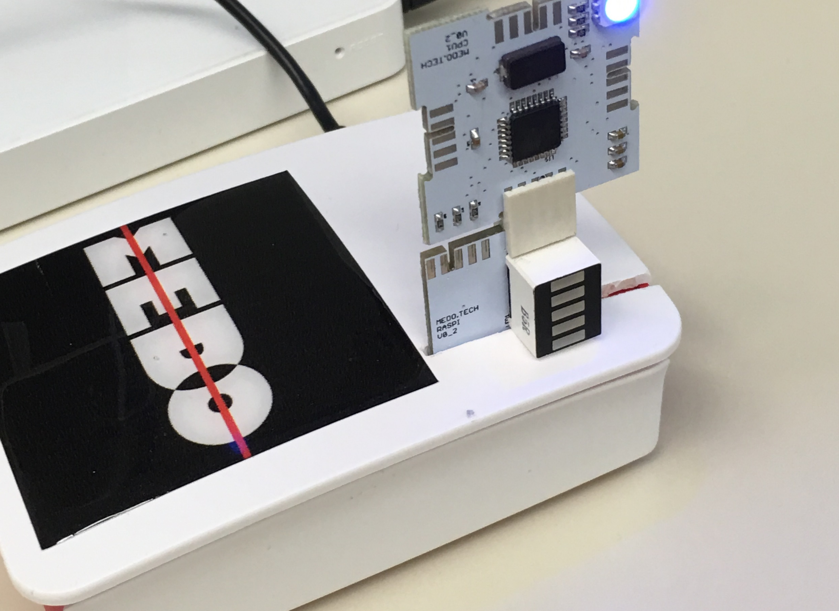
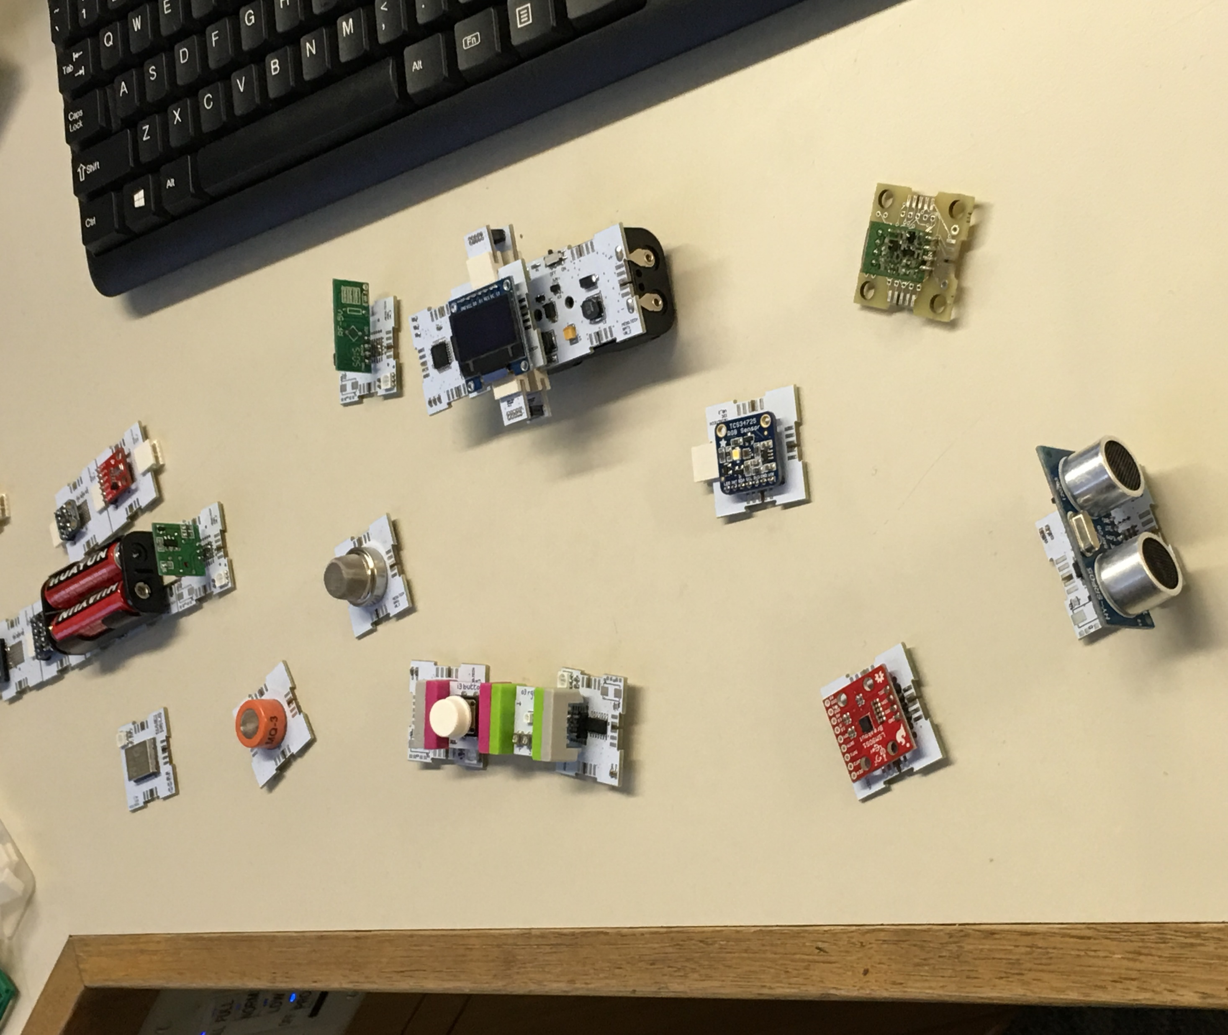
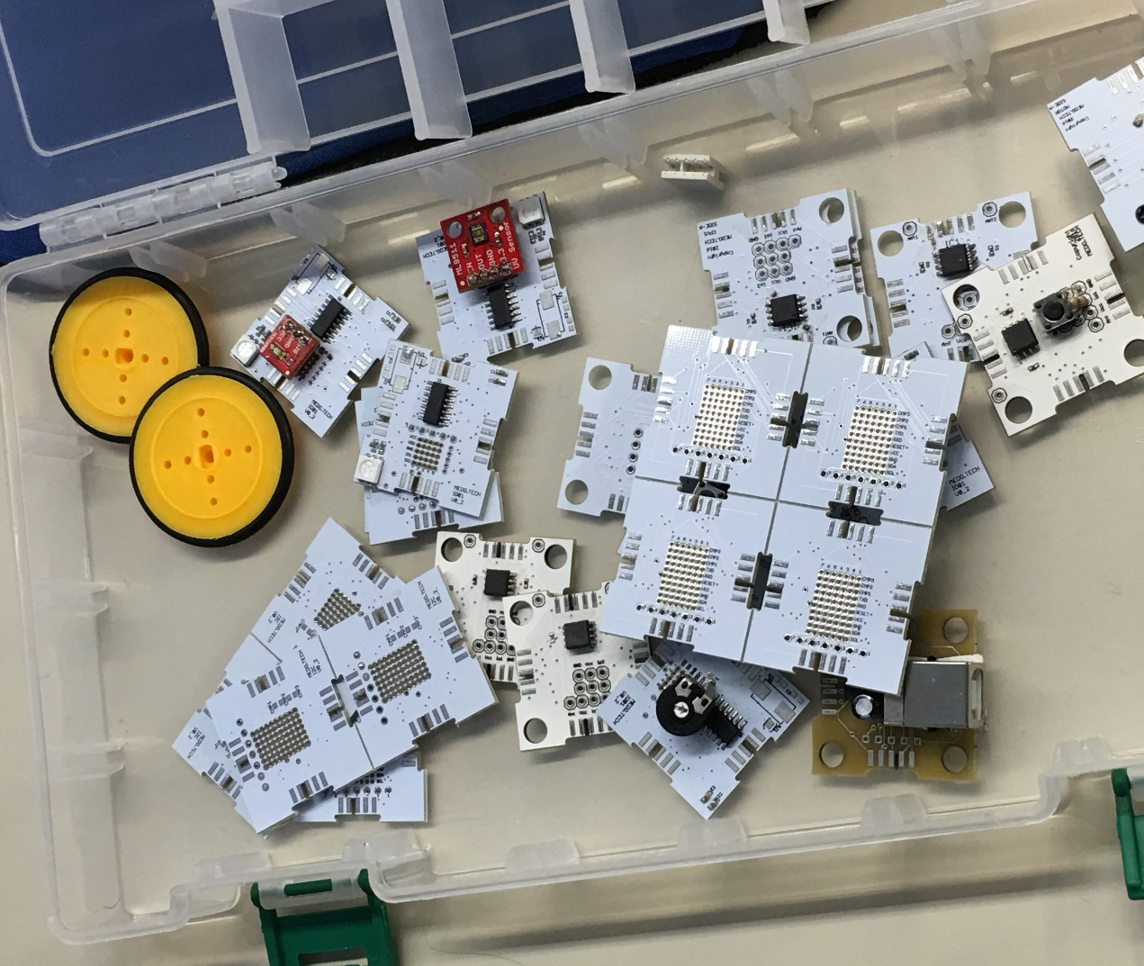
Electronics
Learn to design, program and test various electronic configurations using multiple sensors to create a control module for a nanosatellite to meet your mission requirements.

Slide 8
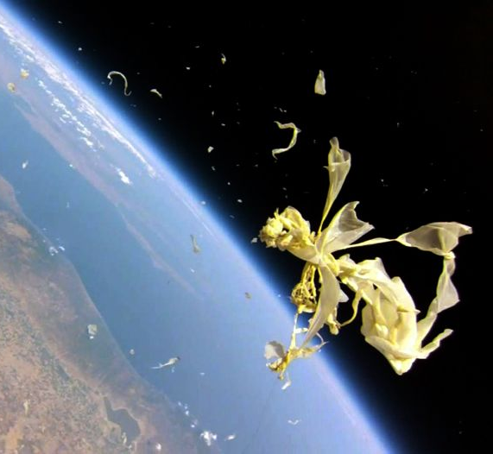
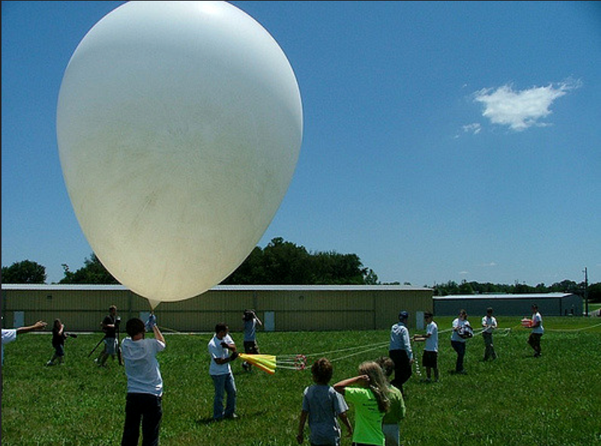
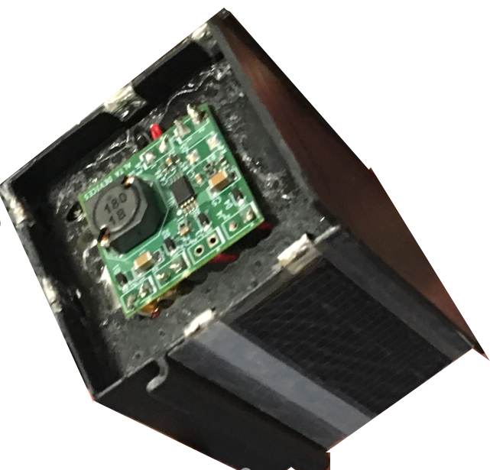
PocketQube
Design, build and launch a PocketQube satellite on a high altitude balloon.

Slide 9
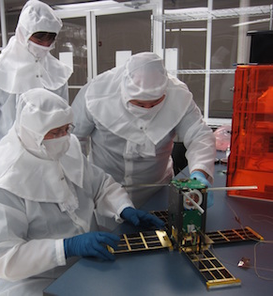
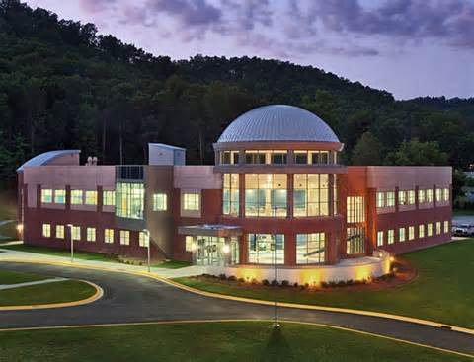
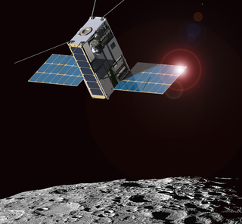
Visit a Space Science Center
Visit the Morehead Space and Science Center and tour their research laboratory and test facilities where nanosatellites are being design, built, tested, and prepared for launch. The Lunar IceCube mission will fly about the NASA Space Launch System EM1 mission in 2018. Images courtesy of MSU.

Slide 10

Launch a Space Mission
Participate in a nation-wide mission to launch approximately 500 PocketQube satellites in a Low Earth Orbit (LEO) off a second stage booster rocket. The Great Aggregated Group Going to LEO Earth (GAGGLE) mission will be the largest deployment of satellite on a single launch and will demonstrate PocketQube technologies and sensors, conduct experiments and collect atmospheric data to analyzed by students and researchers across the United States.

