Slide 1

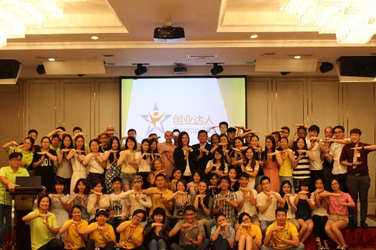
Get inspired and trained to start a business by successful entrepreneurs!
Since 2005, Talentpreneur specializes in entrepreneurship development through training, mentoring and funding.
Change photo to this (in attachment

Slide 2

The Learning Group
www.TLGAasia.com
TLG conducts corporate learning programs that trains high performance teams to execute corporate strategy and create societal impact.
Awesome Leadership!
Achieving Sales targets
A Service Culture
Champion Innovation
Building on Strengths!
Cultivating Intrapreneurship

