Slide 1





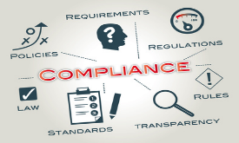


Slide 2


Who We Are
“Delta (Del-ta): A quantitative change.”
Our Mission
Our Vision
Mission Statement
Corporate Vision
“At Delta Outsource Group, Inc. our mission is to provide professional and compliant receivables management solutions built on a foundation of integrity, transparency, and accountability. Our workforce is empowered to deliver superior results, incorporating innovative technology with intelligent analytics.”
“Delta Outsource Group, remains committed to controlled growth which will be achieved by consistently providing our clients with superior performance and unparalleled customer service as companies seek to align themselves with organizations capable of providing this level of service in a profitable manner while maintaining a vigilant eye on compliance so as to ensure a mutually beneficial, long standing partnership.”

Slide 3

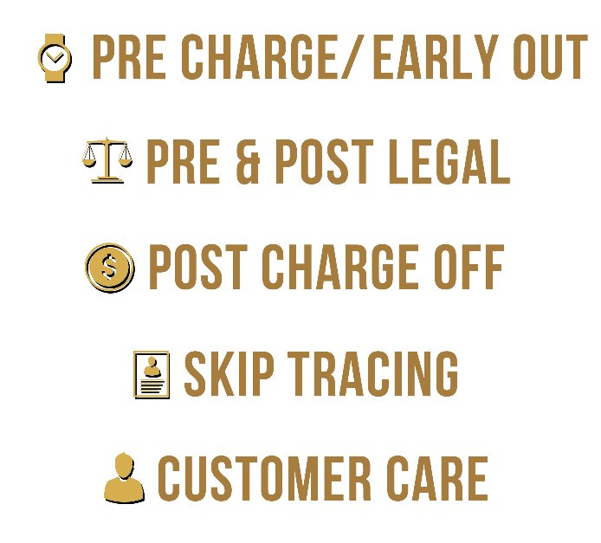




What We Do
Nationwide provider of collection and receivable management programs.
Licensed, Insured, Bonded, and Registered to collect nationwide.
Built an infrastructure to meet the most demanding challenges of the collection industry.
Delta Outsource Group, Inc. employs a highly experienced and motivated workforce that utilizes state of the art technology and strategies.
As a company with full call center capabilities, Delta Outsource Group, Inc. has the expertise and resources to manage the life cycle of an account.
Date Incorporated: 07/02/2009
Years in Business: 7
Company Location: 62 North Central Dr.
O’Fallon, MO 63366
Affiliations

Slide 4
Staying Ahead of the Curve
The P.I.E.C.E.S. to Our Success
Professional Approach
All employees are required to act professional and respectful at all times under all circumstances.
Employee Development
Our employees are the foundation for which our success hinges and therefore we must continually develop them.
Extraordinary Service
Our service we provide to our partners and consumers must exceed always exceed their expectations.
P
I
E
C
E
S
Innovative Technology
We strive to stay up to date and employ the latest technology advances that benefit our partners and consumers we interact with.
Create Opportunities
We look to create opportunities in each aspect of what we do while we focus on taking advantage and valuing each opportunity.
Strong Performance
All of our P.I.E.C.E.S. are important but in a performance driven industry, strong and consistent performance is at the top.

Slide 5
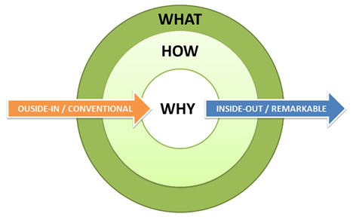



It Starts With Why
Inspiring Employees to Take Action
Why
What
How
The Why
The What
The How
Delta Outsource Group's success plays a vital role in the health of our credit based economy.
Delta Outsource Group turns difficult circumstances into positive experiences.
Delta Outsource Group values every opportunity through a disciplined and deliberate approach.

Slide 6
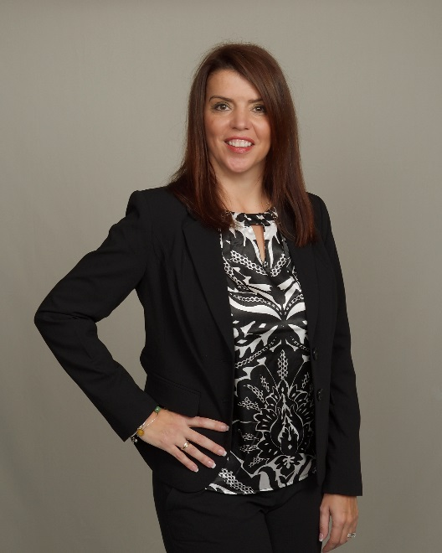
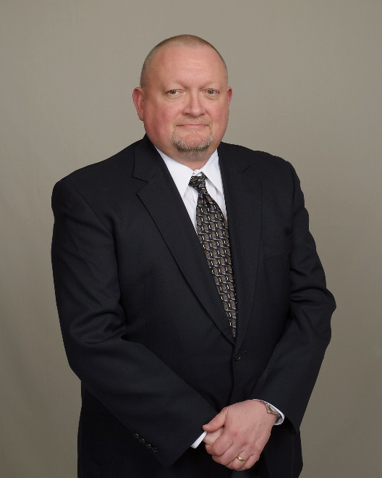
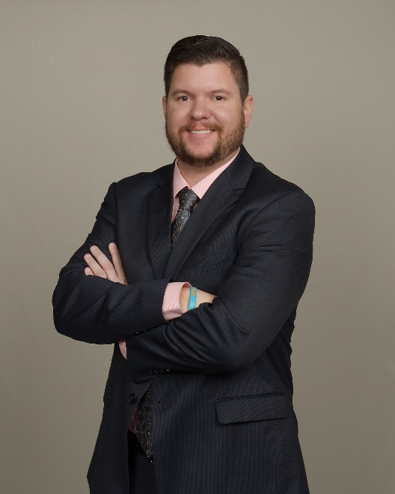
Disciplined Leadership
Meet Our Ownership Team
Jackie Mucha CHIEF MARKETING OFFICER
Jim Peacock CHIEF EXECUTIVE OFFICER
Nick Jarman PRESIDENT & COO
Innovative process development for operational and client support.
Over 23 years of collection industry experience.
Managed high priority client relationships.
Uniquely qualified to understand symbiotic nature between financial services and collections.
Extensive knowledge of technical requirements and client onboarding processes.
Over 30 years of experience encompassing all facets of the ARM Industry.
Consultative approach in defining and implementing custom workflow strategies.
Instrumental in development and execution of skip trace waterfalls and collection triggers.
High level strategy development, team building and interpersonal skills.
Missouri Collectors Association Board of Directors.
ACA International:
Board of Directors
Fellow and Scholar Recipient
Credit & Collections Compliance Officer
Certified Instructor.
Contributor to Collector Industry Publications.
Developed proprietary scorecard to evaluate overall operational performance.
Missouri Collectors Association Past President.
Debt Collection Expert for Credit.com and The Credit Solution Program

Slide 7





Our Values
A SHARED VISION OF Building a Culture THROUGH Positive Experiences.
P.A.W.S.
Community
Best Places to Work
Corporate Culture

Slide 8




Industry Advancement
Driving Solutions
Midwest Compliance Symposium
Debt Collection Forum
Congressional Visits
Association Involvement
A forum for debt collectors…by debt collectors. Created to provide quality content at a price to allow organizations to send multiple attendees and encourage active participation
Delta Outsource Group believes in active participation at all levels of government to create a dialogue and educate government about the debt collection industry.
Our President & COO has served on the ACA Board of Directors for the past 3 years and our CEO and Director of Compliance serve on the Missouri Collectors Association Board.
The best educational workshops and presentations in the credit and collection industry presented at no cost for our clients and prospects.

Slide 9
Employee Development
“We are what we repeatedly do. Excellence then, is not an act, but a habit.”
Leadership Development
Developing leaders who are capable of bridging functions and departments and turning strategy into action.
Provana IPACS
S.O.A.R.
Provana uses its proprietary Integrated Performance, Audit & Compliance Solution (IPACS) framework to deliver a full compliance management system.
Training manual titled “Standard Operation Account Resolution” or “S.O.A.R.” which outlines collector expectations for performance and compliance.
Speech Analytics
The Scorecard
A Collector Scorecard is completed on each collector every month in which the collector receives a scored percentage which rolls up into a team, client, and company scorecard.
Speech analytics enables us to maximize payments while staying compliant and up to date with new rules and regulations.

Slide 10

Extraordinary Service
The Client Experience
Communication
Results
Accuracy
Importance
Personal Touch
Brand Protection
We constantly strive to improve our relationships with our clients with the ultimate goal of creating long lasting partnerships. We focus on ensuring the needs of our clients are being exceeded today, but also work proactively on communication and process improvements to ensure Delta Outsource Group always provides the best in class Client Experience.

Slide 11
Compliance Management
It’s About What You Do and How You Do It.
PPMS Certified
Compliance Matrix
PPMS is a management system for collection agencies based upon developing, implementing and adhering to a set of industry-specific professional practices and policies.
Compliance Matrix which provides a high level overview of Delta Outsource Group, Inc.’s compliance management system.
Compliance Management System
Consumer Relations Help Desk
Delta Outsource Group, Inc. is proud to partner with Provana and its IPACS solution that provides us with an Integrated Performance, Audit, and Compliance Solution.
The Consumer Relations Help Desk to is in place to resolve any consumer complaint to the best of our ability.
Speech Analytics
CFPB Preparedness
Speech analytics enables us to maximize payments while staying compliant and up to date with new rules and regulations.
Our CFPB Preparedness document outlines Delta Outsource Group, Inc.’s preparedness to the CFPB’s Examination Procedures for Debt Collection.
In today’s climate of public awareness, it is imperative that collectors at Delta Outsource Group, Inc. represent our clients in an ethical and diplomatic fashion. Consequently, the ownership and management of Delta Outsource Group, Inc. places special emphasis on public relations and on retaining only those associates which maintain the highest degree of professionalism. Our associates work to protect the privacy, the dignity, and the rights of consumers, and display and ability to adapt and grow within the ARM industry.
The continuous and ongoing education of our collectors ensures we comply with all applicable statues, adhere to existing and new regulations, and meet all ethical standards for the debt collection industry.

Slide 12

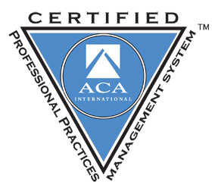
ACA Professional Practices Management System
Certified Debt Collection Agency
Our Advantages Being certified as a PPMS agency, Delta Outsource Group, Inc. is dedicated to best practices in the industry, abides by the association’s stringent code of ethics and is highly qualified to provide credit grantors with the expert collection services needed in today’s competitive business world.
Policies & Procedures
Best Practices
Standardized format across all departments.
Continuous improvement for industry requirements.
Code of Ethics
Extensive Training
Establishes a consistent code of ethics for all employees.
Identifies and provides training opportunities for all aspects of operations.
Process Controls
Management Oversight
Increased Efficiency
Improved Solutions
Root cause analysis performed on all non-conformities to establish long term solutions.
Continual executive management review of the compliance management system.
Delta Outsource Group, Inc. is proud to be one of less than sixty-five
collection agencies nationwide to be PPMS Certified.

Slide 13
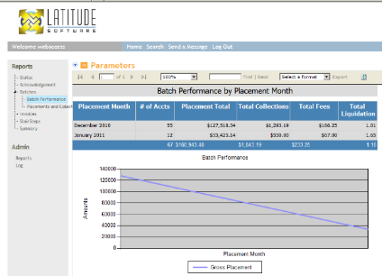
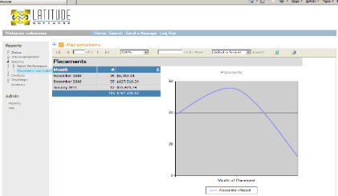
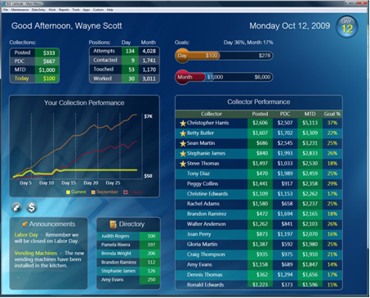
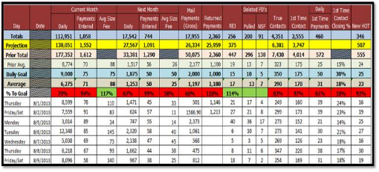
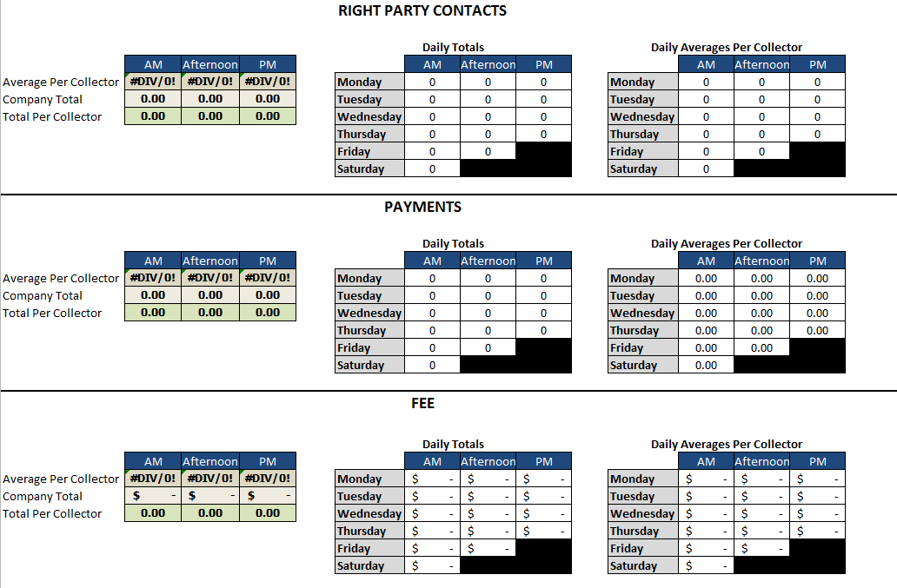
CLIENT WEB ACCESS
Our Client Web Access Portal gives our partners the ability to share real-time reporting and account information via a secure web portal. All data is encrypted using secure socket layer (SSL) protocols and industry-standard web browsers such as Microsoft® Internet Explorer and Mozilla. Information is provided in real time, allowing us to provide better service and insight to our partners.
KEY BENEFITS
Our partners can update their accounts directly – they can notify us of address changes, status changes, payments and adjustments
Anytime access via the web allows for more productive and efficient communication between us and our partners
Reports Available Through WebAccess Include:
Account Status Report
Acknowledgement Report
Batch Performance
Placements and Collections
Invoice Summary
StairStep Reports
Custom Reporting Available Upon Request:
With nearly 300 data points available, Delta Outsource Group, Inc. can build custom reporting and dashboard metrics based on the information you want to see. If you can conceptualize it, chances are we can build it.

Slide 14

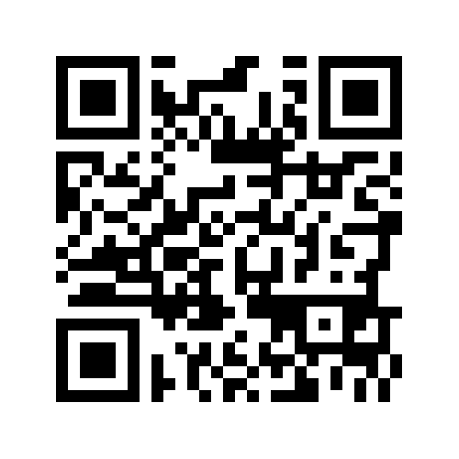




CONTACT US
St. Louis Operation Center:
Delta Outsource Group, Inc.
62 North Central Dr.
O’Fallon, MO 63366
Please Contact:
Jim Peacock, CEO or
Jackie Mucha, Chief Marketing Officer
Phone: (877) 329-0437
Email: sales@deltaoutsourcegroup.com
Online: www.deltaoutsourcegroup.com
Scan barcode to be directed to our mobile site
Find us on:

Slide 15
Data Security
Safeguarding the Rights, Privacy, and Dignity From Those We Collect
TechLock Certified
PCI DSS Compliant
TECH LOCK® Certified is true data security compliance performed by qualified assessors with ARM Industry focus.
Delta Outsource Group, Inc. has completed their PCI DSS audit and achieved the highest data security certification in the credit and collection industry.
SSAE16
Tyco Integrated Security
Delta Outsource Group, Inc.’s SSAE 16 attestation standard provides guidance on financial reporting on our organization’s controls.
Advanced business security solutions to help us protect our employees, customers, facilities, assets, inventory, processes and operations.
Data Security & Privacy Training
Red Flag Rules
Ensures employees safeguard personal information as well as information stored under the aegis of the Delta Outsource Group, Inc.
The Identity Theft Prevention Program was developed pursuant to the Federal Trade Commission's Red Flag Rules promulgated as part of the Fair and Accurate Credit Transactions Act.
Delta Outsource Group, Inc. is a company built on the latest technology in the ARM industry. Our systems are sophisticated and state of the art and maintained by true IT professionals. Our collection platform along with our telephony and dialer platforms are all hosted and are extremely flexible, scalable and most importantly, stable.
With the advent of the Consumer Financial Protection Bureau (CFPB), everyone likes to talk about compliance with data security but many times, it is just that…talk. “Actions speak volumes”. Let Delta Outsource Group, Inc. show you how we safeguard the rights, privacy and dignity from those we collect.

Slide 16

Programming Requests
Making Everything Simple
Onboarding Made Simple
Integrated With Most Platforms
We have created a simple and streamlined onboarding process led by our Director of Client Experience.
Delta Outsource Group is integrated or has experience in all of the major platforms.
Custom Programming
No Cost to Client
Regardless of the request, we can handle any custom programming request to suit our partner’s needs.
All costs associated with IT and programming are absorb by Delta Outsource Group and not placed on our partners.
Full Support
Global Access
Timely
Smart Ideas
Statistics

