Slide 1
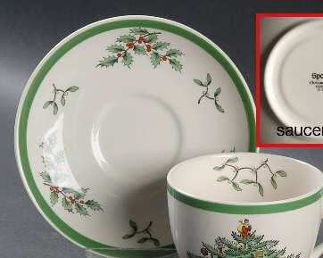
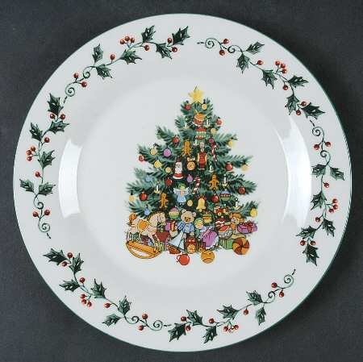
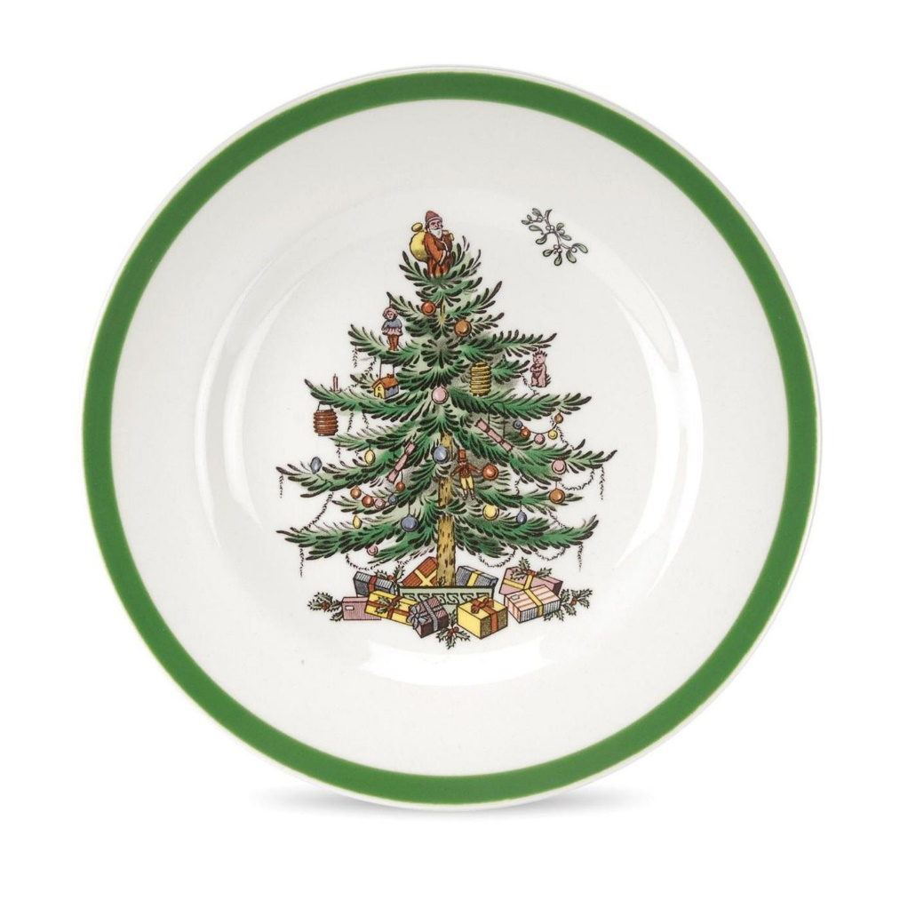
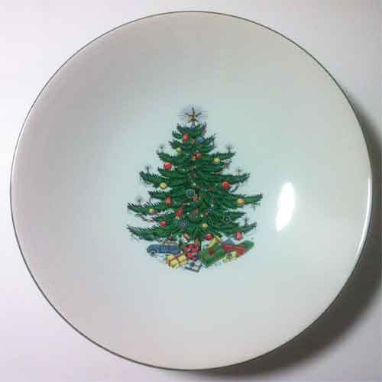
inspiration

Slide 2
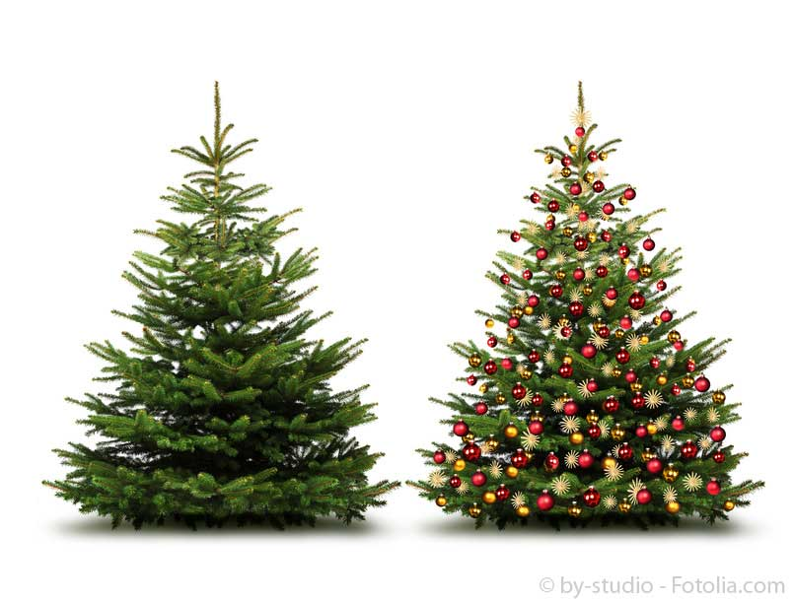
Tree shape to copy

Slide 3
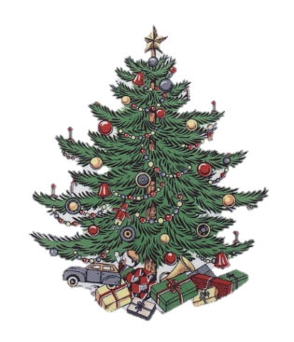
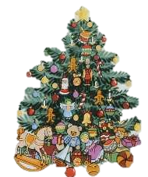
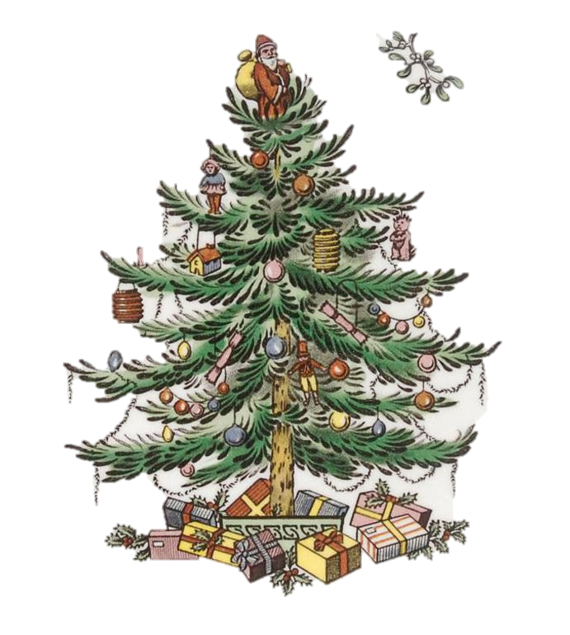
Positioning of ornaments

Slide 4
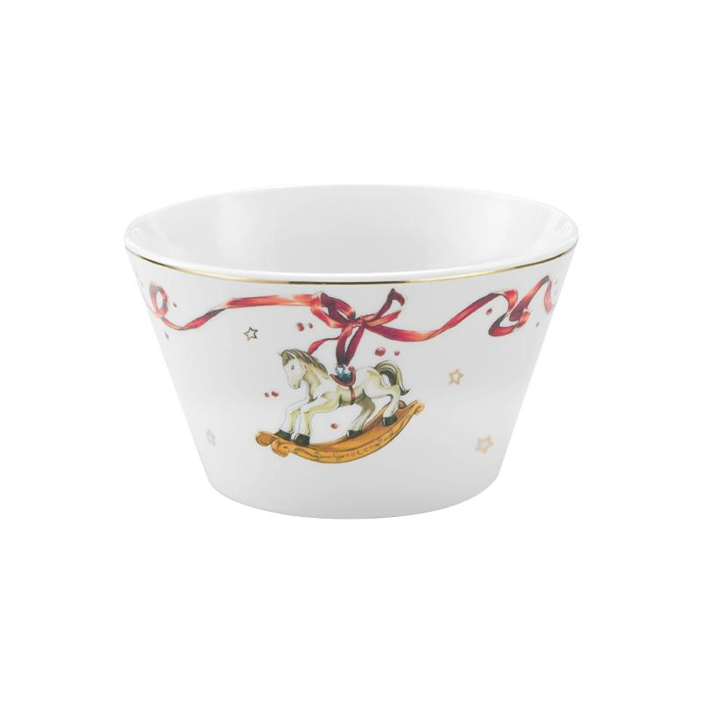
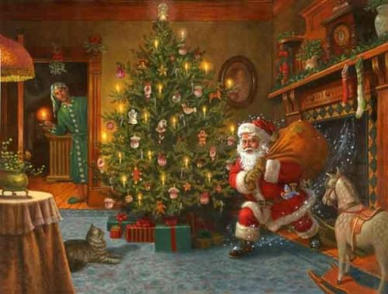
High level of Detail of icons used

Slide 5
Items in or around tree
Santa kneels and puts present under tree
Tinsel
Presents on the bottom
Train tracks on base of the tree
Rocking horse
Car
Doll
Other tree Decoration
Candle light ( may be)
Rain deer ( may be)
Shooting star (may be)
Holly instead of Ivy

