Slide 1
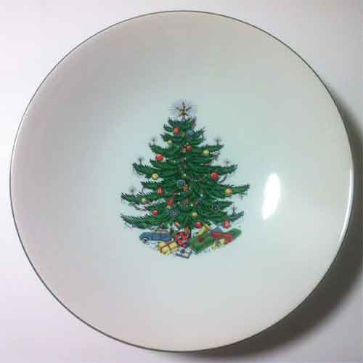
Our plate form Please adjust tree to this shape the below tree is too small for my taste

Slide 2
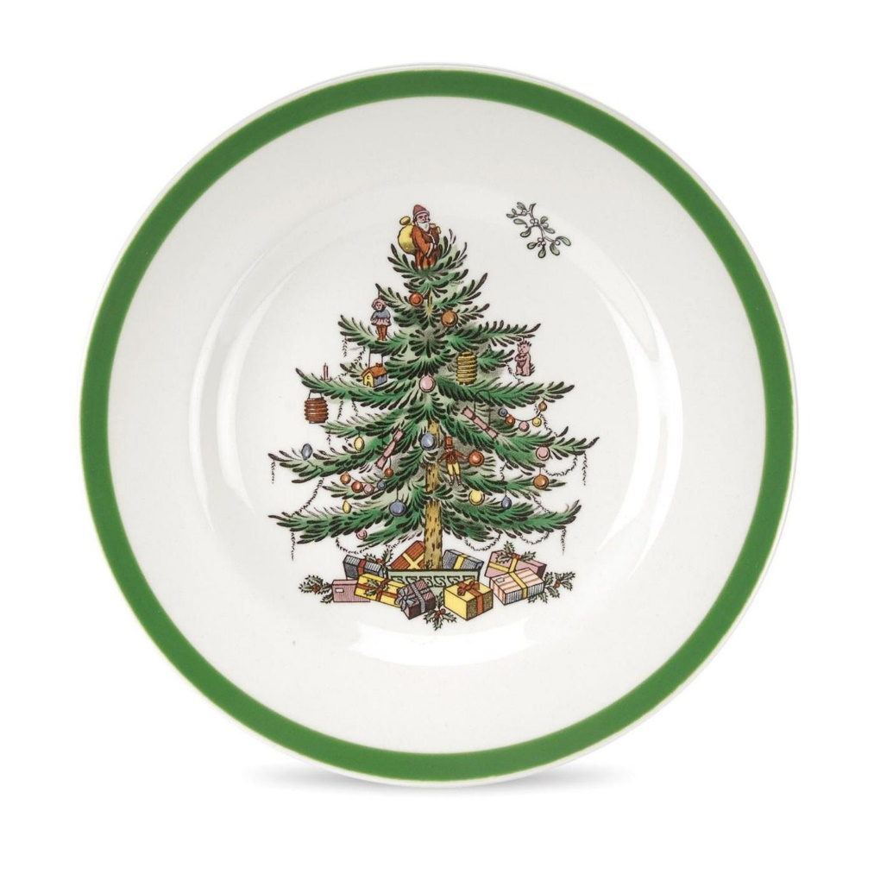
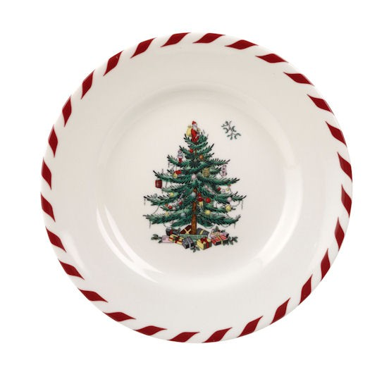
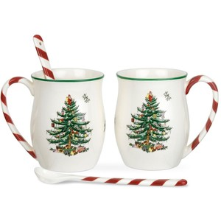
Rim Décor to follow for mug pate and for bowl ( candicane)

Slide 3
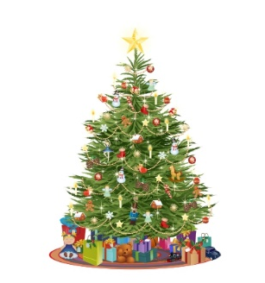

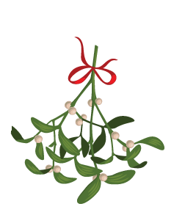
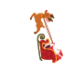
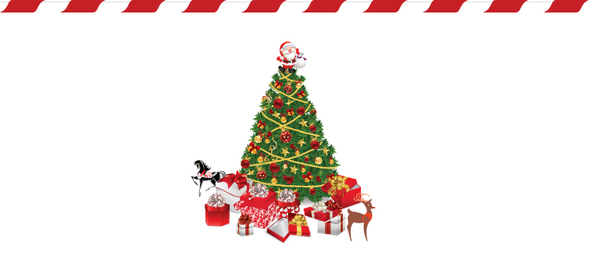
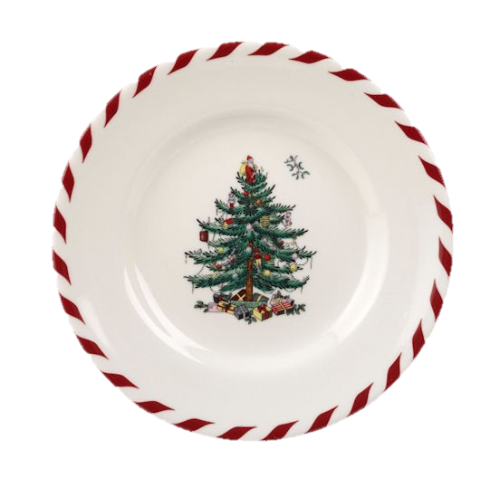
Keep outdoor tree on one side and indoor tree on other side of mug
Rim color with dark green from tree
Snow on tree and
santa in right corner with slay and multiple reindeer. Not just shade ( size like mistle toe in page 2
now snow fall
May be moon light night with stars
Snow on floor may be snow man to side ?
Rim color like candy cane
1 Mistle toe in size of mistle toe from slide 2
2) Fire place with stockings in background
Rim color with dark gree from tree

Slide 4
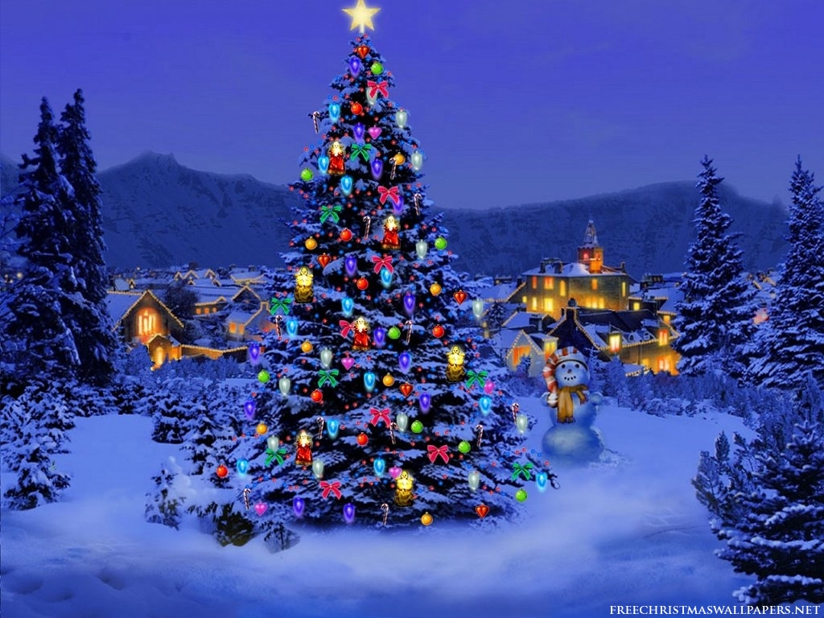
Out door image inspiration

Slide 5
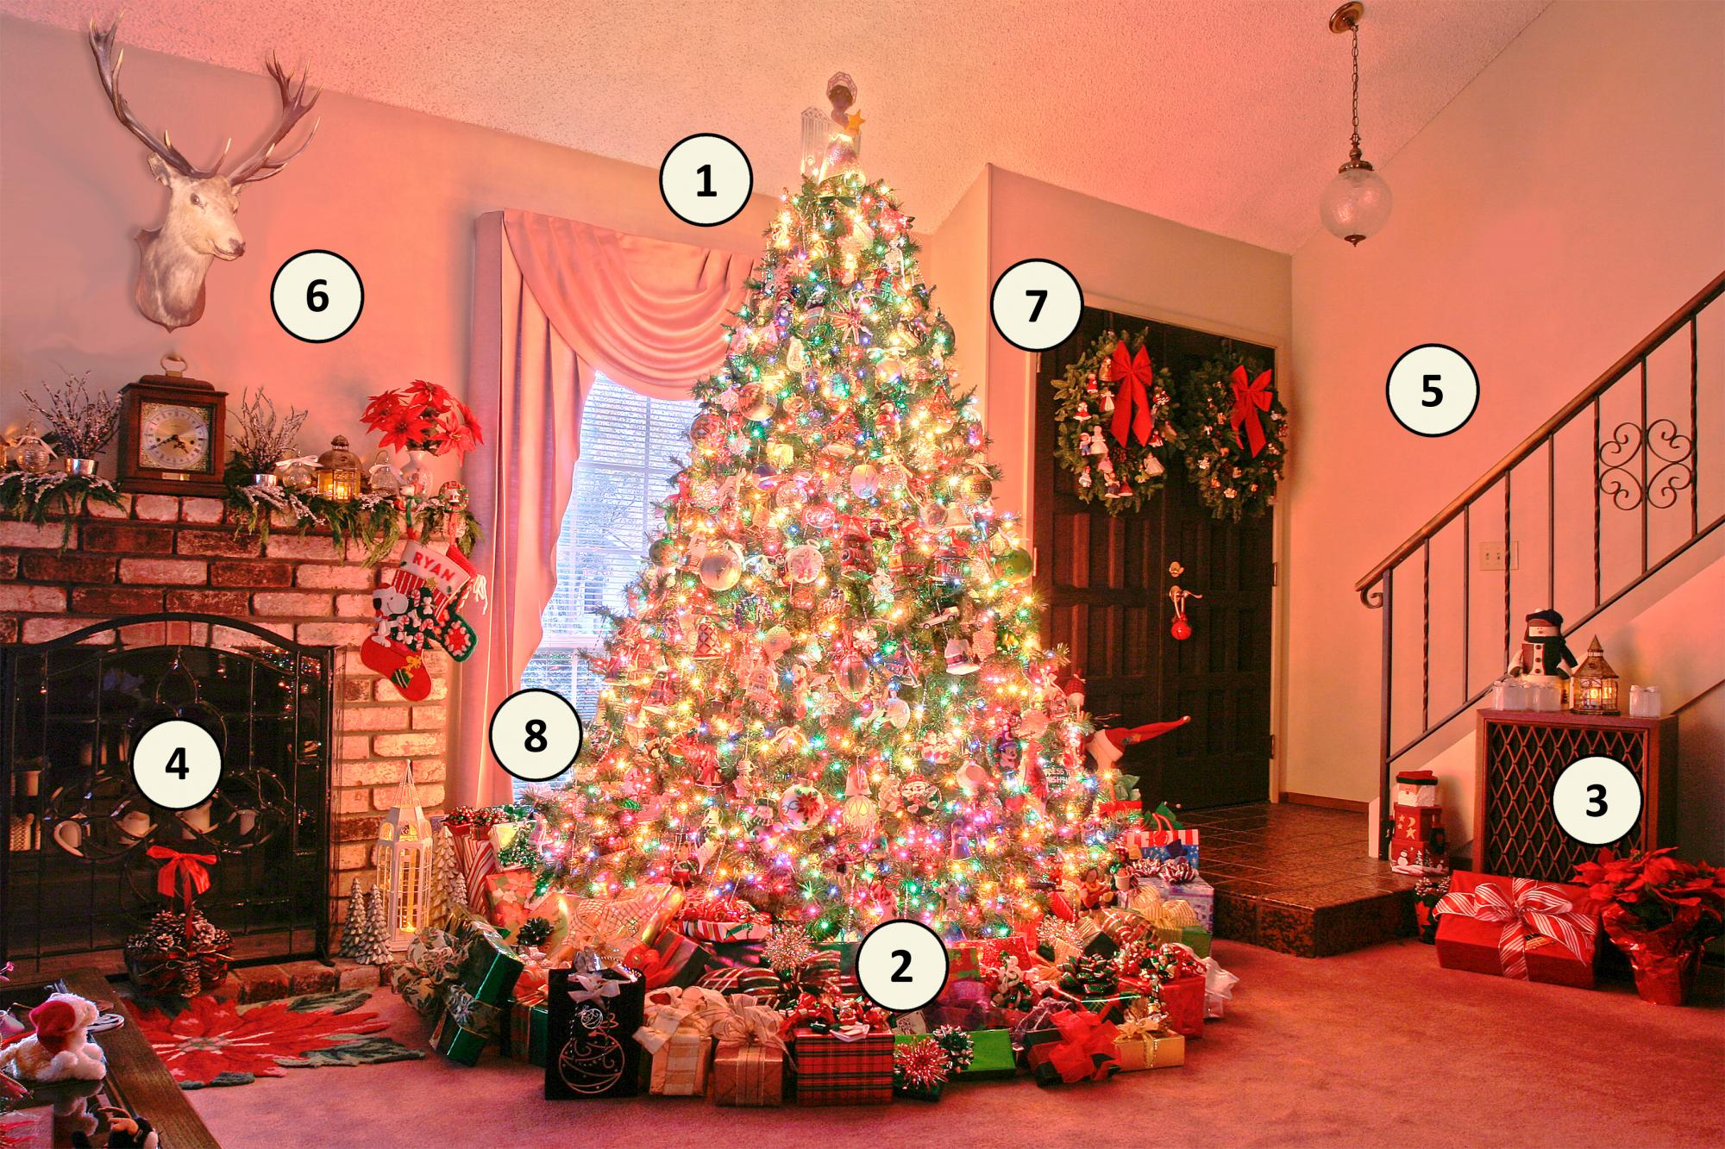
Indoor inspiration
Mistle toe
Fire place in back ground with stocking?
Place with cuckie and milk?

