Slide 1

“Employee Powered, Customer Driven”
May 20th 2016

Slide 2


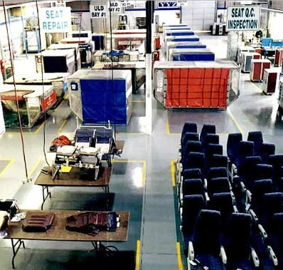
Company History and Overview
Founded in 1962 in Montreal, Canada as Steelbase AeroMarine
Evolved from a distributor and machine shop to a full service maintenance, repair and overhaul (MRO) company in the 1990s
Expanded into a comprehensive network of 15 repair stations and 9 line maintenance support locations at major airports in North America and the UK
First service organization to offer ULD Logistics and Handling airside @ LHR, MAN and LGW Airports
First service organization to offer airside repair facility @ LHR
July 2006 reorganization – 3 TC/FAA repair stations (YUL, YYZ, YVR), 2 line support stations (YHZ, YYC) and strategic partnership (LHR, LGW, and US)
Airbase Services, Inc Canada now owned and operated by original founder and original management team – 100% Canadian owned!
140 Employees

Slide 3
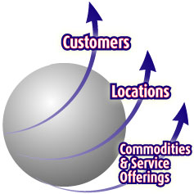
Company History and Overview
Airbase Services will satisfy our customers’ needs through the continuous development of innovative and cost-effective repair and service solutions.
We will continue to provide the highest levels of customer service in the industry to the mutual reward of our customers and our employees
To win the customers’ trust and business, we must demonstrate our ability to professionally deliver products and service on time, while maintaining or improving current operational service levels.
We accomplish the strategy utilizing our 3-axis approach in our business philosophy: Locations, Commodities & Service Offerings, and Customers.

Slide 4
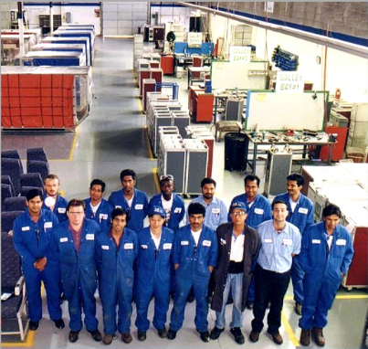
Competitive Advantages
Established MRO service provider
One-Stop Shop for MRO of Non-Flight Critical Components
Ability to take-on overflow capacity work on non-flight critical components
Component repairs for Canadian and US customers including transportation
Geographic Footprint
Experienced team
Notes:
What about this info from the website?
Service Advantage
Quick TAT (turn-around time)
Detailed repair data available
Warranty tracking, OEM part/equipment performance reporting
Manage repair, transportation and cross-border entry as necessary
Access to PMA parts and materials
Quick responsiveness to customer requests & requirements

Slide 5
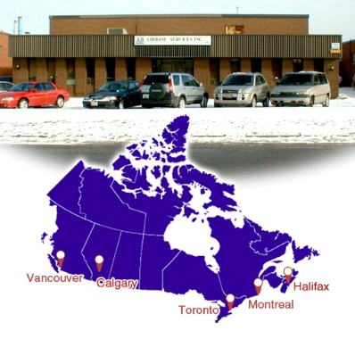
Geographic Locations
40,000 SF manufacturing and MRO facility @ YUL
20,000 SF MRO facility @ YYZ
24,000 SF MRO facility @ YVR
Out-station personnel @ YYC and YHZ
Strategic partners in US, Asia, Europe

Slide 6
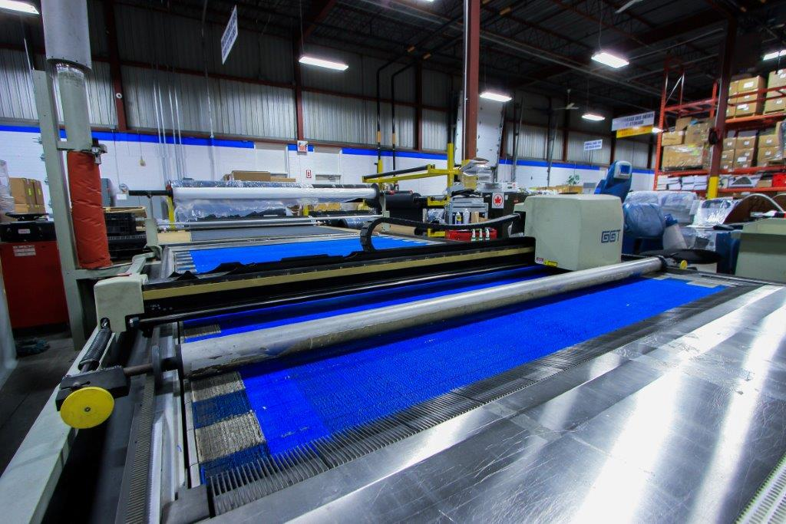
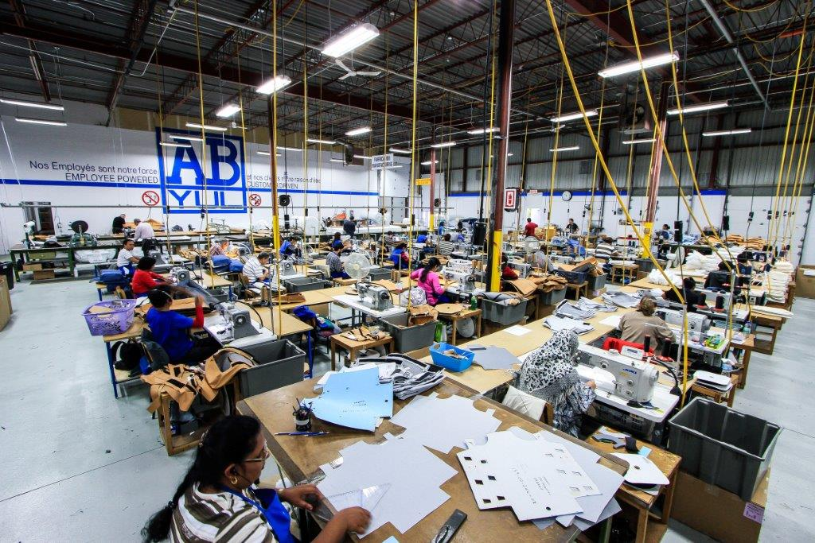
CoService Advantages mpany History and Overview
Airbase assumes full responsibility for the supply or repair of an agreed list of interior or cargo parts for its customers, under a long-term, sole-supplier contract.
Airbase assumes responsibility for forecasting, sourcing, procurement, delivery logistics and repair or manufacturing turn times.
Airbase utilizes its deep knowledge of the cabin and cabin soft furnishings business, ULD industry, planning and its strategic geographical locations.

Slide 7
Company Business Model
Airbase assumes full responsibility for the supply or repair of an agreed list of interior or cargo parts for its customers, under a long-term, sole-supplier contract.
Airbase assumes responsibility for forecasting, sourcing, procurement, delivery logistics and repair or manufacturing turn times.
Airbase utilizes its deep knowledge of the cabin and cabin soft furnishings business, ULD industry, planning and its strategic geographical locations.

Slide 8
Quick TAT (turn-around time)
Detailed repair and inventory performance data available
Warranty tracking, OEM part/equipment performance reporting, equipment design improvements and enhancements
Quick responsiveness to customer requests & requirements
Existing relationships with airport authorities – storage racking, logistics and clean-up services, AVOP access
Manage repair, transportation and cross-border entry as necessary
Approved alternative PMA parts/materials and approved repair processes*
* Airbase Engineering & Certification Services, separate entity

Slide 9
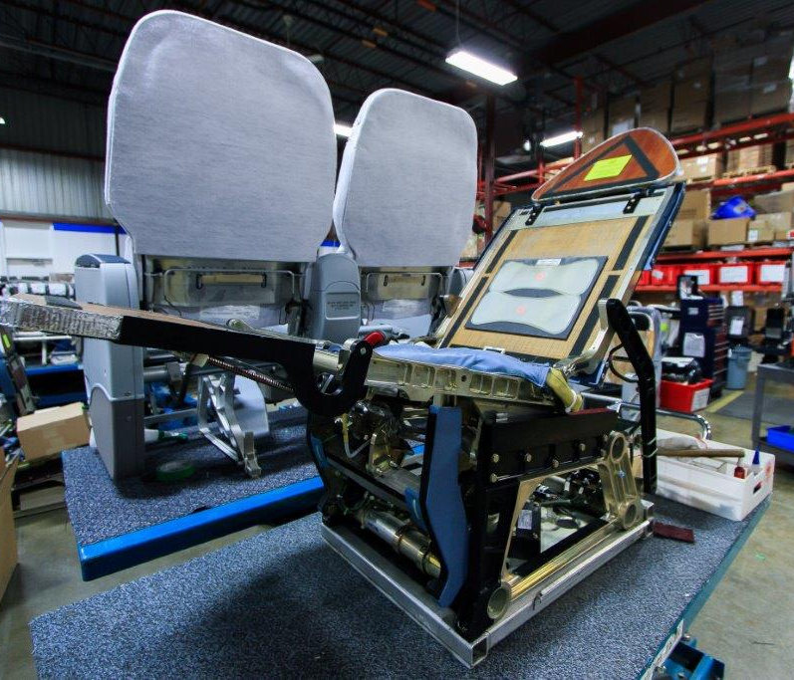
Service Categories
Aircraft Seats – Overhaul, IRAN, modifications, assembly
Line Cabin maintenance
Bench IFE and audio/video maintenance
Cargo Equipment (ULDs, pallets, nets, straps)
Inserts (carts, coffee makers, ovens)
Interior Structures (galleys, lavatories, closets)
Soft Furnishings manufacturing (carpet, covers, curtains)
BFE Management

Slide 10
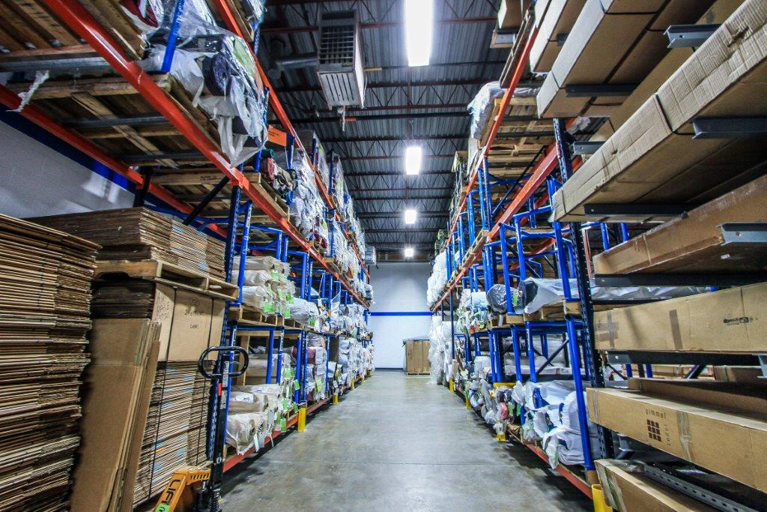
Asset Management Experience
Experienced in asset ownership & management, currently managing 551 different line item products, representing 23,000+ pieces of inventory
Daily transactions exceeding 3,500 per month
B2B software interface for daily data transfer and data integrity
Comprehensive IT reporting capability via Baan ERP©

Slide 11
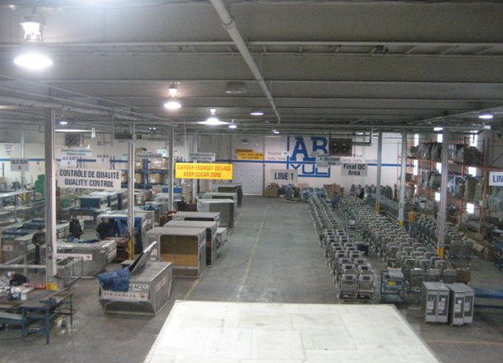
By the Numbers
>6,000 ULDs repaired per year
>12,000 carts repaired per year
Over 2,500 electrical galley components repaired per year
Over 3,000 passenger seats repaired per year
Over 250 flight deck seats per year
600 leather accoutrement recoveries per year
30,000 aircraft seat covers per year

Slide 12
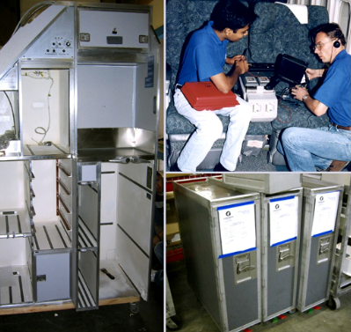
Capability List
Cargo Systems | Galleys & Galley Equipment
Cargo Containers | Carts
Nets & Straps | Carrier Boxes
Pallets | Drawers
 | Waste Containers
Emergency Equipment | Coffeemakers
Flashlights | Espresso/Cappuccino Makers
Lifejackets | Hot Cups
Stretchers | Water Boilers
Wheelchairs | Ovens (Convection, Warming)
 | Controllers
Interiors | Racks
Baby Cots | Structures
Carpets¹ | Standard Units
Curtain Cut & Sew | Waste Bins
Closets | Trash Compactors
Lavatories
Galley Structures | ¹ Cut, Sew, Install, Fit, Maintenance

Slide 13
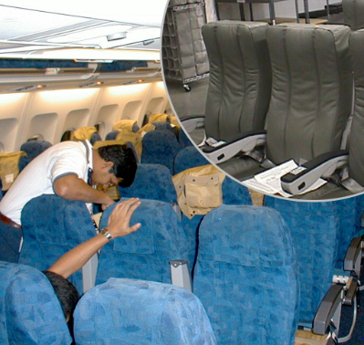
Capability List (cont.)
Seating
Cushion Change Out
Cut & Sew of Seat Covers²
Seat Belt Dry Cleaning
Seat Cover Kitting
Seat Cover Maintenance
Seat Cover Dry Cleaning
Seats (First Class, Business Class, Coach Class, Flight Attendant)
Miscellaneous
Amenity Kit Recovery
Headset Cleaning, Recovery & Testing
Lease/Maintenance Programs
Logistics/On-Airport Recovery
Asset Management
Supply Chain Management
² Antimacassars, Blankets, Duvets, Duvet Covers, Napkins, Pillows, Pillow Covers, Storage Bags

Slide 14
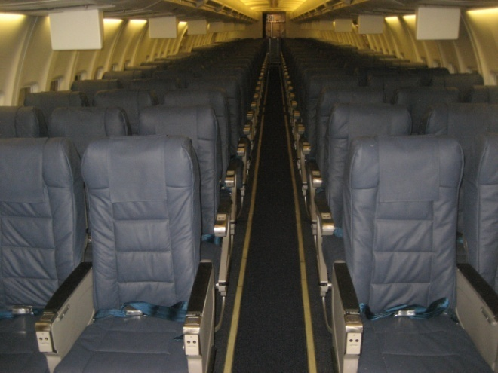
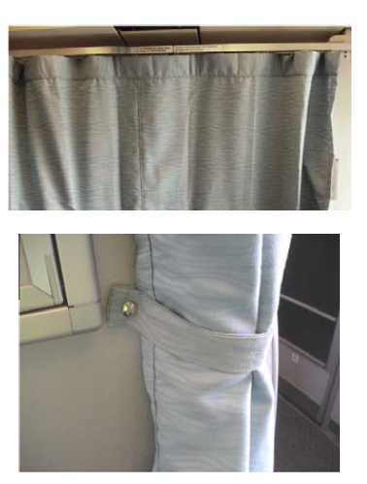
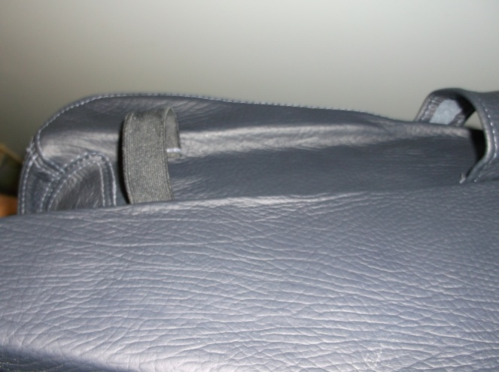
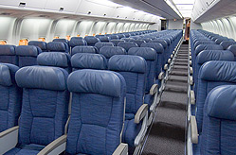
Standard Products
Leather, e-leather covers
Cabin & crew rest curtains
Leather accoutrements
Fabric covers

Slide 15
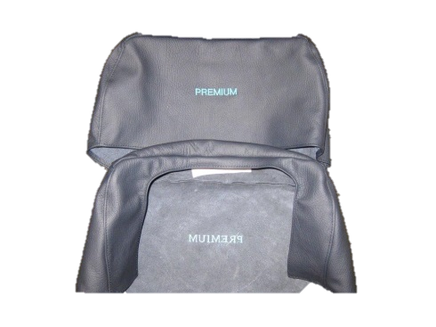
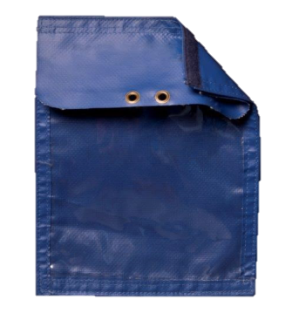
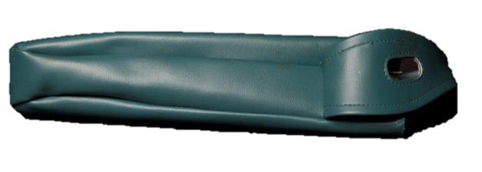
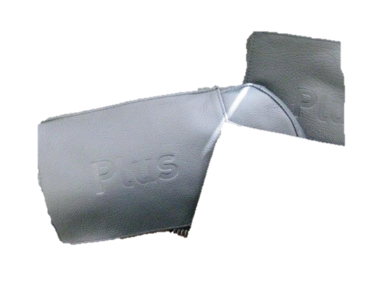
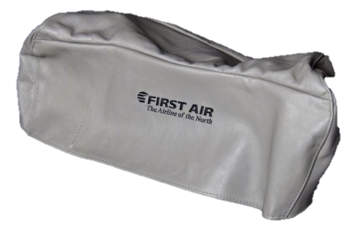
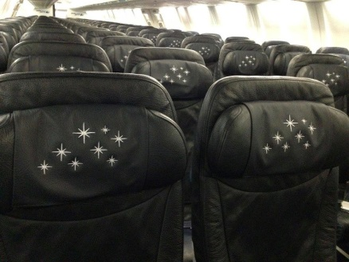
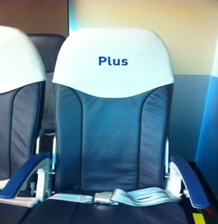
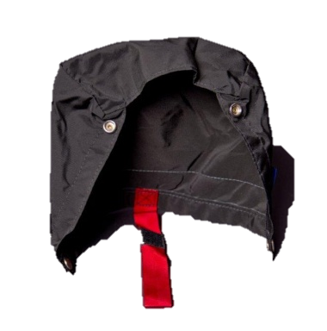
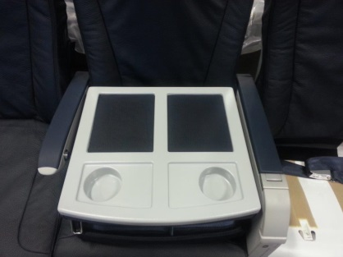
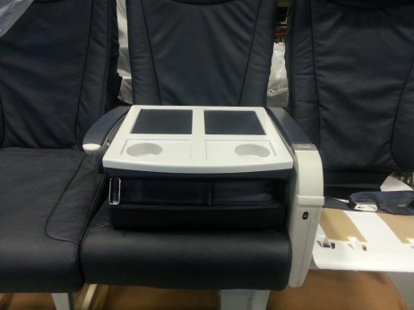
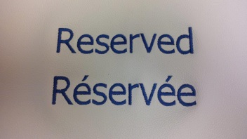
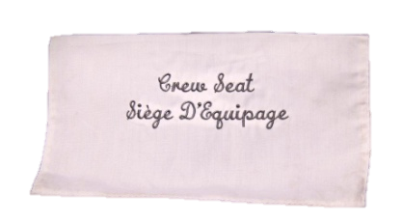
Specialty Products
Holster
Document Pouch
Leather head rests/Antimacassars
Customized covers
Life Vest pouch
Seat blockers with STC

Slide 16
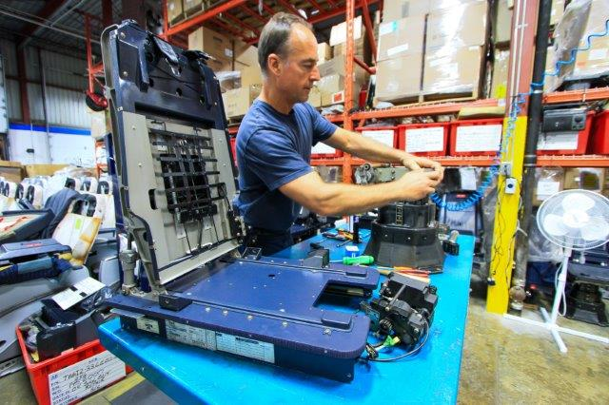
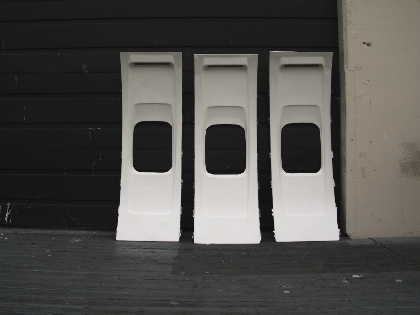
Breadth of Experience
Experienced with monuments, trash compactors, structural galleys, lavatory repair and overhaul
Currently performing sidewall recovery, bagging machine
Currently repair over 2,500 pieces of galley electrical inserts (ovens, coffee makers, water boilers, warming plates) per year
Experienced with cabin interior ad-hoc items (carpets, risers)

Slide 17
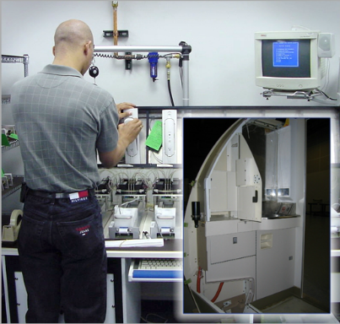
Customers
Major Carriers
Low Cost Carriers
Ground Handlers
OEMs
Heavy Maintenance Contractors
“Our Production Philosophy Drives Productivity”

Slide 18












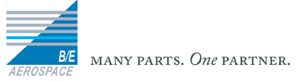
Airbase Customers & Partners

Slide 19

IT Performance / Reliability Reporting
Comprehensive Data Reporting
Labor & Parts Tracking
Repair History

Slide 20
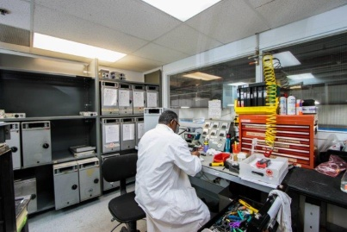
Engineering Support
ACES – Airbase Certification & Engineering Services, Inc.
Design Airworthiness Organization, certified by Transport Canada
STC, LSTC packages
Reconfiguration packages for aircraft interiors
Certified PMA part approvals for alternate low cost parts
Repair Instruction procedures
Flammability tests, certifications
Product support and analysis

Slide 21
Summary
At Airbase Services, we are committed to the highest quality of service and accountability.
We take pride in giving our customers the best value in the business, and are always looking for methods of improving our service our service offerings.
On behalf of our 140+ employees, we thank you for the opportunity to demonstrate our service capability and prove to you why we are the preeminent service company in aviation.

