Slide 1
Info Graphic 1
The following slide needs to be turned into an infographic that will be embedded into the TalentCode HR website.
The fonts should be Helvetica Neue and should have the look and feel of the website.

Slide 2
The people & performance needs of every business
Info graphic 1
How we can help you
Compliance
Trusted advice on people issues including Fair Work Act compliance, redundancies, performance management, terminations, policies and safety.
HR On-Demand
Monthly subscription
HR Operations
Onsite or Remote HR Manager
Outsourced HR (annual subscription)
OR adhoc HR support (fixed fee projects)
Operational HR support including recruitment, performance management and training.
People & Performance Strategy
Business strategy and planning, strategic HR frameworks and interventions to fuel your growth.
Strategic Expertise
Fixed fee project based expertise

Slide 3
Info graphic 2
The following needs to be turned into an infographic that will be embedded into the TalentCode HR website and used in PPT and WORD proposals.
The fonts should be Helvetica Neue, the look and
feel should be consistent with the first infographic.
A mountain analogy is needed that shows how the sequence of services will come together to take businesses on the journey to becoming great.
2 versions of the same information are shown on the following slides. The first is for ease of visibility, the second is to show the sequence of services on the journey.
Samples of possible design ideas for inspiration.

Slide 4
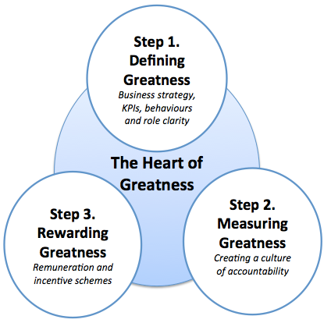
On-site strategic and operational support to sustain your journey
5. Embedding
Greatness
Develop Star Players
Leadership coaching
Create Star Teams
Leadership development programs
4. Developing Greatness
Cultural
X-Ray
Pre-employment assessments
3. Resourcing Greatness
Recruit Assist
The expertise to select
great people
2. The Heart of Greatness
1. The Foundations of Greatness:
Trusted advice and compliance support

Slide 5
The Journey to Greatness
Embedding Greatness: On-site strategic and operational support to sustain your journey
Step 1. Defining Greatness
Business strategy, KPIs, behaviours and role clarity
Resourcing Greatness
Developing Greatness
The Heart of Greatness
Step 3. Rewarding Greatness
Remuneration and incentive schemes
Step 2. Measuring Greatness
Creating a culture of accountability
Recruit Assist
The expertise to select great people
Cultural
X-Ray
Pre-employment assessments
Develop Star Players
Leadership coaching
Create Star Teams
Leadership development programs
The Foundations of Greatness: Trusted advice and compliance support

Slide 6
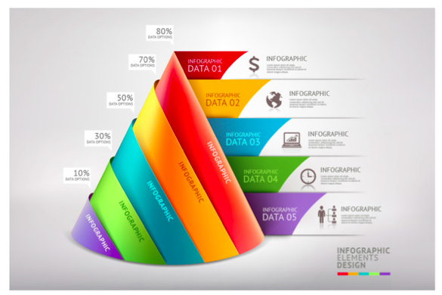

Slide 7


Slide 8


Slide 9
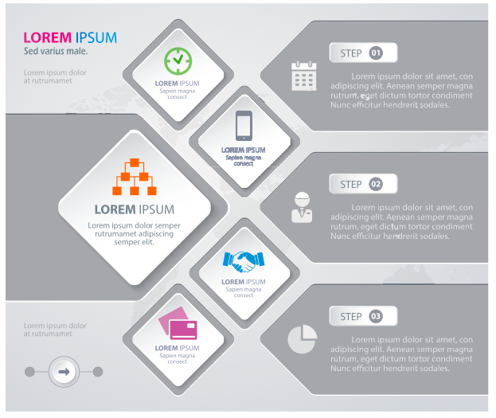

Slide 10


Slide 11
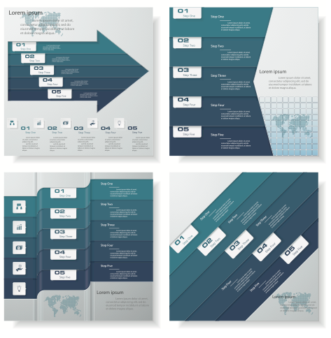

Slide 12
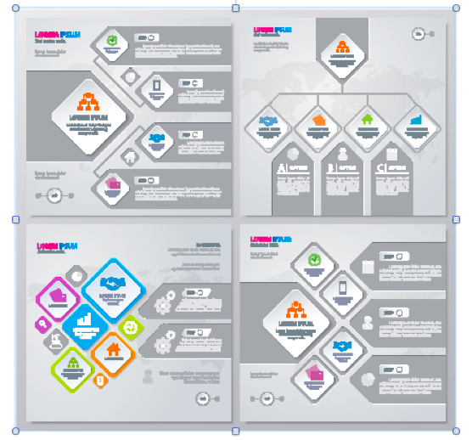

Slide 13
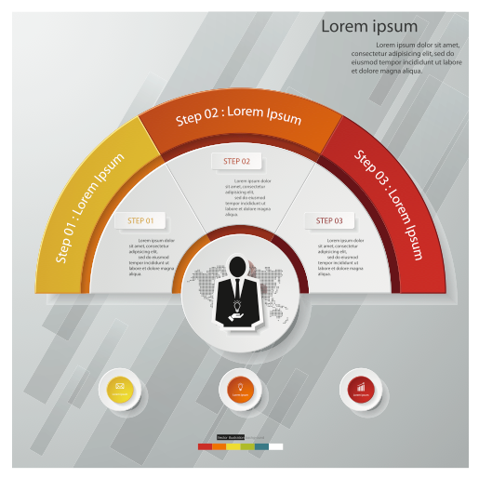

Slide 14


Slide 15
