Slide 1

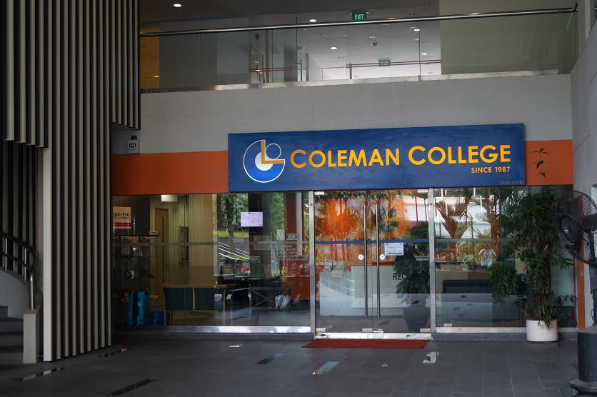
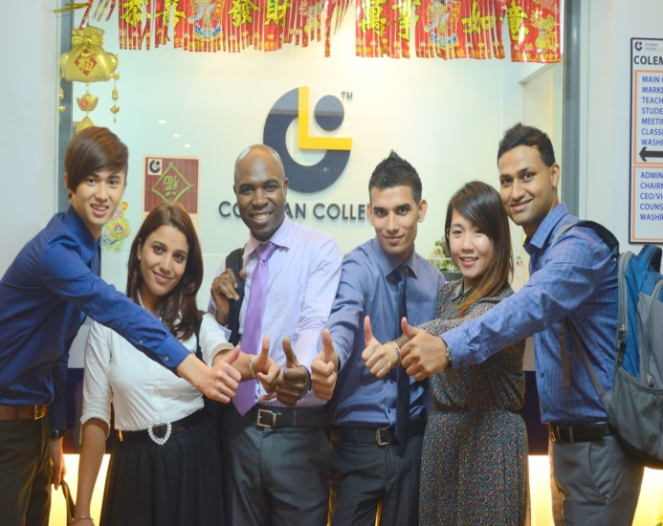

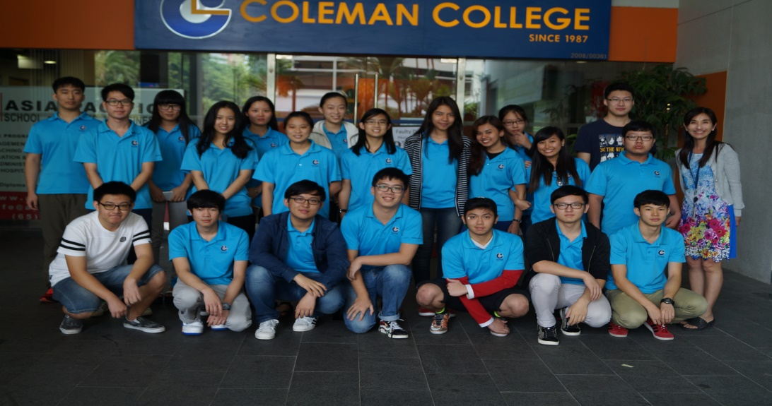

COLEMAN
COLLEGE SINCE 1987
Corporate Brochure
Coleman College
CPE Registration No: 2010000093K
Validity: 25 June 2014 - 24 June 2018
www.colemancollege.edu.sg

Slide 2
ABOUT COLEMAN COLLEGE
Introduction
Coleman College was established in 1987 and has been in operation for 29 years.
Coleman is registered with Singapore’s Council for Private Education (CPE) and has been awarded the prestigious 4-year EduTrust Certification. The EduTrust certification is only awarded to institutions which have attained the CPE’s required level of performance in key areas of management and the provision of educational services.
Over the past 29 years, Coleman College has expanded its scope of operations to offer a wide range of education and training services to meet the needs of its students. To date, Coleman has graduated over 30,000 students from over 20 countries world-wide. Students attain a truly global educational experience.
Today, Coleman College is one of the more established private schools providing quality education services through both its High School and its Higher Education Departments. These departments have work closely with accreditation boards and professional associations such as Cambridge International Examinations (CIE), Edexcel, City & Guilds and Institute of Financial Accountants (IFA). The College also works with colleges and universities, including Blackburn College (UK), United States Sports Academy (USA) and the College of Humanities and Sciences of Northeast Normal University (China), creating pathways and articulation for its students to achieve university and professional qualifications.
Our mission is to create opportunities for all learners to acquire knowledge and skills meeting the needs of the international job market. In line with this mission, we strive to improve and maintain the highest standards in all areas which can contribute towards the achievement of this mission. These include our teaching methods and materials, staff, facilities, systems and processes, learning environment and our range of student services. We foster a high degree of communication and participation within the classroom, and aim seek to produce graduates who are confident, competent and socially responsible. We aim for every student who joins the college to graduate with a global view attained through all these as well as through activities such as co-curricular courses and internship programmes and acquire the capabilities to contribute the larger community internationally.
We have established ourselves as a strong and credible institution known for being caring and socially responsible and for the delivery of effective, quality and affordable educational and training services for our students. For the future, we plan to build on this as well as to regionalise and forge strategic alliances with reputable institutions overseas to further expand and improve our services to our students.

Slide 3
PRINCIPAL’S MESSAGE
Welcome to Coleman College
Coleman College was established in 1987 and has since expanded its scope of operations to offer a wide range of education and training services to meet the needs of our students and working adults in Singapore and the region. Besides being one of the established institutions providing English Language and preparatory courses to foreign students, Coleman College also offers other academic and professional courses including tourism and hospitality, logistics management, sports and coaching.
We are committed to delivering quality services and programmes to our students, customers and partners. As a testimony of the professional quality education programmes and services upheld by Coleman College, we have been awarded the 4 year EduTrust certification by the Council for Private Education, Singapore. This award is given to a PEI (Private Education Institution) for having achieved satisfactory to commendable performance in key areas of management and the provision of quality educational services.
We welcome you to visit us and enquire about our programmes, and experience for yourself our commitment to service quality, effectiveness in the delivery of our services and care for our students.
Chay Yee
Principal

Slide 4
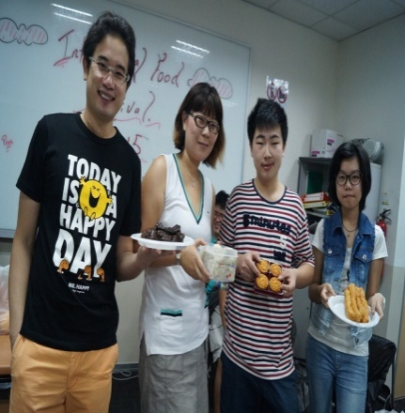
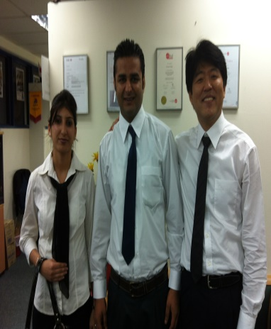
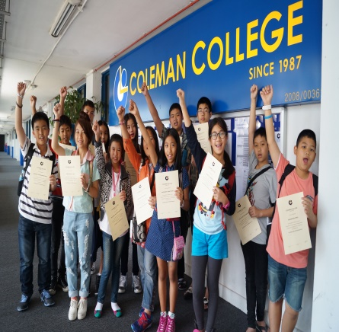
Coleman’s Mission, Vision, Values & Culture
Our Vision
To be the choice provider of quality and affordable education services in Singapore.
Our Mission
To create opportunities for all learners to acquire knowledge and skills meeting the needs of the international job market.
Our Values
Quality: To establish and maintain high quality level in all we do
Affordability: To ensure that our products and services are priced for the broad market
Efficiency: To complete our tasks and projects quickly and meet requirements
Improvements: To constantly explore ways to do things better
Our Desire Culture
With Head and Heart, We Serve

Slide 5
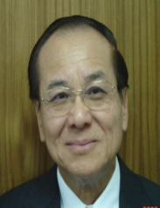

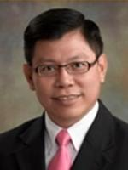



Our Key Personnel
Chay Yee, PBM,
B.A (Hons), M Soc Sc
Executive Chairman / Principal
Chairman, Examination Board
Mark Chay
BA, Brigham Young University
Member, Academic Board
Member, Examination Board
Gan Chin Huat, PK, PPA(P), PBM
M.Ed(Harvard), B SocSci(Hons), BA,
Dip Ed(NUS)
Vice Chairman
Chairman, Academic Board
Dr Joan VillApaz Llanos, CODA
Director, Academic
David Loi
Director, Quality Assurance &
Special Duties
Dr James Loh
PhD, University of Bradford
Hon D, Litt, CurtinUniversity of Technology
MBA, CranfieldSchool of Management
Fellow, Chartered Institute of Marketing, UK
Member, Academic Board
Member, Examination Board
Ryan Wang,
BSc Business, UOL
Director, Marketing (East Asia)
Abid Noor
BSc Industrial Engineering,
Delhi Technological University, India
Director, Marketing (South Asia)
John Lee Chye Huat
B SocSc (Hons), NUS
MA (Instructional Design & Technology), NTU
Member, Academic Board
Member, Examination Board

Slide 6







Working in Partnership with the following
Gearing up for Tertiary Education

Slide 7
Our Programme
Coleman College has distinctive departments which cater to the specific needs of its students.
They are:
Government School Preparatory Programme
The Government School Preparatory (GPC) Programme is a specially designed course to enable
international, non-native English-speaking students to prepare for the Singapore Admission
Exercise for Foreign Students (AEIS) to enter Singapore’s Primary and Secondary Schools.
Students enrolled in the GPC programme have an option to take the International Primary and
Lower Secondary Certificate (IPLSC) examinations. With the IPLSC, students can enter Primary
and Secondary education, or IGCSE course respectively. The GPC is a full-time course which
provides students with a good foundation in English and Mathematics. Students can enrol at the
ages of 8 – 16 years.
The Singapore-Cambridge General Certificate of Education ‘Ordinary” level (GCE ‘O’ Level) is a
standard UK qualification usually taken at the age of 15 (fifteen) of 16 (sixteen). GCE ‘O’ Level
provides the basic foundation or requirement needed to further your study or employment.
The General Certificate of Education (GCE A’ Level) is a demanding course catered to students
serious about pursuing university admission. This course incorporates project work and e-learning
to prepare students for research and rigors of University life.
Language Programmes
The English for Foreigner (EFL) programme is designed in different levels for International
students who wish to acquire a good foundation in this international language. The programme
are categorized into Basic, Elementary, Pre-intermediate, Intermediate, Higher Intermediate and
Advanced Levels. The programme will develop students’ Reading, Writing, Speaking and
Listening skills. The aim of this programme is to help students communicate effectively and
confidently in English.
Mandarin Business Programmes
Coleman College's Mandarin programmes in Business is designed to meet current industry needs
In China. The programmes enhance students’ academic knowledge in specific areas and equip
them with competitive operational skills to meet the challenges in an international commercial
environment.

Slide 8
Department of Higher Education
Hospitality & Management
Coleman College conducts programmes leading to the award of Certificate, Diploma and
Advanced Diploma levels to equip students with the knowledge and understanding of the
hospitality and tourism industry. At the Diploma and Advanced Diploma levels, students develop
an in-depth understanding of front-end operations and back-end process of the hospitality
business through a combination of both classroom learning and on-the–job training (OJT). This
prepares students for careers in all aspects of the vast and varied industry, from commercial tour
operation to national tourism activities, management of hotels from small family-run operations to
major international chains. Recognising the growth of the Chinese market in Asia, Coleman
College also run this programme in Mandarin.
BTEC Business Programmes
Coleman College offers the BTEC Diploma programmes which provide a suite of specialist
vocational learning qualifications in the fields of Finance, Management, Marketing, Human
Resources and Information Technology. Level 4 and 5 reflect the requirements of professional
organisations and meets the National Occupational Standards for each sector or industry. With
strong emphasis on the development of practical skills alongside specialist knowledge and
understanding for the sector, the BTEC programmes are recognised internationally, not only by
employers as providing learners with the key concepts and practical skills for direct progression to
various universities and professional bodies such as the Association of Chartered Certified
Accountants (ACCA), the Chartered Institute of Bankers (CIB),the Chartered Institute of
Management Accountants (CIMA), and the Chartered Institute of Marketing (CIM).
Sports Management
Coleman College collaborates with the United States Sports Academy (USSA) to bring quality
training programmes to meet the increasing demand for trained professionals in the sports,
wellness and recreation industry. It also offers a Diploma in Sports and Exercise which is linked to
BTEC.
Holiday Programmes and Summer Camps
Coleman College is one of the leading private schools providing a wide range of holiday
programmes to meet the needs of students in China, Korea, Vietnam, Indonesia, Thailand,
Malaysia, Myanmar, Cambodia, Japan, Taiwan, Russia, and other counties in the region.
These programmes are aimed at foreign students who may want to spend part of or their entire
school holidays in Singapore to acquire a basic proficiency in the English language, as well as
visit tourist attractions in Singapore and interact with other international students.
Since 1993, more than 5,000 students from the region have benefitted from Coleman’s holiday
programmes.

Slide 9
Our Education Programmes
English Language
Certificate in English for Foreigner
Preparatory Course
Preparatory course for admission to Government School (Primary Level)
Preparatory course for Cambridge Certificate of Education (‘O’ Level)
Examination
Preparatory course for Cambridge Certificate of Education (‘A’ Level)
Examination
Certificate Courses
Certificate in International Food and Beverage Operations (with industrial
attachment)
Certificate in Tourism and Hospitality Management
Diploma Courses
Diploma in International Hospitality Management (with industrial attachment)
Diploma in International Tourism Management (with industrial attachment)
Diploma in Sport and Exercise Science
Specialist Diploma in Global Logistics Management
Pearson BETC Level 3 Diploma in Business (QCF)
Advanced Diploma Courses
Advanced Diploma in Tourism and Hospitality Management (with industrial
attachment)
Advanced Diploma in Sport and Exercise Science
Pearson BETC Level 5 HND Diploma in Business (QCF)

Slide 10
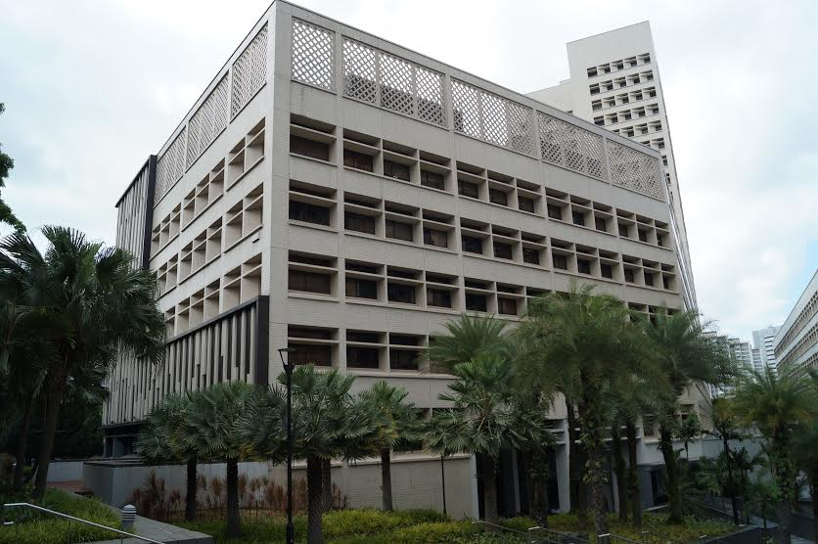
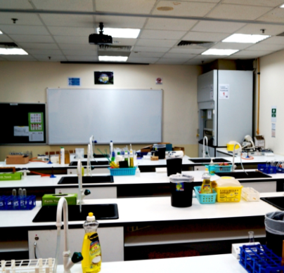
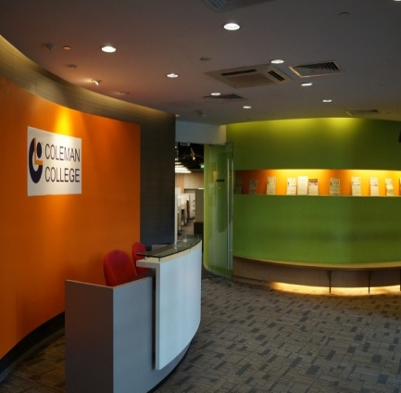
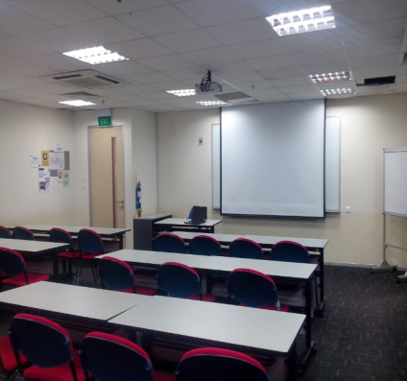
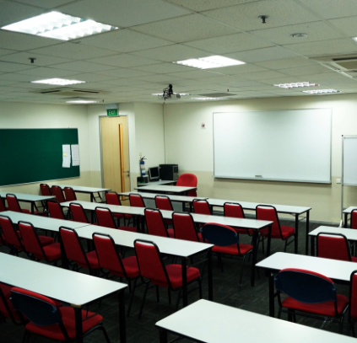
Our Facilities
Housed in 15,000 sq. feet of space and surrounded by lush greenery, Coleman College is a college that is truly conducive for learning.
There are a total of 14 fully-facilitated and connected training rooms. As laboratory experiences are essential for students, there is also a fully-equipped Science Laboratory for our students to conduct experiments.
Students get free access to Wi-Fi which enable them to connect to useful online learning resources and to communicate with friends and relatives overseas.
International students will find Coleman College a home away from home. Around the school are numerous amenities that are within walking distance for the students. These amenities range from food outlets to convenience stores, from clinics to supermarkets. For the convenience of those who drive, there is ample parking space in the building and within the vicinity.

Slide 11
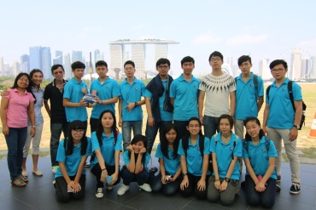
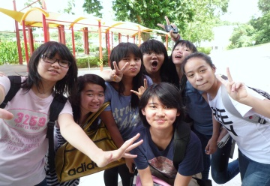
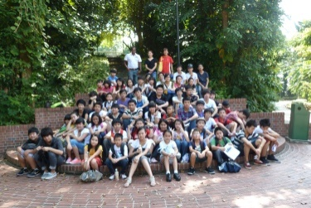
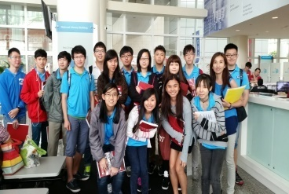
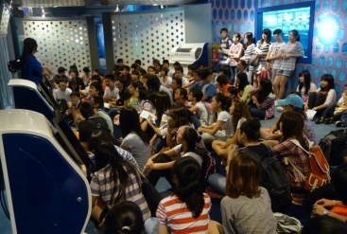
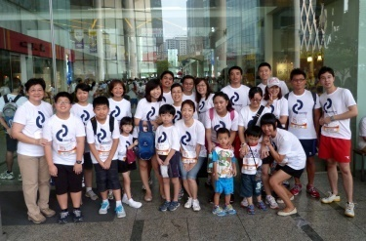
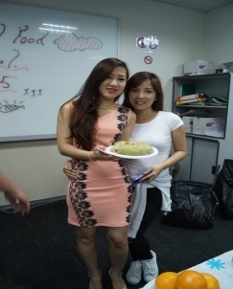

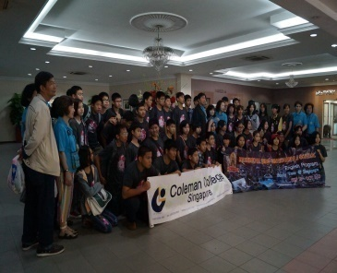
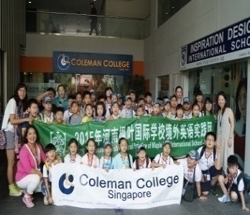
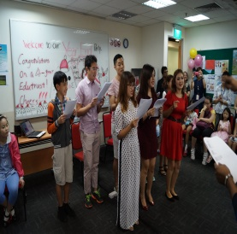
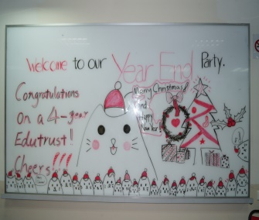
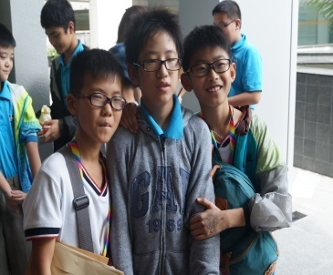
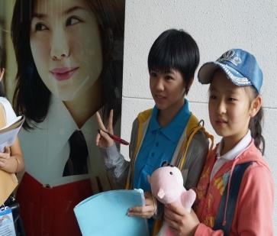
Holistic Education
Our holistic education includes classroom learning, student activities, outdoor activities and cultural celebration.
Excursions / Field trips
Festive Celebrations
Exchange Programmes with other colleges

Slide 12

COLEMAN COLLEGE
Coleman College Pte Ltd
Blk 167 Jalan Bukit Merah
#02- 15
Tower 4, Connection 1
Singapore 150167
T: (65) 6336 3462
F: (65) 6336 0929
Email: info@colemancollege.edu.sg
www.colemancollege.edu.sg

