Slide 1
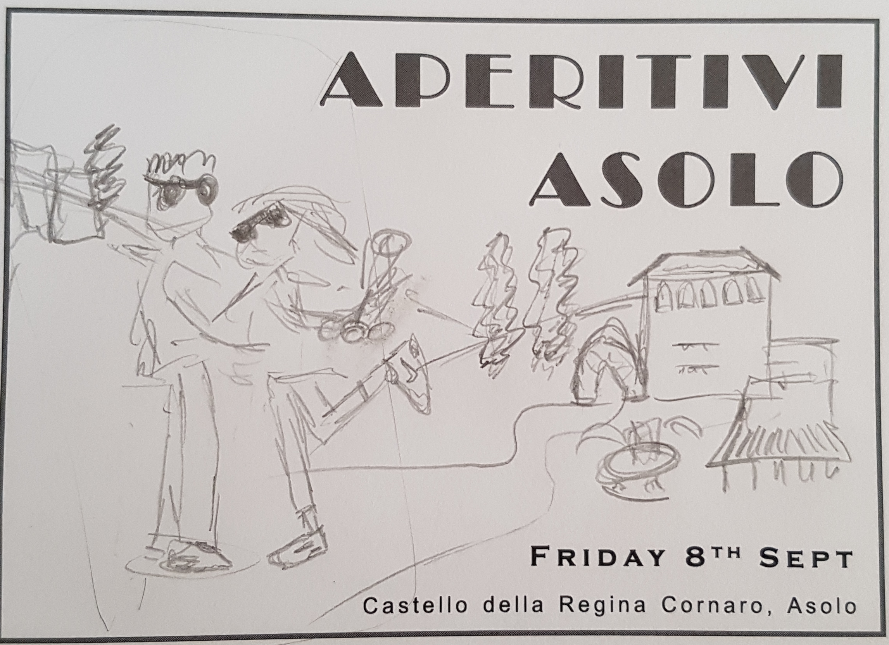
Mock up and key features
Prosecco glass
Sunglasses
Castle & arch
Shop front & fountain
Us
Friday 8th Sept 2017
Nike trainers
Leg up
Poplar trees

