Slide 1
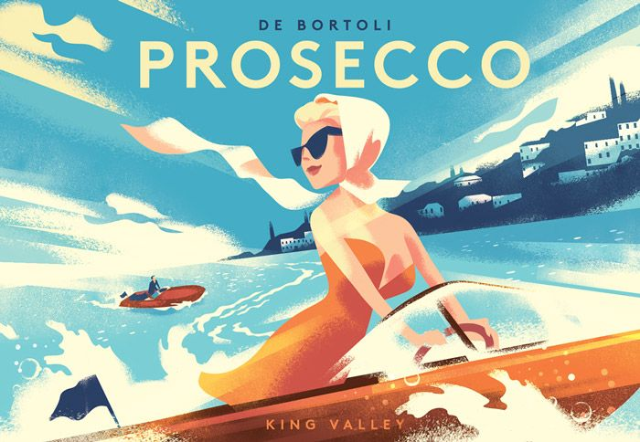

Style/inspiration – art deco (ish)

