Slide 2
agileDSS at a glance
As an excellence center in Business & Data Intelligence, agileDSS help organization to become « Data Driven »
Architecture
Integration
Strategy
Governance
Transformation
Delivery
Technology
Process
Organization

Slide 3
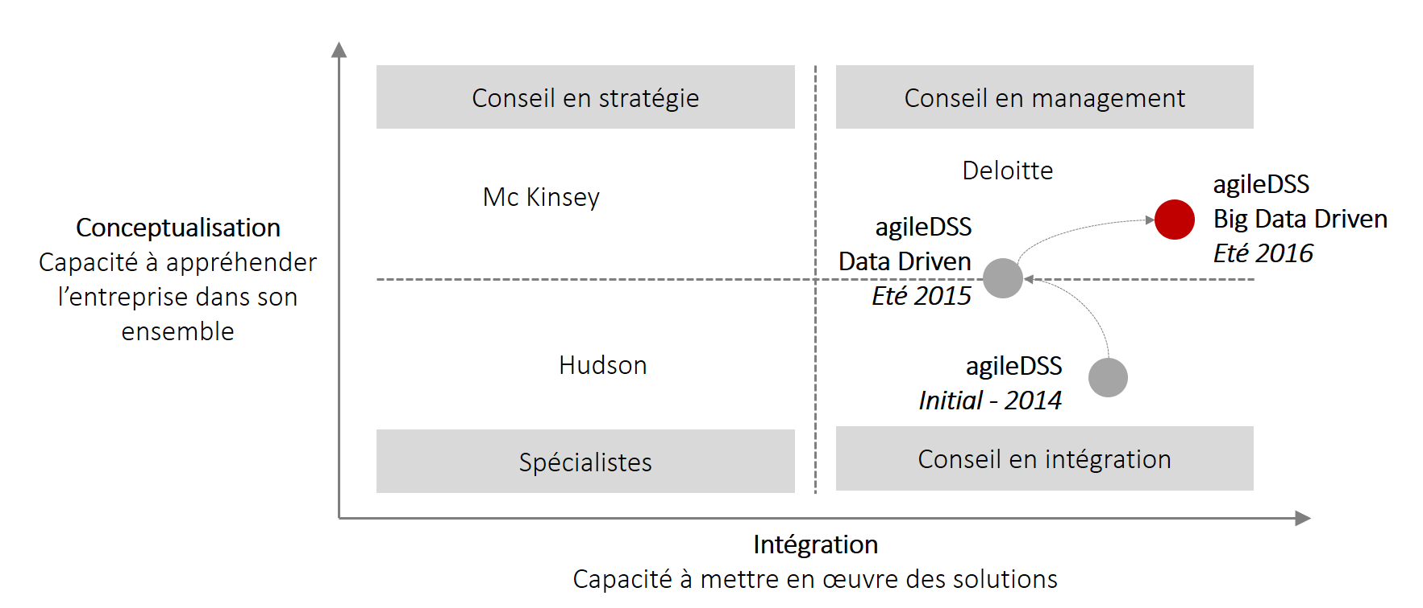
Repositioning A double upskilling
Axe intégration
Hard skills
Axe conceptualisation
Soft skills

