Slide 1
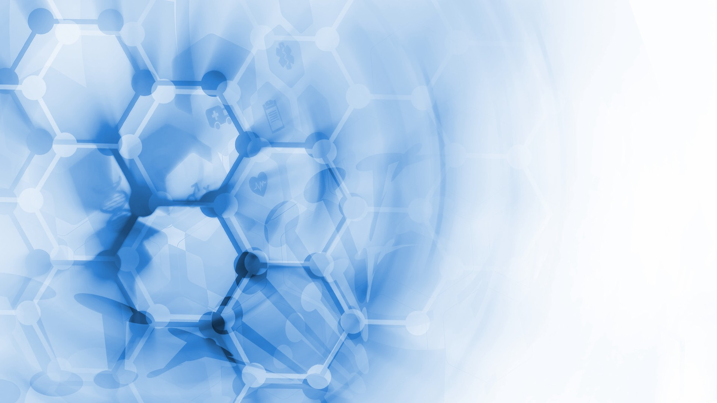
Bolb Inc.
Boost Output, Live Better

Slide 2
Brief
Bolb designs and fabricates solid-state ultraviolet (UV) devices including deep UV Light-Emitting Diodes (sometimes called UVC LEDs as these wavelengths are classified into UVC regime) and UV photodetectors.
Deep UV LEDs emit lights with wavelengths shorter than 280 nm.
Microorganisms, such as bacteria, viruses, and funguses, are all vulnerable to UVC emissions. The UVC photons can easily damage their DNA/RNA to prevent microorganisms’ reproduction. The peak efficiency germicidal wavelength is 265 nm. Our test indicates our UVC LEDs can kill bacteria and viruses in a few seconds. Micro-organisms on earth are protected by the UVC light from the Sun by the ozone layer.
Using UVC light to kill bacteria and viruses is much safer and more efficient than any other methods currently available. It is a physical process, using high-energy photons to bombard the viruses’ DNA and RNA strand. There is no chemical involved, no poisonous residual to worry about.
Bolb’s UVC LEDs can dramatically improve hygiene and disease prevention efforts. Our technology can keep food and diary fresh much longer, and make water and air safe to drink and breathe. There are many many applications in healthcare, home appliances and industrial production and packaging.
Widely employing our UVC LED and detector technology can make the world with fresh food safe water and air, where people can live a healthy life, and fluidly exchange ideas.
As such, our vision is that we develop a simple technology to fundamentally improve the world.

Slide 3
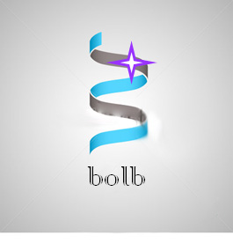
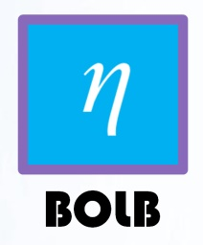
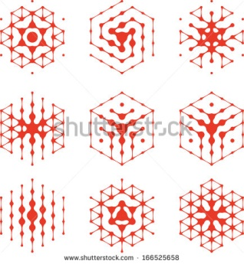
Here are some past rejected logos but maybe of interest to designers. The Greek symbol “Eta” means “quantum efficiency” in physics.
η
Invisible Force for Life
Magics with Invisible Light
η
η^{μν}
Note: The Crystal structure of AlGaN material used in our devices is hexagonal
Invisible Power for Life
BOLB

