Slide 1
IAMMO design strategy & semiotic study

Slide 2
Objectives
To define how we will leverage design to bring to life IAMMO equity pyramid
To understand how to bring to life IAMMO’s equity PODs from a visual cues standpoint thanks to a semiotic assessment in order to inform the key visual assets (e.g. the logo) and the website design

Slide 3
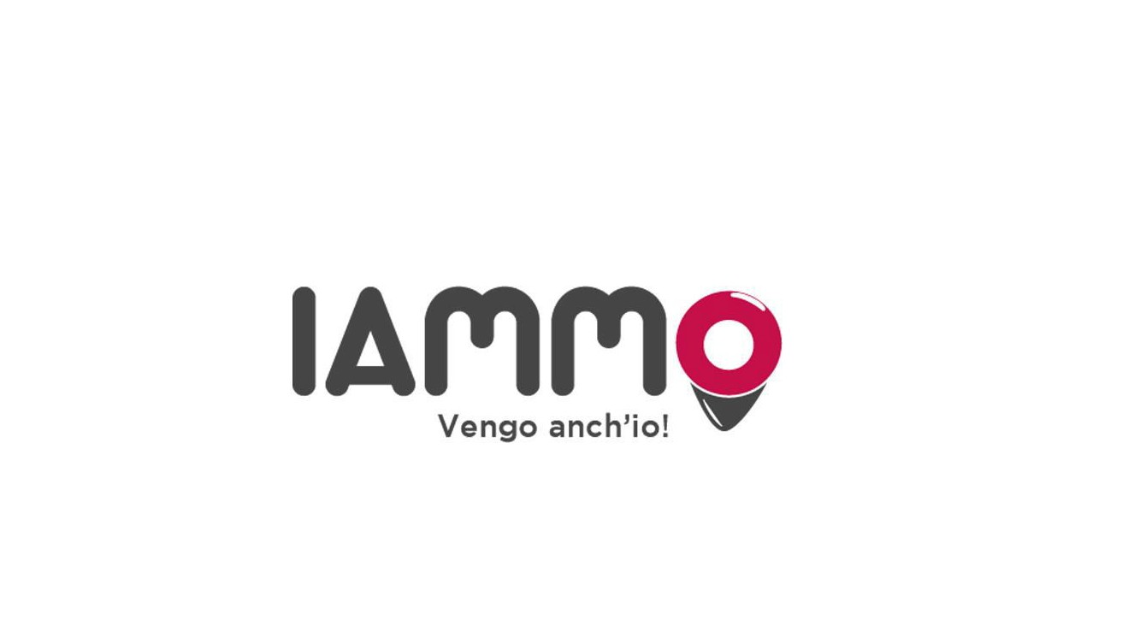
IAMMO equity pyramid
PURPOSE
Entertainment made simple, anytime, anywhere for any taste!
SUPERIOR PROTOTYPICAL BENEFIT
Infinite entertaining opportunities for everyone
ICONIC ASSETS
App icon
“Vengo anch’io”- “No tu no!”
ESSENTIAL POINTS OF DIFFERENCE
The only platform that offers multiple entertainment opportunities, acting as we’ll as a social network and offering as well to the entertainment Companies the opportunity to unleash their full productivity potential
BRAND CHARACTER
Fun, bold & smart!!

Slide 4
The design of the platform and the logo is strategic to communicate the brand character
Fun & Bold will be brought to life via all the visual assets (logo, platform design)
“Smart” will be mainly expressed by the functionalities of the platform, that will be intuitive, easy to use and “proactive” to consumers needs.

Slide 5




Fun is represented by movement and water elements, very often the sea

Slide 6

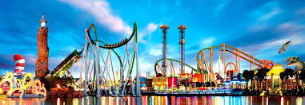
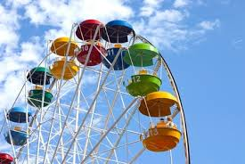

Bold colors characterized “fun” pictures

Slide 7




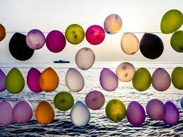

Balloons are often associated with the word fun, as they symbolize carefreeness

Slide 8
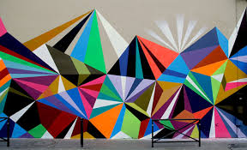
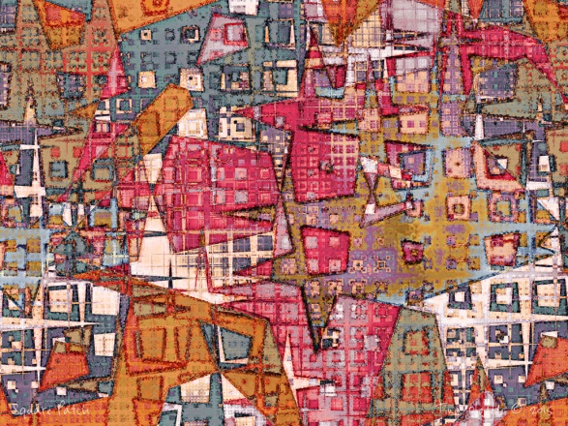
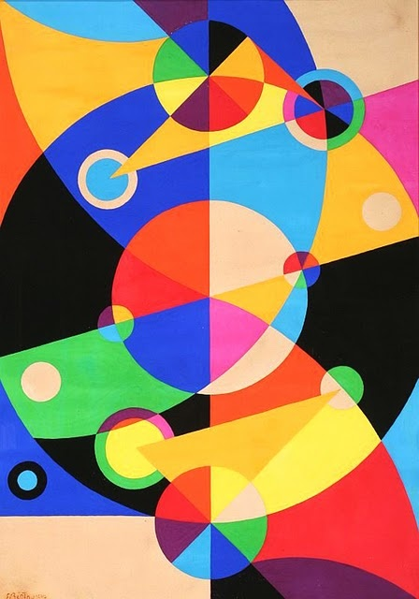

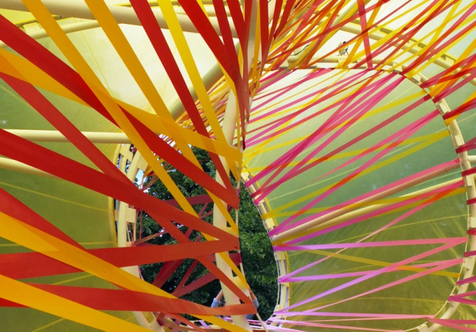
The word bold is often associated with the “courageous” use of shapes.

Slide 9

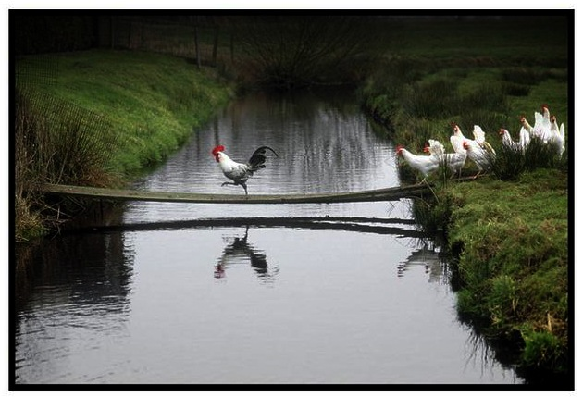
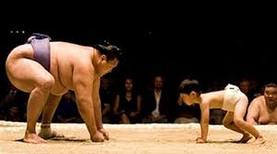
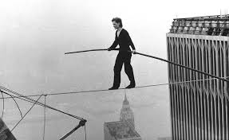

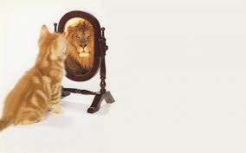
Bold means courageous and often represented by the “unexpected”

