Slide 1
Information & Concepts for
Athelas Therapeutics, Inc.

Slide 2
Athelas Therapeutics, Inc. - Mission Statement
Athelas Therapeutics, Inc., focuses on the creation of disruptive drugs for treatment of lethal invasive fungal infections (IFIs).
Building on broad experience in the epigenetic space & genomics, Athelas Founders & Scientists will prosecute IFI targets to create innovative medicines that address critical unmet medical needs.
ATHELAS THERAPEUTICS
Notes:
Change “Epigenetic” to “the epigenetic”

Slide 3
“Athelas” is an imaginary plant mentioned in the “Lord of the Rings” (LOTR) & in “The Hobbit”; also called “King’s Foil”.
It has extraordinary curative properties, saving lives that otherwise would perish. It is most powerful when administered by a “King” (his foil against illness).
There is also a plant known as King’s foil in botany.
We believe that our new drugs will have the power to cure otherwise hopeless fungal diseases.
ATHELAS THERAPEUTICS
Notes:
Change “Epigenetic” to “the epigenetic”

Slide 4
We would like to use a stylized LOGO evocative of the scripts of the LOTR/Hobbit, but not too overt
Artwork can include elements related to fungi, epigenetic structure such as nucleosomes & histones, the magical Athelas plant, some of the miscellaneous concepts shown in the end of the slide deck
ATHELAS THERAPEUTICS
Notes:
Change “Epigenetic” to “the epigenetic”

Slide 5
The LOGO used in the bottom right is what we have been using as a placeholder.
We would like “Athelas” to be very clear but distinct & “Therapeutics” to be a Sanserif font
ATHELAS THERAPEUTICS
Notes:
Change “Epigenetic” to “the epigenetic”

Slide 6
Some False Color Pictures of Various Fungi

Slide 7
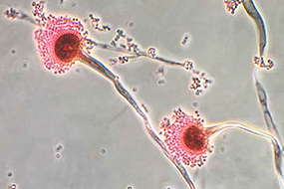
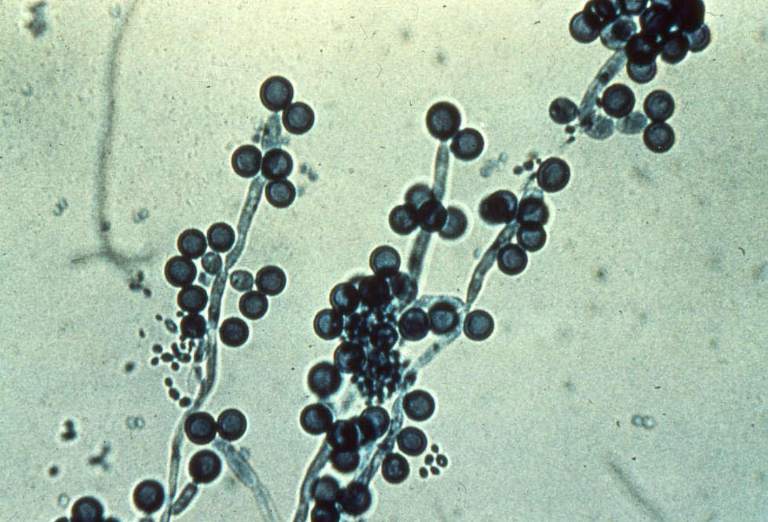
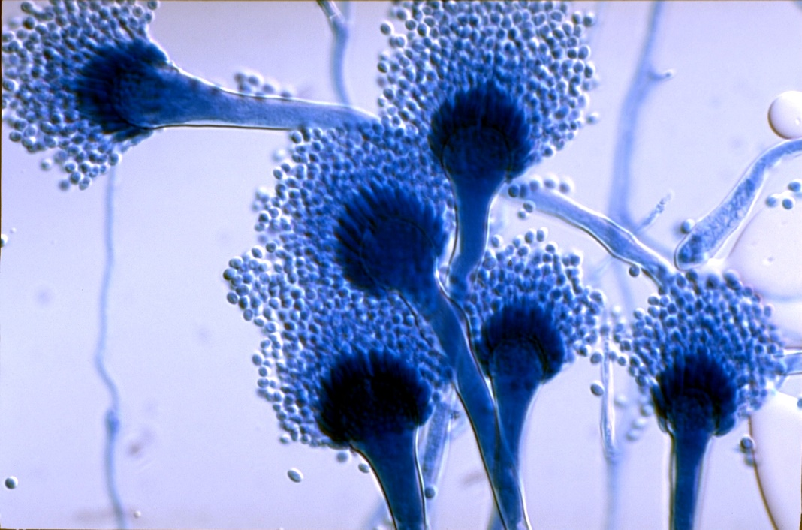
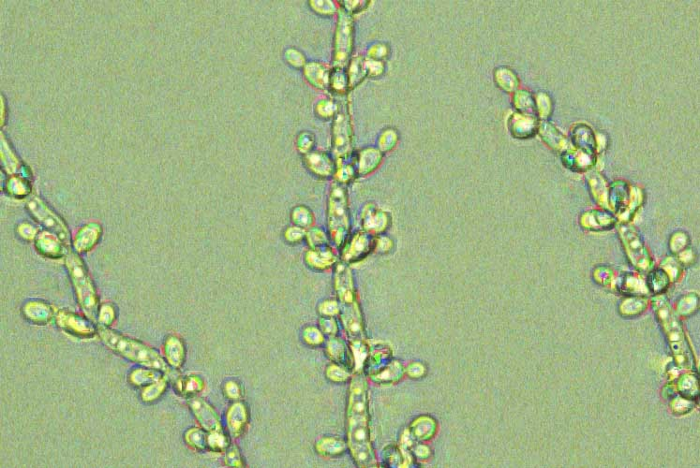

Slide 8
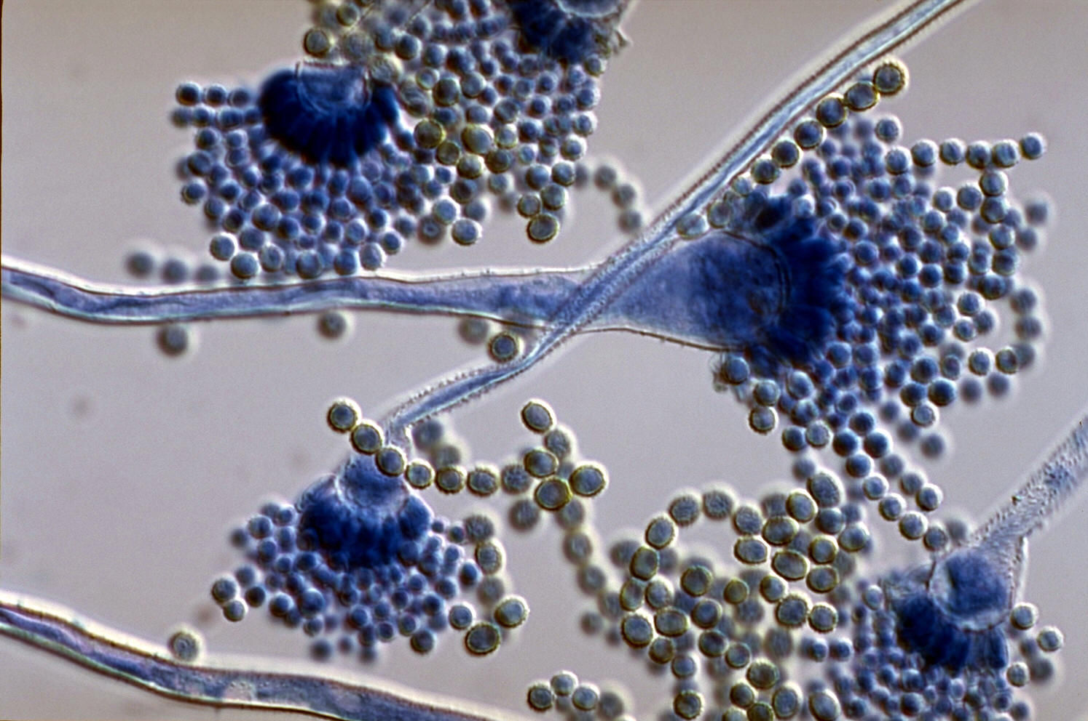
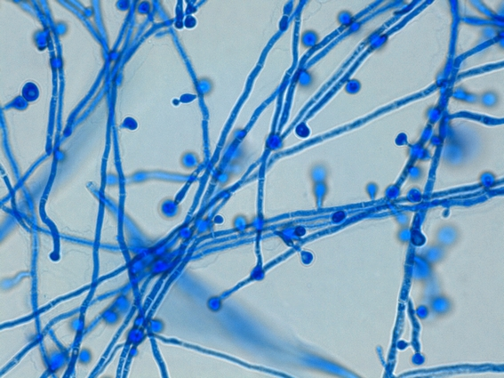
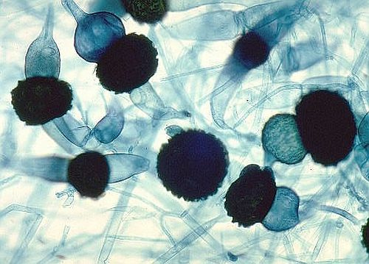
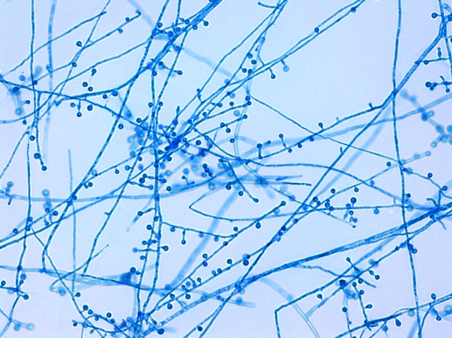

Slide 9
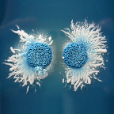
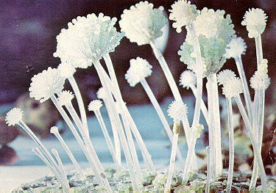
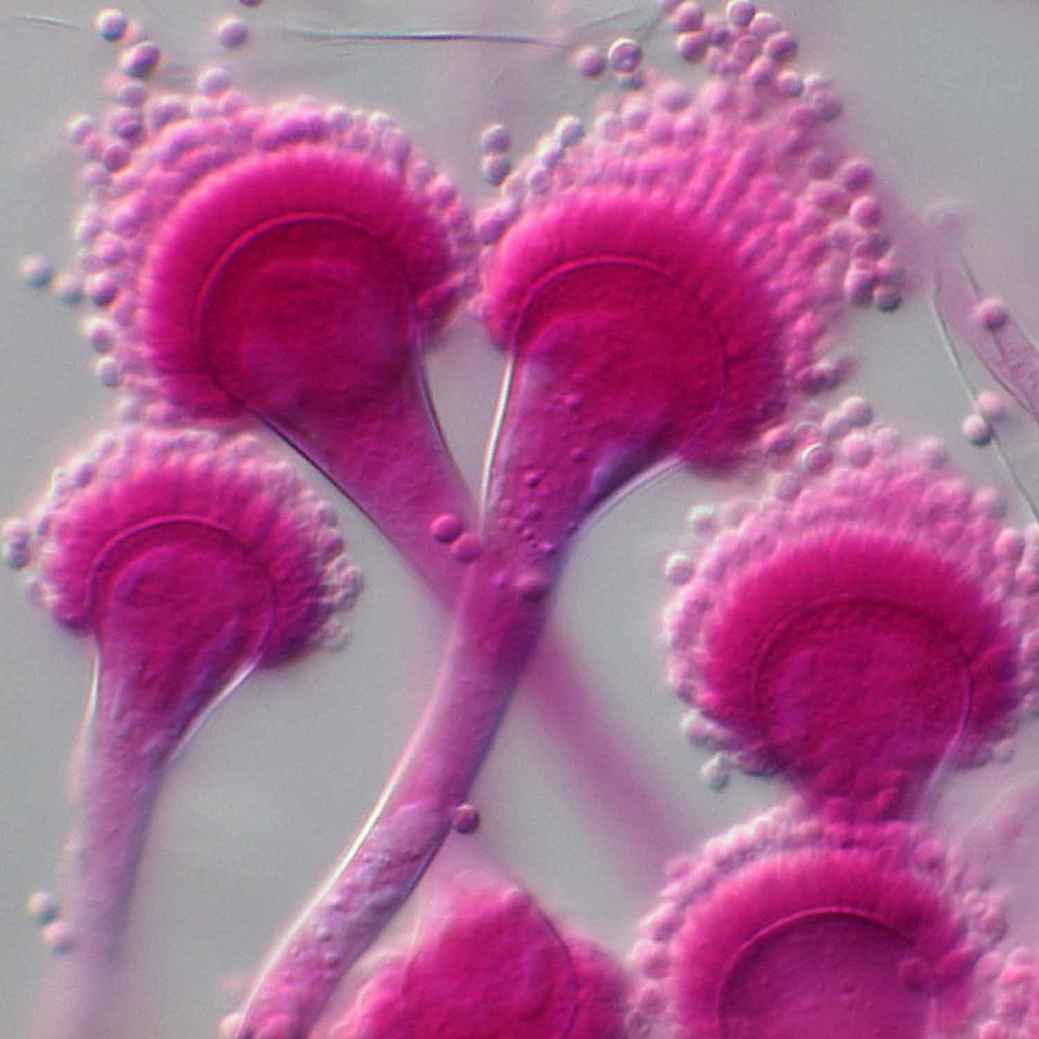


Slide 10
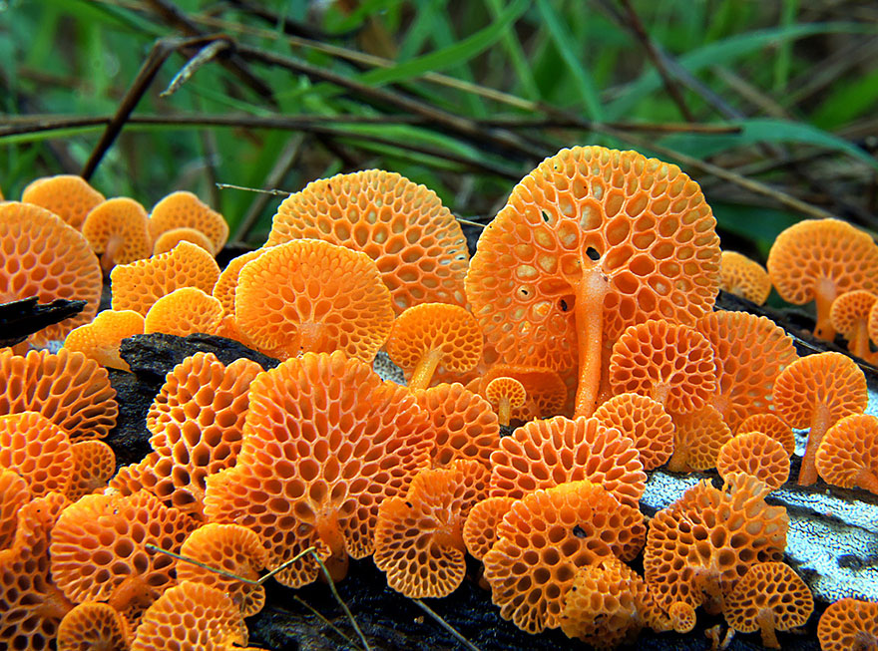
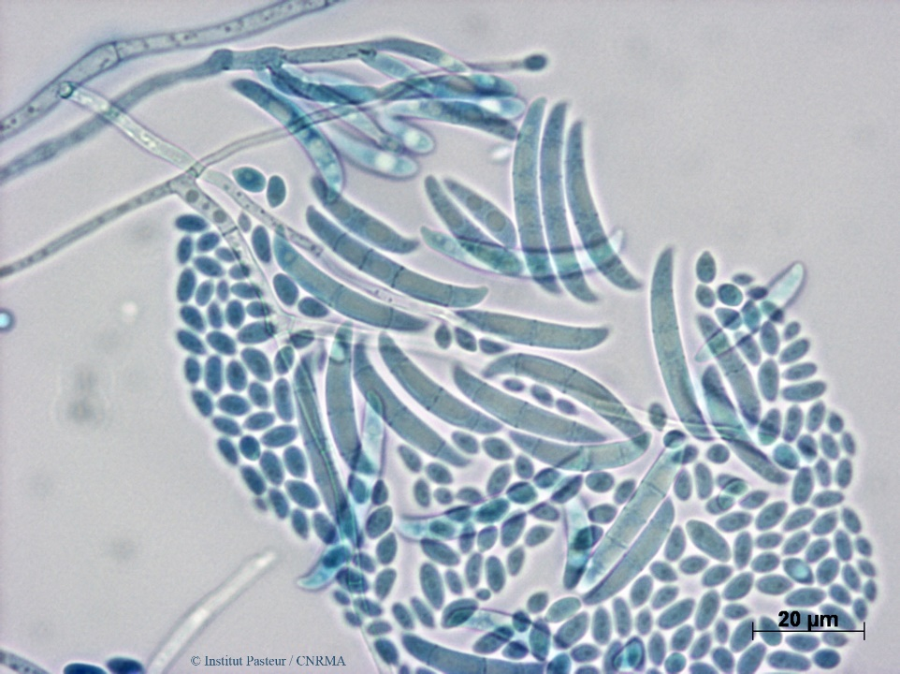
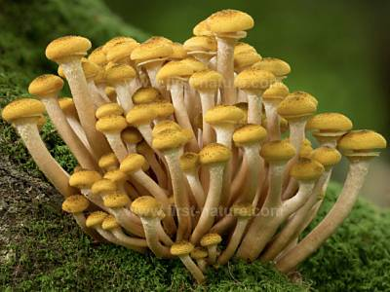
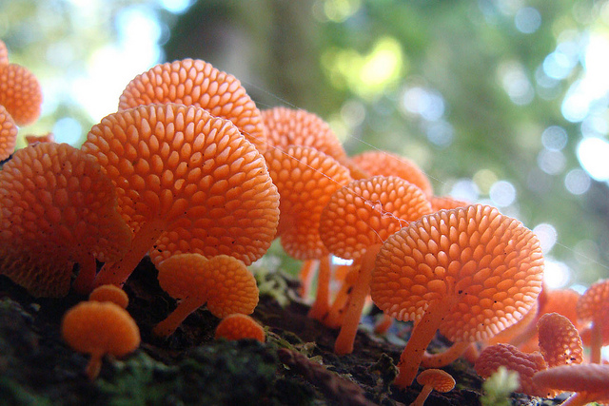

Slide 11
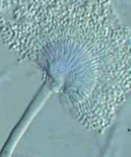
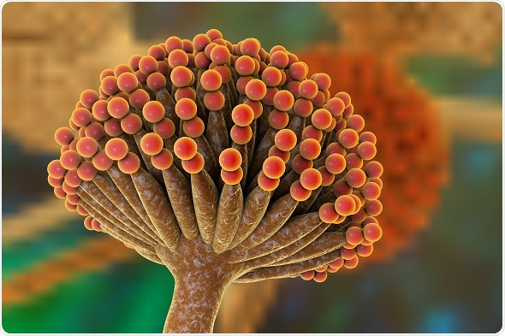

Slide 12
Some Pictures/Diagrams of
Histones & Nucleosomes

Slide 13
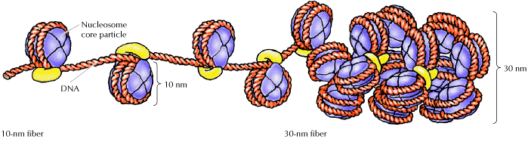

Slide 14
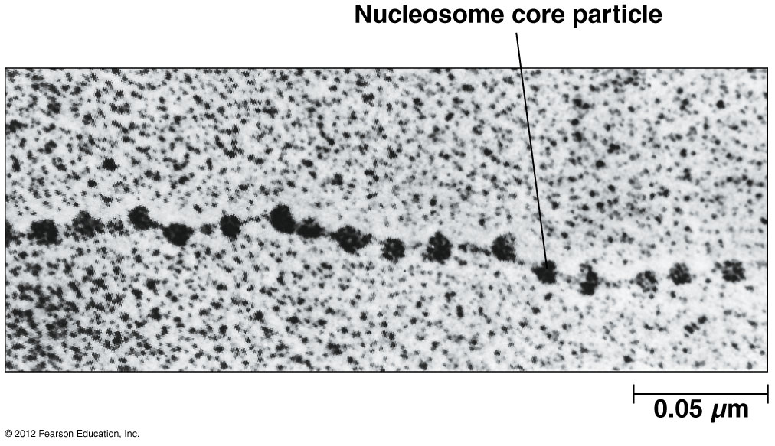
************

Slide 15
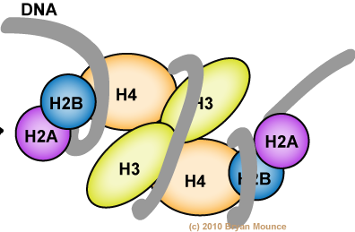
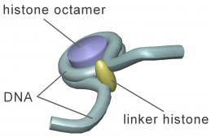
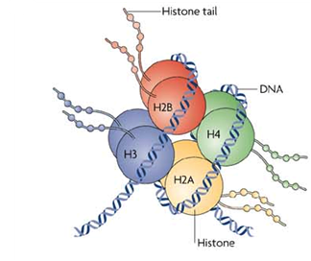
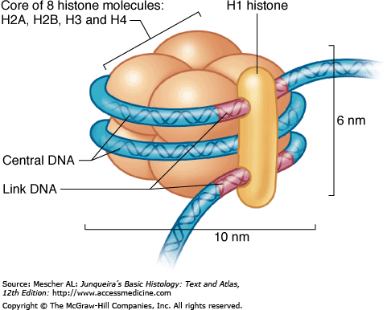

Slide 16
Some Ideas for LOGOS

Slide 17
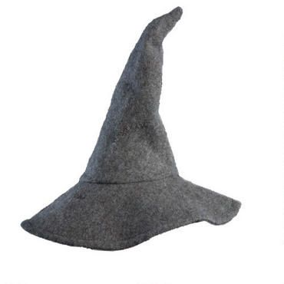
Incorporate Gandalf’s hat
Outline as the “A” in Athelas??
A
THELAS
THERAPEUTICS

Slide 18
A
T
H
E
L
A
S

Slide 19

ATHELAS THERAPEUTICS
ATHELAS THERAPEUTICS

Slide 20


ATHELAS THERAPEUTICS
ATHELAS THERAPEUTICS
ATHELAS THERAPEUTICS

Slide 21


ATHELAS THERAPEUTICS
ATHELAS THERAPEUTICS

Slide 22
Some Fonts/Alphabets Used in
The Lord of the Rings & The Hobbit

Slide 23
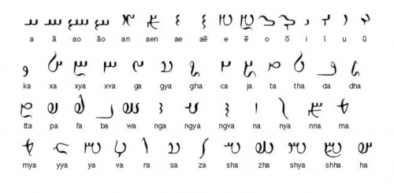

Slide 24
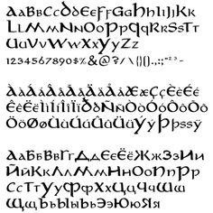

Slide 25
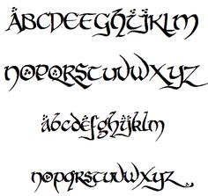

Slide 26
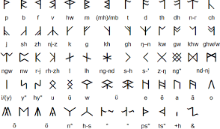

Slide 27
Some Pictures of Athelas (King’s Foil)

Slide 28
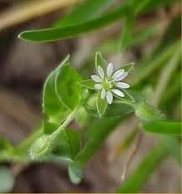
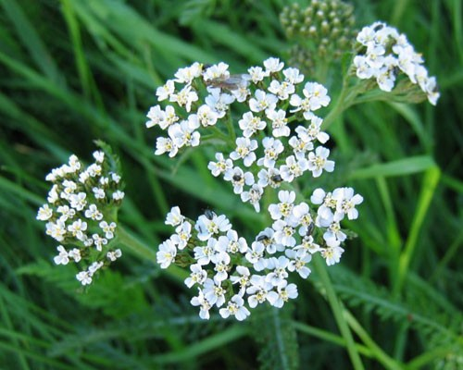

Slide 29
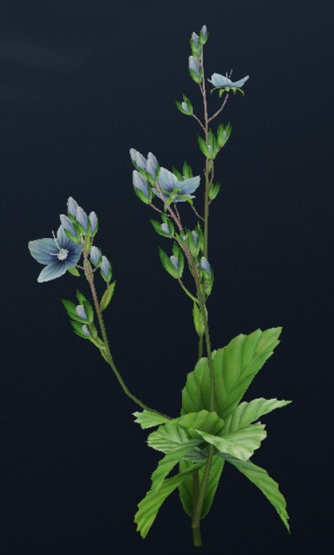

Slide 30
Miscellaneous

Slide 31

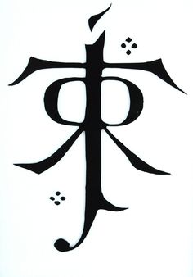
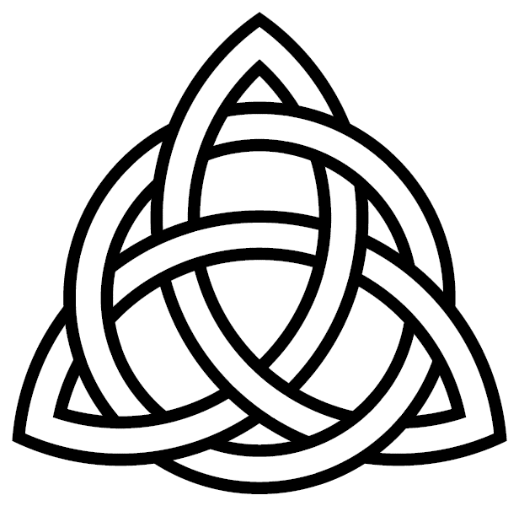

Slide 32
