Slide 1
Management Service Program
VMS Technology
Notes:
1.- Drag your picture on the slide
2.- Send to back the layer to write your title

Slide 2
Endurix
About us
Endurix National Staffing works to unite the best talent with the best employment across a national and geographical scope. We have established ourselves as industry leaders by working to place ourselves at the forefront of the Managed Service Provider and Vendor Management System approach to staffing.
At Endurix National Staffing we have found that success can be measured by the strength of the relationships that we cultivate with both our candidates and clients. We have extended this principle toward the relationships that we sustain with MSP and VMS providers as well. We work closely with MSP program managers to formulate strong relationships built upon trust and accomplishment that will in turn benefit our clients.
Our Core Values
Operate with the utmost integrity to ensure that all relationships are built on trust
Communicate in a straightforward and transparent manner
Build a reputation that will serve as a positive reflection on our clients and candidates

Slide 3
Endurix
Service Across the Nation
Endurix National Staffing operates on a national basis, spanning across all fifty states, and will soon include the entirety of North America. We support five niche verticals: Professional (Administrative/ Clerical/ Customer Service), Finance & Accounting, Engineering, Scientific, and Information Technology. Our national recruiting center is strategically located to reach across all four time zones and operates as a 24/7 production.

Slide 4
Endurix
Customizable Solutions
Great Ideas
Specialty
Recruitment
VMS Knowledge
Pace Setting
Innovate
Endurix National Staffing
Positive Turnaround
MSP Values
Perfecting Strategy
Unique Approach
Proven VMS/MSP
Knowledge
Strong
Partnerships

Slide 5
Endurix
Power of Partnering
Together we create a custom and unique contingent labor management program for Customer. Combining world-class products and services, our proposed solution achieves critical business requirements.
VISION
Strategic
Objectives
World class products and services
Implementation and processes
Ongoing Training and technical support
Risk Mitigation
Cost Control
Talent Management
Compliance Analysis
MSP Personnel
VMS Software
Efficient Change Management
Proven Methodology
Continuous Improvement
Scalable and Flexible
Metrics driven programs
Quarterly business reviews
Measurable cost savings
Timely implementations
Supplier management
Talent management
Trained, motivated users
Custom application development
How we
Measure success

Slide 6
Endurix
Comprehensive Workforce Management
Finance
Supplier mgmt
Risk
Technology
Process
Standardize rates
Aggressive discounts
Invoice validation
Invoice consolidation
Custom interfaces
Reverse billing
Payment to suppliers
Tax filing/Global EOR
Reporting
Analytics
Contracts:
- Administration
- Enforcement
Monitor compliance
Track service quality
Diversity spending
Supplier audits
Supplier reviews
Supplier sourcing
Supplier mentoring
Worker classification
Co-employment management
Insurance coverage
Workers’ comp
NDA’s
Right to work in country
Provisioning process: - Systems security
- Facilities security
- IP /asset protect
System administration
User IDs, passwords
Business rules
Business units/CC
Approval authorities
User training
Program support
New User setup
- Suppliers
- Service providers
- End users
Proper classifications
Order distribution
Candidate screening
Candidates submittals
Interview scheduling
On-boarding
Off-boarding
Performance surveys
KPIs / SLAs
Ongoing improvement
Best practices
Daily Task Management

Slide 7
Endurix
Challenges in Contingent Staffing
Decentralized selection & management of Supplier
  Lack of visibility & control over contracts, pricing, performance
No formal requisition approval process
  Unauthorized spend across the company
Time capture, Invoicing & Payment Processes are manual
  Time fraud, billing errors, lost invoices, and duplicate data entry
No formal process for qualification of 1099 workers
  Risk of audit and potential for significant financial exposure
Reporting is a manual process
  Headcount, Usage, Financial, Diversity, Performance – labor intensive, multiple sources for information
  Produced after the fact – cannot be done in real-time
Heavy demand on resources & time consuming processes
  Inability to focus on strategic business issues

Slide 8
Endurix
Streamlined, Automated Workflow
Requisition &
Approval
Sourcing & Screening
Selection & On-Boarding
Time & Expense
Invoicing & Payment
Reporting
Off-Boarding & Quality Reviews
Supports unique workflow processes for:
Traditional Temporary/Contract Staffing
Temporary or Contract to Hire
Independent Contractors
Payrolled Workers
Professional Services Consultants
Direct Hire

Slide 9
Endurix
Vendor Management
Supplier Selection | Supplier Management | Supplier Compliance
Evaluate & retain key supplier relationships | Train suppliers on requirements, workflow processes & utilization of Essential software. | Manage & maintain contracts
Identify gaps in service coverage | Facilitate communications throughout the requisition and fulfillment processes | Maintain insurance certifications
Facilitate supplier selection process, ensuring ability to meet client requirements | Provide help desk support services to address questions | Conduct periodic audit to ensure compliance with business requirements
Establish & execute contract agreements | Pay suppliers
 | Conduct regular business reviews with suppliers

Slide 10
Endurix
Cost Savings Realized
Cost Savings Category | Cost Savings Area | Assumptions
Bill Rate Savings | Rate Standardization | Establish competitive rate card by job title & geography Consolidate supplier base to leverage best pricing
Utilization Savings | Eliminate Unauthorized Usage | Implement Approval hierarchy controls
Productivity Improvement | Workflow Process Automation | Implement & Configure Internal resource re-deployment
1099 Reclassification | Risk of Audit and Financial Exposure | Implement 1099 Compliance Program
Demand Management & Right Skilling | Requisition Management | MSP Validation of requested skill requirements & job duties prior to bursting requisitions to suppliers
Typical Cost Savings: | 8-12%

Slide 11
Endurix
Cost Savings Realized
Project
Definition
Solution Design
Execution
Control
Close
Design project charter
Stakeholder mapping and change plan
Qualify project scope and risk mitigation
Current state data collection
Process discovery
Fit gap analysis
Process engineering
Solution modeling
Technology design
Support role definition
Support model installation and resourcing
VMS configura-tion and UAT
In-flight / historical data conversion
Supplier rationalization and contracting
Training
Go-live launch and support
Process assurance monitoring
Operational and technology adaption
Change management advocacy
Lessons learned calibration
Final documentation completion
Implementation hand-offs
Project Plan
Solution Design & Change Plan
Business Assessment & Execution
Operational Stability
Project Closure & Sign-Off

Slide 12
Endurix
Discovery Session with Key Stakeholders
Policies Workshop
Operations Workshop
VISION
Tenure Policy
Requisition Approval
Background / Drug Screen
Rehire Policy
Independent Contractor
Travel / Expense
Order Approval & Distribution
On Boarding & Off Boarding
Assignment Management
Evaluations
Time & Expense Entry
Assignment Termination
Technology Workshop
Invoicing Workshop
Invoicing Processes & Procedures
Invoice Design
Cost Codes / Code Validation
A/P Export
Company Hierarchy
Configuration
System Users
System Sign On & Passwords
Technology Compatibility
Security
Communication & Training Workshop
Communications / Change Management Plan
Communication Approval Process
Training Plan – Delivery Method, Timing, Location, etc.

Slide 13
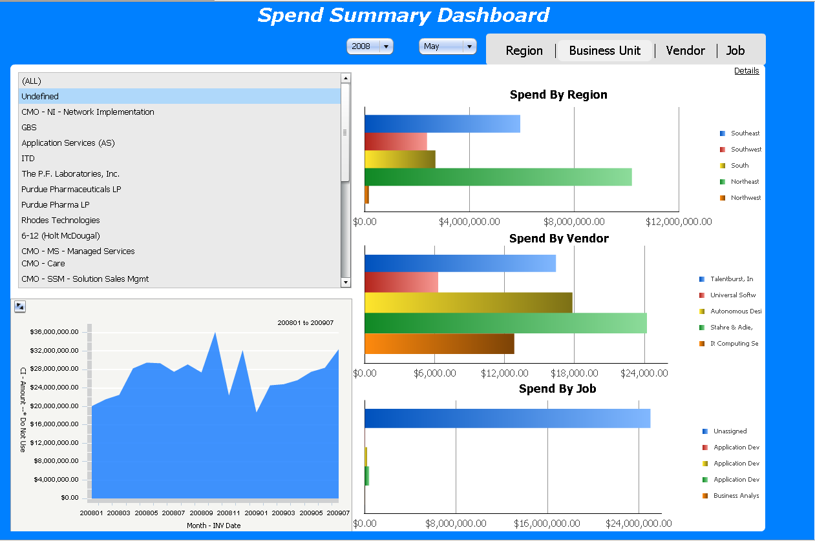
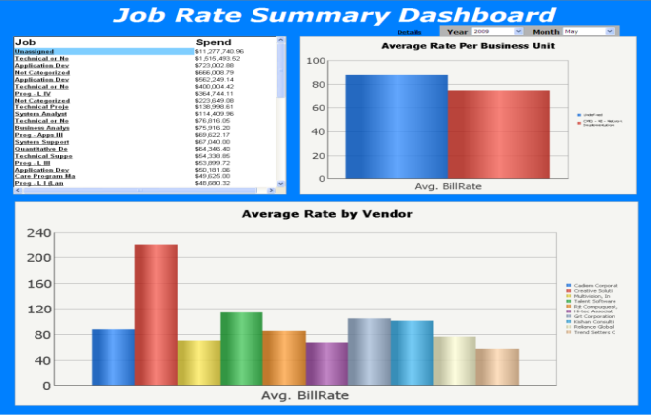
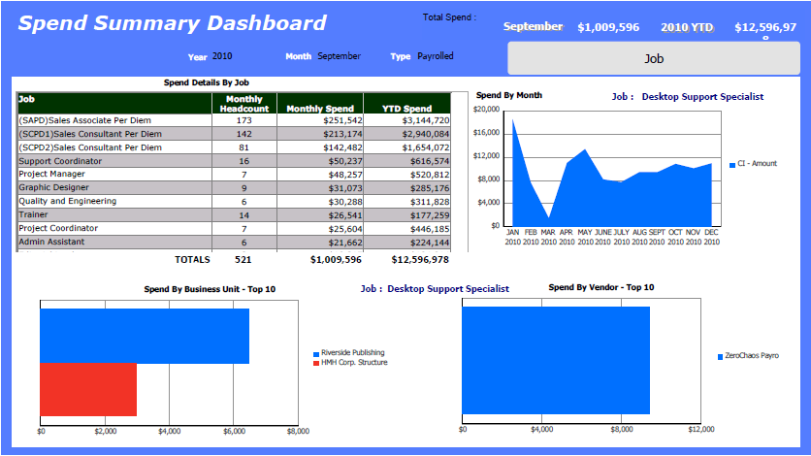
Endurix
Enterprise Visibility
Key Features
Personalized Dashboards | Forecasting & Planning Tools
Ad-hoc Reporting | Easy-to-use Interface
Automatic Scheduling & Delivery | Easy-to-read Reports
Reporting Categories
Financials | Usage | Suppliers | Projects
Expenses | Head Count | Tenure | Compliance

Slide 14
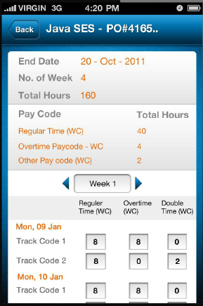

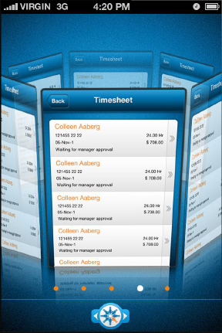
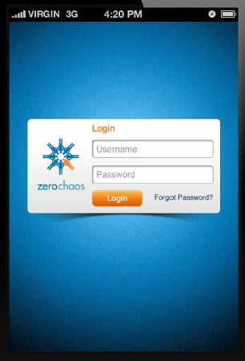
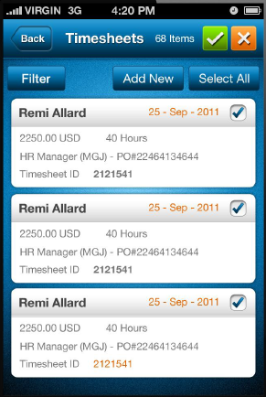
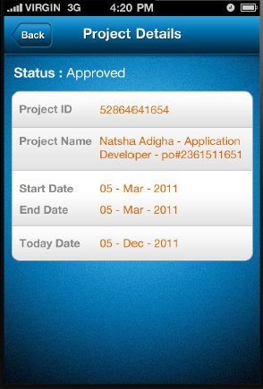
Endurix
Access ZC Web Anywhere

Slide 15
Thank you
We at Endurix National Staffing thank your for the opportunity and look forward from hearing from you soon.
Please contact Mike Malta for any questions or concerns.
Phone: (609) 455-6000
Email: mmalta@endurixstaff.com

