Slide 1
Physagogy
‘Achieving through Physical’
A Social Enterprise (company limited by guarantee)
Company Number – 10137620
Business plan 2016-2021

Slide 2
Contents
Page 3 – Foreword
Page 4 – Supporting documents
Page 6 – Vision and mission
Page 7 – Values
Page 8 – Pedagogy
Page 9 – Charitable aims
Page 10 – What we offer
Page 11 – Who we support
Page 13 – Meet the team
Page 14 – Track record
Page 16 – Goals and Objectives
Page 17 - Pricing

Slide 3
Executive Summary
Wales is facing spiralling health issues including many conditions associated with lack of physical activity and a shortage of skills required for economic growth. The alignment of current complementary cutting edge policies and plans in Wales, such as the ‘Well-being of Future Generations (Wales) Act (2015) and Qualified for Life (2014), presents a unique opportunity for a long term collaborative approach to improving the outcomes for people in Wales, particularly those experiencing inequalities and barriers.
The ‘Link between pupil health and well-being and attainment’ Public Health England publication (2014) stated that:
  Pupils with better health and well-being are likely to achieve better academically
  Effective social and emotional competencies are associated with greater health and well-being
  The culture ethos and environment of a school influences the health and well-being of pupils and their readiness to learn
  A positive association exists between academic attainment and physical activity levels of pupils.
‘A curriculum for Wales – a curriculum for life’ (2015) sets out the steps to achieve Successful Futures and Teaching Tomorrow’s Teachers. Four ‘enablers’ underpin this work: working in partnership, strong school to school working, inspiring leadership and inclusivity. At the heart of the new curriculum are four purposes, one of which requires all children and young people to be healthy and confident individuals. Health and well-being is one of the six areas of learning and experience.
At Physagogy Ltd we believe that Physical Literacy is the pivotal foundation to the success of these policies and plans and fundamental to children and young people becoming healthy and confident individuals. Physical Literacy is the motivation, confidence, physical competence, knowledge and understanding to value and take responsibility for engagement in physical activity for life (Whitehead 2016). Physical Literacy not only gives children and young people the skills to be physically active, but if delivered through a person centred/personalised learning approach can provide opportunities to develop resilience, decision making, communication skills, thinking skills, self management, social skills, leadership and volunteering, risk assessment and dedication, to name but a few.
Physagogy Ltd has
  Extensive experience of working with schools and communities in South Wales, that demonstrate how enhancing physical literacy can improve attendance, behaviour, engagement (learners, parents and communities), literacy, numeracy, self efficacy and self esteem, particularly for learners experiencing poverty (insightful case studies to support).
  The expertise to support schools and communities to ensure that children and young people become healthy and confident individuals and go on to play a vital role in improving the economy and social fabric of Wales and in doing so narrow the academic attainment gap and reduce the health gradient for those experiencing poverty.
Physagogy Ltd is a socially responsible enterprise that aims to improve the lives of children and young people in Wales. This business plan defines what Physagogy Ltd is and what it intends to be over time as well as clarifying the purpose and future direction of the enterprise.

Slide 4
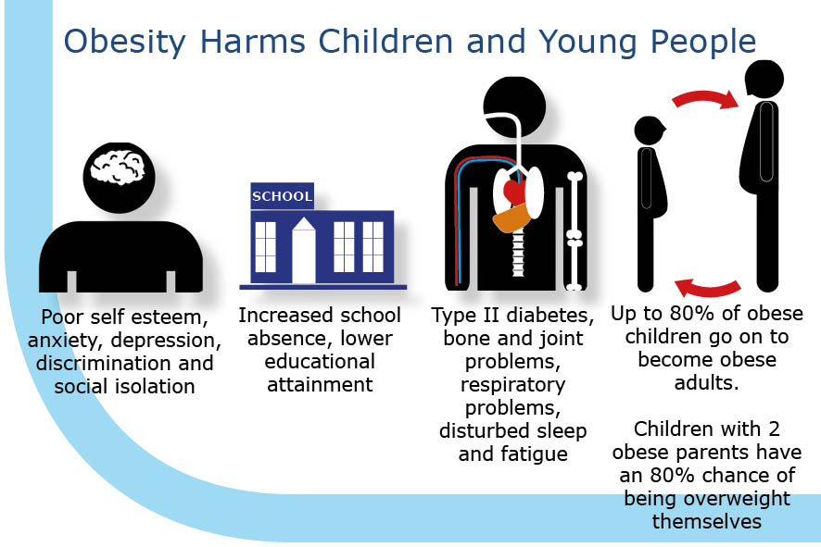
Supporting Documents
Children and adolescents with more developed movement skills find it easier to acquire specialised sports skills, be physically active and may mean they are more likely to pursue a wider variety of physical activities than peers who have lower movement skills (Stodden, et al, 2008)
The Wellbeing of Future Generations Act (2015)
Qualified for Life (2014)
A curriculum for Wales – A curriculum for life (2015)
The Draft ‘Fit for Future Generations” Childhood Obesity Strategy for Gwent to 2025 (2015) states that tackling childhood obesity has to be a priority and the most relevant objective to collaborate on is wellbeing, with the timing for such collaborations having never been better.
Healthy, confident individuals who: – apply knowledge about the impact of diet and exercise on physical and mental health in their daily lives – know how to find the information and support to keep safe and well – take part in physical activity – take measured decisions about lifestyle and manage risk – have the confidence to participate in performance – form positive relationships based upon trust and mutual respect – face and overcome challenge – have the skills and knowledge to manage everyday life as independently as they can (Donaldson, 2015)
Fit for Future Generations: A childhood obesity strategy for Gwent to 2025

Slide 5

Physical Literacy holds the key
Enhanced Health Outcomes
Enhanced Sport Outcomes
Enhanced
Education
Outcomes
Improved
Resilience
Academic attainment
Health
Equality
Community cohesion
Work skills and Economic activity
Quality of life
= Wellbeing of Future Generations
Increased PA
Increased
H&WB
Physical
Literacy
Increased Physical Competence

Slide 6
‘Every child to be physically literate’
Our Vision
Our Mission
‘To enhance leading and learning to support children and young people to become healthy and confident individuals’

Slide 7
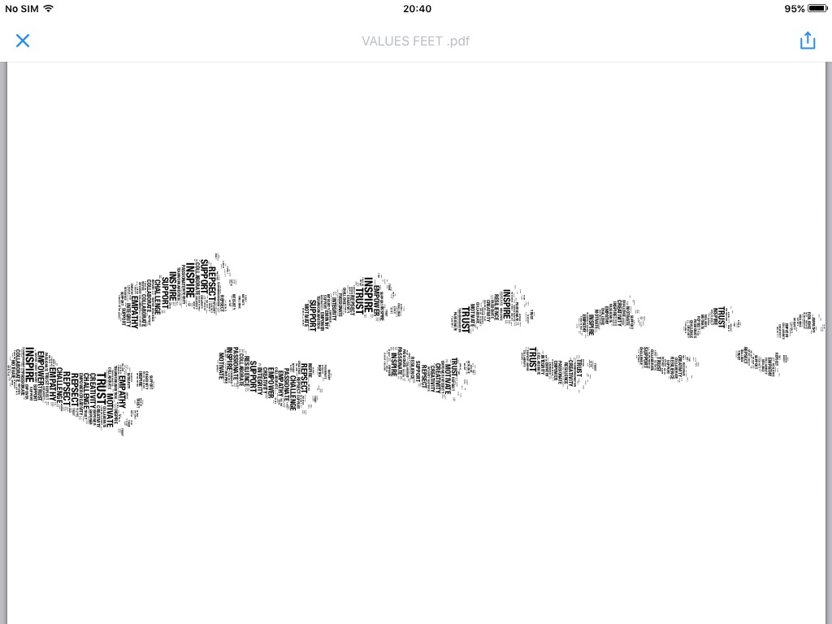
Our Values

Slide 8
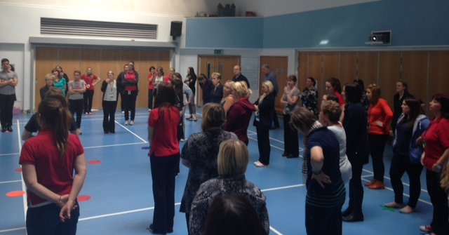
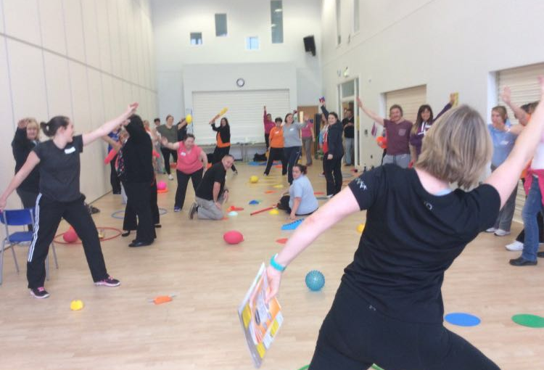
Pedagogy
Physagogy is a blend of Physical and Pedagogy
Physical - The benefits of physical activity are ends in themselves not a means to other ends. By being physical, humans interact with the world around them and in so doing reach their potential and consequently enrich their lives.
  The principles of the Accelerated Learning suggest that children and young people learn better when they involved their whole body and all their senses.
Pedagogy refers to instructional techniques and strategies which enable learning to take place. It is the method and practice of teaching, especially as an academic subject or theoretical concept (Oxford Dictionary) with another definition being ‘any conscious activity by one person designed to enhance learning in another’ (Mortimer, P. 1999).
Physagogy is learning through being physically active and achieving through physical. Physagogy Ltd have evidence to show that by enhancing children and young people’s physical literacy, that improvements in attendance, attitude, behaviour, engagement as well as more academic outcomes can be achieved, when other more traditional approaches have failed to produce improvements.
“Good pedagogy is about guiding students to learning. It's about posing challenges, asking the right questions, and presenting relevant problems for learners to explore, answer and solve. True pedagogy is where educators transport their students to a place where they will be amazed by the wonders of the world they live within” (http://www.steve-wheeler.co.uk, 2016).

Slide 9
Social Objectives
Health – to play a pivotal role is supporting schools and families to improve opportunities and experiences of physical activity for children. The result being an improvement in children’s confidence, self esteem and health and wellbeing and a reduction in levels of obesity. Creating physical literate young people who have the confidence and habitual behaviour to take part in regular physical activity.
Education – to support and enhance the provision of Physical Education in schools. The primary aim is to develop teachers who are confident and knowledgeable in delivering high quality physical education which has a positive impact upon children's experiences of physical activity and health and wellbeing choices throughout life. This will have an impact upon resilience, attainment, attendance and engagement in school.

Slide 10
What we offer
Professional Development
Bespoke Support and Challenge
Training packages
Curriculum reform
Mentoring
Bespoke projects
Educational resources
Case Studies
Leadership programmes

Slide 11
Active Families
Who we support
Schools
Physical Literacy, wellbeing and creative curriculum training for schools
Community and
Sports providers
Training for coaches and sports officers to help create a nation of physically literate children
Family Engagement
Universities
Deliver CPD training and mentoring for initial teacher training students.
Bespoke interventions
Support pioneer schools with developing the ‘successful futures’ health and wellbeing area of learning
Deliver bespoke training packages for leadership teams and teachers
Engaging with a range of stakeholders to enhance the offer of Physical Activity and Physical Literacy
Supporting families with embedding Physical Literacy within everyday play
Creating active adults who can engage in physical activity with their children.
Extra curricular club support.
Supporting the physical literacy journey for children.
Workshops to help students plan for the ‘successful futures’ area of learning.
Ambitious Learners
Healthy and Confident Young People

Slide 12
Accredited courses we offer
Physical Literacy course which complement the ‘successful futures’ curriculum in Wales and the National Curriculum in England.
PESS – Gymnastics modules 1, 2, 3 and 4
PESS – Dance courses – creative movement (foundation phase), KS2 dance and KS3 dance
Play to Learn (Foundation Phase)
Dragon Multi-Skills (KS2-3)
AfPE level 5 & 6 Primary School Specialism and Subject Leadership in PE & School Sport
Insights Leadership training

Slide 13
Co-founders Biog
Jan English is
Vicky Evans is a highly experienced teacher whose varied background in primary and secondary education connects physical education with creative education. As a former Physical Literacy programme manager and Regional Mentor she has been able to systematically support school improvement using a creative process. Vicky has challenged herself to improve life chances for children in her charge, by exploring cultural, physical and artistic activity.
Gemma Mitchell is an experienced primary foundation phase lead teacher with a specialism in PE and literacy. Gemma is passionate about family and community engagement and through her fourteen year career in teaching has led many initiatives that bear witness to the impact that family and community engagement can have on whole school improvement and children's lives.
Clare Roberts is an experienced primary and secondary school PE teacher who has a passion for working with young people living in deprivation and poverty. Clare has worked with numerous schools to coordinate initiatives which focus on closing the gap between free school meal pupils and their non free school meal peers. This work is also supported by community development work which clare has worked in for the past fourteen years. Clare has vast experience of tutoring and assessing in a wide range of settings including nurseries, schools and communities.

Slide 14
Interested Parties Biog

Slide 15
SWOT Analysis
Strengths
  Over 20 current case studies, showing the impact of our work.
  75+ years experience in education across the team.
  20+ years experience in community development.
  Breadth of educational and community experience from board members.
  Established relationships with a wide range of educational settings and stakeholders.
  Knowledge of education settings for all key stages.
  Designated training and resources to support schools with health and wellbeing.
  Established mentoring support programme for teachers.
Weaknesses
New to developing a social enterprise. In response to this advice and guidance was sought from a Business Wales Mentor and Wales Coop
Small contracts sought but additional grant to support start up is needed.
Opportunities
To develop wider links with schools across Wales.
Establish supportive links with Public Health Wales, Sport wales and Welsh Government as well as educational consortia.
Threats
Competitors – Play Learn Play, Healthy Schools,
Illness – plan for contingency plan via sub contractors
Changes in government legislation

Slide 16
Testimonials
“The Physical Literacy intervention has shown recorded improvements in attendance, lesson engagement and parental involvement, which has have been significant for some learners. There have also been improvements in equally important but ‘softer’ performance indicators including staff/student relations, student self-confidence and physical coordination. The project targeted some of our most disadvantaged and disengaged learners including a high proportion of eFSM students which makes their progress even more impressive”(Rob King, Headteacher - Llanwern High School, Newport)
“The project was designed to investigate PE approaches to the Successful Futures Curriculum. The ideas were creative and innovative and a real challenge to the traditional approaches to teaching PE in secondary schools. School staff were expertly supported throughout the process in a way that developed their thinking and challenged their thoughts on the learning process. The end result was a high quality, well presented festival that engaged our community and was thoroughly enjoyable for all learners” (Damien Lawler, Deputy Headteacher – Newport High School, Newport)
“This initiative has enabled us to meet our SDP target and reach all of our pupils and parents at a feeder school and improved the take up at our school by more than 50%. Learner’s confidence, skills and self-esteem were improved considerably by being actively involved in the activities. The team took a great deal of pressure off the school, leading and developing an initiative we had discussed at the end of the year. Their professionalism and expertise ensured we were always fully informed of the interventions, whilst centering fully on the learners. I would have no hesitation of using PLPS at any time in the future.” (Pete Ward, Bedwas High School, Caerphilly)

Slide 17
Market Research
Gwent Schools
Newport – 8 secondary schools and 44 primary schools
Torfaen – 6 secondary schools and 26 primary schools
Monmouthshire – 4 secondary schools and 30 primary schools
Caerphilly – 13 secondary schools and 75 primary Caerphilly
Blaenau Gwent – 4 secondary school and 23 primary schools
Special Needs Schools –

Slide 18
Goals and Objectives
Goals
To be the sector leading support system for schools across Wales in enhancing leading and learning within physical education and health and wellbeing
To support Welsh Government and Sport Wales with the development of getting more children, more active, more often.
Targets – 12-24 months
Work with 40 families to develop enhanced home play provision which contributes to the develop of physically literate children
Train and mentor staff from across 20 schools
Train initial teacher training students from 3 universities
Work in partnership with key stakeholders Public Health Wales, Welsh Government and Sport Wales.
Targets – 3 – 5 year plan
Work with 250 families across South Wales to develop a culture of healthy and confident young people.
Provide training for staff from across 50 schools
Develop 10 flagship schools for health and wellbeing within Wales
Develop partnerships with schools, colleges, universities and local authorities to deliver training and provide support on an annual basis.
Develop links with schools and universities in England to broaden our offer.
To have an office base.
To have a 6 members of staff that deliver upon programmes.

Slide 19
Pricing
£750 (per day) for whole school inset (full day). This provides schools with two experienced tutors, full day of training and resources.
£375 for whole school inset (half day/twilight). This provides schools with two experienced tutors, half day of training and resources.
£350-£500 (per day) - Consultancy for curriculum development, mentoring support and project development
£150 for a place on a host course (£125 early bird deal). This provides the participant with two experienced tutors delivering the course, full day of training and resources.
£200 for a place at one of our conferences (£175 early bird deal). This provides delegates with a range of engaging workshops delivered by experienced tutors and/or experienced teachers/mentors, lunch and resources and ideas to take away.

Slide 20
Projected Income
Year 1 - £80,000. This will come in the form of contracts from large organisations, small grants for local projects and income generated from school and university contracts.
Year 2 - £120,000. This will entail a large amount from income generated from schools and universities and contracts from large and medium organisations.
Year 3 - £200,000. This will entails rolling contracts with schools, universities and contracted work. New work sought from English schools and universities.
Year 4 - £250,000
Year 5 – £250,000

Slide 21
Finance – Income – 12 Month Forecast

Slide 22
Finance – Income – 5 year forecast

Slide 23
Appendix
Reference supplementary materials and resources

