Slide 1



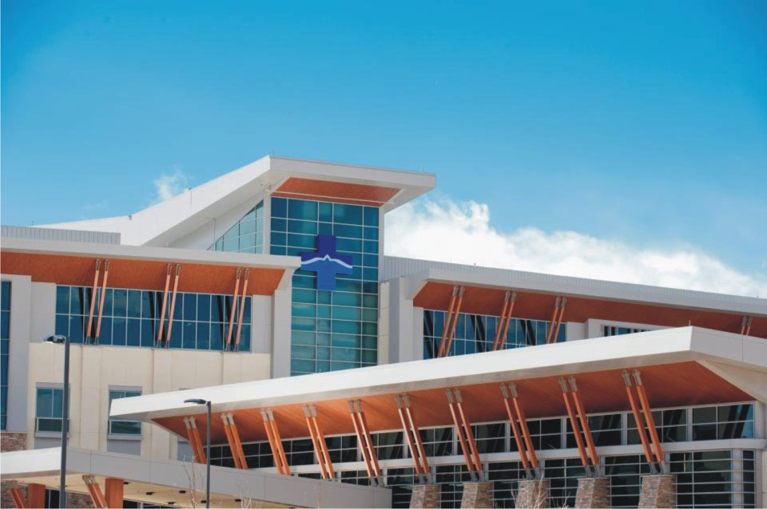
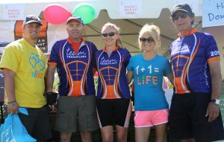

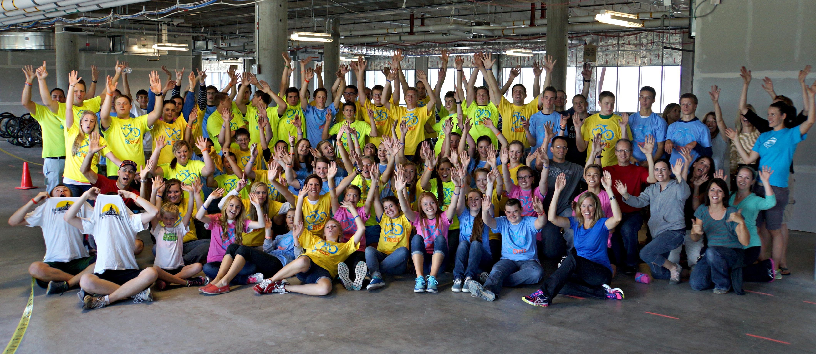
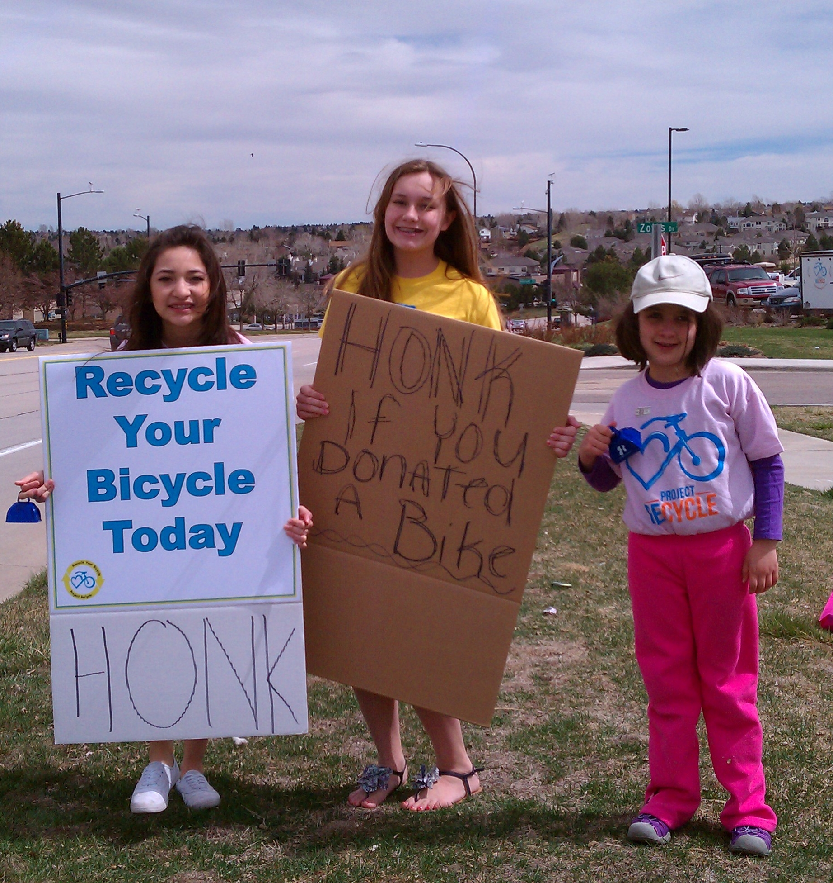

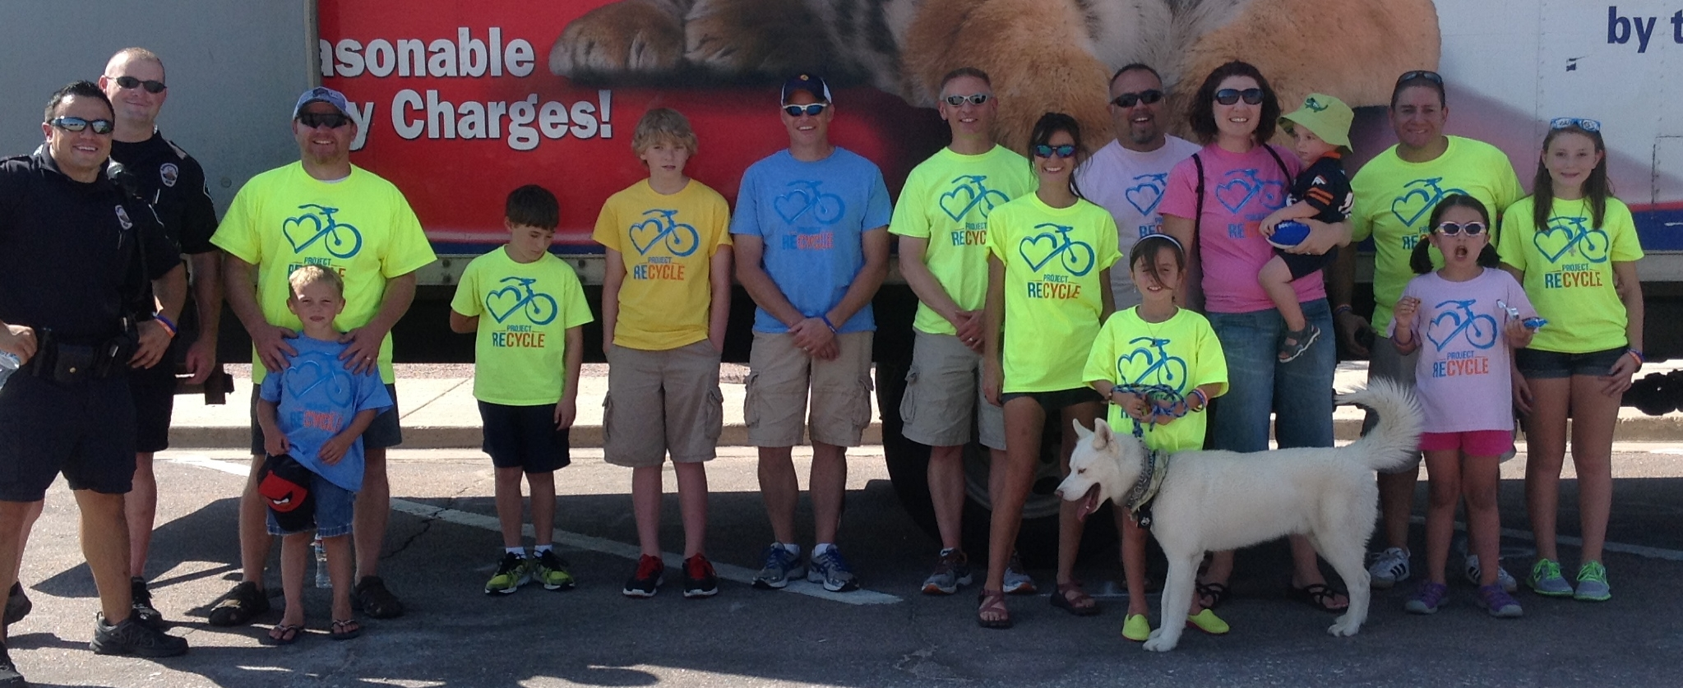
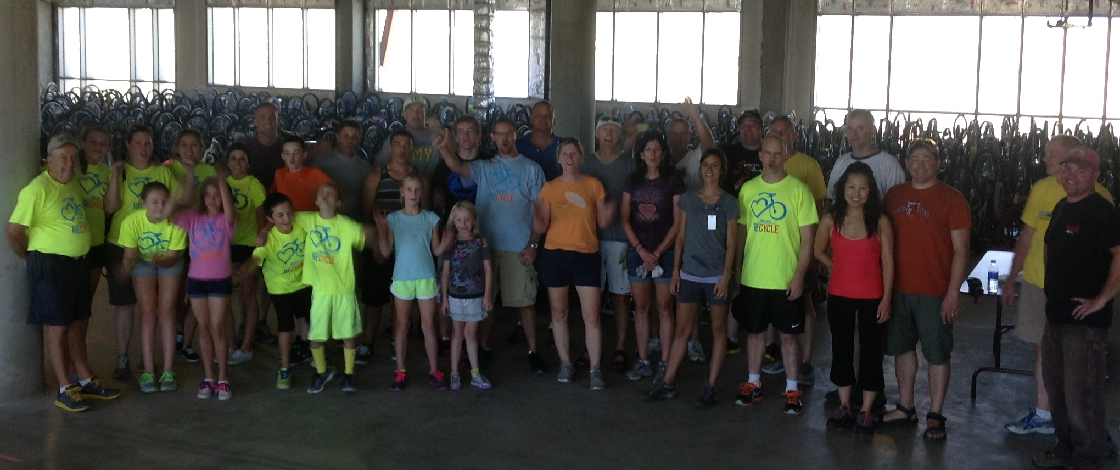
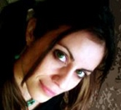
[YOUR LOGO & TAGLINE]
Be Clear: what it is about and who it is for
Thank you Project ReCycle Volunteers
The Kick Stand moves to Castle Rock
Bikes 4 Tykes Event nears
This December we will celebrate our 5th year donating bikes to children during the Christmas season. A tradition started by Jeff Fleck owner of Xperience Colorado and Board Member of Project ReCycle. This amazing event aims to gift bikes to at-risk children through local agencies.
You are invited to participate by donating your gently used bicycles to one of our participating bike shops. The bike shops donate their time and expertise to prepare the bikes for our event.
Drop off Locations
^{UPCOMING}
^{EVENTS}
Ever since we started collecting bikes in 2008, volunteers have been fueling the engine that runs Project ReCycle; From manning our booth at events to cleaning a bike so that every child will get a near-new looking bike. The reason for our great success and rapid growth lies primarily in the commitment of our volunteers. It is only fitting to salute them in our first edition of our newsletter. Full Story
November
Team Tykes Party
Starlighting Ceremony
The big warehouse on Compark Blvd that Project ReCycle came to call home for almost a year was filled with bikes, tools, and the smell of it's typical vast cold air. The soft rumble of mechanics and volunteers there to witness the last few days of occupancy at what we called, The Kick Stand.
Full Story
December
PR Christmas Party
United Fantasy Flight
Bikes for Tykes
View Full Calendar
Thank you SO much for letting us come today! … … It turned out to be everything we were hoping it would be and more. The kids loved it and feel inspired to follow God by reaching out to those around them and lending a helping hand. We were so touched by the words you shared, so excited about the joy we felt while working for a good cause, and you will definitely be seeing us again!
Many Thanks,
Julie
I wanted to let you know what a great help Kent was and how wonderful it was to have had the opportunity to give the Abbas family their new bikes! You have an incredible organization that puts a lot of smiles on people’s faces.
Thanks so much for your help!
Sharif – Regis University
Cynthia Edwards elected Board Chair
Cynthia will begin serving as Board Chair effective December 1st 2013. Cynthia is excited to lead and inspire the rest of the board members. The main Board focus for the next year will be to develop strategies to help us meet our long vision.
The Board also elected as officers: Jeff Fleck, Vice-Chair, Dave Repka, Treasurer and Nancy Stapleton, Secretary.
Read their bios here

Slide 2

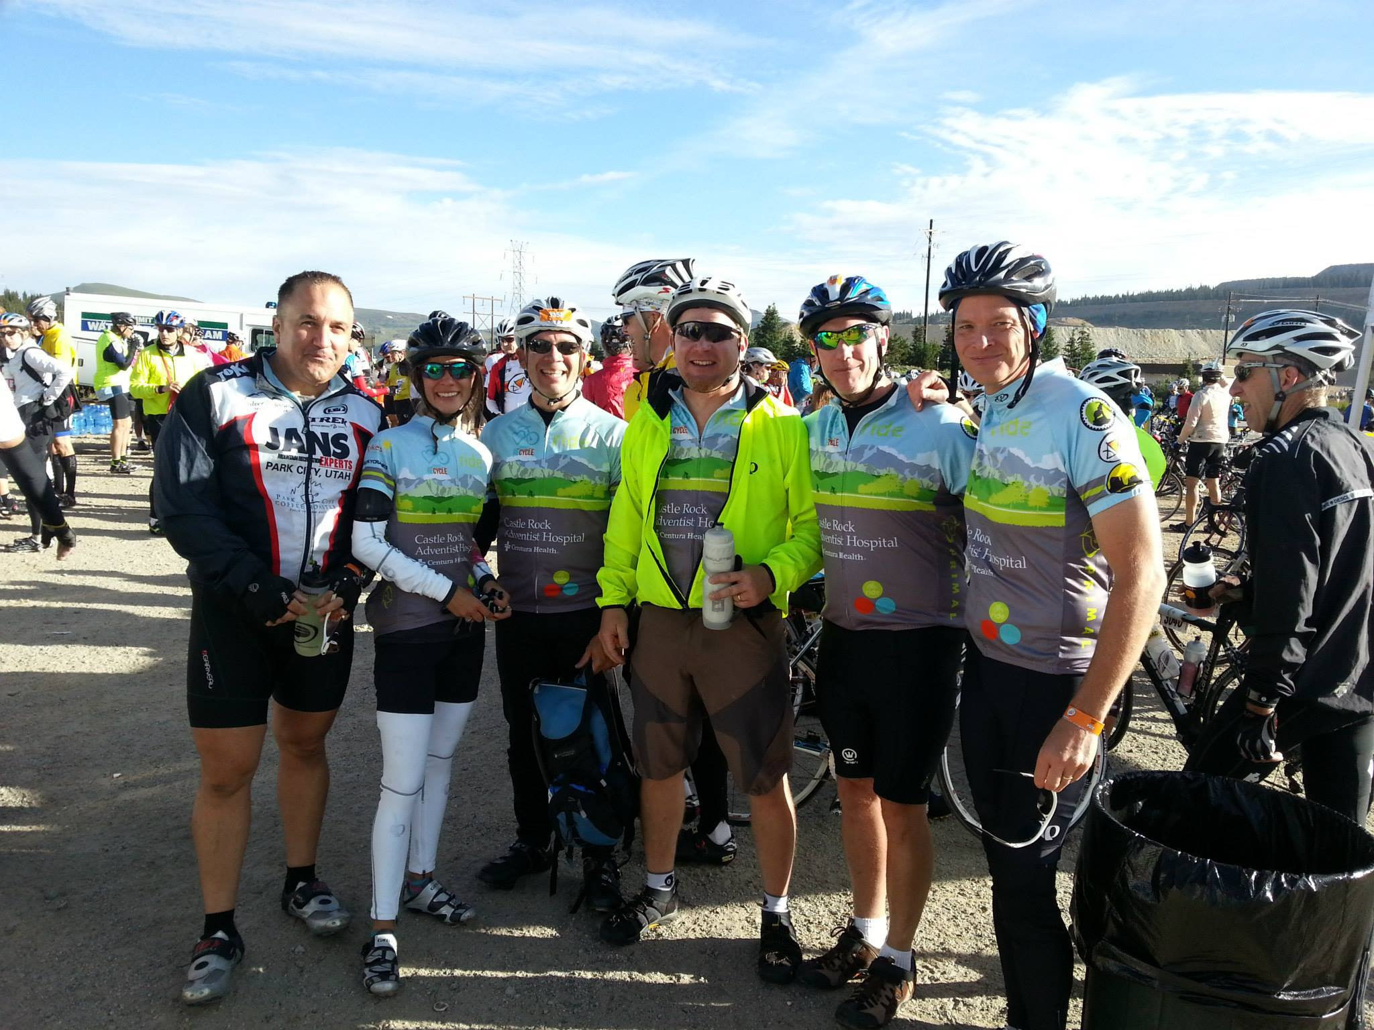

Executive Director’s Corner
Team Tykes!
The Kick Stand
At
Dear Friends and Supporters,
Welcome to our inaugural newsletter. It comes at a great time for us at Project ReCycle. Next month we will celebrate our third year as 501©3 public charity. In this short time we have made a large difference in the lives of thousands of children and their families in Colorado.
We are proud of the direction we are heading. We added several new Board Members, changed the name of the non-profit, fortified relationships with current sponsors and welcomed new ones, to mention a few. Additionally, we created “Team Tykes”, a riding club that has helped us raised funds this year.
We are thankful to be able to meet the bike requests that come in weekly via emails or from groups we support. We are looking at finishing the year having donated over 1200 bikes. (A long way from the 139 bikes we donated over 6 years ago before we were a non-profit).
We continue to look for innovative ways to raise capital to reach the vast number of children that can benefit from owning a bike. We invite you to become a member of Project ReCycle today and share on the excitement, the laughter, the joy that we bring children.
Thank you,
AJ Stapleton;
Executive Director
What an inaugural Banner Year!
Early This year we put together a “Fun-Raising” cycling team to help create awareness and funds for Project ReCycle. Our “Core” team of 8 riders finished the year by raising over $13,000 Full Article
Is opened
Saturdays 9-1pm and Wednesdays 4-8 pm
Come by and help us fix a bike or two.
Learn more
[USE PHOTOS!]
Don’t forget the importance of photos
Become a Supporting Member of Project ReCycle today and help us support the thousands of children we service.
Join Team PR
“We ride today so they can tomorrow”

