Slide 1
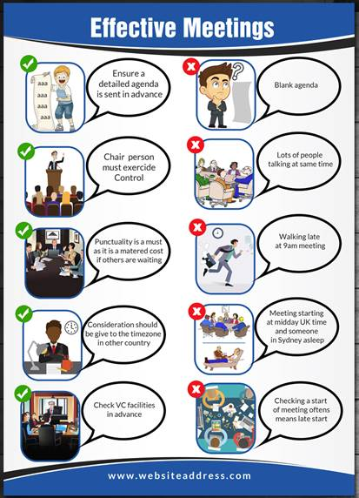
“Neither agenda or objective is stated”
The picture are a bit amaturish. Is there another caricuture type scheme ?
Use pic below.
This pic should be more appropriate for the Chairperson point above. Suggestion “Meetings are costly. Punctuality is a must.”
Being late and unprepared
Don’t understand this point.

