Slide 1

HEALTH WELLBEING SAFETY

Slide 2
Objective
1. To clearly define ATQ’s Health, Wellbeing & Safety offering both internally and externally
2. To position and deliver our offering
The above clearly assumes we should be at the forefront of Health, Wellbeing & Safety.

Slide 3
WHAT WE HAVE
Trade Safe
ATQ Safety Alerts
ATQ Wellbeing Program
WH&S Initiatives
*Just a lot corporate communication. There is no clear connection

Slide 4
The common theme is that both health and safety contribute to ones overall WELLBEING
WELLBEING
HEALTH
SAFETY

Slide 5

LETS CREATE A
SUB-BRAND INITIATIVE THAT CONNECTS IT ALL TOGETHER

Slide 6
WHAT WE CONSIDERED
SMARTER CHOICES
HEALTHY 24/7
PERFORM AT YOUR PEAK
DO IT RIGHT
Wasn’t clear enough
Health fund lingo
Motivational & Corporate
Do what right?

Slide 7
WORK SAFE
LIVE WELL

Slide 8
UNDER THIS SUB-BRAND INITIATIVE WE WILL:
Branded and meaningful communication - Tool Box Talks - Alerts - Blog content for Twitter, LinkdIn & Facebook - Combined into our existing health & wellbeing program -Uniforms
Be everywhere it’s suppose to be where it doesn’t clutter the core brand.
WORK SAFE
LIVE WELL

Slide 9

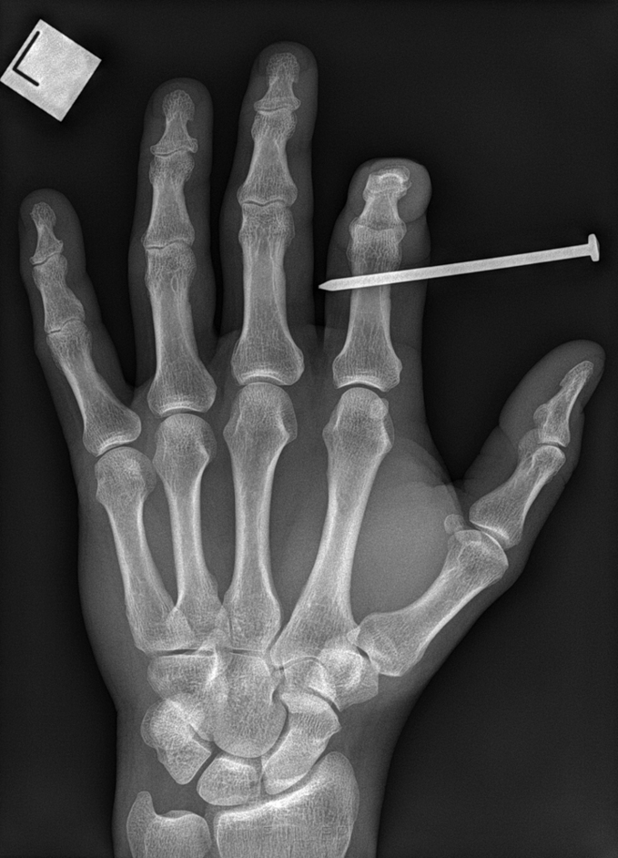



WORK SAFE..
LIVE WELL
Free Quit Smoking Program
NAIL GUN SAFETY TIPS

Slide 10
The rules this initiative needs to abide by:
Not to be nanny state
Not to be judgemental – “Your not going to be deemed as a bad worker if you smoke” Not to lecture – “Force feeding the program. It’s a program about choice”
WORK SAFE
LIVE WELL

Slide 11
WORK SAFE..
LIVE WELL
Its about providing our employees with the best resources and knowledge for making smarter choices

Slide 12
HOW DO WE DELIVER THIS?
PROGRAM INITIATION
COORDINATION DELIVERY
IMPLEMENTATION
Monitor & Evaluate
Revise & Update Initiatives

Slide 13
WHAT WE WILL ACHIEVE
Recognition for Corporate Social Responsibility Brand Differentiation – Employer of Choice Employee Engagement Customer (parents & hosts) Trust A Better Product - Healthy Workers

