Slide 1

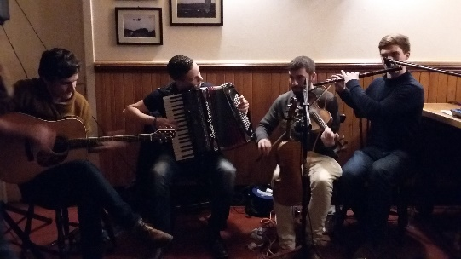

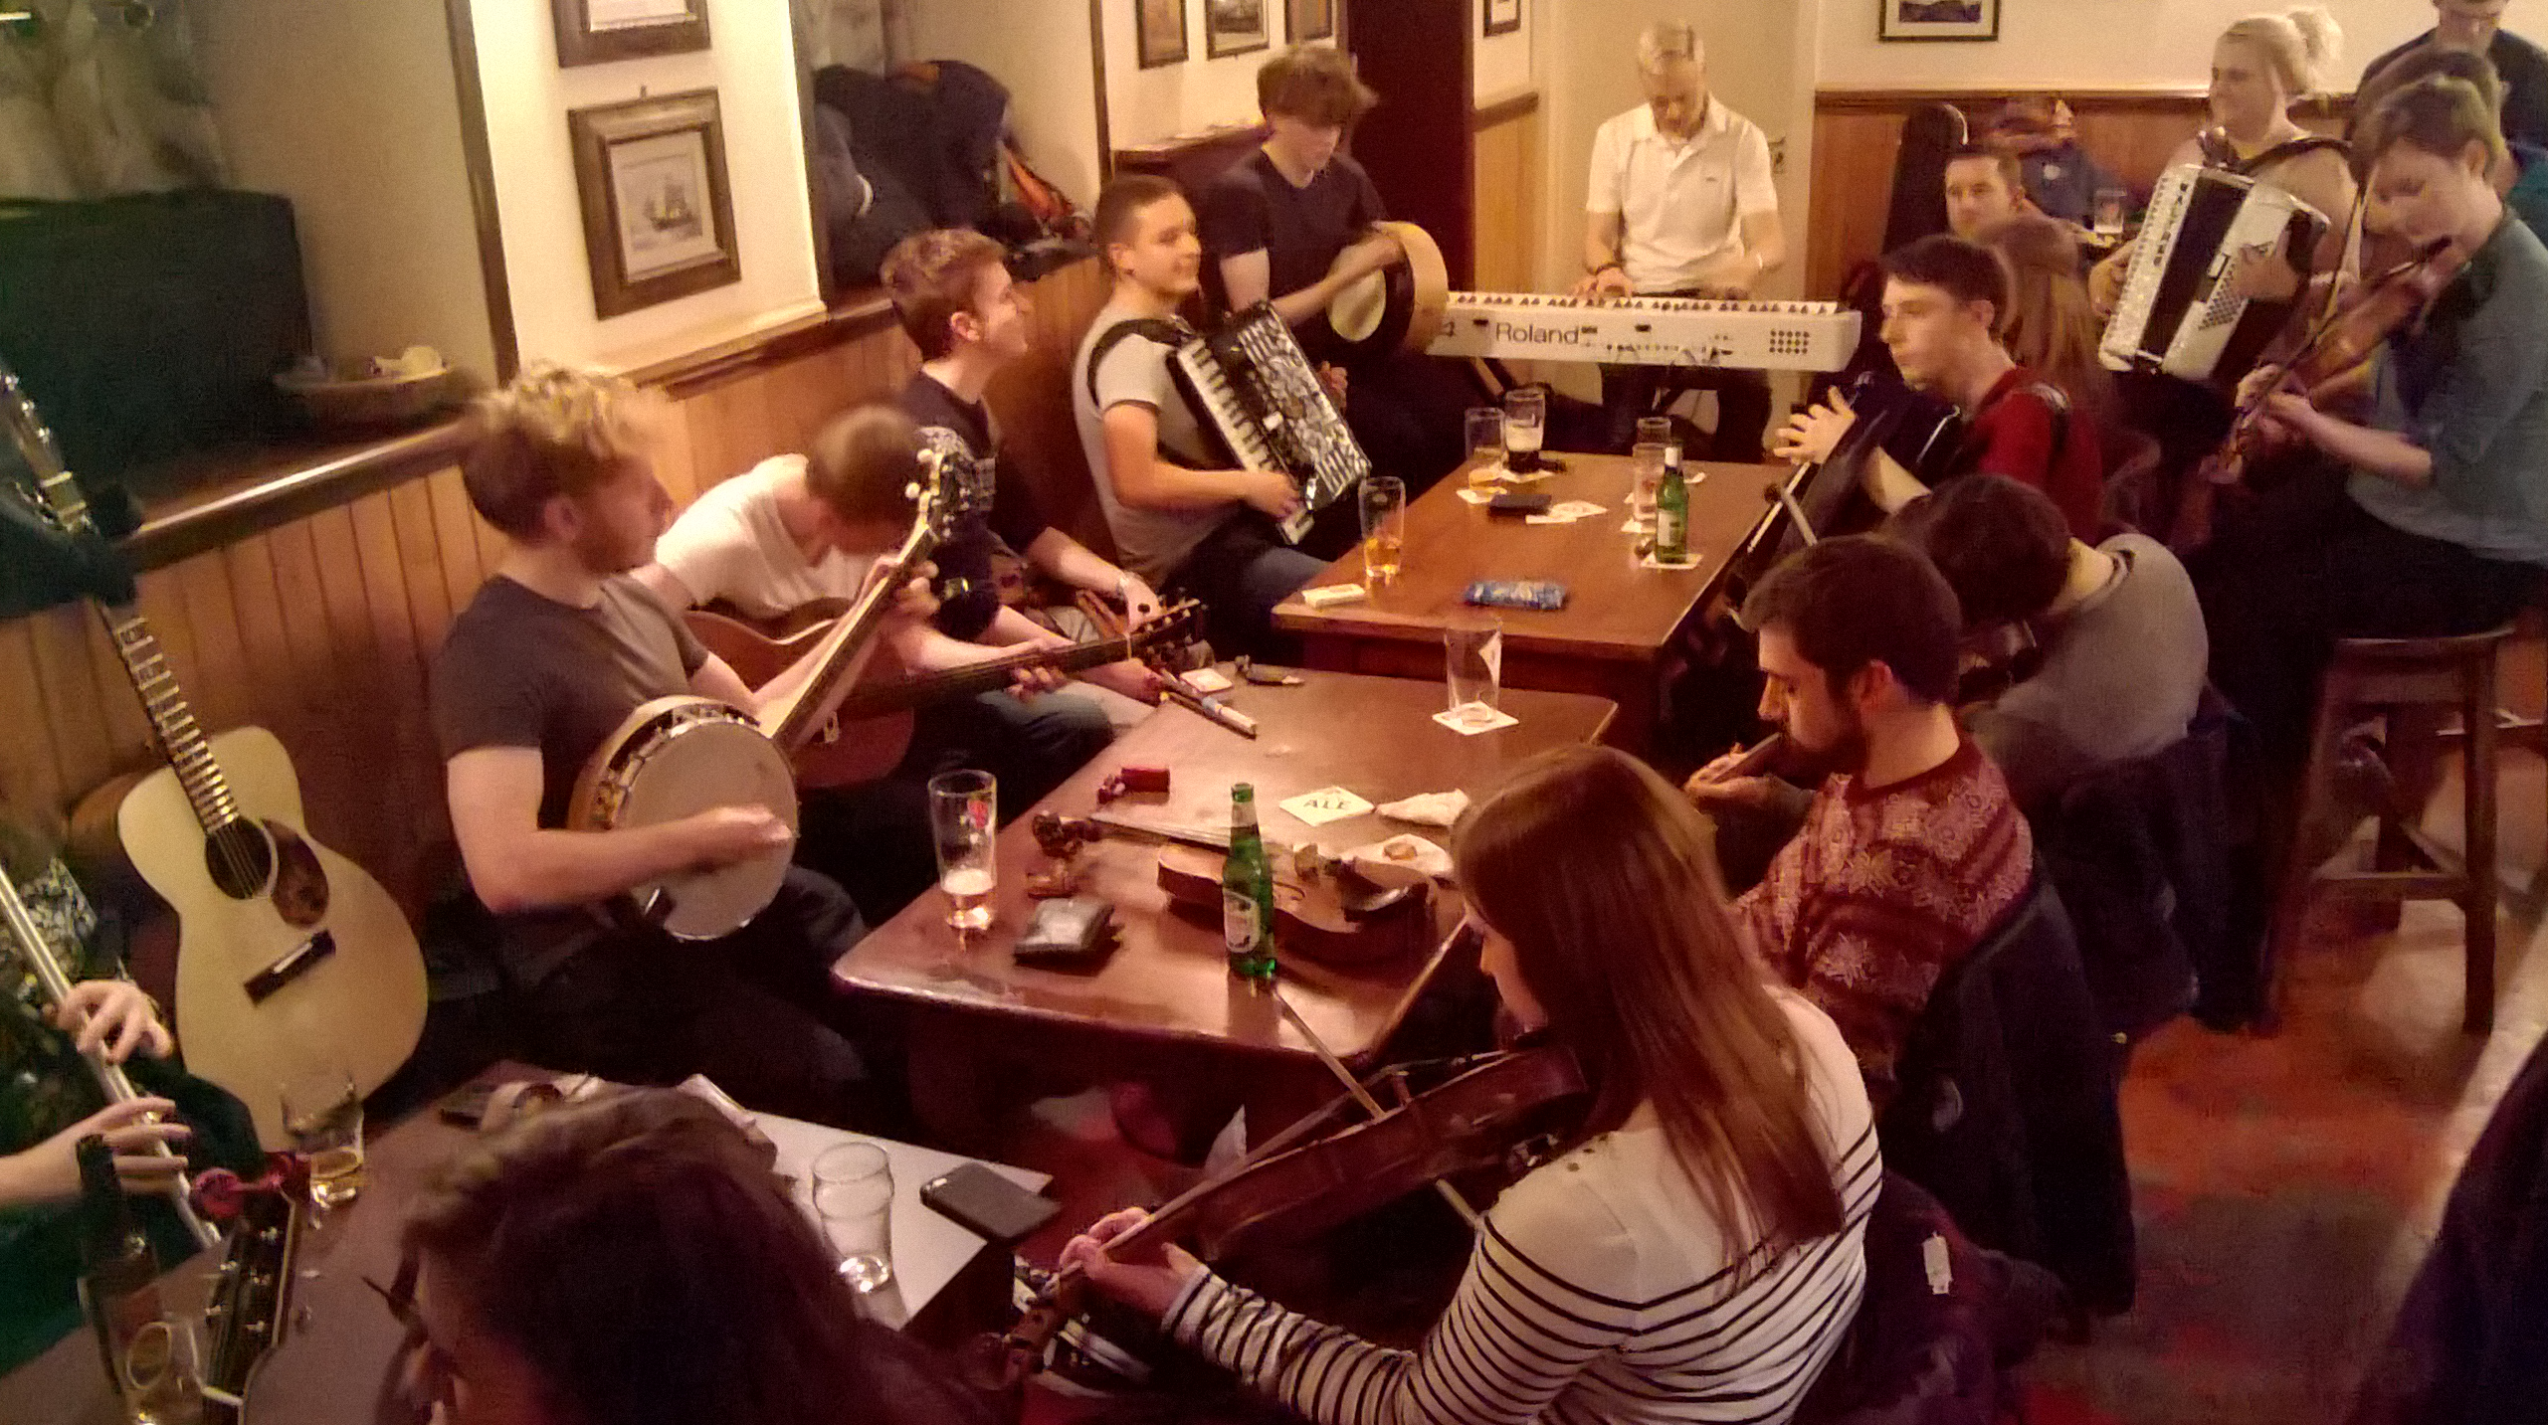
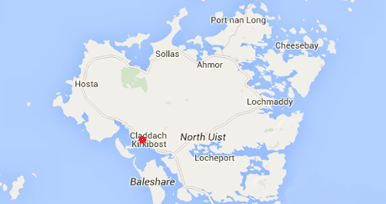

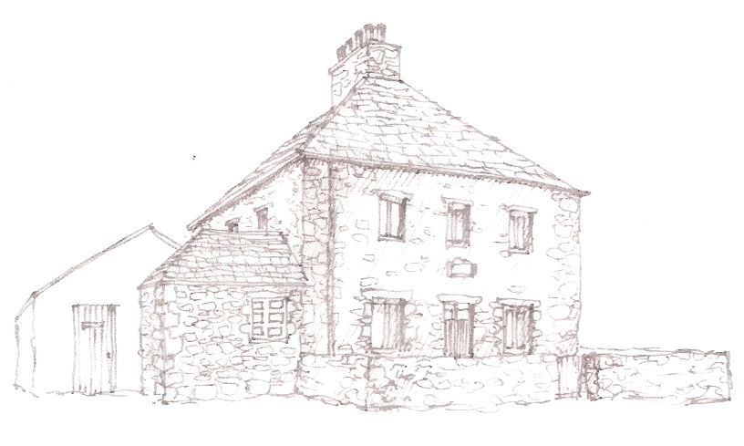

Westford Inn is a Georgian listed building located on the west side of North Uist, on the edge of the Atlantic, owned and run by Eilidh and Colin Murray.
“Westford” is a friendly pub with a traditional Hebridean atmosphere and stocks an extensive range of drinks including real ales from Skye Brewery.
We offer a variety of home-cooked food including local produce when available.
Facilities: TV, free Wi-Fi, pool table, darts, table-games and outdoor games. There is outdoor seating for sunny days/evenings.
Westford Inn
Westford Inn
Claddach Kirkibost
North Uist
HS6 5EP
01876 580653
www.wesfordinn.com

