Slide 1
Introduction to ThinkTime
Prepared for :

Slide 2





ThinkTime is a Division of Productive Edge
2008
Founded as a software engineering firm focused on Web application development with agile processes and open source technologies
4
Offices in countries
HQ in Chicago
“Enterprise Boutique”
225+
2013/2014
Service offerings now span:
resources
✔
Web
Mobile
Ecommerce
Intranets/Portals
Built on quality and personal touch
45%
80%
✔
onshore
employees
55%
20%
✔
offshore
contractors
✔
Notes:
Joel

Slide 3

















Productive Edge & ThinkTime Clients
Notes:
TVG
ULTA
Easy Beauty
CCRA

Slide 4
ThinkTime Mission
Create the most intuitive and powerful Operational Platform in the retail industry to solve one of the most challenging problems in business --- Achieving consistent execution and communication across your many locations and employees.
Our Approach
100% in the cloud
Mobile enabled technology
A full-featured, intuitive UI
No feature bloat
Many low risk approaches to get started
Competitive pricing
Scalable and secure
Retail centric with role-based views for corporate, field and stores

Slide 5
Next Generation Operational Platform
Built by retailers for retailers to achieve perfect store execution
1
RETAIL TASK MANAGEMENT
Task distribution to stores & roles
Simplified tracking
Task calendar
4
CUSTOM FORMS
Employee engagement surveys
Polls & data capture
Distributed via Task engine or through email
2
5
HELP TICKETING
Manage support requests
Service level agreements
Unlimited support groups
DASHBOARDS & REPORTS
Drag and drop widgets
Personalized widgets for the sores, field, & corporate
3
6
KNOWLEDGE BASE
Lightweight intranet
Support for ticketing & task
Easy article creation
MOBILE
Native iPhone and Android apps
Phone and Tablet
Web is fully responsive

Slide 6
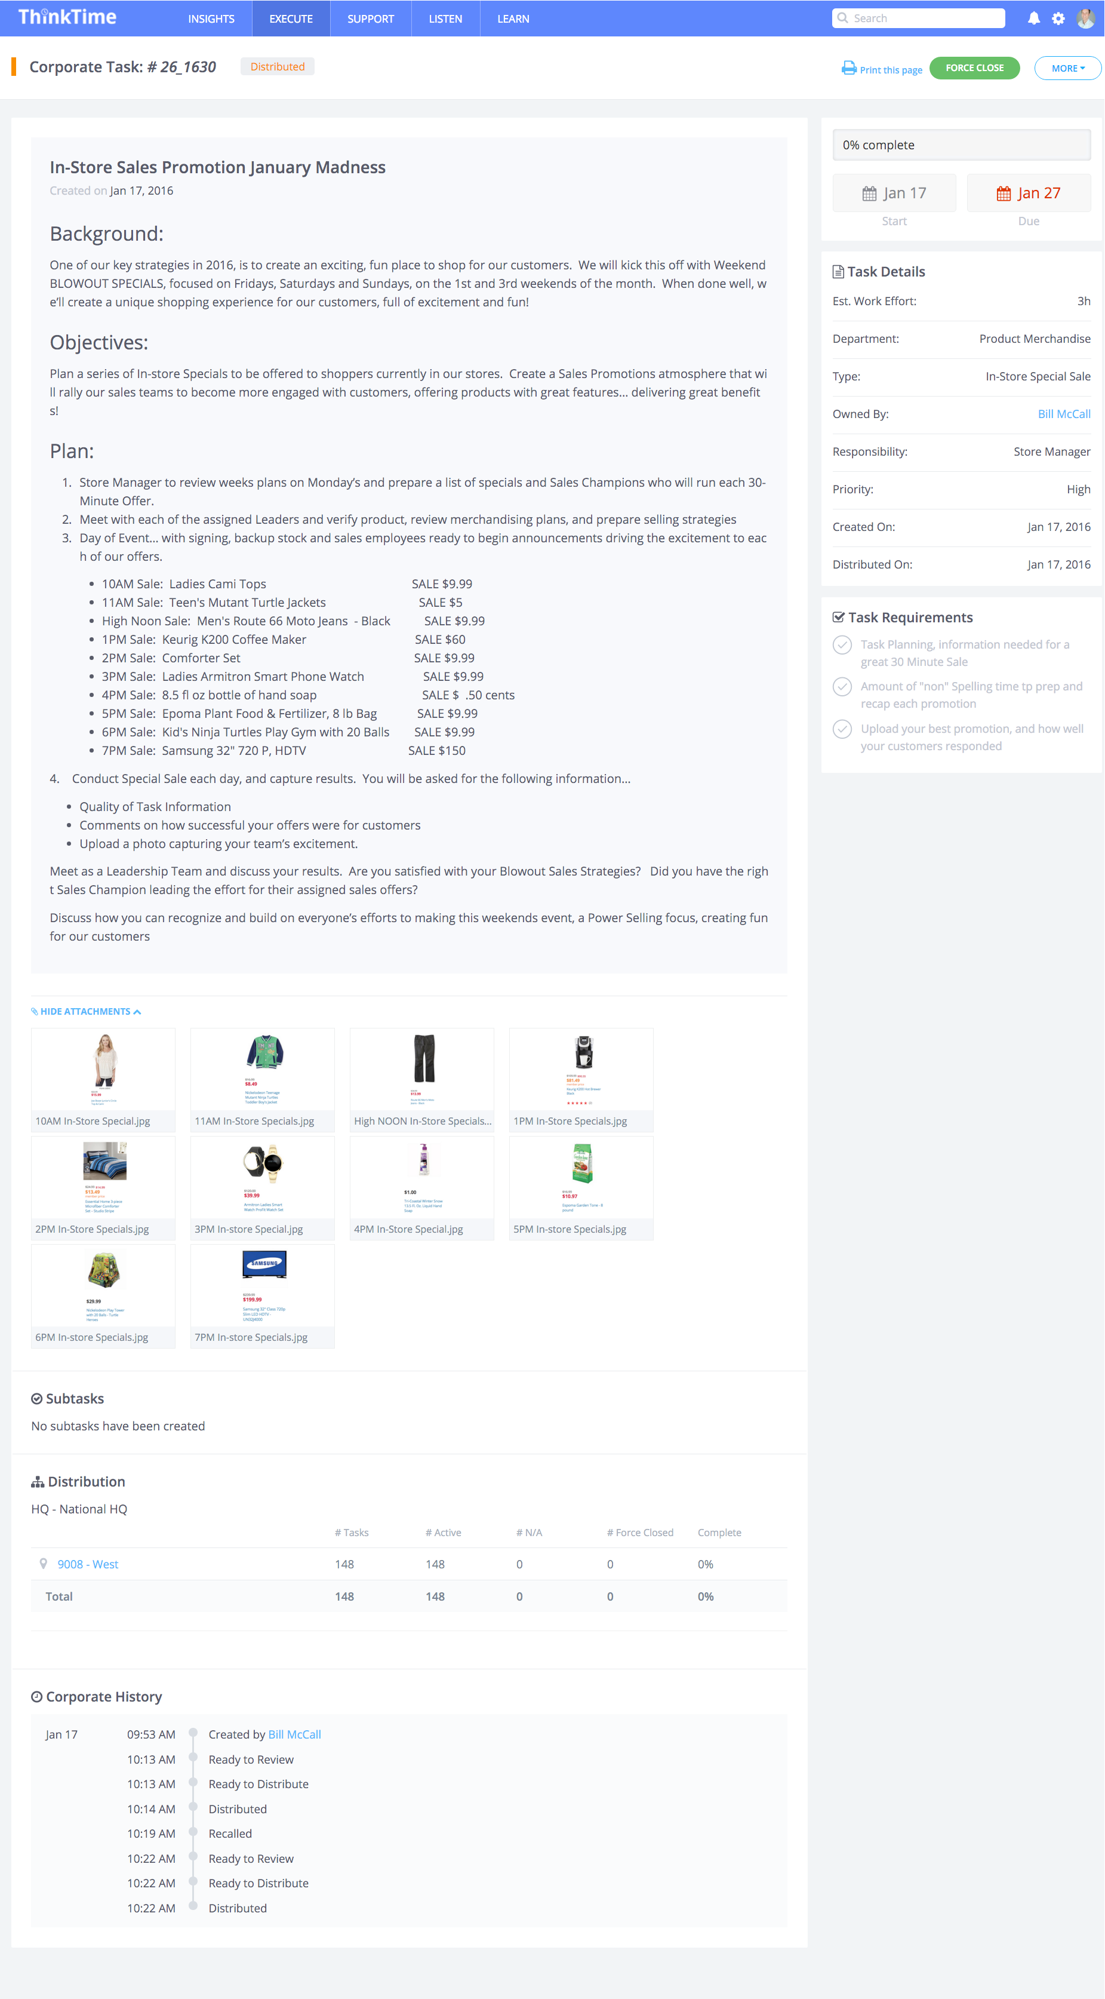
Task Management – Drive Perfect Store Execution
Convert your strategic initiatives into well planned tasks
Targeted task distribution to locations, roles, and individual
Provide extensive details necessary to execute the task – POGs, videos, pictures, links, etc.
Achieve real time completion results
Benefits
Achieve peace of mind that compliance tasks are completed
Aligning the organization on one single process
Continuous improvement of task execution removes costs from the business
Set a high bar for task execution in your company
Notes:
Follett options – exploring the market

Slide 7
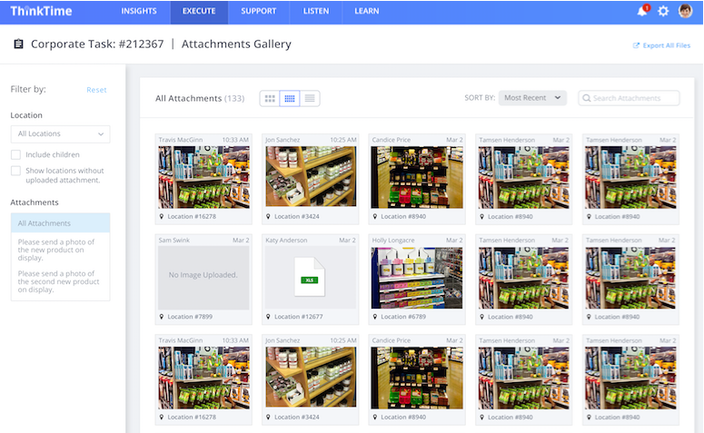
Task Management – Capture Data Requirements
Take a QuickPic with your mobile phone to validate task completions
Utilize proof of task execution for vendor subsidies and compliance
Compare and contrast locations using drill down capabilities
Benefits
Opportunities to recognize and reward best execution
Identification of gaps in intended task completion
Easy comparison & export of images
Leverage data for continuous improvement opportunities
Notes:
Follett options – exploring the market

Slide 8
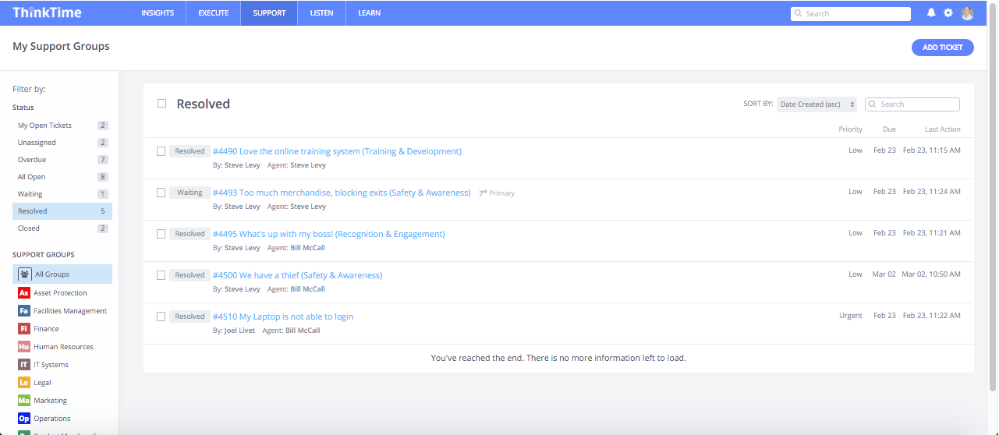
Help Ticket – Deliver World Class Support
Never let another field question fall through the cracks
Target help tickets to the corporate experts
Reduce tickets with ticket deflection and Knowledge Base articles
Configure SLAs to drive fast service
Leverage reporting to drive team behavior
Benefits
Consolidates help requests via one channel
Minimizes rogue emails and phone calls
Employees reduce non-productive time searching for answers
Enhance store and corporate relations
Notes:
Follett options – exploring the market

Slide 9
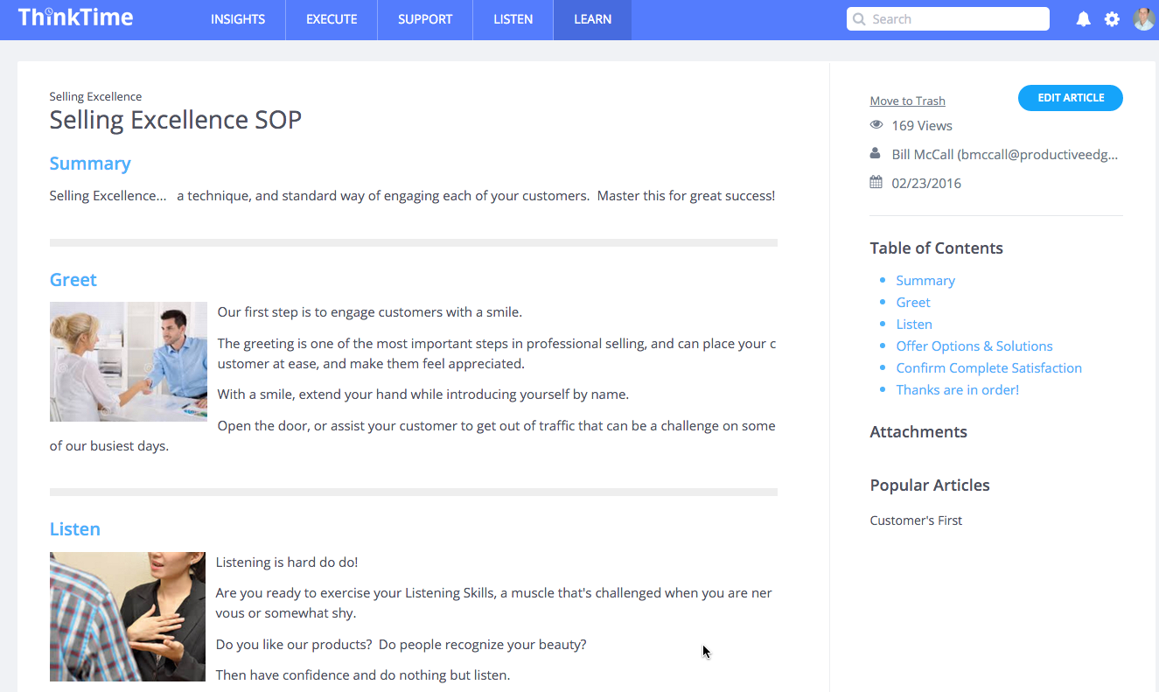
Knowledge Base – Your Centralized Repository of Information
Search articles from all levels in the organization
Unlimited private & public knowledge bases, folders and articles
A Library of standard operating procedures
Self help finding answers to minimize tickets
Benefits
Constantly evolving library of employee knowledge
’How to’ content builds consistent task execution
Central repository of business critical information
Build the acumen of your people
Notes:
Follett options – exploring the market

Slide 10
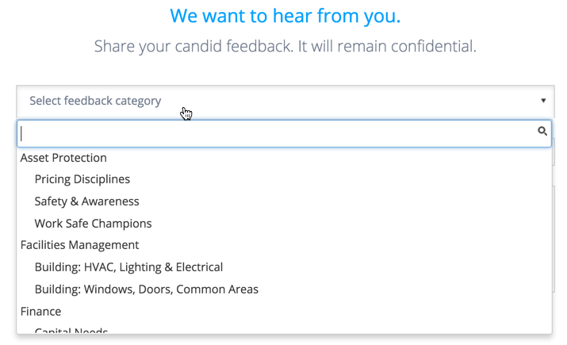
Custom Forms – Build a Proactive & Responsive Culture
Immediately understand employee engagement and happiness
Create detailed surveys for tasks, tickets, or online in minutes
Route anonymous feedback to the appropriate team
Quick edit of public responses to the field
Benefits
Understand the reality of what is happening at the ground level (demonstrate listening)
Proactively discover hotspots and potential risks
Get into action quickly to improve performance
Listen, learn and respond
Notes:
Follett options – exploring the market

Slide 11
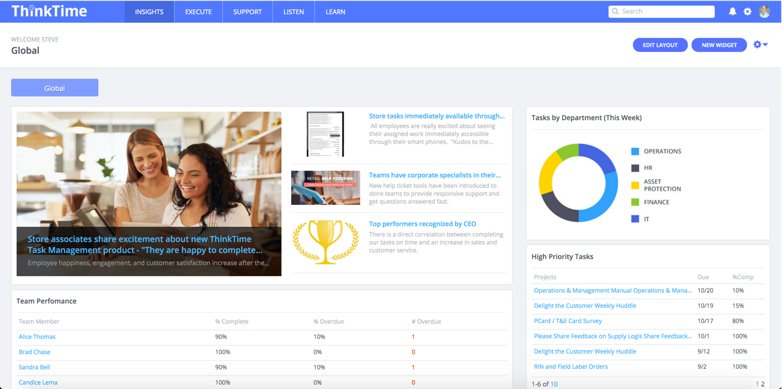
Dashboards and Reporting - Your Personalized Insights
Dashboards provide direct communications to the right person
50+ precise drag and drop widgets by role & location
Real time metrics
Leaderboard & employee recognition
Company news and updates
Benefits
Better informed organization
Performance gaps identified
Save time searching for actions to take
Build a high performance culture through effective communication
Notes:
Follett options – exploring the market

Slide 12
Mobile – Execute At The Point Of Attack
Employees remain connected to their most important tasks and tickets
iPhone, iPad, Android, and responsive design
Take a photo, assign a task, and validate completion
Respond and resolve tickets from anywhere
Benefits
Influence the outcome by sharing your mission and vision in the hands of your associates
Minimize downtown and increase employee and customer engagement
Drive productivity as if you are actually there
Notes:
Follett options – exploring the market

Slide 13
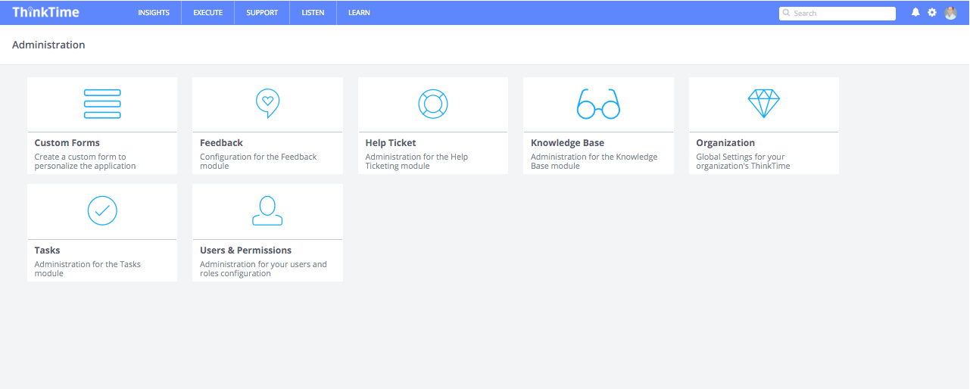
Administration – 100% Configurable To Your Needs
Configure your organization in ThinkTime
Hierarchy - Corporate, region, district, store, etc.
Departments and roles
Employee attributes
Service level agreements and notifications
Benefits
No coding – easy configuration by your team
Quick setup, adjusts to changing environment
Establish corporate standards for higher accountability
Enable rapid setup, security and deployment
Notes:
Follett options – exploring the market

Slide 14
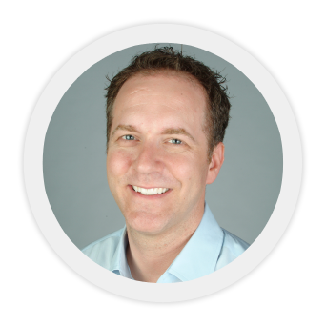




Team Introduction
Steve Levy President
ThinkTime
More than 20 years experience in Workforce Management (WFM) Consulting and Product Development
President
Runs day-to-day operations.
Actively involved in all aspects of the business.
National Director of Services
Grew Retail, Gaming, and Healthcare service groups to more than 200 associates / $40M per year
Co-Founder
Optimized Scheduling and Time and Attendance, acquired by Oracle/360 Commerce
European Manager, SAP Campbell
WFM projects in London, England and South Africa.

Slide 15
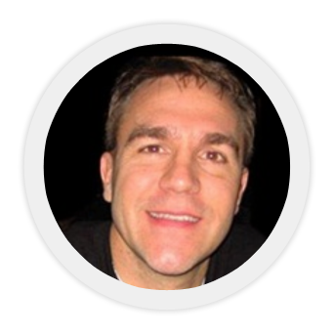



Team Introduction
Joel Livet Product Visionary
Chief Technical Officer
ThinkTime
More than 20 years experience building enterprise software
Founder and Managing Partner of Productive Edge, a software development consulting firm based in Chicago, IL.
Productive Edge was recently named to the Inc 5000 as one of the fastest growing companies in the US with more than $16M in annual revenue.
Ran Portal and Business Intelligence practices for 5 years. Built out company Intranet, Task Management and Operational Tools for 300,000 employees.
Featured in Retail Information Systems News (RIS News) as one of the "Top 15 Up-and-Coming IT Executives”.
Worked at Microsoft from ‘92 to ’95 at a time when innovation was at its peak.
Product support of their Network Operating Systems.

Slide 16
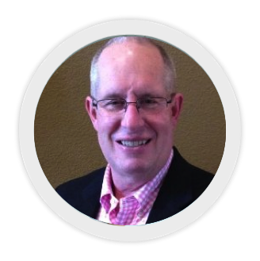
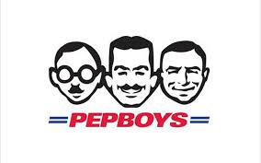

Team Introduction
Bill McCall SVP Strategic Solutions
ThinkTime
More than 30 years experience in Retail Sales and Service Operations, Leveraging the use of Intranet and Web Based Leadership Products
SVP Strategic Solutions
Sales and Service Consulting, Solutions Strategies to enhance growth and profits
Focused on ways technology can drive operational efficiencies and manage change.
VP Operations and Administration
Designed and built
Customer 1st SOPs
Enhanced effective communications
Success in 2009 profit turnaround exceeding goal and better than past 12 years
West Division Vice-President of Stores
Operated 90+ stores in Western US , delivering improved customer service.
Improved communications and teams motivated to work as one
Senior Director Sears Retail Stores
Retail Stores
Sears Auto Group
. Store Management
. Group Merchandiser
. Region Manager
. National Quality Mgr
. Director Sales & Ops
. Business Systems
DVP Sears Appliance Stores
Appliance Outlets
. Inventory Management
. Sales & Pricing
Strategies
. Outlet Store Expansion

Slide 17
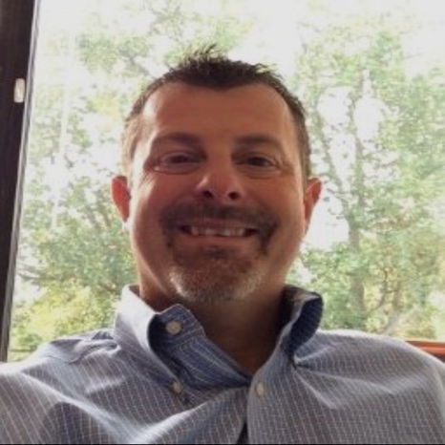
Team Introduction
Doug Spiron SVP Business Development
ThinkTime
Over 30 years retail leadership experience delivering solutions through process simplification and technology enhancements
SVP of Business Development of ThinkTime, a software development consulting firm based in Chicago, IL.
Focused on ways technology can drive operational efficiencies and manage change.
Business Operations, Merchandising and General Management roles both in the Home Office and Field across 9 years.
Ran $1B+ P&L businesses including carpet, tile and services departments.
Rich 21 year history in home office and field based leadership roles in business operations across Automotive, Brand Central and National Customer Care departments.

