Slide 1
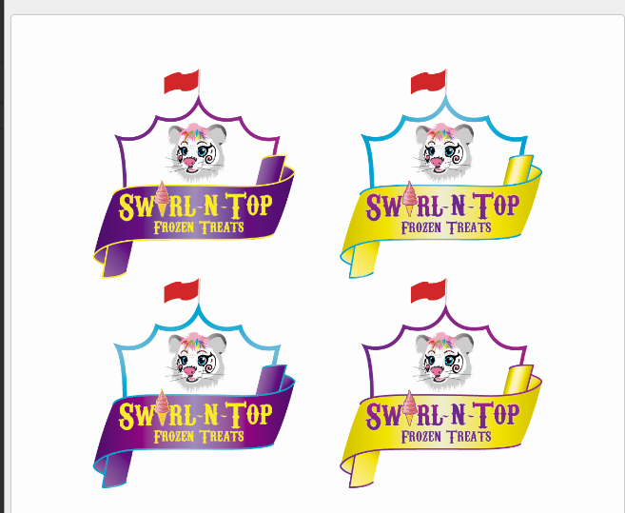
Almost there. The banners are lighter colored in the middle. I think that makes them harder to read. If possible please just make them a all solid color.
Please make the tent yellow and outline the banner in purple
Make this banner the same purple color as the one above. (This one looks like it is lighter.) Please outline the banner in yellow and make the tent yellow.

