Slide 1
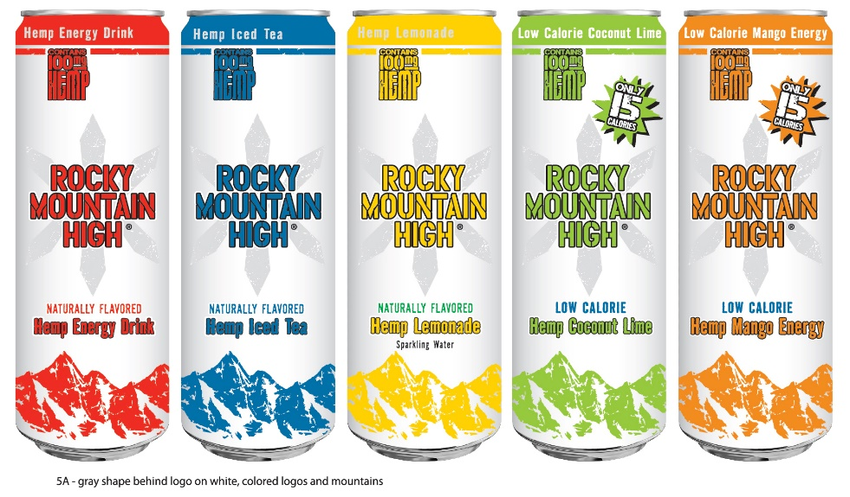
Rocky Mountain High Brands

Slide 2
ROCKY MOUNTAIN HIGH BRANDS, INC.
Publicly Traded Company (OTC: RMHB)
RMHB based in Dallas, TX.
Products Made in USA (Memphis, TN)
Over 60 Years of Beverage Experience
Hemp Infused Product Line-Up

Slide 3
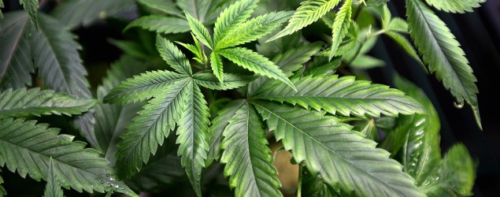
Never before in the history of any business has there existed the potential for a $50B - $100B market (1) with NO “Clear Cut” Brand Name Leader !
HEMP
IS A
SUPERFOOD !
HEMP CONTAINS OMEGA 3 & OMEGA 6,
PLUS
ALL EIGHT (8) ESSENTIAL AMINO ACIDS
HEMP has been known to help:
Cardiovascular
Digestive Health
Insomnia
Strong Bones
Acne
Weight Loss
Boost Immunity
Detoxification
Endurance
Improve Muscle Mass
(1) Estimate of the current national market for marijuana
Jon Gettman, Ph.D. (Author of 2006 US Marijuana Crop Report)

Slide 4



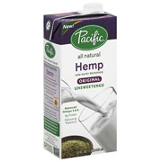




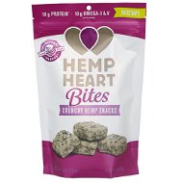
HEMP PRODUCTS IN THE MARKETPLACE
Sells twenty (20) pages of hemp-based products 712 in food, beverage and snacks
Sells forty-nine (49) Hemp Grocery
products, up 11 more products than
this time last year.
Sells more than
thirty (30)
hemp-based food
and beverage products
Sells 18 Hemp-based grocery
items including granola bars, milk,
protein shakes and supplements
Twenty (20) Hemp Products

Slide 5
HEMP CATEGORY
ANNUAL RETAIL SALES FOR HEMP-BASED PRODUCTS
 |  | 2011 |  | 2012 |  | 2013 |  | 2014
$ in MILLIONS |  | $364.8 |  | $393.5 |  | $471.2 |  | $620.0
% CHANGE |  | 7.3% |  | 16.5% |  | 24.0% |  | 26.8%
Source: The Hemp Industries Association (HIA)

Slide 6
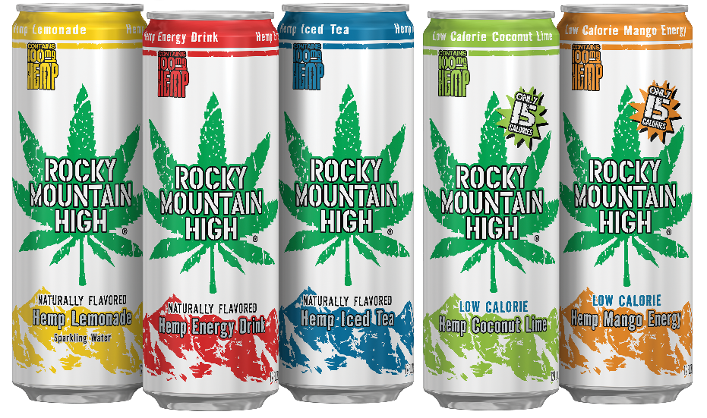
ROCKY MOUNTAIN HIGH
“LEAF” GRAPHIC
“SNOWFLAKE” GRAPHIC

Slide 7
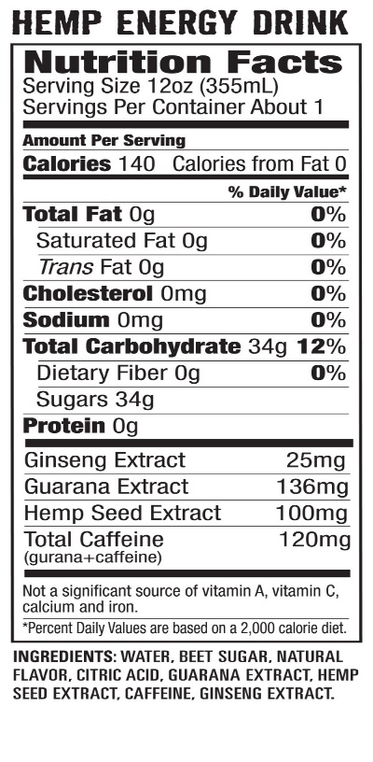
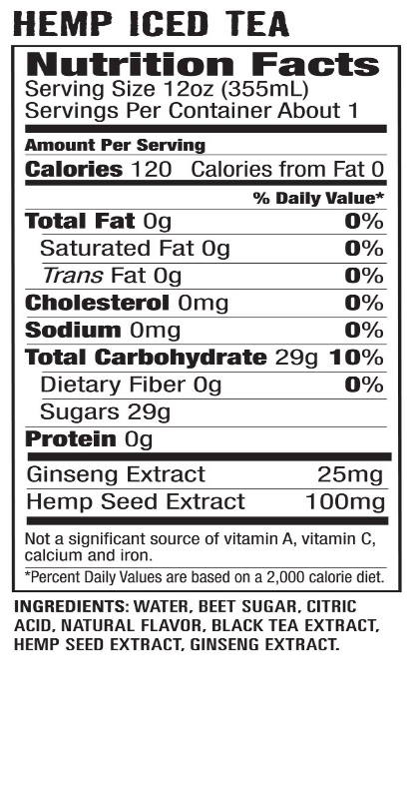
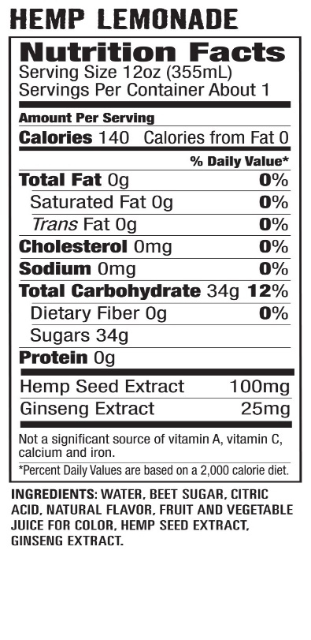
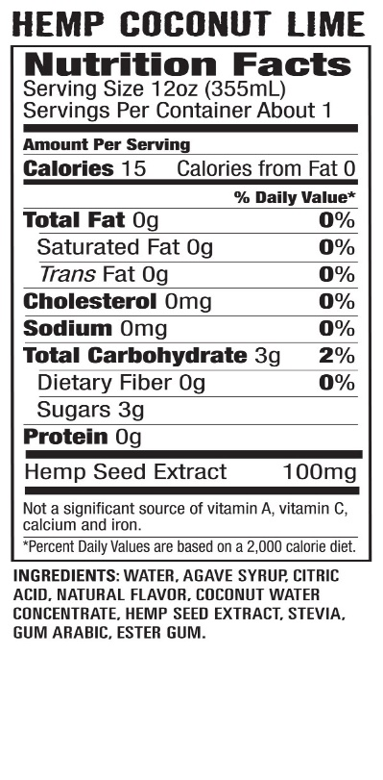
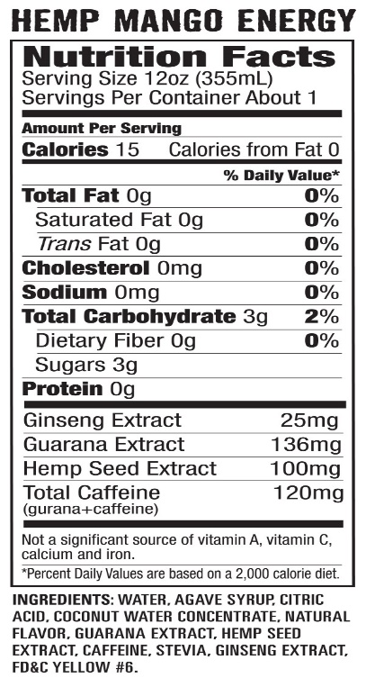
NEW PACKAGING
100 mg
of Hempseed
in each can !

Slide 8
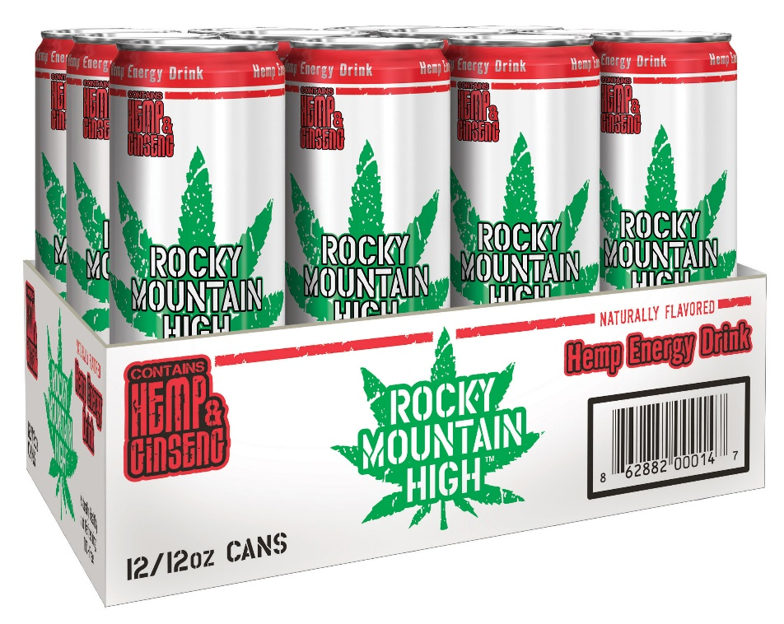
PRODUCT INFORMATION
12 oz. Cans
“LEAF GRAPHIC"
“LEAF" PRODUCT | 12 OZ CAN UPC CODE | 12 PACK CASE UPC CODE
ENERGY DRINK | 8 62882 00012 3 | 8 62882 00014 7
LEMONADE | 8 62882 00010 9 | 8 62882 00013 0
ICED TEA | 8 62882 00011 6 | 8 62882 00015 4
COCONUT LIME | 8 62882 00017 8 | 8 62882 00016 1

Slide 9
Innovation Pipeline

Slide 10
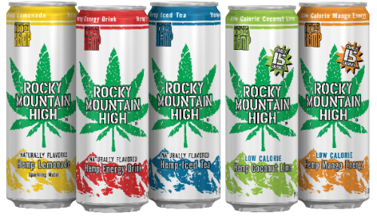
DEVELOPMENT OF NEW “HEMP-INFUSED” PRODUCTS:
  TWO (2) OZ. SHOTS
    ENERGY (MIXED BERRY & MANGO)
    RELAXATION
    LIBIDO ENHANCEMENT
  EDIBLES
    ENERGY BAR (CHOCOLATE)
    PROTEIN BAR (PEANUT BUTTER)
    CHIA CRISP BAR (CHOCOLATE & PEANUT BUTTER)

Slide 11
2 oz. SHOTS “SNOWFLAKE” GRAPHICS

