Slide 1

Blue Owl Life Writing
Sharing Our Stories

Slide 2

Week One
Getting Started
What is a memoir?
  Autobiography v Memoir
  Memoir v Chronicle
Which story will you tell?
  Exploring Memory Prompts
“After nourishment, shelter and companionship, stories are the thing we need most in the world.” – Phillip Pullman

Slide 3
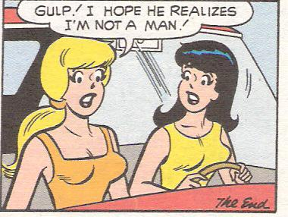
Week One
Getting Started
Pre-writing includes:
  List making
  Perusing letters, journals and newspaper clippings
  Sorting photos
  Reminiscing
  Interviewing family and friends
  Studying history texts
  Reading memoirs and novels from the same period or on the same topic
  Journaling
People live in a social, economic and cultural context. Pre-writing will set the stage for your stories.

Slide 4

Week One
Getting Started
Do you want to…
  Preserve a bit of history?
  Set the record straight?
  Celebrate your achievements?
  Show “the way” to others?
  Write for your family?
  Write for yourself?
Write a free flow paragraph that places you in historical context.
What world event?
How old were you?
How did you feel?
Where were you and what were you doing?
How did this event alter your family or your relationships with others?

Slide 5

Week One
Getting Started
Discovering Your Audience to Find Your Voice
Are you writing a chronicle for family?
Are you writing a memoir for a larger audience? The memoir is often theme-driven and message-rich.

Slide 6
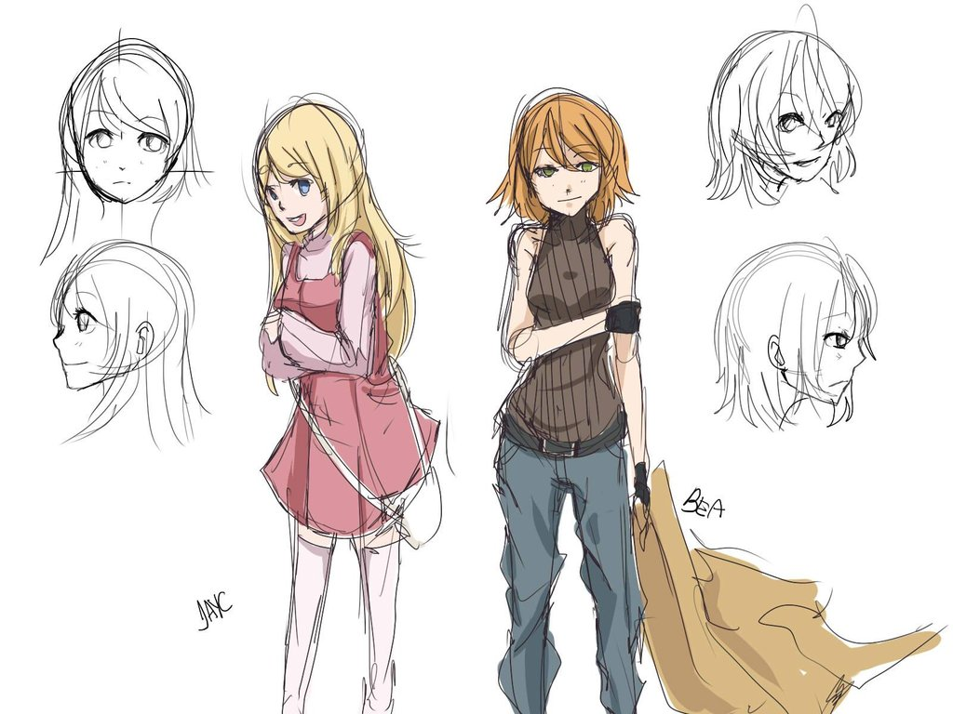
Week Two
Writing
Discovering Your Characters
Emotional acreage
Physical characteristics – how do they stand, walk, what are their facial expressions?
What first impression do they make?
How are they dressed and why?
6 months to live – flossing or smoking?
What are this person’s routines?
What does this person believe?
How would this character write in their own journal?
All of the points on your story map will grow from your character. The development of your character creates plot.

Slide 7
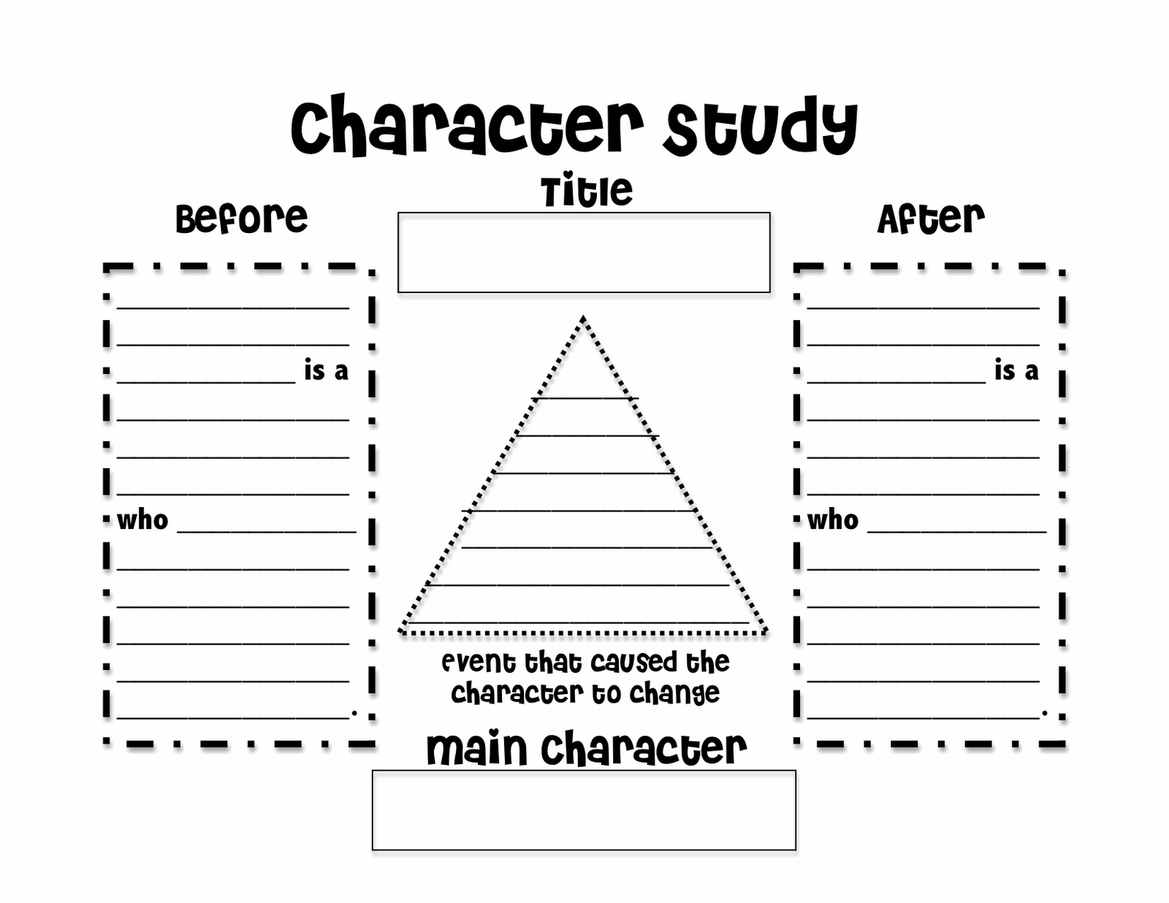

Week Two
Character Studies
Creating vibrant characters means describing them using all five senses.
Identify on your Memory List what is special and true about each of your characters then describe them in detail.

Slide 8
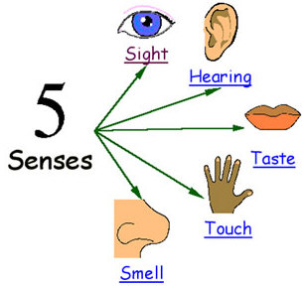
Week Two
Character
Taste – Let the reader sample foods associated with your past or with the person you are writing about. A food image or metaphor can give a deeper sense of a person’s personality.
Sight – What did the person look like? How did they move, talk, walk, sit? What ways did that person typically express emotion with body language?
Sound – This includes voice modulation, timber and pitch as well as favorite expressions, accents and use of dialect. Don’t forget aural clues like throat clearing, foot scraping, or the knocking of a wedding ring against glass.
Smell – You should make reference to perfumes, colognes, pipe tobacco, barn odors, the smell of the kitchen or the smell of a workshop. Smell is one of the most evocative senses in describing character.
Touch – Help the reader feel how rough your character’s skin was, how satiny the clothing or how gentle the hands.
Using the 5 Senses to Describe Character

Slide 9
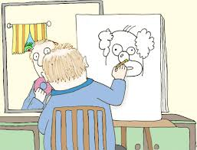
Week Two
Writing
Writing Your Self Portraits
“Writing is like driving a car at night.
You can only see as far as your headlights,
but you can make the whole trip that way.”
E.L. Doctorow

Slide 10

Week Three
Discovering Your Core Stories
Using your Memory Prompt sheets, uncover up to 10 core stories that resonate with you. Write a paragraph about each memory. As you write, remember to
Double check your memories
Tell the truth
Explore the myths in your family stories
Consider the connections between your stories
Ask yourself who you are writing to and what you hope to impart to them.

Slide 11

Week Three
Discovering Your Core Stories
Commit to one story at a time.
Don’t worry about how the stories and vignettes can be pieced together.
Start writing from anywhere. Resist the urge to start writing from what seems like the beginning. Start with whatever grabs your attention.
Your core stories will form the basis of your theme and story map. As your story map and theme come into focus, your choice of core stories may change. But keep things organic! Don’t force stories to fit a theme, or theme to fit stories.

Slide 12
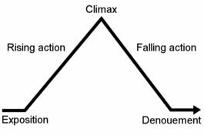
Week Four
Story Mapping
Hook
Set Up
1st Turning Point
2nd Turning Point
Rising Action
Climax
Falling Action
Resolution
Tag

Slide 13

Week Four
Story Mapping
Use these 5 questions to uncover your arc.
I wanted_______ ( the desire line)
To get it, I __________( action)
But ___________(obstacle)
So, I __________ ( rising action action)
It came to a head when ____(climax)
And in the end, _________(resolution), I learned, I changed, I received…

Slide 14

Week Four
Story Mapping
In your memoir, remember that you are the protagonist. Your reader will want to know not only about external obstacles, but about your internal obstacles and the processes you used to overcome them.
Often, the real drama of a memoir is in watching the narrator shed beliefs or behaviors that keep her from getting what she wants.

Slide 15
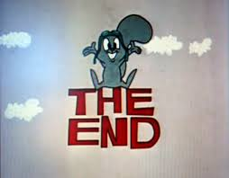
Week Four
Story Mapping
Understanding the end point of your story is crucial. Life goes on, but memoirs mustn’t. The desire line defines the ending. When the narrator gets what he wants ( or doesn’t, or stops wanting it) the story has reached the end of its arc.

Slide 16
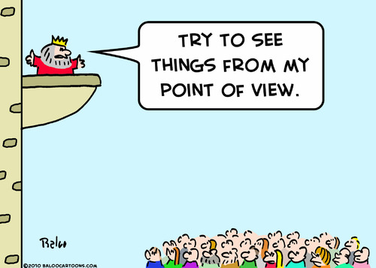
Week Five
Point of View and Voice
“Nothing is more important than a likeable narrator. Nothing holds the story together better.” – Ethan Canin
“Having a great narrator is like having a great friend whose company you love. Don’t forget – a person’s faults are largely what make him or her likeable. Perfect means shallow, unreal and fatally uninteresting”. – Anne Lamott
Tie your narrator/voice to your audience
Your narrator needs to have clarity of vision and be reliable
Be honest

Slide 17

Week Five
Point of View
One of the things that happens to you when you get older is that you discover lots of new ways to hurt yourself.
Recently in France, I was hit square on the head by an automatic parking barrier, something I don’t think I could have managed in my younger, more alert years.
First- Person Point of View
Used primarily for autobiographical writing and essays
No apparent dissonance between the narrator and the witness who is providing the account
Affords for intimacy
I, we, me, my, mine, us, our, ours

Slide 18

Week Five
Point of View
Monday, October 9, 1933, began as a gray day in Seattle. A gray day in a gray time.
Along the waterfront, seaplanes from the Gorst Air Transport company rose slowly from the surface of Puget Sound and droned westward, flying low under the cloud cover .
20 miles to the north, Joe Rantz woke…
Third-Person Point of View
Most common form in used fiction, journalism and academic writing
He, she, it, they
“Someone must have slandered Josef, for one morning, without having done anything wrong, he was arrested.”
“It was the best of times, it was the worst of times.”

Slide 19
Week Six
Style and Theme
Theme will reveal itself as you write and re-write.
Theme is revealed as you find yourself using certain words and phrases or expressing certain ideas over and over again.
Your treatment of plot will vary according to your theme.
Inauthenticity of theme will show up as a muddled POV and mixed messages.
Memoir theme will stand as an “ethical will,” the core meanings and values you wish to impart to your friends and family.
Underlying all of your stories is theme. The theme is your message, the global way in which you understand your story.
For your readers, the theme conveys the essence of you that you want your readers to know and understand.
The theme will provide your reader with insights – glimpses of understanding. As your reader accumulates these insights, they will understand you and your life in deeper and more meaningful ways.

Slide 20
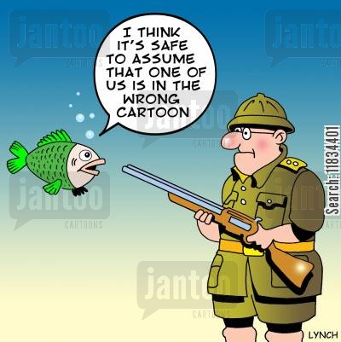
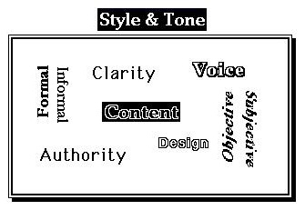
Week Six
Style
Economy
Precision
Action
History
Music
Personality
POV
Organization
Coherence

Slide 21
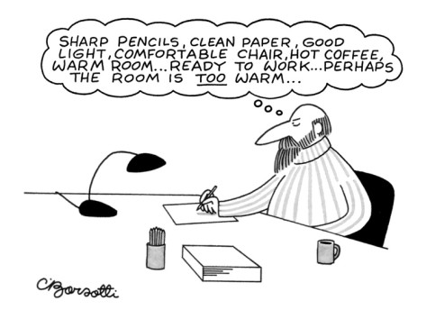
Week Seven
Write!
Exercise your writing muscle with 2 pages on:
Something you cannot deny
What got left behind
Something you did that you no longer understand
A physical characteristic you are proud to have inherited or passed on
What you had to have
A humiliating experience
A time your felt compassion unexpectedly
What you have too much of
When you know you are in trouble

Slide 22
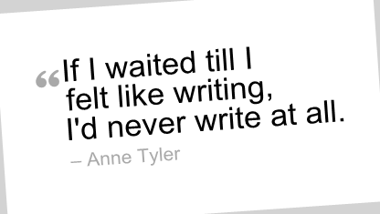
Week Seven
Write!
Sharing stories from our memory prompts.

Slide 23
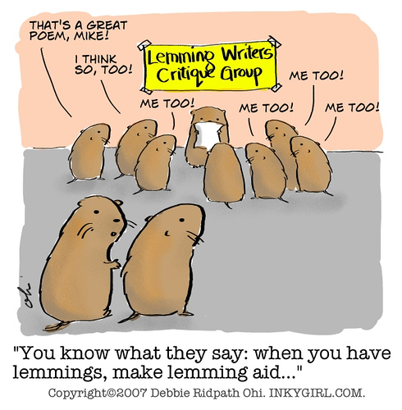
Week Eight
Moving Forward
Go to your desk on Monday morning and write about some event that’s still vivid in your memory. What you write doesn’t have to be long—three pages, five pages—but it should have a beginning and an end. Put that episode in a folder and get on with your life. On Tuesday morning, do the same thing. Tuesday’s episode doesn’t have to be related to Monday’s episode. Take whatever memory comes calling; your subconscious mind, having been put to work, will start delivering your past.
Keep this up for two months, or three months, or six months. Don’t be impatient to start writing your “memoir,” the one you had in mind before you began. Then, one day, take all your entries out of their folder and spread them on the floor. (The floor is often a writer’s best friend.) Read them through and see what they tell you and what patterns emerge. They will tell you what your memoir is about and what it’s not about. They will tell you what’s primary and what’s secondary, what’s interesting and what’s not, what’s emotional, what’s important, what’s funny, what’s unusual, what’s worth pursing and expanding. You’ll begin to glimpse your story’s narrative shape and the road you want to take.
Then all you have to do is put the pieces together.
Let’s form a writers group and stay accountable!

