Slide 1
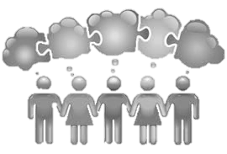
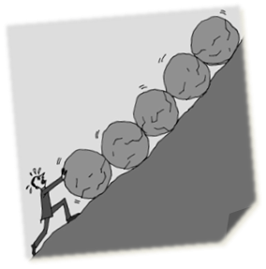


Collaboration
Persevering
Planning
Reflection

Slide 2
Collaboration
Empathy and Listening
Interdependence
Communication
Questioning

Slide 3
Persevering
Managing distractions
Meta-Learning

Slide 4
Planning
Distilling

Slide 5
Reflection
Monitoring
Evaluating

