Slide 1
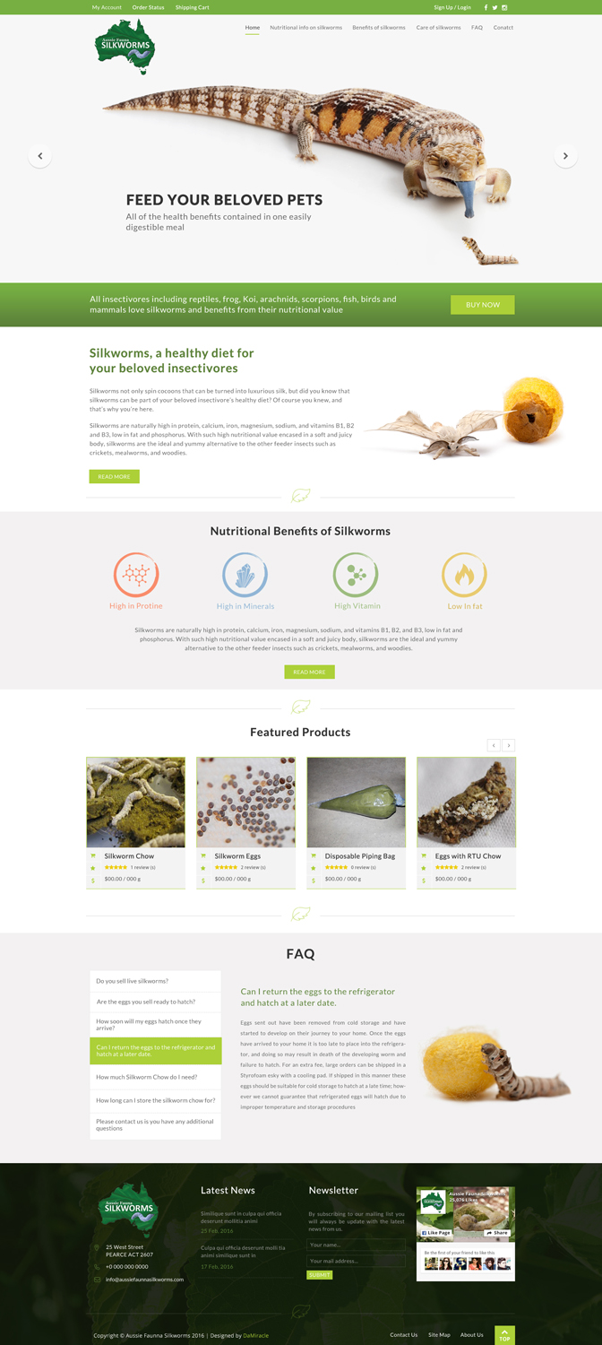
Facebook Only
Home
Nutritional Information
Benefits of Silkworms
Care of Silkworms
Online Store
FAQ
Contact
INDULGE YOUR PETS
Please use the silkworm image on the leaf (used in your other design) as the first picture of the jquery slider, followed by the images of the various lizards, frogs, spider, koi, etc.
Replace Koi with koi
Silkworms, a healthy addition to
your insectivore’s varied diet
Protein
High in Vitamins
Fat
Some of the products photo will
require updating, however I should
be able to easily change myself in the
Big Commerce Platform.
I added another Q to FAQ, please refer
to update word file in brief, and make
“Why are you cheaper” as the first FAQ

Slide 2
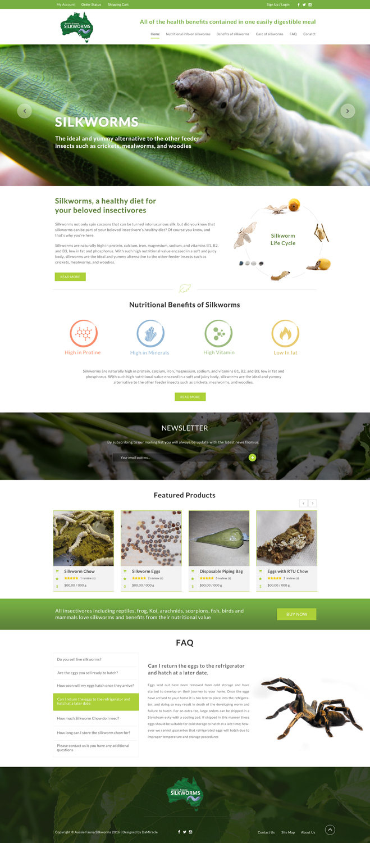
I like this life cycle, please
incorporate into above design

