Slide 1

Knowledge. | Integrity. | Quality.

Slide 2
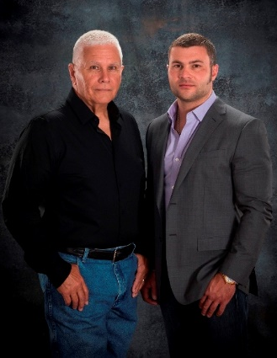
INTRODUCTION
Welcome,
We appreciate your time and the opportunity to introduce ourselves to you.
Rush Resources was founded in 2007 by my father and I. We genuinely share a lifelong friendship established on mutual respect, wholehearted trust, and a compelling desire to make progress that benefits our surroundings.
With over 60 years of diversely combined experience, my father with +45yrs. and myself with +15yrs., we have been blessed with countless opportunities to build genuine relationships with extremely talented individuals who commonly share similar moral beliefs and characteristics. We are grateful for their mutual trust in us and our teams’ keen interest in exceeding expectations of our clients. We have extreme confidence in our resources and we are proud for them to represent us.
Our diverse experience in various industries enables us to offer our clients a unique systematic approach to solving technical challenges. We urge clients to engage us in discussions as early as project conception to offer our knowledge and various potential solutions to explore best options to accomplish objectives as efficiently as possible. We offer insight to clients to express our mutual interest in favorable results.
We have successfully contributed to managing and executing many industrial construction projects ranging from small to large magnitude (mega projects) from concept to completion. We are confident our services will positively impact your bottom-line and contribute to your success.
We look forward to speaking with you soon!
John Rush
Founder CEO

Slide 3
SUMMARY
Rush Resources is a highly dynamic Industrial Services organization that specializes in:
Construction Project Management
Technical Services
Consulting
We strive to build long-term genuine relationships based on trust and results!
We proactively seek opportunities to add value by effectively utilizing our knowledge, integrity, and quality attributes to ensure desired results.
The foundation of our organization’s culture is high integrity, character, and respect. We empower individuals that demonstrate strong leadership skills with the belief that good leaders create more leaders and encourage a strong sense of trust in our organization.
We look forward to discussing how our partnership will contribute to your success!
Integrity
Knowledge
Quality

Slide 4
SUMMARY
Services & Industries
Oil & Gas
Upstream (Land & Offshore, Subsea)
Midstream (Terminals & Plants)
Downstream (Refineries & LNG)
Petrochemical
Power Generation
Nuclear Power
Fossil Fuels
Renewable Energy
Rush Resources is highly experienced in the Services & Industries displayed.
We offer complete turn-key solutions and/or simply provide professional resources to augment your current project demands.
Construction
Project Management
Complete EPC Oversight
Owner / Client Representation
Independent 3rd Party
Inspection
Coordination
All Project Resources
Technical
Services
Turnkey Commissioning / Completions
Instrumentation & Electrical Technicians
E&I Construction
Automation Integration Specialists
Analytical Specialists – Process Analyzers
Consulting
Project Management Consulting
Project Optimization
Project Controls
Lean Practices
Disaster Recovery
Professional Development

Slide 5
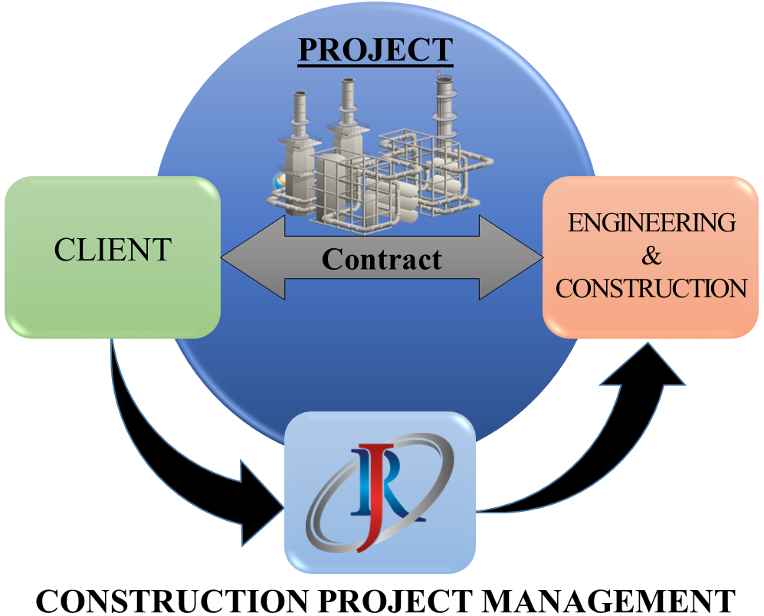
MANAGEMENT
Rush Resources provides management solutions to clients and has the dynamic ability to manage turn-key project execution or simply provide professionals to augment your project demands.
We communicate with our clients to ensure the highest level of service possible. Our goal is to establish a mutually beneficial relationship with our clients built on trust and dependability.
Regardless of the size and scope of your project, we can offer solutions. Our results and high level of client satisfaction are direct indications of the quality of our organization.

Slide 6

MANAGEMENT
CLIENT
Project
Manager
CLIENT-REPRESENTATIVES
Project
Leadership
(one or multiple positions)
Project Controls Lead & Team
Technical Lead & Team
Logistics Lead & Team
Safety
Manager
QA/QC
Manager
Civil/
Structural
Manager
Mechanical
Manager
Heavy-Lift
Manager
Piping
Manager
Electrical/
Instrument
Manager
Commissioning
Start-up
Manager
Discipline Oversight
Team
Discipline Oversight
Team
Discipline Oversight
Team
Discipline Oversight
Team
Discipline Oversight
Team
Discipline Oversight
Team
Discipline Oversight
Team
Discipline Oversight
Team
ENGINEERING
FIRM
CONSTRUCTION CONTRACTOR

Slide 7
MANAGEMENT
Position / Title Examples
Project Leadership
Program Manager
Project Director
Construction Manager
Project Manager
Site Manager
Implementation Mgr.
Project Controls Lead
Cost Engineers
Schedulers
Estimators
Planners
Technical Lead
Logistics Lead
Project Engineers
Construction Engineers
Equipment/Package Specialist
Constructability Coordinator
Regulatory Compliance Specialist
Procurement Specialist
Materials Coordinators
Logistics Coordinators
Project Administrative Support
Lodging & Catering Support
HSSE
Manager
QA/QC
Manager
Civil/
Structural
Manager
Mechanical
Manager
Heavy-Lift
Manager
Piping
Manager
Electrical/
Instrument
Manager
Commissioning
Start-up
Manager
Lead
Inspectors
Field-
Coordinators
Lead
Inspectors
Field-
Coordinators
Lead
Planner
Field-
Coordinators
Lead
Planner
Field-
Coordinators
Lead
Planner
Field-
Coordinators
Lead
Planner
Field-
Coordinators
Lead
Planner
Field-
Coordinators
Lead
Planner
Field-
Coordinators

Slide 8
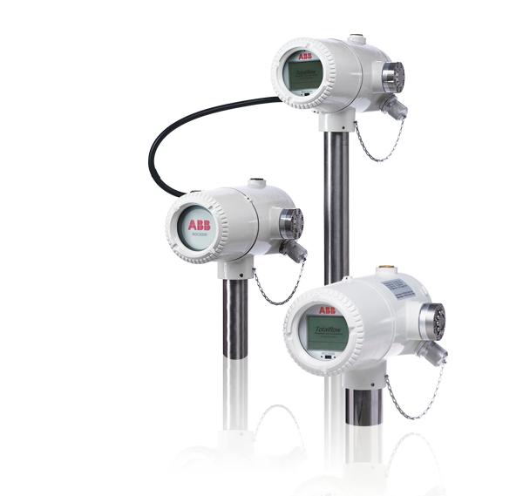
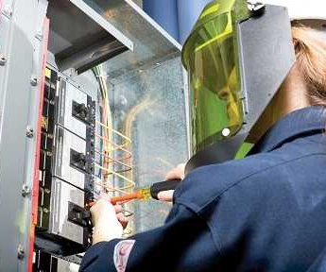
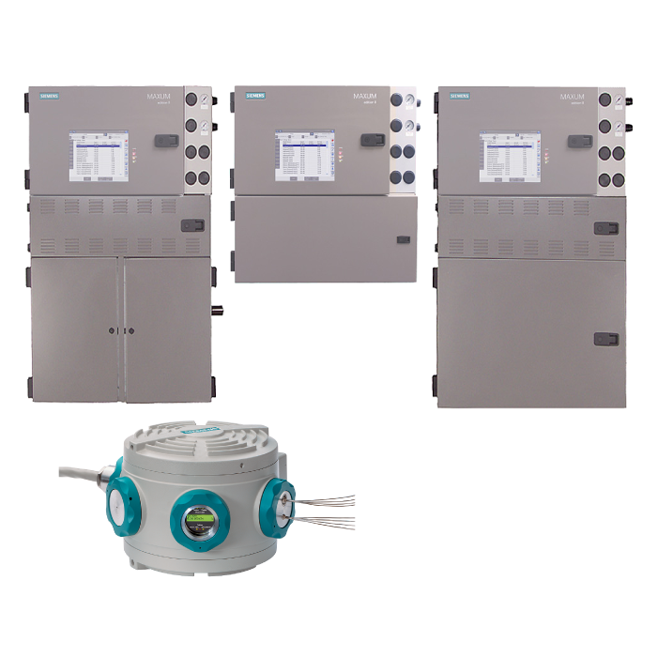
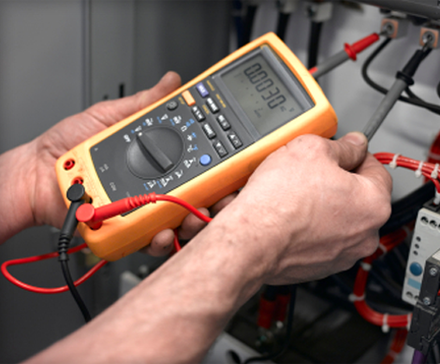
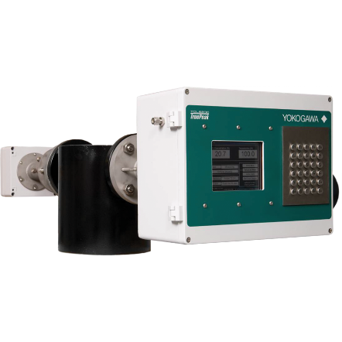
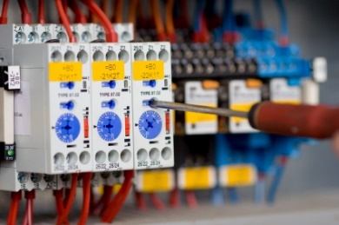
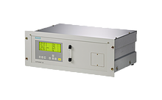
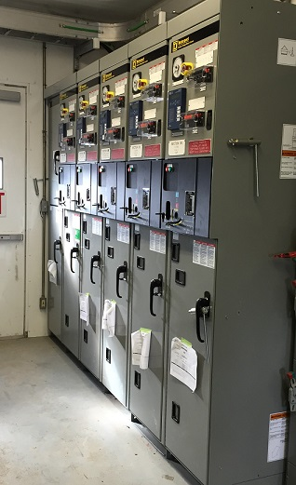
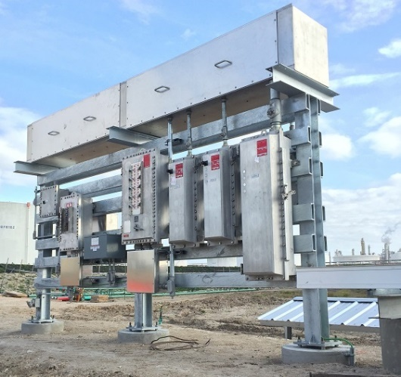
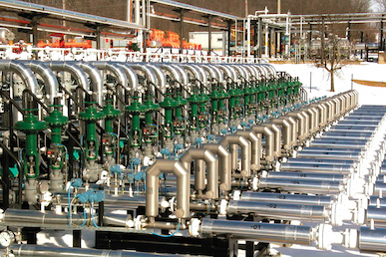
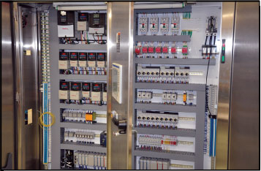
TECHNICAL
Instrumentation & Electrical Technicians
Complete Field Services
Calibration & Testing
Analytical Specialists – Process Analyzers
Automation Integration
Construction (TDLR 31573)
Metering
Fabrication

Slide 9
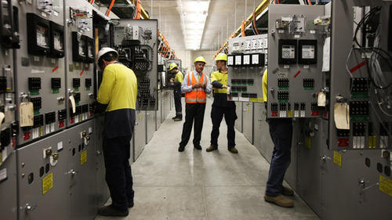
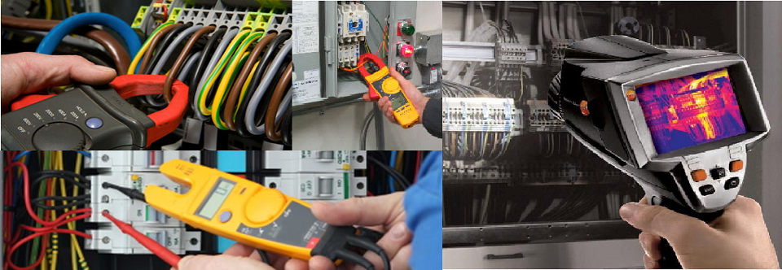
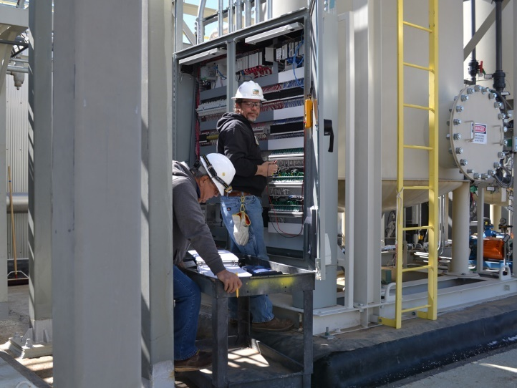
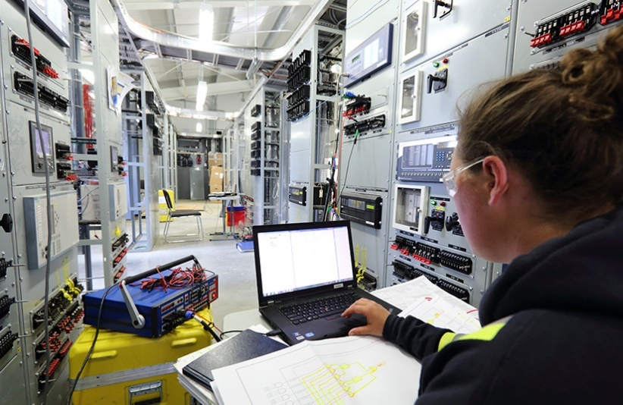
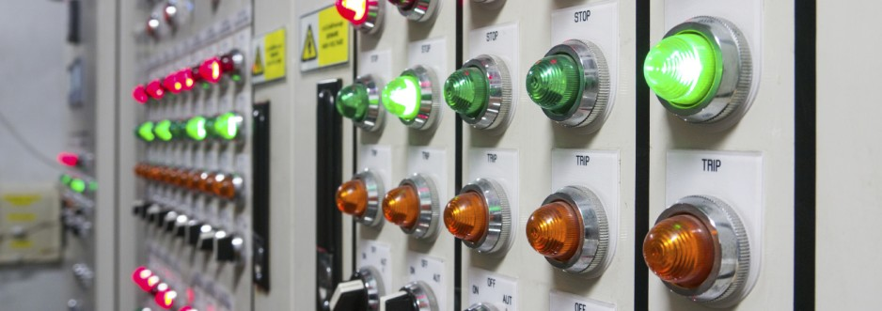
TECHNICAL
Turnkey Commissioning/Completions
(All Disciplines)
Planning
Fabrication QA
Mechanical Completion
Pre-Commissioning (Static)
Commissioning & Startup (Dynamic)
Complete Database & Databooks

Slide 10
TECHNICAL
Completions Org. Chart
Quality
Assurance
Lead
QA
Data
Clerk
Civil & Structural
QA Lead
Piping & Mech
QA Lead
E&I
QA Lead
Procurement
QA Lead
Site Completions
Lead
Database
Clerk
Controls
Lead
Completions &
Commissioning
Manager
Sr.
Tech
Sr.
Tech
Sr.
Tech
Tech
Tech
Tech
Tech
Tech
Tech
Electrical
Lead
Sr.
Tech
Tech
Tech
Sr.
Tech
Tech
Tech
Sr.
Tech
Tech
Tech
Mechanical
Lead
Sr.
Tech
Tech
Tech
Sr.
Tech
Tech
Tech
Sr.
Tech
Tech
Tech

Slide 11
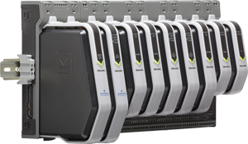
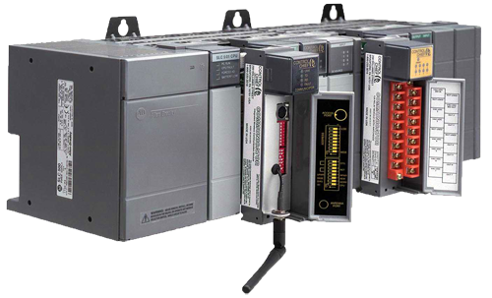
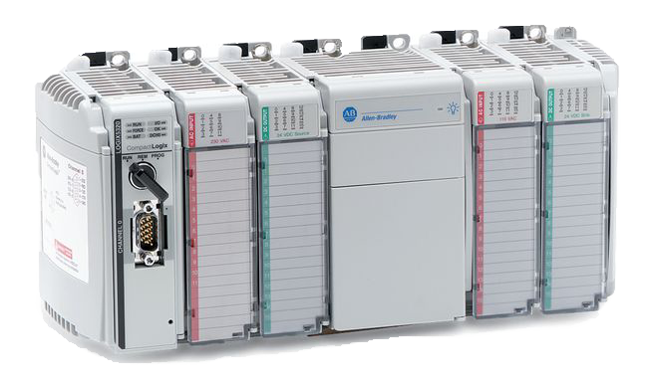
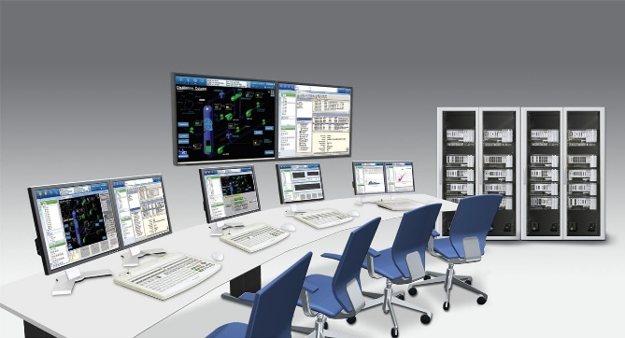
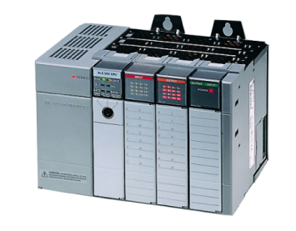
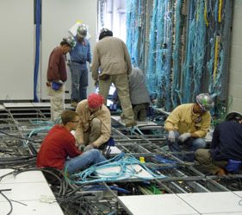
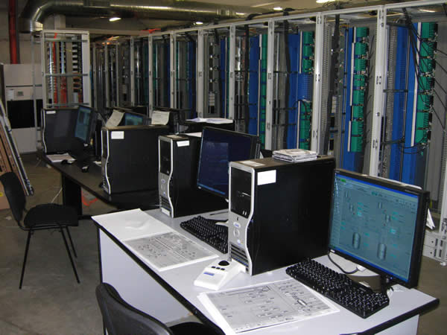
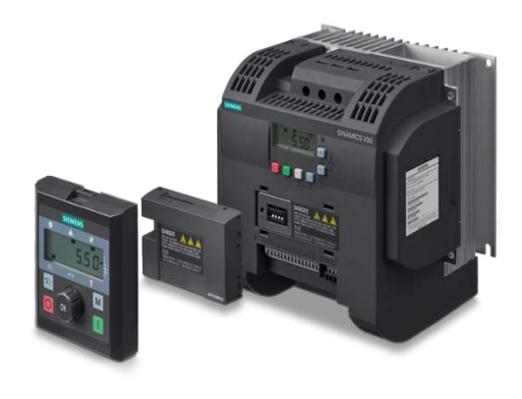
TECHNICAL
Complete Control System Installation
Control Modernization Upgrades
DCS – Distributed Control Systems
PLC – Programmable Logic Controls
Scada – Supervisory Control & Data Acquisition
Fire & Gas Detection Systems
Process Control Systems
Vibration Monitoring Instrumentation
Security

Slide 12
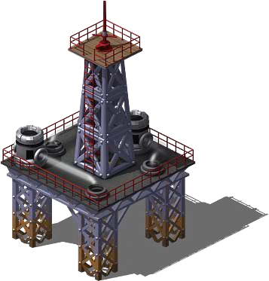
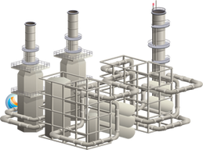

CONSULTING
Project Management Consulting
Development
Execution Planning
Best Practices
Project Controls
Work Control Process
Risk Management
Program Management
Accident Analysis & Recovery
Project Optimization
Resourcing
Planning
Performance Management
Risk Management
Lean Practices
Management Development
Custom Programs
Leadership Strategies
Organization Development
Coaching & Mentoring
HSE Culture Development
Professional Development

Slide 13



















EXPERIENCE

Slide 14
EXPERIENCE
American Electric Power
BASF
BHP Shenzi Deepwater Project
BP Atlantis Deepwater Project
BP Galapagos / Phase III
BP North Slope
Chevron
Chevron Refinery
Conoco / CSDGL - Gas Processing Plant
Energy Transfer Company
Fitzpatrick Nuclear Generation
Flint Hill Refinery
FPL Turkey Point Nuclear
Freeport LNG
Golden Pass LNG
Hope Creek Generating Station
Indian Point 2 Generating Station
Indian Point 3 Generating Station
Kinder Morgan
Limerick Generating Station
Matheson Tri-Gas
Motorola MOS 13
Nine Mile Point 2
Noble Energy - Big Bend Project
Oyster Creek Nuclear Generation
Peach Bottom Atomic Power Station
PG&E - Diablo Canyon Generating Station
Praxair
REB Gas Injection Plant
Salem Generating Station
San Onofre Nuclear/ SCE
Shell Deer Park
Shell/Motiva CEP
South Texas Project
St. Lucie Generating Station
State Line Generating Station
Technip
Valero
Will County Generating Station
Williams

