Slide 1

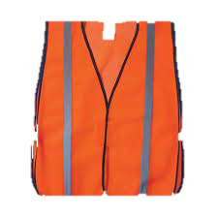
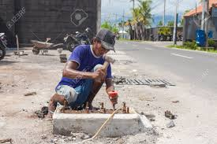

Hard Hat Foundation www.hardhat.org.au
The Hard Hat Foundation was established with a simple goal – we strive to provide every worker in the world with a safety helmet and ‘hi vis’ vest. We have started our journey in Bali – a place where thousands of Western Australians travel and visit every year.
We have all seen some unsafe work practices in our travels – here is your chance to prevent workplace injury or death in places we love and owe so much to... And to working people who have given us all so much joy..
For just $10 you can provide a Hard Hat to a construction worker in Bali - and soon the world. This initiative is supported by Training Course Experts, who will distribute the hats and provide safety training in Bali and beyond to the value of 50% of the funds raised. You can even visit us at Training Course Experts and write a personal message on your hat – we will deliver it for you. Watch our facebook site for updates and our gifting ceremonies or news on our next work safety session in Bali or beyond.
To make a difference and possibly save a life in Bali or beyond donate here

