Slide 1
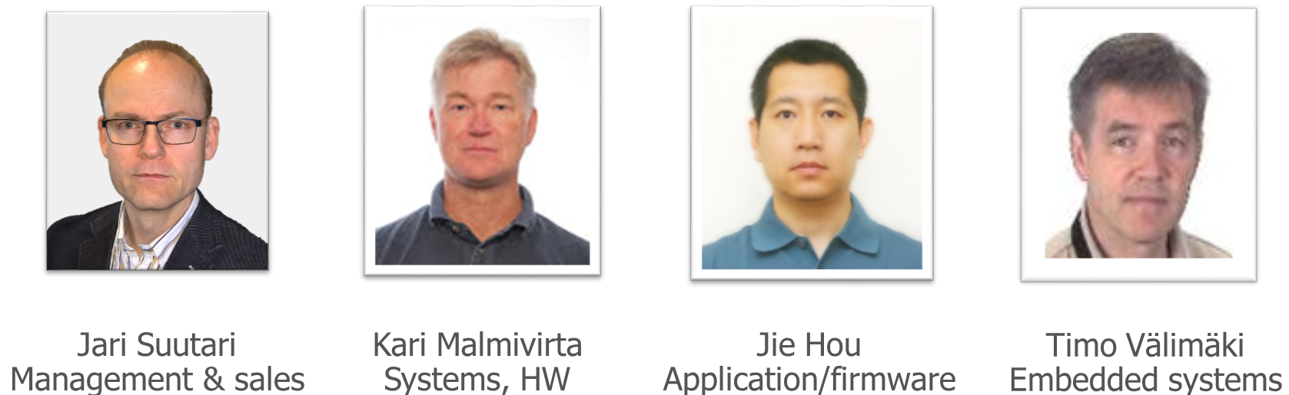
SENSOAN
Sensor Architectures and Networks
THE TEAM
Currently Sensoan offers IoT engineering projects to our business partners
We develop sensor products, applications and cloud services e.g. for sports and industry
In future we are looking more customers and partners in the area of IoT and industrial internet
Experienced co-founder team high tech background from Nokia and Microsoft
Startup is located in Salo, Finland
Company was established in February
Goal is to grow and be a significant player in IoT
Sensoan.com is reserved but company pages are waiting for graphical and visual appearance which start from logo design

