Slide 1


The Power players
Brought to you by:

Slide 2
Brief
We are launching a new service called the power players
Its designed for female business owners
We need a logo “The Power Players” that is strong and bold yet fits with Business Chicks
Check out our brand at these links:
https://www.instagram.com/businesschicks_usa/
www.businesschicks.com
Would like to use the pink as a highlight only – focus on grey/white/black

Slide 3
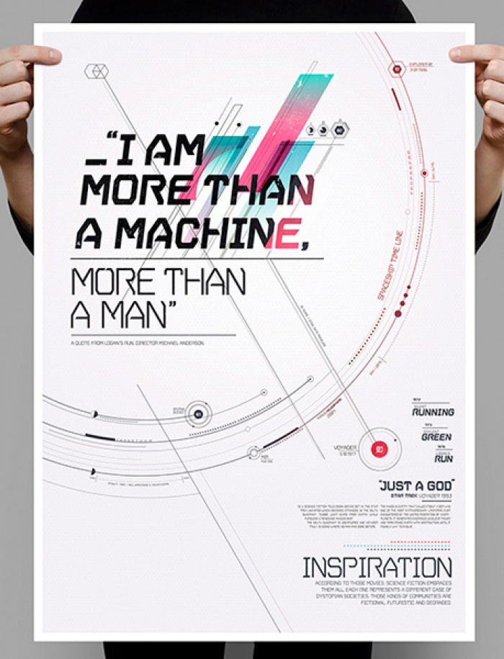
The quote could be:
“I am a power player, and business will never be the same”
Down the bottom right oculd be the new logo ad the tag line – Come and play

Slide 4

We could have a big word like POWER and the players in smaller font

Slide 5

Something interesting like this could work…

Slide 6
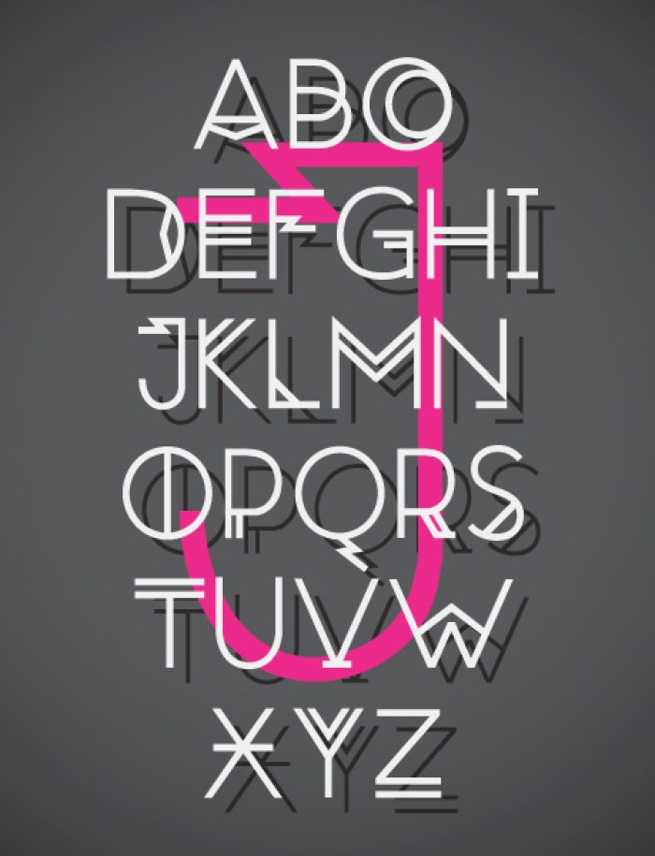
We could write
The
Power
Players
Then have the business chicks logo in the background

Slide 7
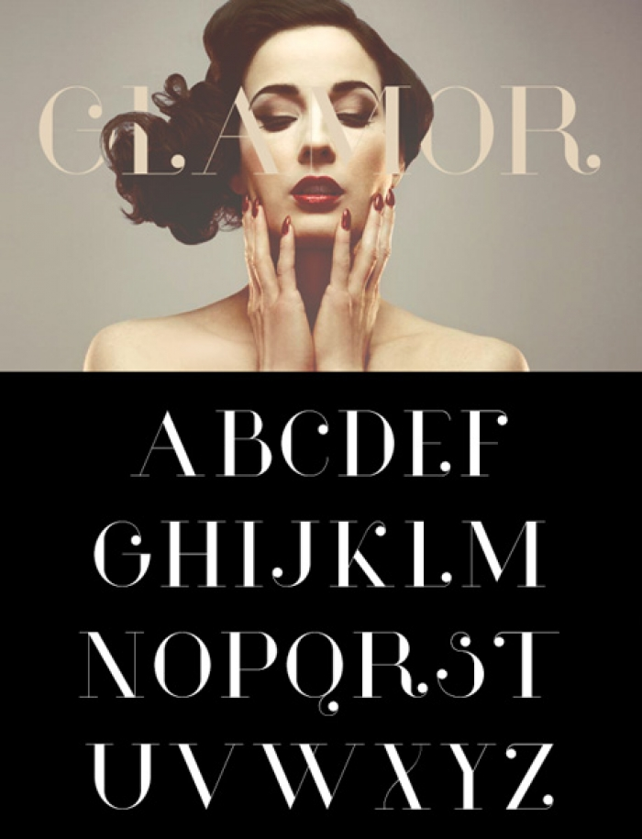
This idea could be more glamours
With the workds
The Power players over the black area

