Slide 1

Water Safety and Aquatic Education
(landing page for the site, needs to be an effective scare about water stats)
Each year globally there are 372 000 people drowning everyday, from young children to victims of flood. ­¹ According to a 2007 report released by Safe Kids Worldwide, as many as 30,000 children between 0 and 14 years old die by drowning each year in China. That accounts for up to 60 percent of China's annual 50,000 accidental child deaths - and the figures are climbing ² If this tally isn’t frightening enough think of the non drownings that lead to permanent brain damage and disability. Spreading the message of water safety and education is important to reduce this number and give everyone a fighting chance. There are many simple life saving skills and tips that can be spread with very little cost. Barriers on waterways, safe areas to leave children away from water, education in swimming, training in lifesaving techniques and most importantly education on the associated risks to young children around water.
1:Drowning Global Report, Accessed 2016-12-17, [ONLINE]http://www.who.int/violence_injury_prevention/publications/drowning_global_report/Final_report_full_web.pdf.
2:Drowning prevention begins with awareness, 2015-12-17. [ONLINE] http://www.bjd.com.cn/10beijingnews/metro/201406/16/t20140616_7020334.html.

Slide 2
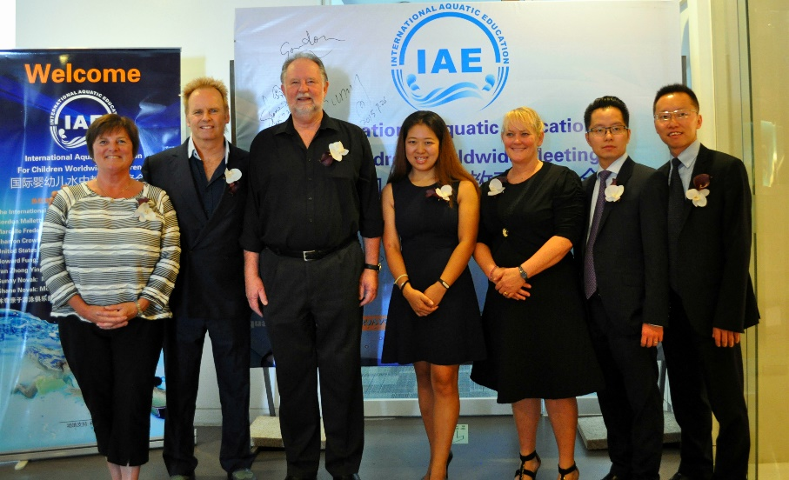
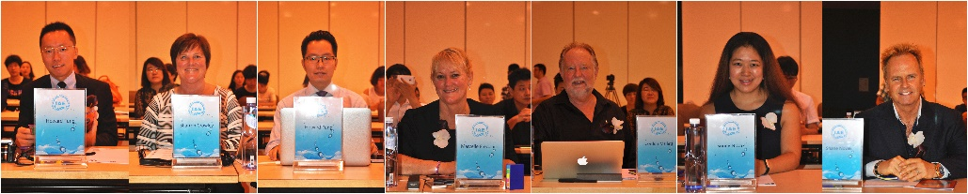
About Us
(Clean simple page)
Our Motto:
Life through knowledge
It was a long time coming, with passion for Water Safety and Education, a small group of educators banded together and created a company. With just one goal, reducing water related fatalities.
Information and Education, not just on a local level but an international platform. It started with four countries: Australia, Canada, China and the USA. Our goal is to build an encompassing international platform for everyone. Sharing knowledge and information to make a difference.
Latest News Event: (Single editable upload, no stored history of articles, no date. Just a simple functional article with image)

Slide 3




Community
(the format should be country based, each entry having a bio and headline)
Australia
Marcelle Frederick: Principal of Aquatic Education, AE China and owner of Stirling Swim School
China
Sunny Novak: Founder and CEO of Mookey Swim School’s 6 soon to be 7 locations.
Hong Kong
Howard Fung: Founder and CEO of Stanford Swimming
Canada
Sharon Crowley: Founder of Aquaventures Swim Centre
USA
Sue Mackie & Miren Oca: United States Swim School Association

Slide 4
Events
(clean simple half year calendar that displays the next 6 months but has 18 months worth of editable entries for site management)
January | February | March | April | May | June
 |  |  |  | Hong Kong Conference
 |  |  |  |  | Shanghai Conference
 | Canada Coaches workshop
 |  | Memphis Community gathering
Click the link to apply

Slide 5
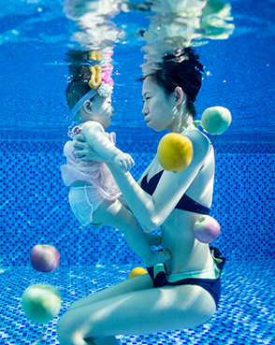
Why become involved
The best way to provide education is in a safe controlled environment. Running your own facility is a rewarding lifelong move into business. Providing a community service with an opportunity to work with a passionate and driven community. Become a leader in educating children to be safe around water.
Creating a purpose built facility can be tough. Having a good heart is a great start, but misinformation can be just as dangerous as no information. Your good intentions need to be directed effectively.
The most important asset is great coaches and a top notch pool. Luckily the industry has been around for a long time and has produced some excellent models that you can follow.
With many countries having turn key consulting to help you on your way.

Slide 6
Becoming Certified
To become apart of the registered community of pools we want to make sure you are providing a high standard of lessons and have a facility which reflects the international standard of professional pools. The following points will be looked at:
Coaches Education and training method
Full facility setup
  Water Quality
  Evacuation Plan
  Layout and access
  Safe teaching equipment
Ability to create community water safety events
Attending continuing education, International or National
Apply to become certified

Slide 7
Member Login
(this is the access point to a member forum. Would like to see your ideas on a good forum with 3 levels. Member, moderator, admin)
Become apart of our community to access the latest in education updates, video tutorials and an extensive community forum.
Username:
Password:

Slide 8
Contact Us
If you would like more information regarding becoming members, turn key consulting or general enquiries please email.
Email: | info@iae.com
Phone: | +86 blah blah blah
Wechat: | info@IAE

