Slide 1
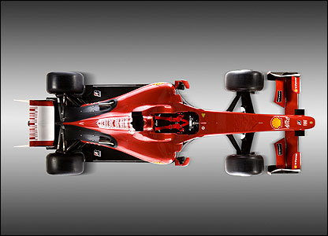
Reviewing new technology
behind the scene, we review, test, recommend, reject or implement to always have the best recruitment systems available
Recruitment Systems are core
enhancements of our database and talent sourcing tools, promotion of new products, reporting & live support
Contractor Workplace Health & Safety & Privacy
we make sure our contractors are safe & that Peoplebank & clients meet legal obligations
Database Cleansing - helping you find and get candidates to clients first by keeping our talent database fresh
Quality Management System
making sure our systems & process are world class; they are externally audited too
Proactive Sourcing Training
(teaching our teams how to fish)
assisting you find the perfect candidate for clients
Redeployment Program
& Hotlists
ensuring you and your clients have access to our top talent
Immigration Service (457s) and advice
we have access to the world’s best workers
Notes:
Brief: to have a visual representation of the offerings the Talent Management Team provide the business. We are a recruitment company and the team supports our sales teams by providing the systems, practices and processes that allow them to do their jobs exceptionally well. Like a F1 pitt crew, we help the F1 driver win the race by making sure the recruitment ‘machine’ is tuned, repaired, fuelled and accelerates as quickly as possible to reach the right candidate first for our clients.
The image here is an idea, with the following image showing the team scramble over the ‘recruitment machine’.
I am keen to highlight what happens behind the scenes (and sometimes may be taken for granted by the sales teams).

Slide 2

Recruitment Systems are core
enhancements of our database and talent sourcing tools, promotion of new products, reporting & live support
Contractor Workplace Health & Safety & Privacy
we make sure our contractors are safe & that Peoplebank & clients meet legal obligations
Reviewing new technology
behind the scene, we review, test, recommend, reject or implement to always have the best recruitment systems available
Database Cleansing - helping you find and get candidates to clients first by keeping our talent database fresh
Quality Management System
making sure our systems & process are world class; they are externally audited too
Proactive Sourcing Training
(teaching our teams how to fish)
assisting you find the perfect candidate for clients
Immigration Service (457s) and advice
we have access to the world’s best workers
Redeployment Program
& Hotlists
ensuring you and your clients have access to our top talent
Notes:
Brief: to have a visual representation of the offerings the Talent Management Team (a team which runs and drives our core technical systems to ensure we have access to the right candidates).
We are a recruitment company and the Talent Management Team supports our sales teams by providing the systems, practices and processes that allow them to do their jobs exceptionally well.
Each box represents a service we provide
Option 1 was thinking we are like a F1 pitt crew, we help the F1 driver win the race by making sure the recruitment ‘machine’ is tuned, repaired, fuelled and accelerates as quickly as possible to reach the right candidate first for our clients.
Second option (women selecting candidate http://www.123rf.com/clipart-vector/recruitment.html?mediapopup=19479818 ) was showing candidates in a ‘system’ with someone selecting one. Internally we like this better as it represents what we do more accurately. Plus with the female imagery it helps support our push to assist clients with their diversity targets.
I just need 1 design The purpose of this ‘flyer’ is to show both internal teams (our direct customers) what happens behind the scenes (and sometimes may be taken for granted by the sales teams).
Brief is to create a single flyer that best depicts what we do. I am keen for feedback/original ideas of how to represent this best.

