Slide 1
Our Mission
Hemeos believes that all bone marrow transplant patients should have a donor match delivered on time at an affordable price. To that end we are building a world class registry to aid Transplant Centers in treating their ethnic minority patients. We are committed to proving customer service excellence second to none.
What we Do
As a total transplant procurement solution, Hemeos vertically integrates as a registry and donation center to maximize efficiency and provide operational excellence to deliver marrow/PBSCs on time - at industry leading prices. Hemeos harnesses industry leading best practices to target, recruit, and maintain active donors with unprecedented donor follow through rates. Transplant Center clients access these donors through our web based software, Prometheus. Once identified as a potential match, Hemeos guides donors through CT, workup, and collection. We then personally deliver the product to our transplant center clients.

Slide 2
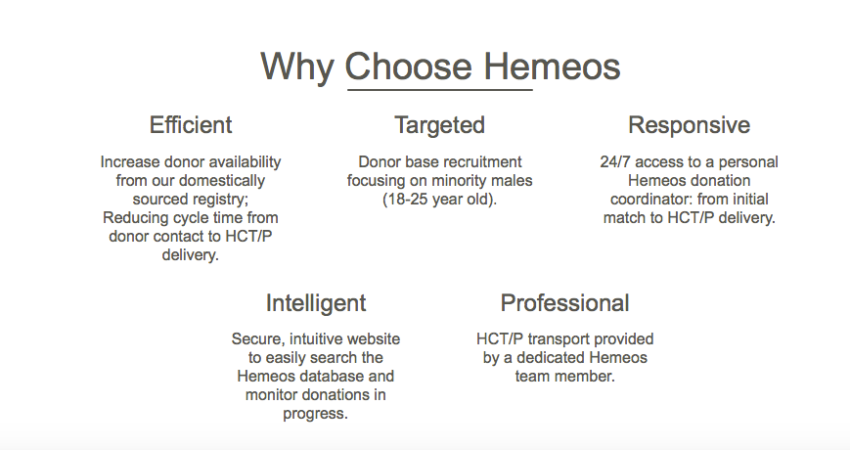
From our website hemeos.com

Slide 3

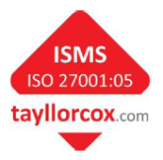

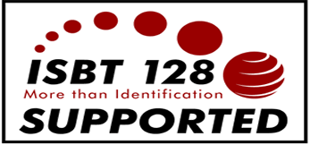
Prometheus
Transplant Centers match their patients to Hemeos donors on Prometheus, developed by Steiner, an Industry leader used in numerous international registries
Integration with Bone Marrow Donors Worldwide and European Marrow Donor Information System (EMDIS).
Complies with World Marrow Donor Association
Verified FDA compliant by independent consulting audit
ISO accreditation requested by BBMR
  9001 (Quality Management System)
  27001 (Information Security Management System)
SOPs, project plans
Guarantees for testing, validation, security, etc.

Slide 4












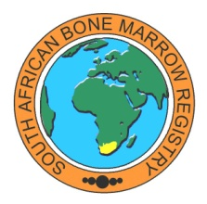


International Registries Utilizing Prometheus
2007: Czech Republic, Slovakia
2008: Cyprus, Bulgaria, ALF Poland
2009: South Africa, Finland
2010: Sweden, Denmark, Slovenia, Israel
2011: Hungary, Argentina, Great Britain (BBMR), Belgium, Ireland, Saudi Arabia
2012: Nigeria, Netcord, …

Slide 5
Donor Recruitment Results
Hemeos is on track to register 10,000 donors in 2016

Slide 6




Our Partners
Hemeos has partnered with industry leaders for efficient donor CT, workup, and collectionof PBSC and marrow.

