Slide 1
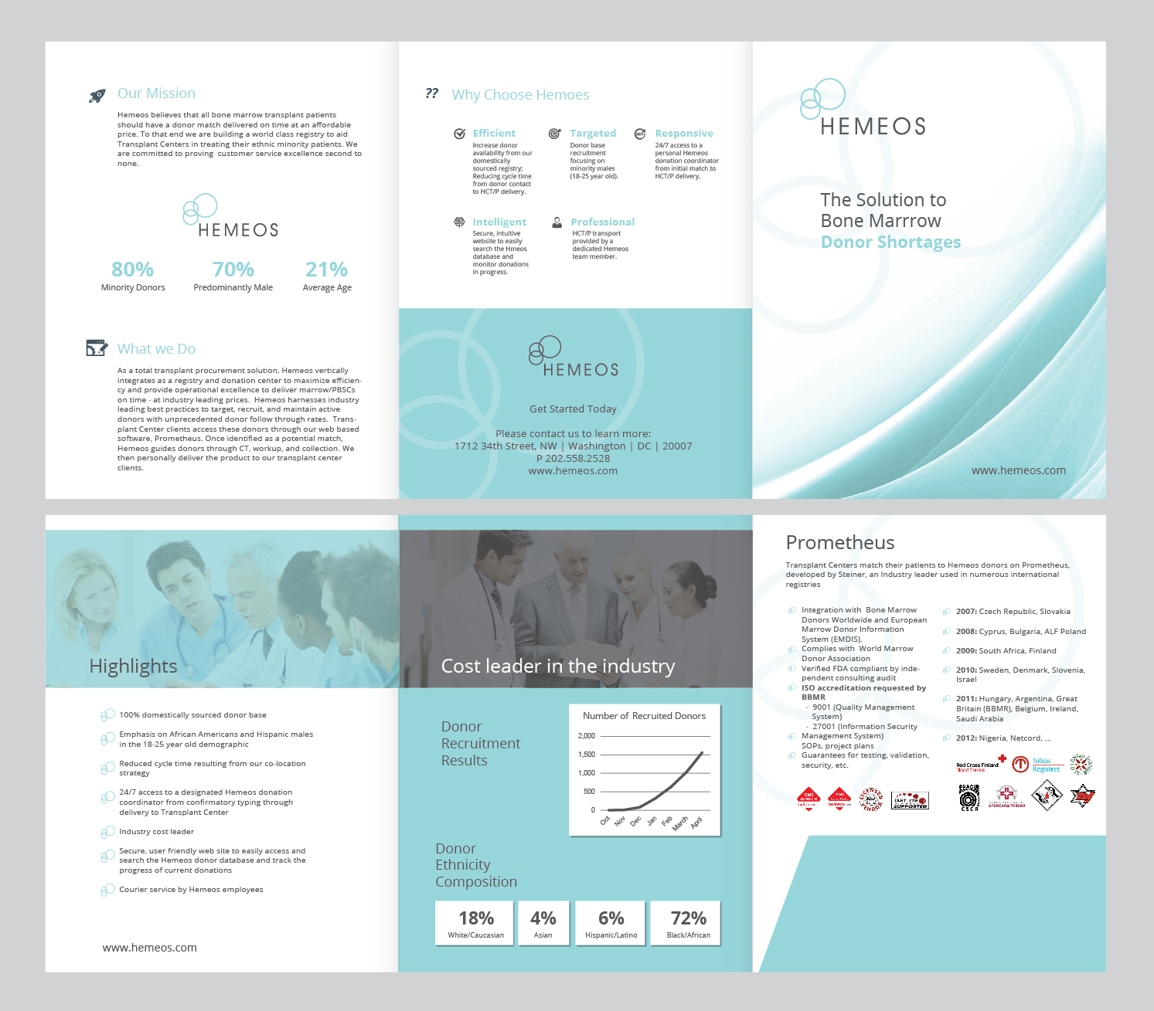
I like the style the text should say the following
Hemeos Registry at Glance instead of “donor recruitment results”
80% Ethnic Minorities 70% Male 21 – Average Age
Move this section up and add an “our partners” section Include logos of labcorp, apheresis assocaties of northern virginia, salute to life, and steiner. These logos are in the next slide in this deck
Delete this
Replace this

Slide 2




Our Partners
Hemeos has partnered with industry leaders for efficient donor CT, workup, and collectionof PBSC and marrow.

